Slide 1
Bellringer
DropBox your Parent Contact form.
Pick up a Susette Kelo – Eminent Domain handout from the front table and read it carefully.
On a separate sheet of paper answer the following question:
Was the government right to take Susette Kelo’s home to make way for new commercial property that would generate more tax revenue for the government?
Give a reasoned argument backing up your answer to the question above.
Make sure your name is on your paper.

Slide 2
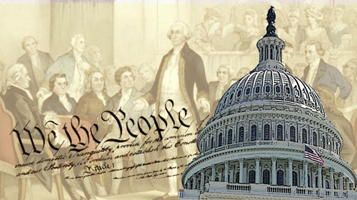
American Government

Slide 3
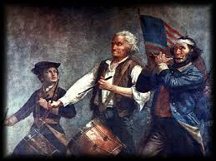
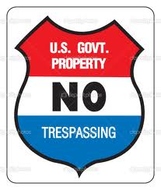
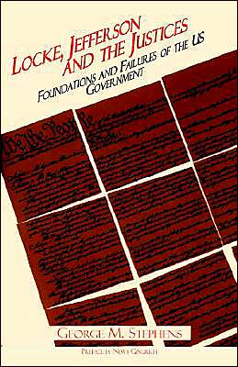
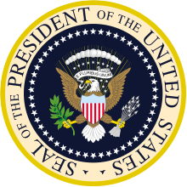
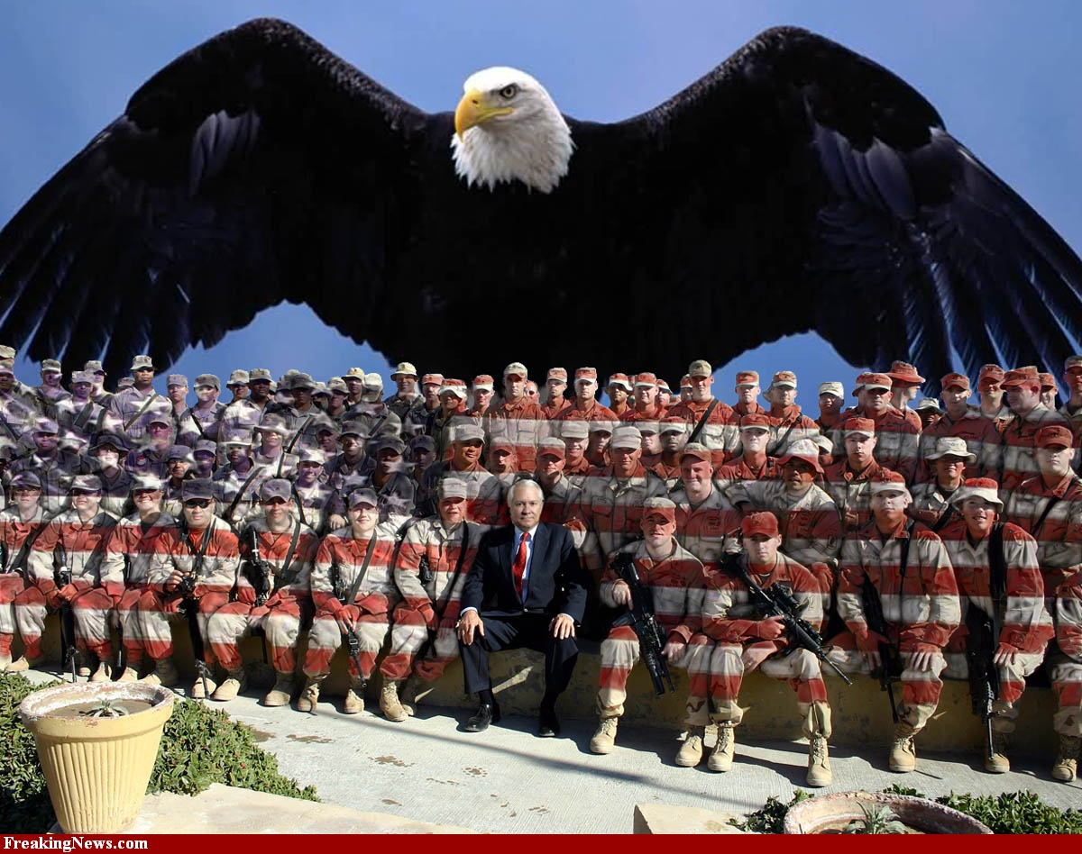
1.1 – Principles of Government

Slide 4
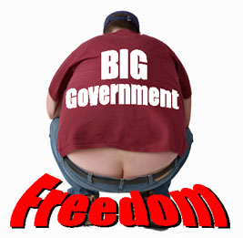
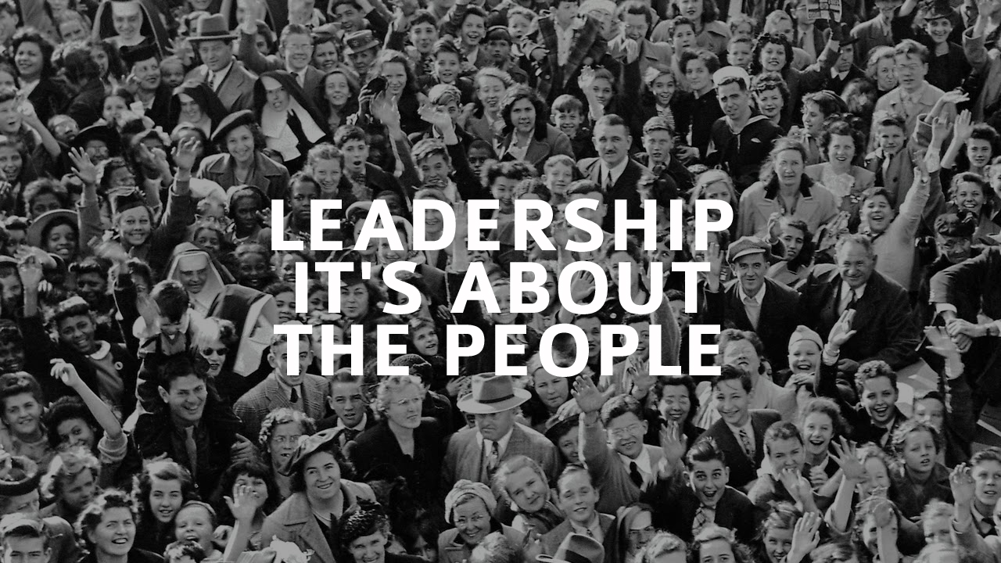
I. Government – We the People
A. What is Government? – the institution through which a society makes and enforces its public policies.
1. Public policies are all those things a
government decides to do.
Refer to page 4 in your textbook.

Slide 5
B. Basic Powers of Government
“Power” is the ability to command OR prevent action.
Every government wields three types of power
1. Legislative Power – the power to make laws
Executive Power – the power to execute (put into action), enforce, and administer laws.
Judicial Power – the power to interpret laws, determine their meaning, and resolve societal disputes.

Slide 6
B. Basic Powers of Government
Hundreds of years ago, legislative, executive, and judicial power, was often held by just one person – the king or emperor.
Today, most countries divide these powers among branches of government and outline these powers in a written constitution.

Slide 7
C. Government as a Human Invention
Government was “invented” by humans to bring order to humans living closely with one another.
i.e. to settle property disputes, to provide for community defense, etc.
It is an ancient concept
Don’t confuse “politics” and “government”.
Government is the institution
Politics is the process by which government is conducted.

Slide 8
Let’s See How We’re Doing
What are the three basic powers of government?
Today, the powers of a government are often outlined in a written document called a _______________.
“The institution through which a society makes and enforces its public policies.” This is the definition of _________________.

Slide 9
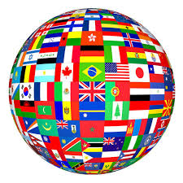
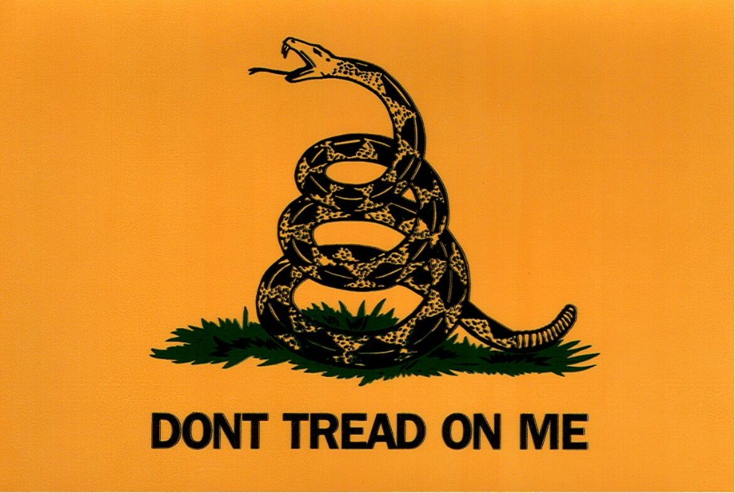
II. The STATE
A. Characteristics of a State
1. Population- The people
2. Territory- Clear and recognized borders
3. Government- Political organization
4. Sovereignty- The power to act within one’s own territory and control one’s external affairs
Political unit w/ power to enforce laws over people in a specific territory
Refer to page 6 Graphic

Slide 10
III. How States Arose
A. Four Theories (page 8 graphic)
The Force Theory
Evolutionary Theory
Divine Right of Kings
Social Contract Theory
Take a moment to read over the four State Origin theories on page 8. Using the handout, IN YOUR OWN WORDS, briefly explain each theory and answer the Comprehension Question.

Slide 11
B. The People Agree to Form a State
1. The Social Contract Theory argues that the state arose out of a voluntary act of free people.
2. The Social Contract Theory promotes the values of
a. Popular Sovereignty
b. Limited Government
c. Individual Rights
3. These are ALL enshrined in the Declaration of Independence and the U.S. Constitution.
a. The Declaration of Independence justified the American Revolution by appealing to the social contract theory.

Slide 12
III. What Government Does
For a More Perfect Union
Declaration of Independence - 1776
Articles of Confederation 1781
Constitution ratified in 1787
Establish Justice
Insure Domestic Tranquility
Provide for the Common Defence
Promote the General Welfare
Secure the Blessings of Liberty
Do I have a volunteer to read the Preamble to the U.S. Constitution?
Page 9
Everyone else, please listen attentively and follow along.
What is Patriotism? Why is it important?

Slide 13
https://youtu.be/1aPnKCDArdE
Notes:
John Locke by Mrs. Edgar

Slide 14
Quiz Time
Do Your Own Work
Use Your Own Paper
Make sure your name is on your paper
You may use your notes and handouts

Slide 15
The government can take private property (your house and land) for public use. In exchange, the government must pay a fair price for the property. The exercise of this is called ____________ _____________ .
The institution through which society makes and enforces its public policies is called ________________.
What are the three types of power EVERY government wields?

Slide 16
Today, the powers of a government are often outlined in a written document called a _______________.
The love of one’s country is called ________________.
Of the four theories of the origins of government, which one states that government arose out of a voluntary act of free people?

Slide 17
The process by which government is conducted is called _______________.
Of the four theories of the origins of government, which one states that God gave those of royal blood a special right to rule?
The four characteristics of a state are Population, Territory, Government, and _____________.
The power to act within one’s own territory and control one’s affairs is called _________.

Slide 18
Make sure your name is on your paper
Dropbox your quiz

Slide 19
Peer Grading

Slide 20
The government can take private property (your house and land) for public use. In exchange, the government must pay a fair price for the property. The exercise of this is called ____________ _____________ .
The institution through which society makes and enforces its public policies is called ________________.
What are the three types of power EVERY government wields?
Eminent Domain
Government
Legislative, Judicial, and Executive

Slide 21
Today, the powers of a government are often outlined in a written document called a _______________.
The love of one’s country is called ________________.
Of the four theories of the origins of government, which one states that government arose out of a voluntary act of free people?
Constitution
Patriotism
Social Contract Theory

Slide 22
The process by which government is conducted is called _______________.
Of the four theories of the origins of government, which one states that God gave those of royal blood a special right to rule?
The four characteristics of a state are Population, Territory, Government, and _____________.
The power to act within one’s own territory and control one’s affairs is called _________.
politics
Divine Right of Kings
Sovereignty
Sovereignty

