Slide 1
Bellringer – use pencil
Pick up a checkbook Register from the front table.
Put your name on the front cover.
It’s payday and you opened up a checking account with your paycheck.
On line one, add today’s date, “Opening Deposit” under Transaction Description, and put $450.00 in Balance.
Later that day, you write a check to the cell company for your service. Enter this transaction on line two.
Check #001 to Cricket Cellular for $49.00.

Slide 2
Opportunity Costs
1.2

Slide 3
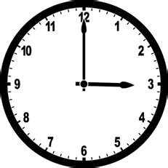
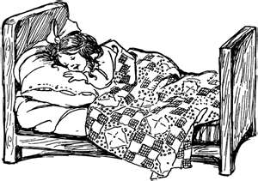
What did you do yesterday from 3:00 till you went to bed? What were some other choices that you did not do? Why not?

Slide 4
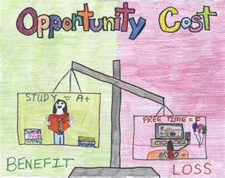
Opportunity Cost
The value of the best alternative passed up for a chosen item/activity.
Opportunity Costs will vary.
Opportunity Costs will be a personal thing.
Opportunity Costs are not just financial – what about time, relationships, etc.?

Slide 5
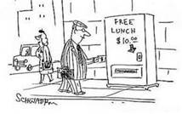
Making Choices
No Free Lunch
All choices have a cost
choosing one thing means giving up another, or paying a cost
cost can take form of money, time, other thing of value

Slide 6
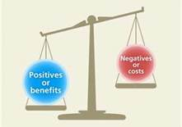
Opportunity costs Concepts
Trade-offs: alternative you give up for your choices.
Cost-Benefit analysis: weighs the benefits against the costs.
Marginal costs: additional cost for using one more unit of product.
Marginal benefit: additional satisfaction from using one more unit of product.

Slide 7
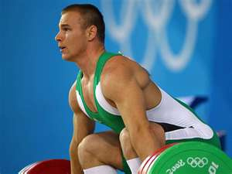
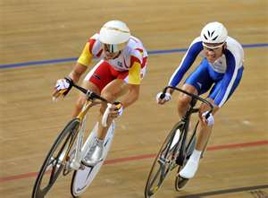
If you were an extremely talented athlete and wanted to make it to the Olympics, what are your opportunity costs?
Answer on your own paper

Slide 8
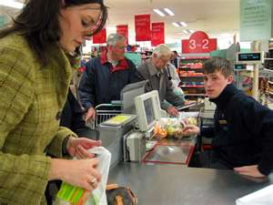
Sunk Cost
A cost you have already incurred and cannot get back regardless of what you do.
“no crying over spilled milk”
Standing in a line at store for 5 minutes and a new one opens up? Do you change lines?
What if you are in college for two years and struggling, but have a great job opportunity. Do you take the job?

Slide 9
Reviewing Key Concepts
Explain the relationship between the terms in each of these pairs:
incentive and utility
trade-off and opportunity cost
marginal cost and marginal benefit

Slide 10
Links
http://www.youtube.com/watch?v=yoVc_S_gd_0 – Scarcity and Choice video (4:00)

