Slide 1
www.mrwyka.weebly.com
When you are absent, when you want to review, or if you want to preview the day’s lesson, you can find the class presentations at
www.mrwyka.weebly.com

Slide 2
Production Possibilities
Eco 1.3

Slide 3
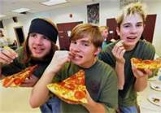
A busy day
Think of one of your busiest days.
Could you add more activities?
Or is there a point there is no more room for anything else.
That is the way it is for economies and businesses.
This can be shown with a Production Possibilities Curve.

Slide 4
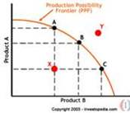
Graphing the Possibilities
Production Possibilities Curve
PPC runs between extremes of producing only one item or the other
Data is plotted on a graph; lines joining points is PPC
shows maximum number of one item relative to other item
PPC shows opportunity cost of each choice
more of one product means less of the other

Slide 5
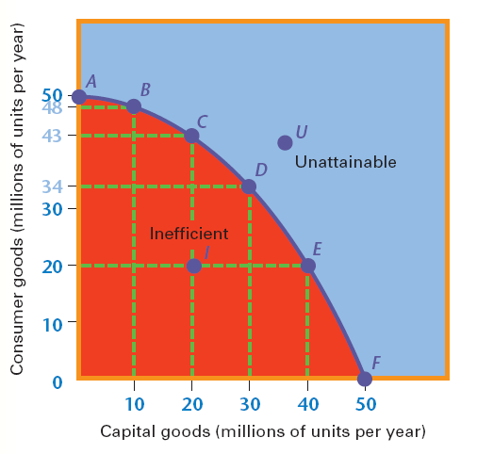
Production Possibilities Curve
A through F are attainable
I represents inefficient use of resources
U represents unattainable combinations

Slide 6
Efficient or inefficient
Efficiency – Producing the maximum possible output from the available resources
Why would there be inefficient economies?

Slide 7
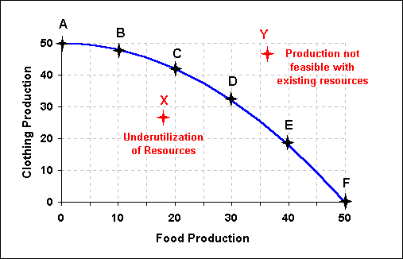
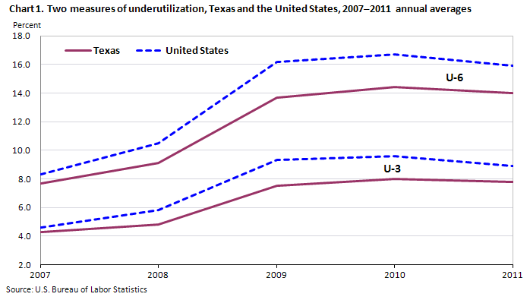
Underutilization
Economic resources are not being used to their full potential.

Slide 8
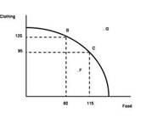
Changes
Law of increasing opportunity cost – Each additional increment of one good requires the economy to give up successively larger increments of the other good.

Slide 9
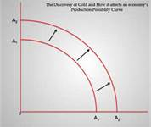
Changing Production Possibilities
Example: A Shift in the PPC
A country’s supply of resources changes over time
Example: U.S. in 1800s grew, gained resources, workers, new technology
new resources mean new production possibilities beyond frontier
Increased production shown on PPC as shift of curve outward
Increase in total output called economic growth

Slide 10
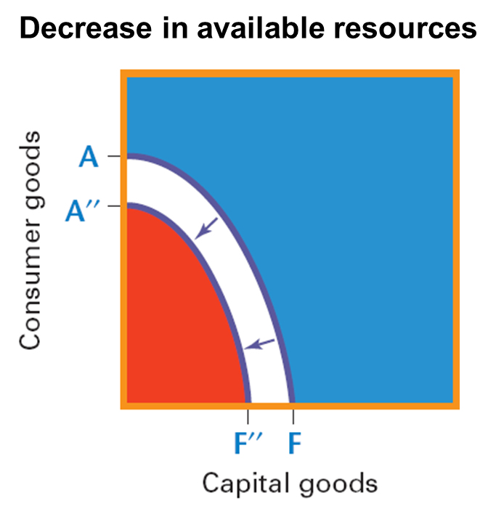
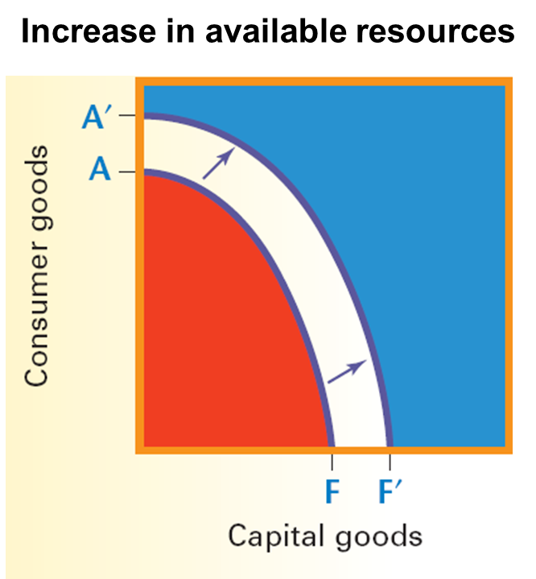
Shifts in PPC graph
Changes in resource availability
Increases in stock of capital goods
Technological change

Slide 11
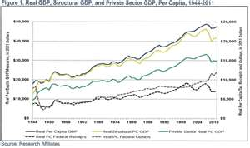
Economic Growth
An expansion in the economy’s production possibilities or ability to produce.
This is the goal of the government to have – constant economic growth.
Measured by the GDP (Gross Domestic Product)

Slide 12
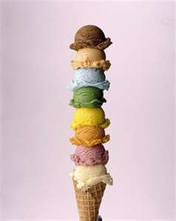
Ice Cream Anyone?
What effect, if any, do you think an increase in ice cream production in Chile will have on the country’s production of capital goods?

Slide 13
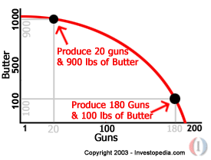
Guns vs. Butter
Opportunity Costs for a nation
If more resources are used to make military products, there are fewer resources for other things such as consumer goods

Slide 14
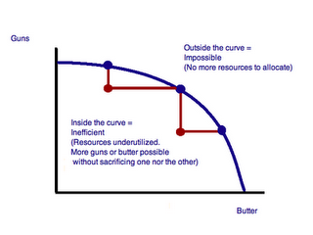
Guns and Butter
Much like the PPC graph, but it focuses on what the government should spend on. Guns replaces capital goods, and butter replaces consumer goods.

Slide 15
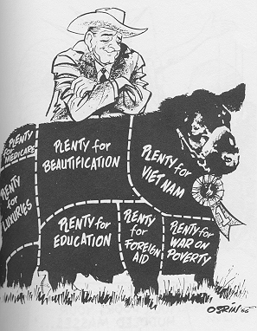
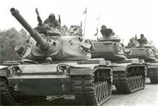
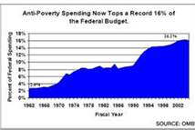
History and Guns and Butter
President Lyndon Johnson’s Great Society vs. Cold War

Slide 16
Reviewing Key Concepts
Explain how each term is illustrated by the production possibilities curve:
underutilization
efficiency

Slide 17
Links
https://youtu.be/O6XL__2CDPU PPC ACDC Leadership
http://www.youtube.com/watch?v=uvnHPeQrk0E&feature=relmfu – graph review (4:30)

