Slide 1
Let’s Review from Ch 1.3
https://youtu.be/O6XL__2CDPU?list=PLA46DB4506062B62B

Slide 2
Macro vs. Micro and Economist’s Toolbox
1.4

Slide 3
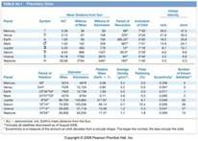
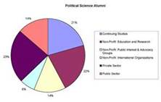
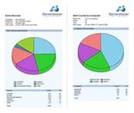
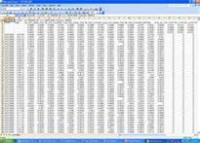
How do you use data in everyday life?
The ability to interpret data is an essential skill in the increasingly technological world.
Books
Work
Web sites
Newspaper
FCAT/College Test results

Slide 4
Working with Data
Using Economic Models
Economic models focus on a limited number of variables
based on assumptions and use simplification
expressed in words, graphs, equations
Using Charts and Tables
Economists look for statistical relationships, trends, connections
Charts and tables display data in rows and columns
can reveal patterns by showing numbers in relation to other numbers

Slide 5
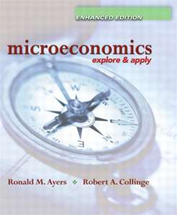
Microeconomics
Study of Economic Behavior in a section of the economy (part of an economy) such as individuals, families and businesses.
Also know as Market Economics
Examples: house sales, service products, unskilled labor

Slide 6
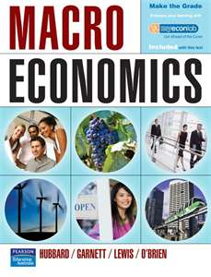
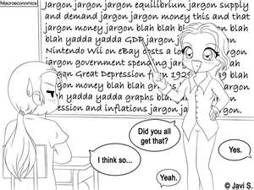
Macroeconomics
Study of the Economic behavior as a whole.
Also known as National Economics

Slide 7
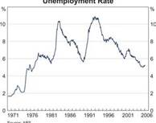
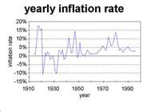
Who would be concerned with the following:
Answer either a Macroeconomist or a Microeconomist
A large corporation going bankrupt
Unemployment statistics of the US
A rise in inflation rates
The success of fast-food restaurants in Citrus County

Slide 8
Who would concerned with the following:
Answer either a Macroeconomist or a Microeconomist
A large corporation going bankrupt - Micro
Unemployment statistics of the US - Macro
A rise in inflation rates - Macro
The success of fast-food restaurants in Citrus County - Micro

Slide 9
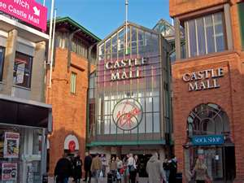
Market
The means by which buyers and sellers carry out exchanges.
Who is involved:
-Households
-Businesses
-Governments
-Foreign countries

Slide 10
Identify different groups of customers who might choose to purchase a Ford F150?
Answer on your own paper

Slide 11
https://youtu.be/mN5HPJYJzus?list=PLA46DB4506062B62B

Slide 12
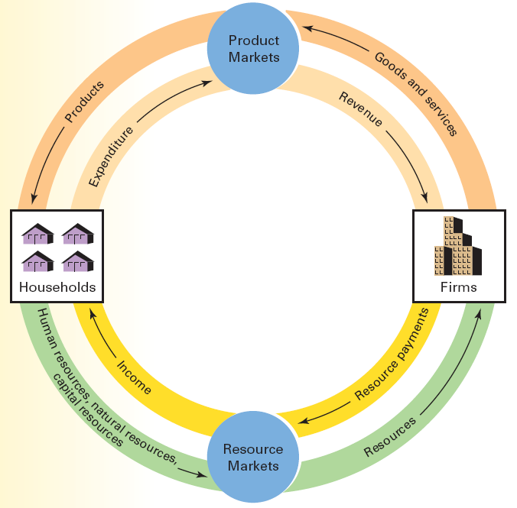
Circular-Flow Model

Slide 13
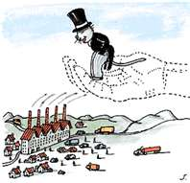
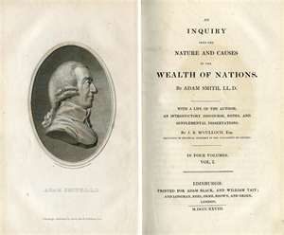
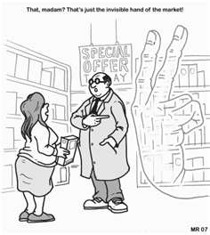
Adam Smith
Economist in the 1700s
He argued that the invisible hand of market (competition) will promote the general welfare.
The idea is still popular today.

Slide 14
Positive Economics and Normative Economics
KEY CONCEPTS
Positive economics describes and explains economic behavior as it is
uses verifiable facts; does not make judgments
Normative economics studies what economic behavior should be
makes value judgments to recommend future actions

Slide 15
Reviewing Key Concepts
Explain the differences between the terms in each of these pairs:
statistics and economic model
macroeconomics and microeconomics
positive economics and normative economics

Slide 16
Links
http://www.cleanvideosearch.com/media/action/yt/watch?videoId=ukQ1ZVCp72o – Micro vs. Macro (Models series – 2:10)
http://www.youtube.com/watch?v=w8tUIq7Blsg&feature=relmfu – video (1:00)
http://www.youtube.com/watch?v=uvnHPeQrk0E&feature=relmfu – graph review (4:30)

