Slide 1
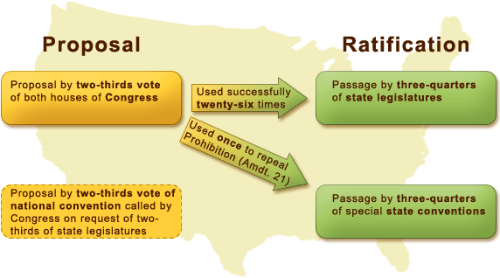
III. An Enduring Document
A. How the Constitution is Amended
1. Cooperation of state and federal government
Supermajority
Why so complicated?

Slide 2
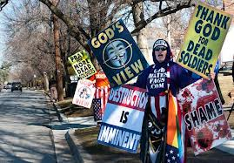
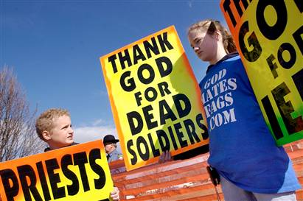
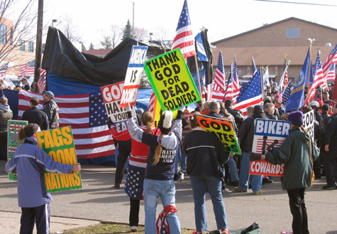
Should there be limits on the first amendment?
Westboro Baptist Church of Kansas

Slide 3
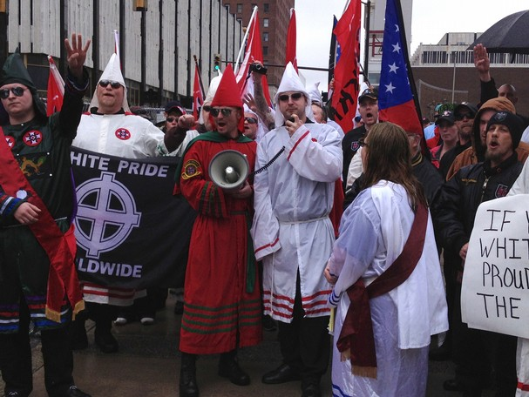
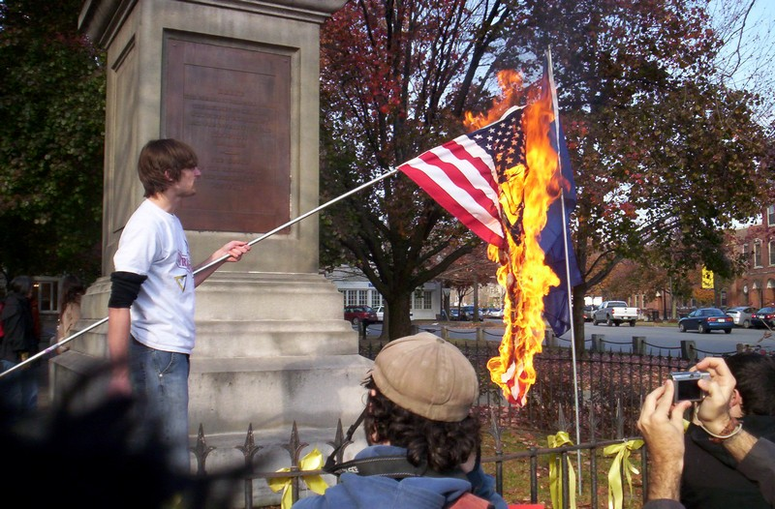

Slide 4
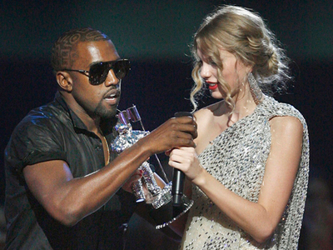
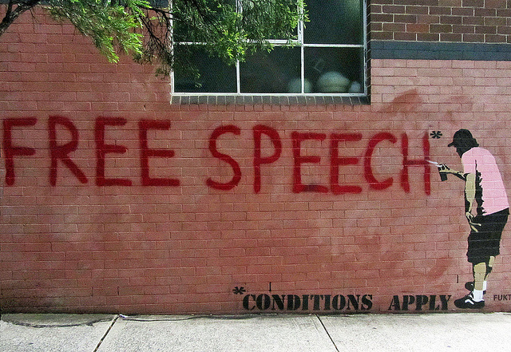
http://www.youtube.com/watch?v=6AdDLhPwpp4
http://www.youtube.com/watch?v=6bVa6jn4rpE

Slide 5
Should there be limits on the second amendment?

Slide 7
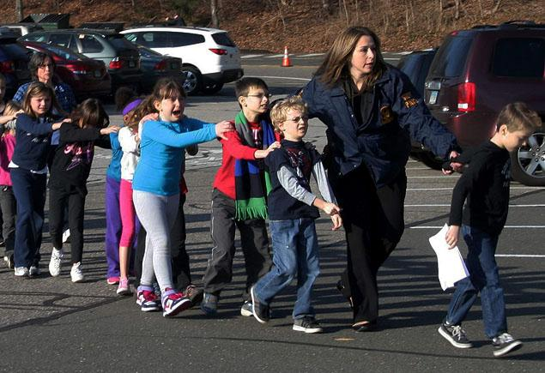

Slide 8
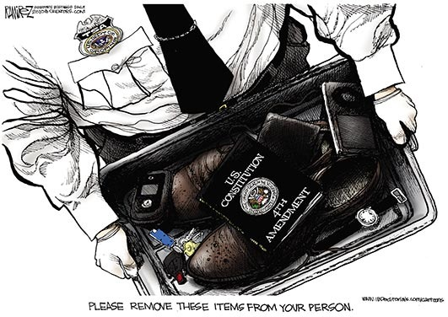
What is the 4th Amendment? Why is it in the Bill of Rights?

Slide 9
