Slide 1
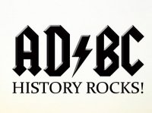
World History Nine Week Review
Presented by the combined talents of
Mr. Bolin
Mr. Gossert
Mr. Wyka

Slide 2
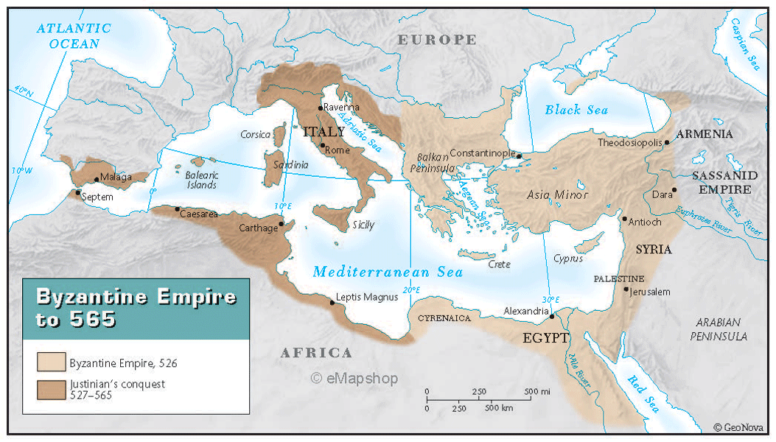
1. When the Roman Empire divided in to Eastern and Western sections. The Eastern part of the empire was known as the Byzantine Empire. It was located in modern day Turkey. Its capital was Constantinople named after the Roman Emperor Constantine.

Slide 3
Edict of Milan
The Edict declared freedom of religion in the Roman Empire.
This is similar to our own First Amendment of the U.S. Constitution.

Slide 4
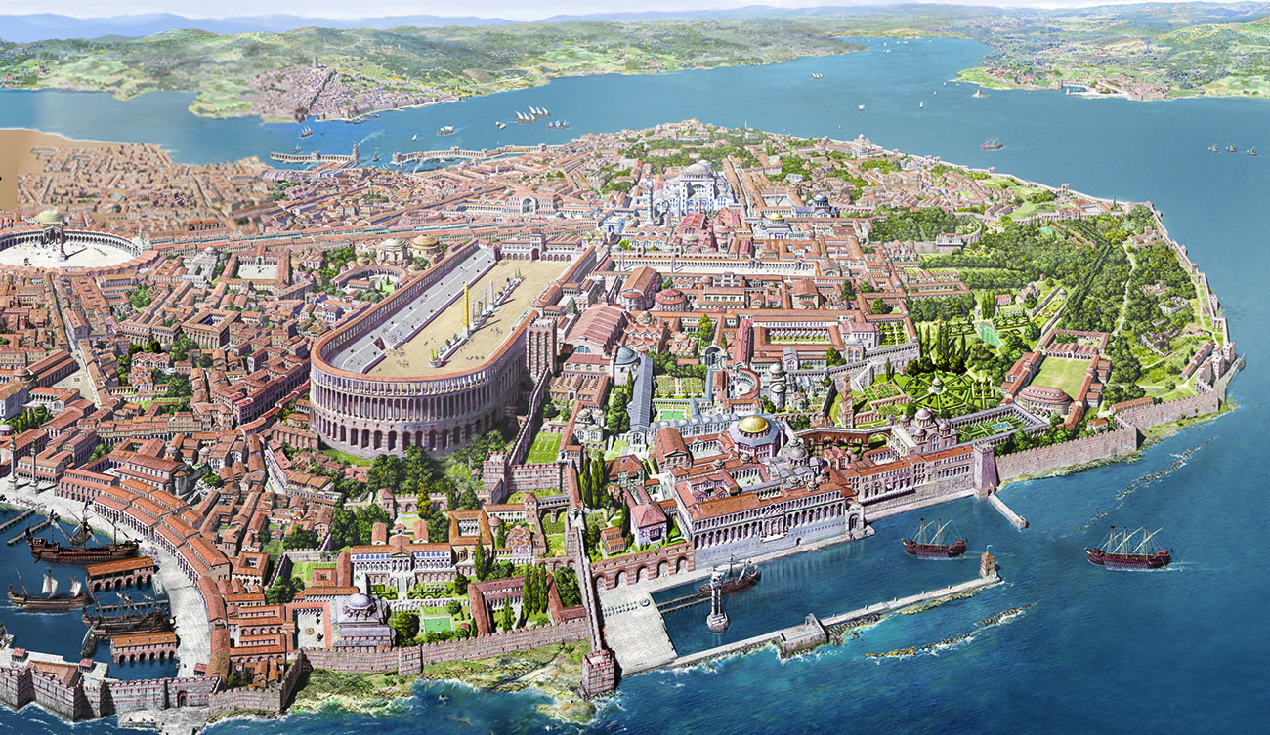
3. The Byzantine Empire is thought to be part of Rome. People who lived in the Byzantine Empire thought themselves as Romans.
Rome?
Nope!
It’s Constantinople

Slide 5
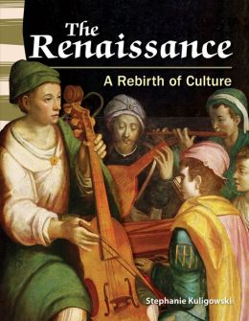
4. When Rome fell, the Eastern part (Byzantine Empire) lived on. The Romans in the Byzantine Empire preserved Roman learning, science, art, culture, etc… This preservation lead to the Renaissance, a rebirth of learning after the Middle Ages.

Slide 6
5. The Byzantine Empire had arguments with the Roman Catholic Church. The Byzantines (or Eastern Orthodox followers) did not believe that the Pope was the true head of the church and Christianity.
In the Byzantine Empire, the emperor was involved in church affairs. This is called caesaropapism. The pope opposed this because he felt secular powers should not have a say in how the church was run or organized.

Slide 7
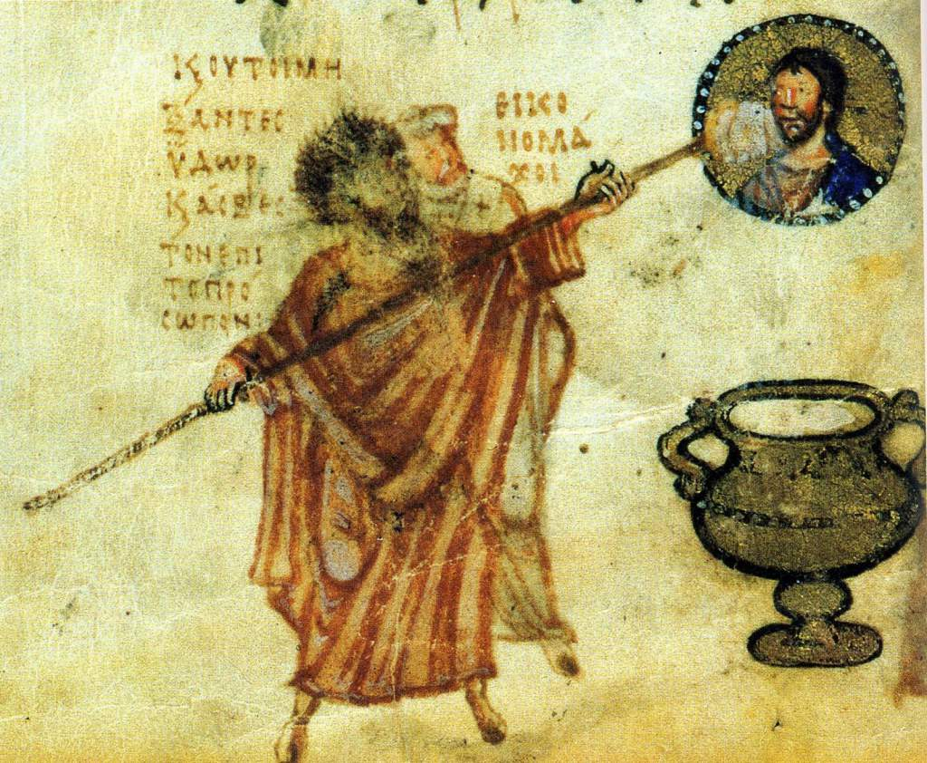
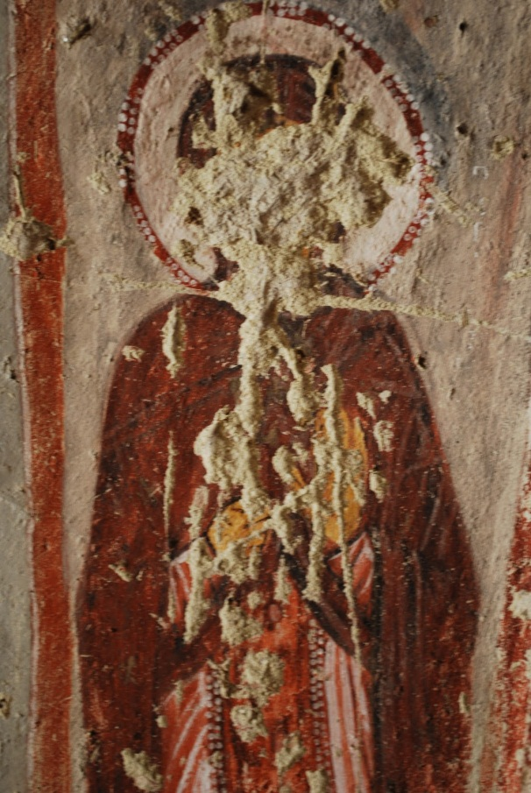
6. An ‘Icon’ is a religious painting or statue. The Iconoclastic controversy as an argument over people worshiping these icons.

Slide 8
7. The Ottoman (Turks/Muslims) conquered the Byzantine Empire in the mid-1400s. The city of Constantinople fell to the Ottoman (Turks/Muslims). The Ottomans had superior weapons, such as gunpowder guns and cannons.

Slide 9
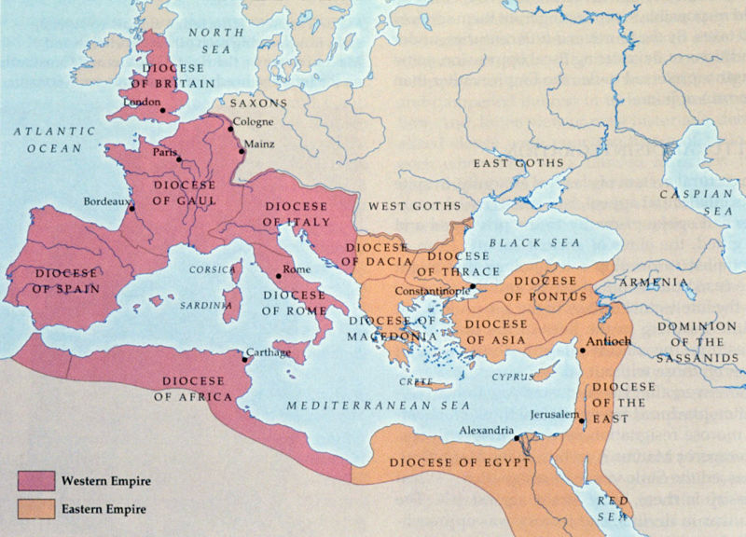

Slide 10
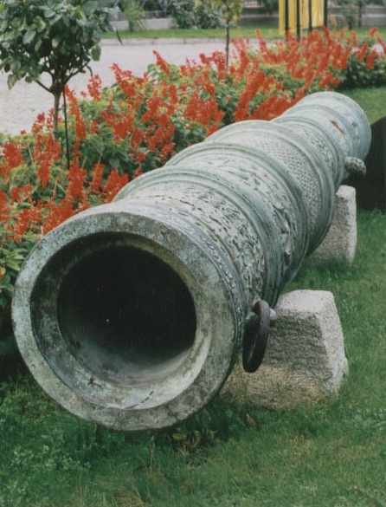
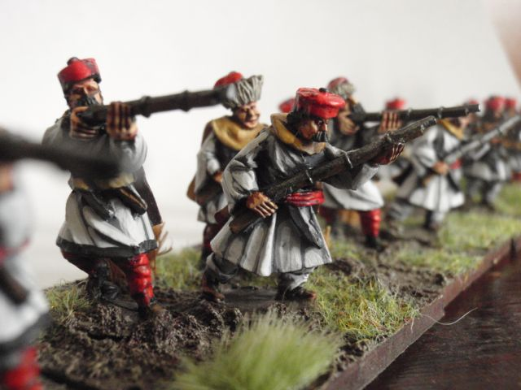
8. Gunpowder was a major reason why Muslim conquerors like Mehmet could conquer cities in the Byzantine Empire.

Slide 11
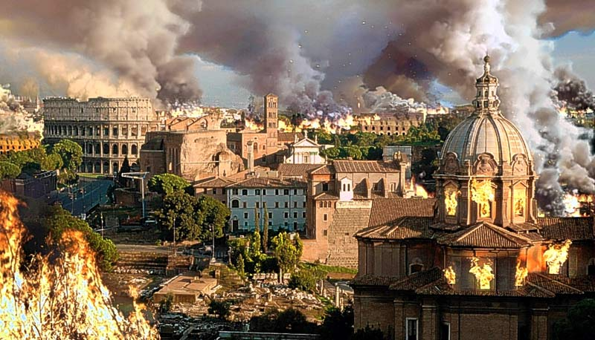
9. After the Western part of the Roman Empire fell, it was the Catholic Church and especially the Pope who kept stability and political law and order in Europe.
A.D. 476

Slide 12
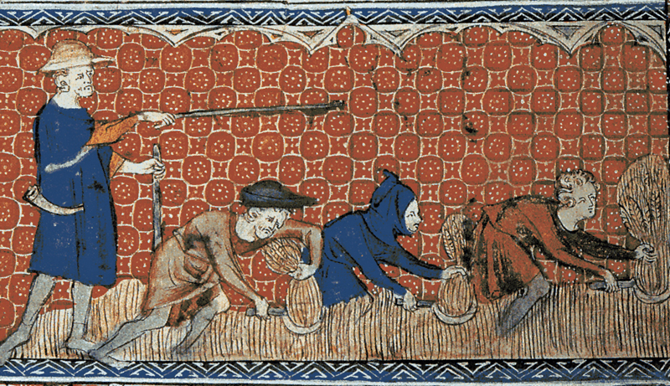
10. A serf was a farm worker who had to turn over a large part of his crops to a local noble (lord, baron, prince, etc…).

Slide 13
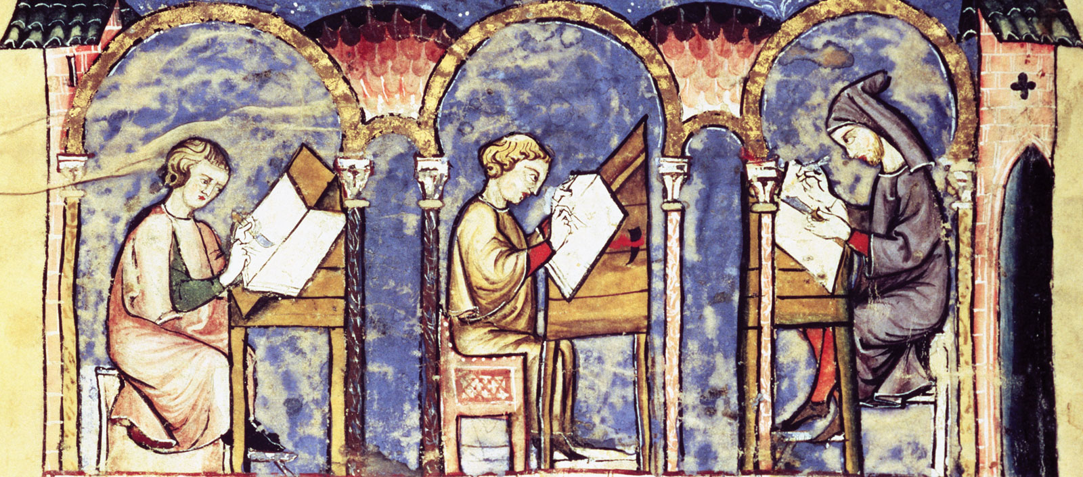
11. Monks in monasteries preserved works of literature, science and art from previous ages.

Slide 14
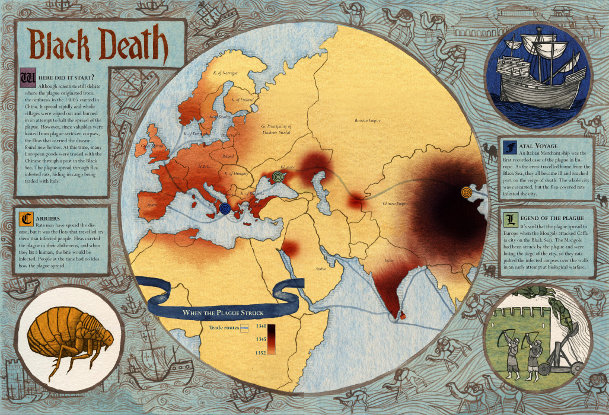
12. The Black Death/Bubonic Plague killed millions and cause social, political and economic changes.

Slide 15
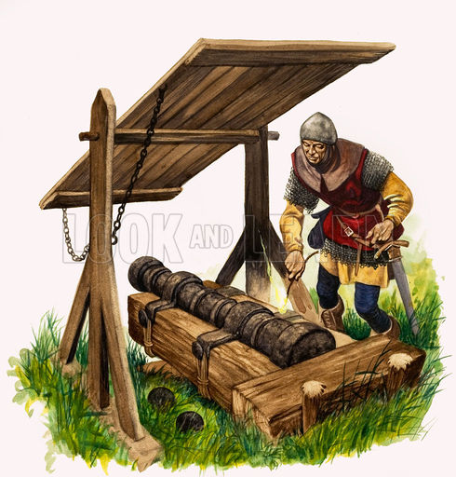
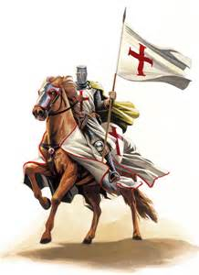
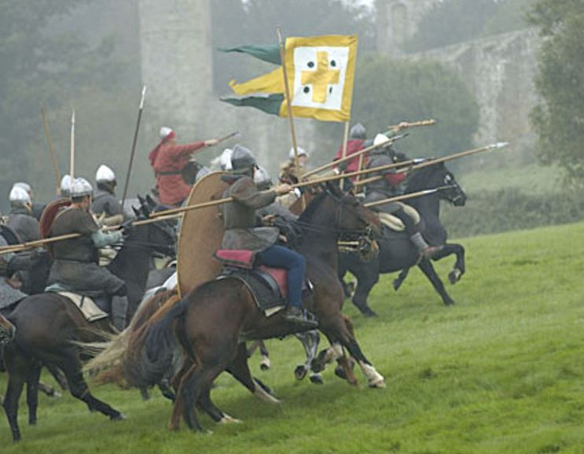
13. The age of knights ended as guns and cannons came into use.

Slide 16
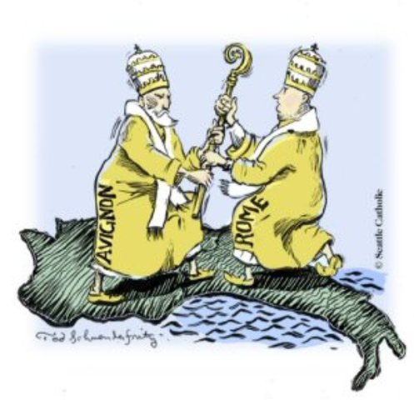
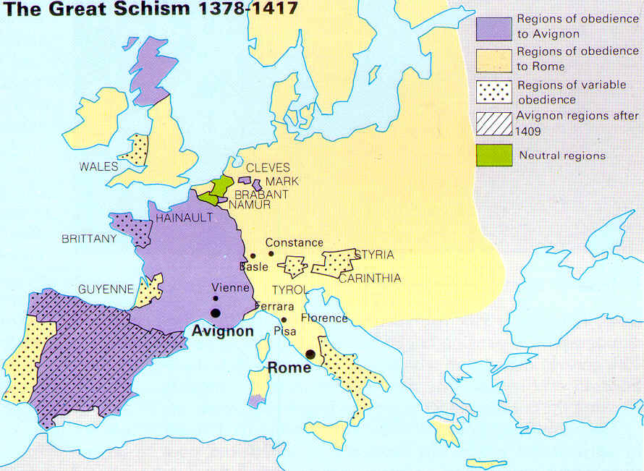
14. The Great Schism, when there were two Popes weakened the church’s power and authority.

Slide 17
15. In the later Middle Ages, Agriculture improved, diets improved the population of Europe increased and new products were developed for the larger population of Europe.
Wyka-Ism # 3
More Food ALWAYS = More Babies!

Slide 18
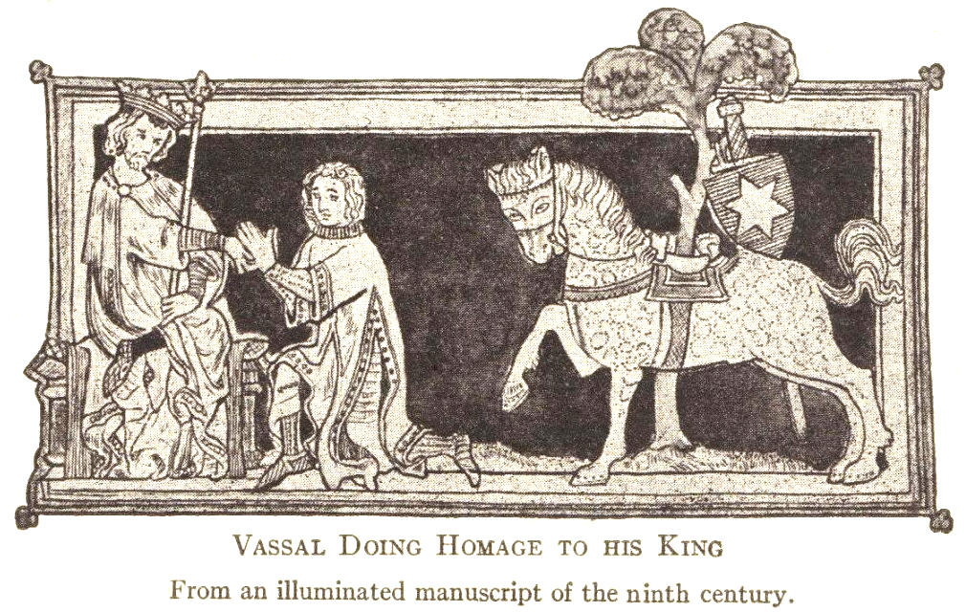
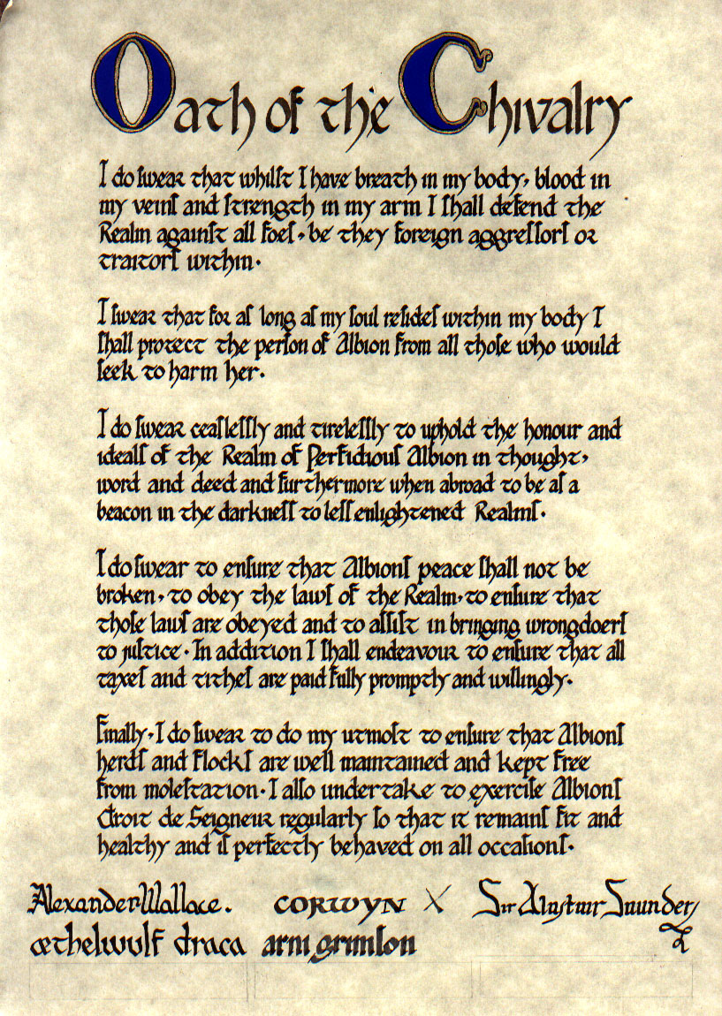
16. Knights - Warriors and religious defenders of the church.

Slide 19
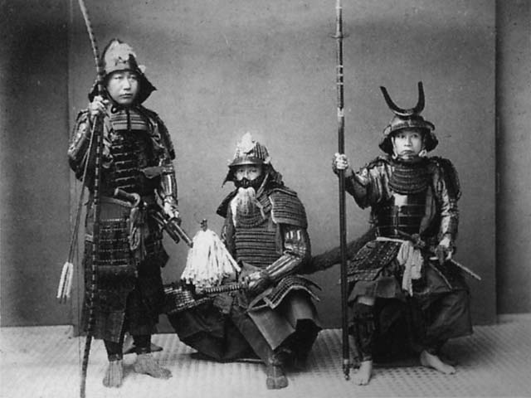
17. Samurai – Elite Japanese warriors who served the daimyo and Shogun.

Slide 20
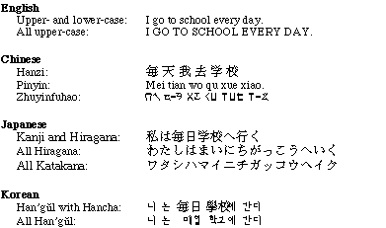
18. The Japanese learned the value of a written language from the Chinese.

Slide 21
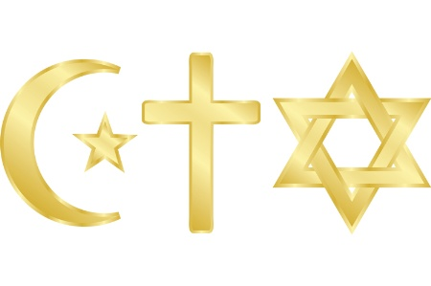
19. Islam, Christianity, and Judaism, all believe in one God.
Monotheism

Slide 22
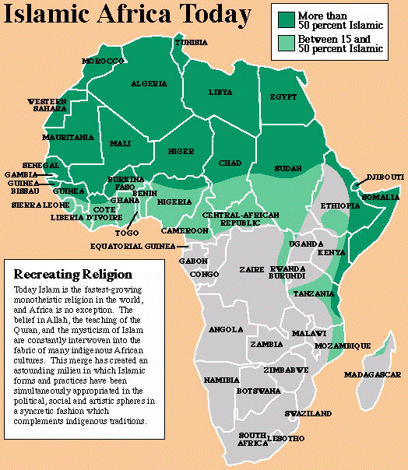
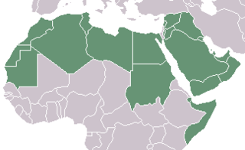
20. Many Africans began to speak Arabic following Muslim invasions of Africa.
Arabic Spoken Here

Slide 23
21. To encourage conquered people to convert to Islam, often , Muslim conquerors gave economic and political rewards to convert to Islam.
Dhimmitude

Slide 24
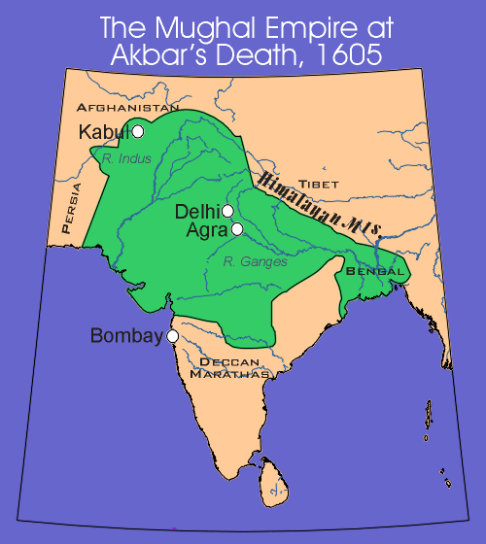
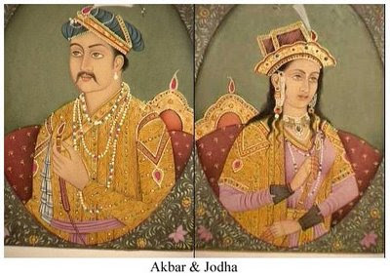
22. Akbar, a Muslim conqueror of India was able to rule over diverse group of religious by guaranteeing equality of all religions.

Slide 25
Islamic philosophers and mathematicians preserved the works ancient Greeks. Later, Europeans would use these Arabic works when they re-discovered the works of the Greek philosophers and mathmematicians.
This is a major contribution to Western Culture.
Arabic translation of Aristotle

Slide 26
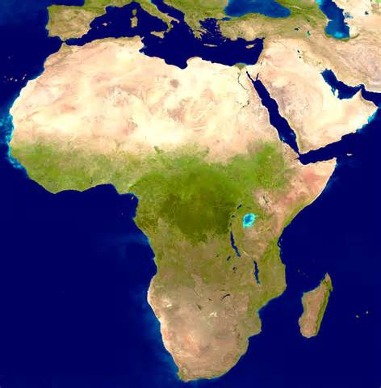
24. Caravans of camels carried on salt and gold trade in the Sahara.

Slide 27
25. Muslim academics and teachers spread Islam by starting schools in Africa.

Slide 28
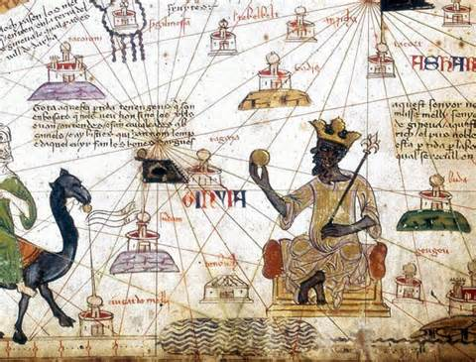
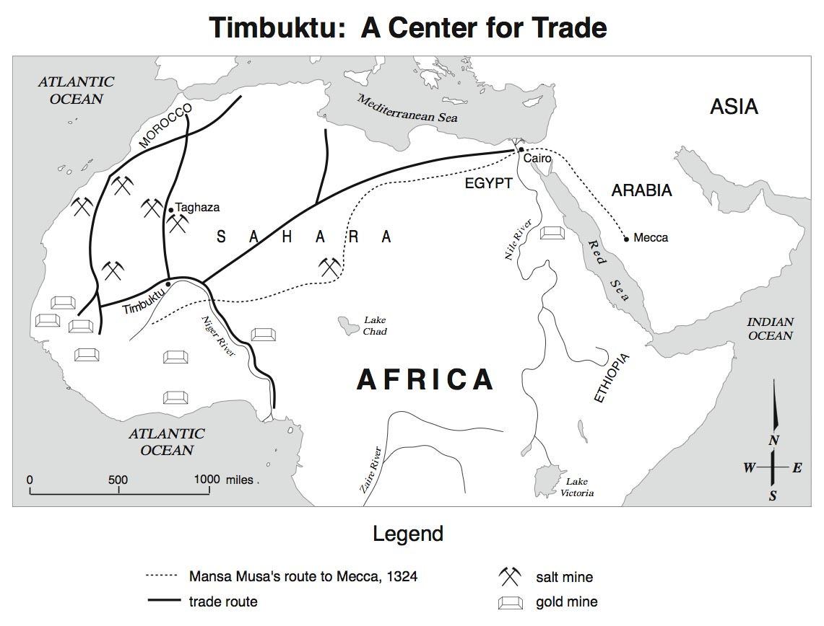
26. Mansamusa was a hugely wealthy west African king who traveled to the Arabic/Islamic world on the Hajj, impressing all with his great riches.

Slide 29
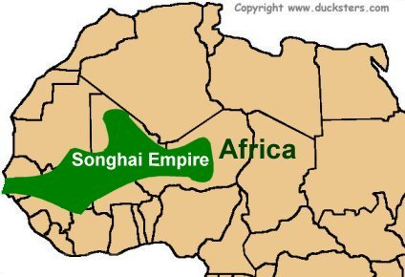
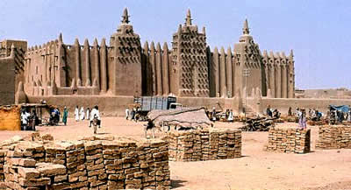
27. The Songhai Empire was on the Atlantic Shores of Africa.
Islamic
1375 to 1591

Slide 30
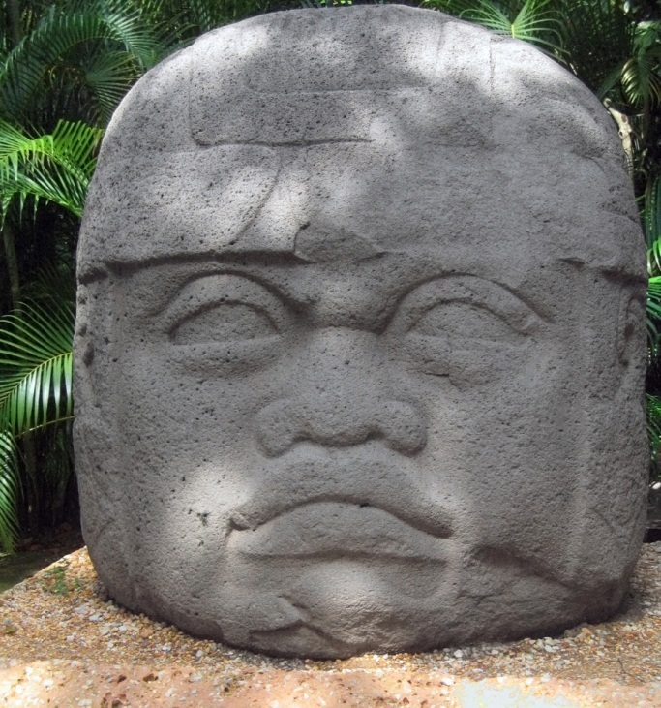
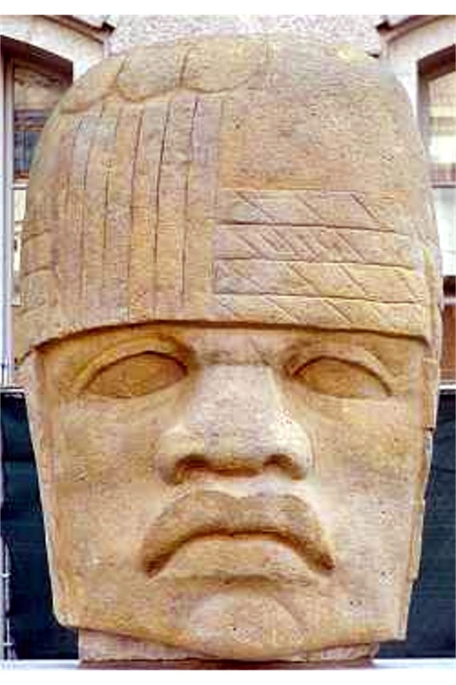
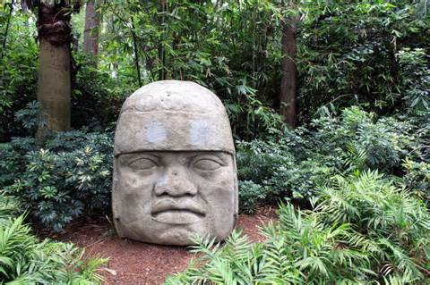
28. Meso-American is the term we use for native Americans of Central America BEFORE Columbus’ journey of 1492. The Olmec’s were an early group of Meso-Americans.
See next slide for map

Slide 31
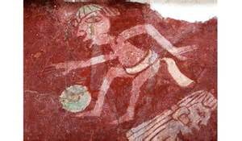
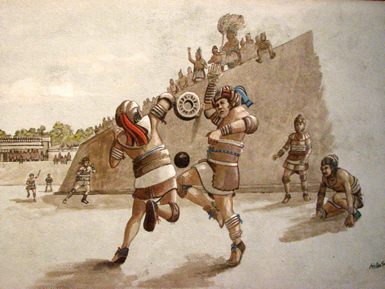
29. Meso-Americans (i.e. Olmecs, Mayans, etc.) liked sports like Lacrosse and a game similar to soccer.

Slide 32
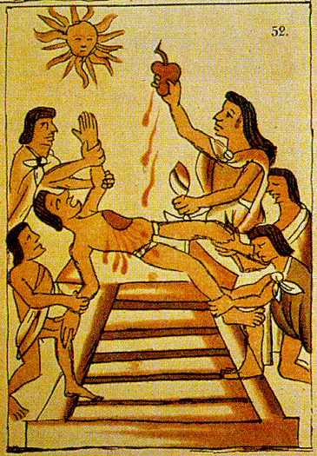
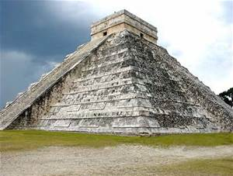
30. The Aztecs of Mexico demanded payments, human sacrifices and loyalty from those they defended and conquered.

Slide 33
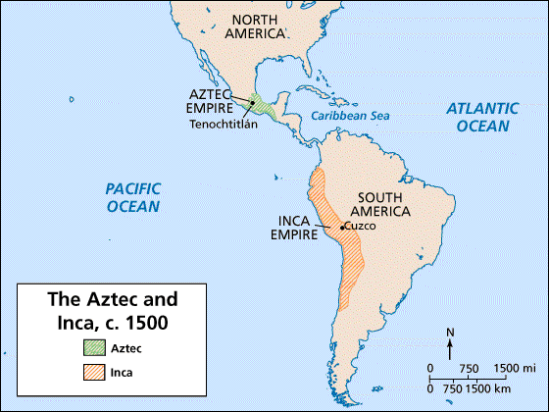
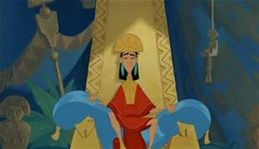
31. Aztecs in Mexico and Incas in South America- were both ruled by Emperors .

Slide 34
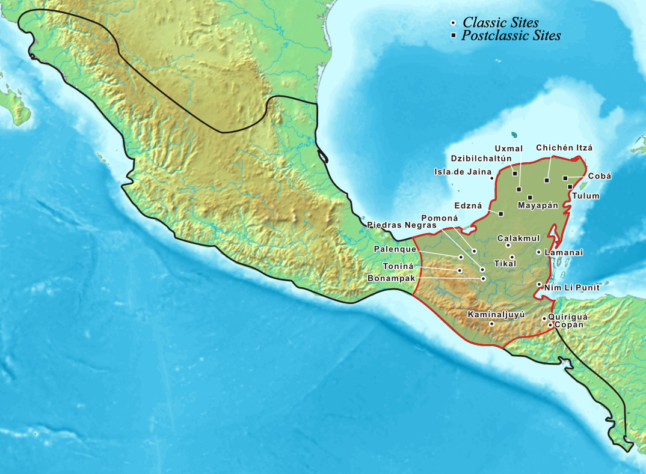
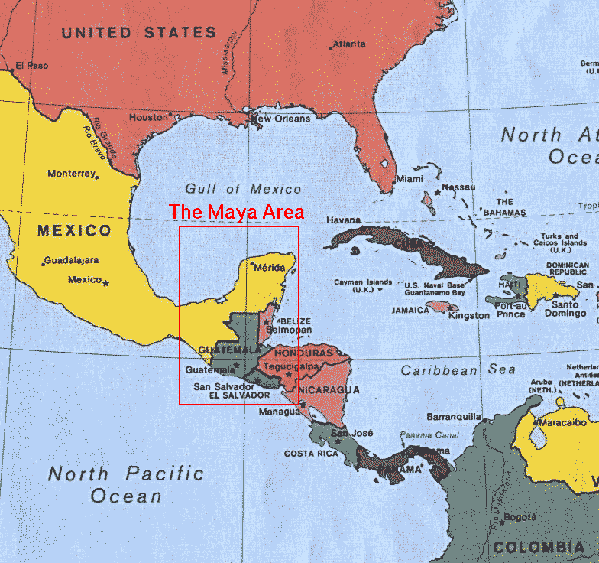
32. Mayans lived in Central America, mostly in present day Mexico.

Slide 35
33. Aztecs and Incas shared these things in common:
Empires
Conquerors
Emperor worship
Terrace farming.

Slide 36
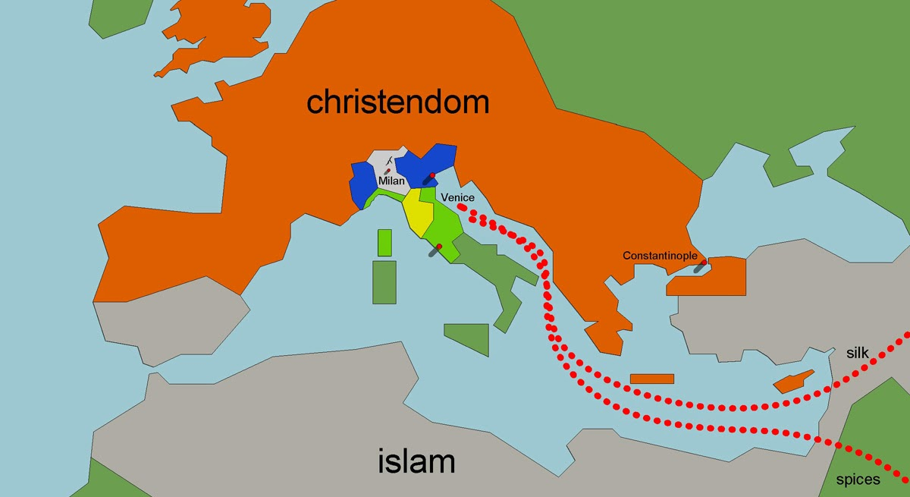
34. Italian cities grew & became wealthy due to business and trade.

Slide 37
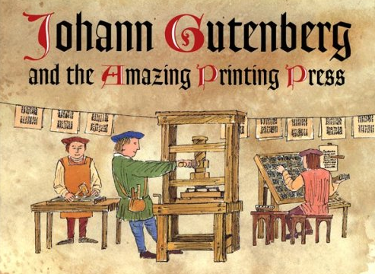
35. The printing press made printing faster, easier and cheaper.
1450
Revolutionized communication and the spread of ideas.
Made the Protestant Reformation possible.

Slide 38
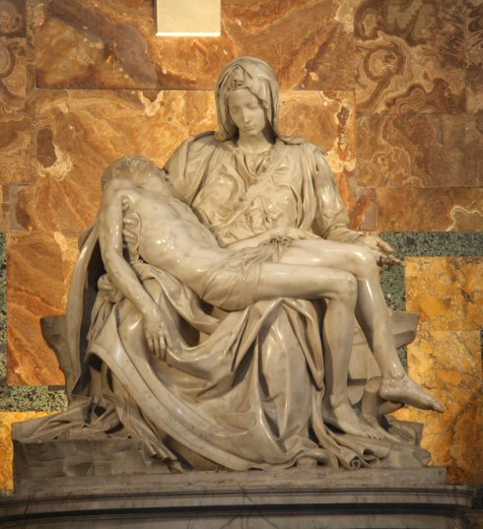
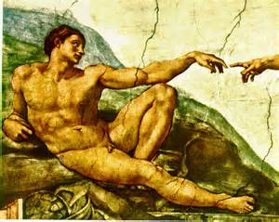
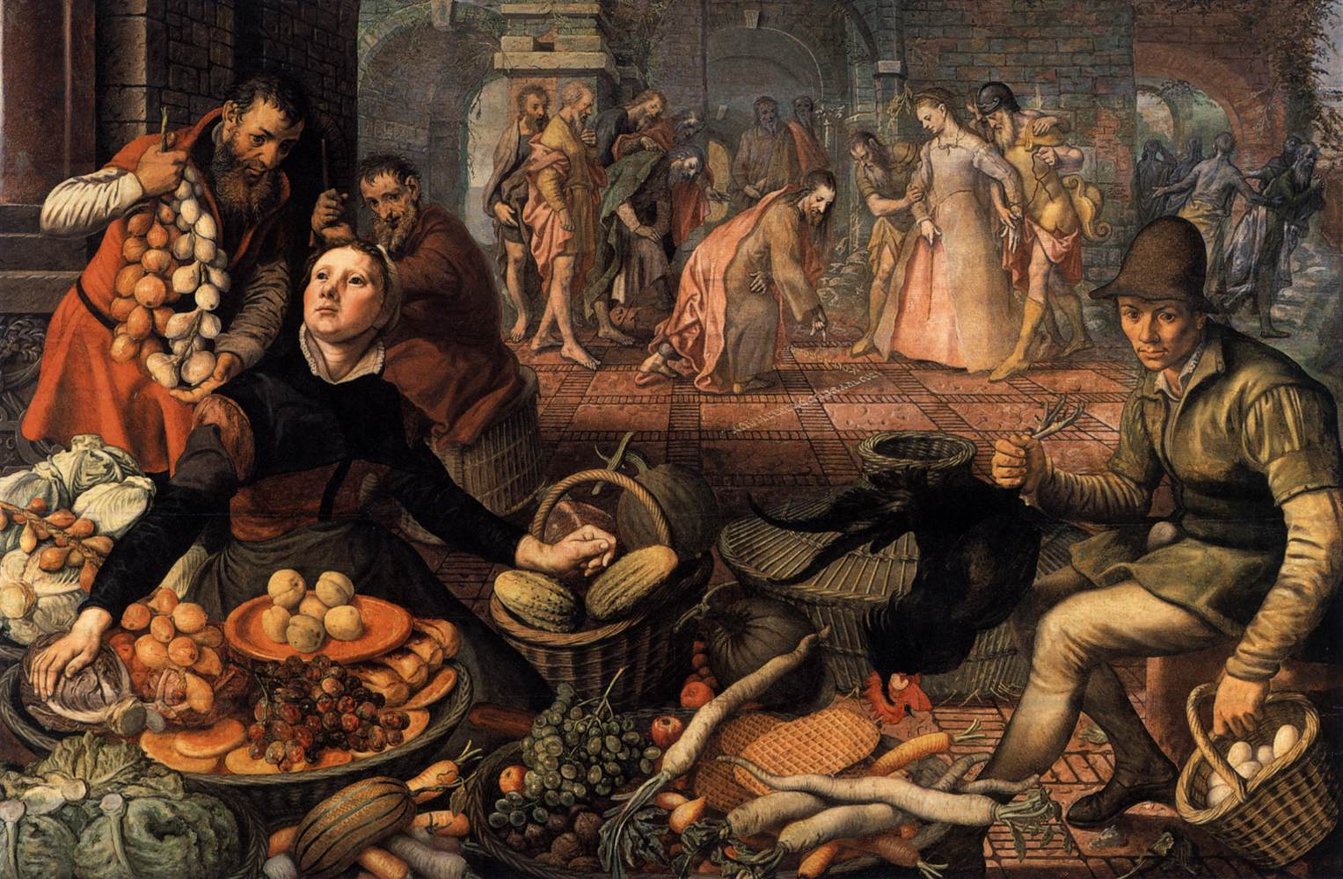
36. Humanism in art = Actual real life.
ITALIAN RENAISSANCE

Slide 39
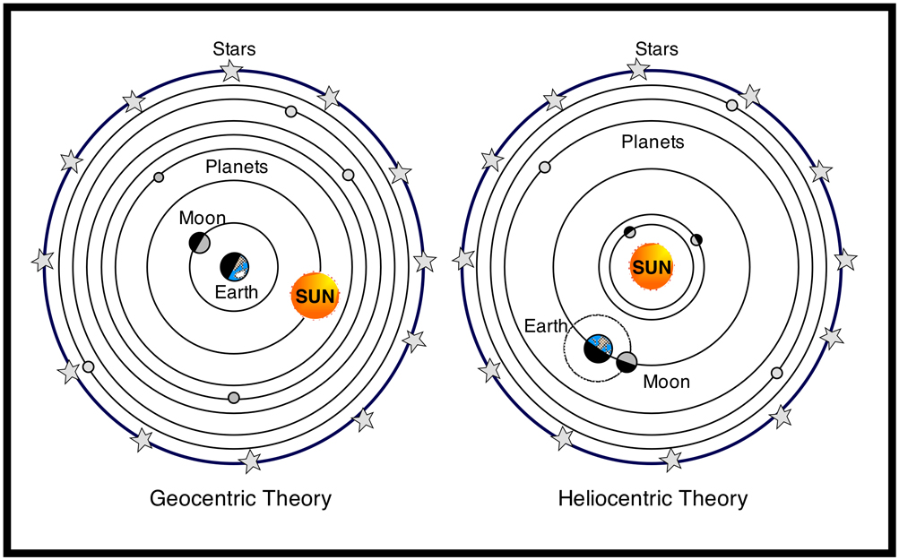
37. Copernicus was an astronomer. He developed the heliocentric idea.
Heliocentric = Sun Centered
Old
Model
New
Model

Slide 40
38. The development of the scientific method was seen as a threat to religion and earlier scientific knowledge because it implied that early authorities could be wrong.

Slide 41
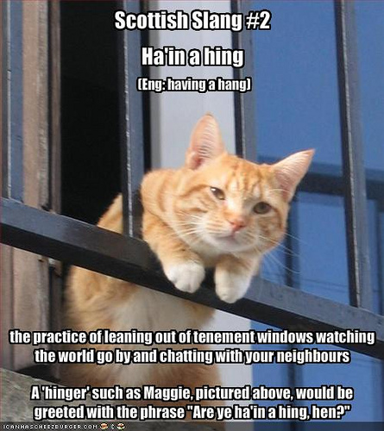
39. Vernacular = ordinary, everyday language.

Slide 42
40. Disregard

Slide 43
41. King Henry VIII broke from the Catholic Church and started the Church of England (i.e. Anglicanism).

Slide 44
42. Luther protested against the Roman Catholic Church by posting the 95 Thesis.
Start of the Protestant Reformation.
Kind of a big deal!

Slide 45
43. The Counter Reformation tried to reform the Catholic Church and stamp out the Protestant faith.
Council of Trent
Defend Catholic Doctrine
Condemn Protestantism

Slide 46
44. Magellan circumnavigated the Earth.
Wow!
Circumnavigate – to go completely around.
5 ships sailed from Spain in 1519.
Only 1 returned, the Victoria, with 18 men aboard, in 1522.

Slide 47
45. Columbian Exchange although a trade system hurt native Indians.
Disease

Slide 48
46. Slavery was used to make money through selling crops like cotton and tobacco.
Cotton
&
Tobacco
Cash
Crops
=

Slide 49
47. Africans, unlike Indians, had resistance to European diseases and so made much better slaves in the Americas.

