Slide 1
Bellringer, August 28th
On a separate sheet of paper, create a list of powers YOU would grant to the Chief Executive (i.e. president, prime minister, etc.) of your new government .
They can overlap with Executive powers existing in governments today.
Put your name on your paper.

Slide 2
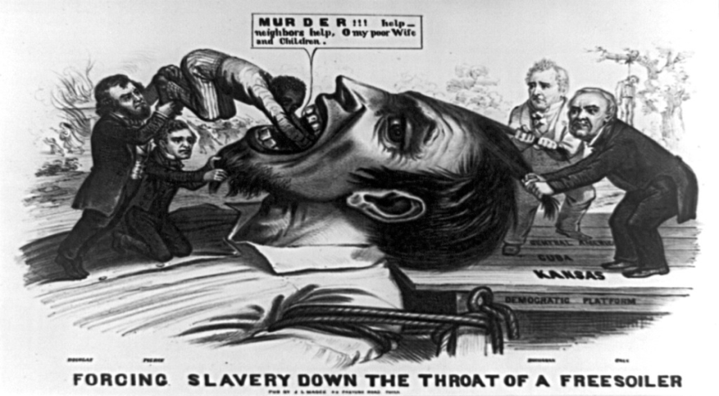
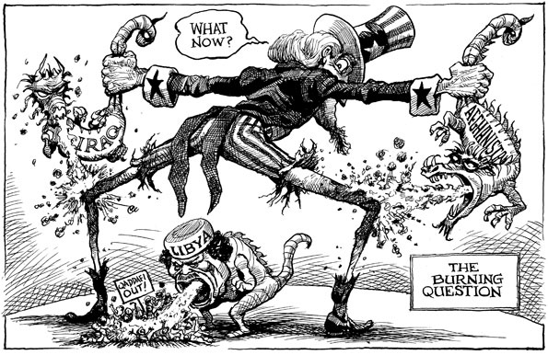
II. Blueprint for Government
A. Major Principles of the Constitution
1. Popular Sovereignty- Authority of the people
a. “We the people” consent to be governed by specific rules and laws
2. Judicial Review- Power to determine whether actions of legislative & executive branches are constitutional
a. Marbury v. Madison-

Slide 3
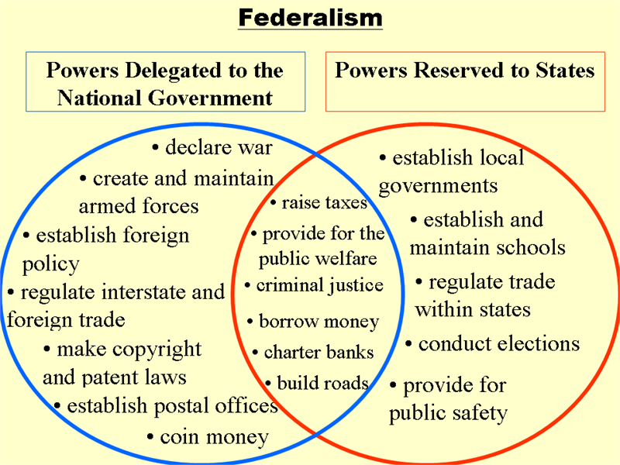
3. Limited Government
4. Federalism- Creation of a strong central govt. sharing power w/ states
a. Enumerated Powers- Powers that belong only to federal govt. (printing money…)
b. Reserved Powers- Powers that belong to the states (establishing schools, marriage laws…)
c. Concurrent Powers- States & Fed. Gov.

Slide 4
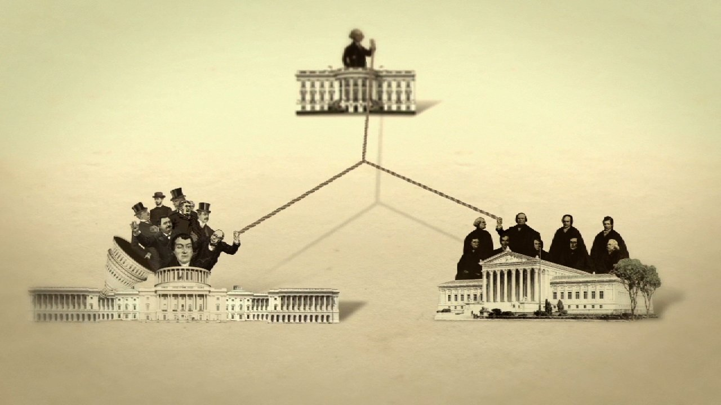
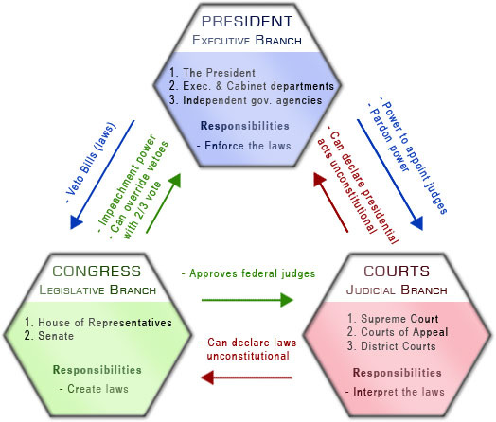
5. Separation of Powers- Govt. is divided into 3 branches (Legislative, Executive & Judicial)…Why?
6. Checks and Balances- Limits the power of any one branch of Govt.

Slide 5
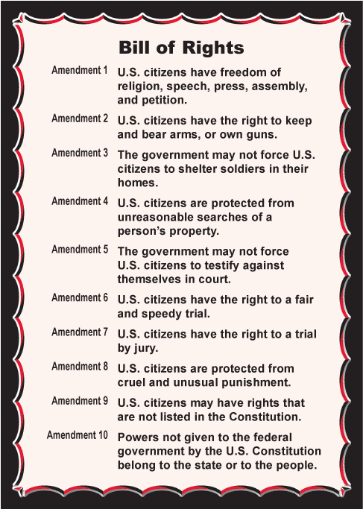
7. Individual Rights- Bill of Rights (1st 10 amendments) & 17 others (see handout)

Slide 6
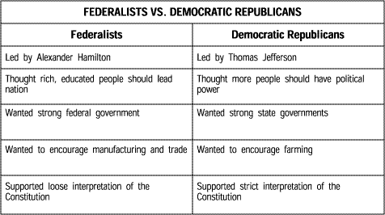
B. Founding Fathers Debated
1. Jefferson wanted to revise the Constitution every generation (Good idea or dumb?)
2. Hamilton wanted to be able to amend it but not alter the body of the document

