Slide 1
The Reformation in Europe 1517-1600 Chapter 10, lesson 1 The Protestant Reformation
Mr. Wyka - World History

Slide 2
What does the word Protestant mean?
Protestant <Protest – ant>
What were the first Protestants protesting?

Slide 3
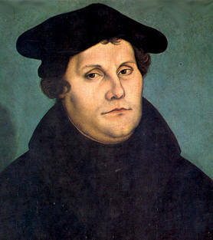
Essential Questions
What conditions can encourage a desire for reform?
Is a reform different than a revolution?
Martin Luther, 1529

Slide 4
Why does it matter?
Today’s Christianity was shaped by the events of the Protestant Reformation.
Christian Europe’s ability to respond to outside threats was affected by the dis-unifying effect of the Reformation.

Slide 5
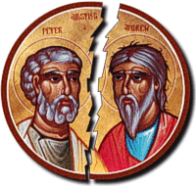
Lesson Vocabulary
Schism
Christian humanism
Salvation
Indulgence
Lutheranism
Fundamental
External
valid

Slide 6
The Background
For 1000 years, Christianity had been essentially united.
In 1054, the Western and Eastern Churches split (schism).
Catholic (western), Orthodox (eastern)
In the early 1500s, several groups broke from (schism) the Catholic Church. These became the first Protestant churches.

Slide 7
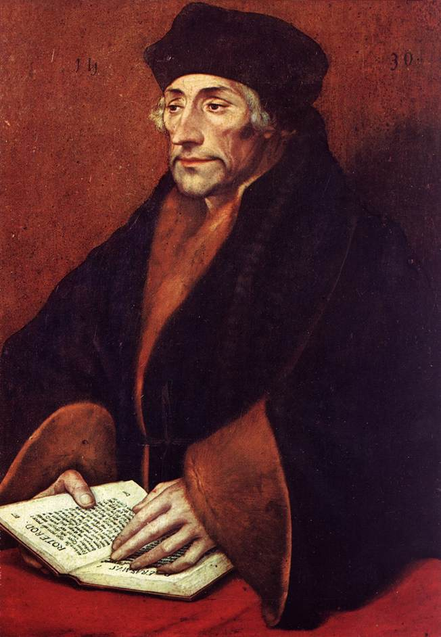
Leading to Reformation
Christian Humanism and Erasmus paved the way for the Protestant Reformation in Europe.

Slide 8
Christian Humanism
Grew out of Italian humanism.
Major goal was the reform of the Catholic Church.
Erasmus downplayed outward forms of religion such as pilgrimages, fasts, and relics.
Urged that Christians read the Bible and the fundamental works of Christianity.

Slide 9
Erasmus
Best known Christian humanist
Wrote The Praise of Folly in 1509, which criticized society’s moral and religious practices.
Wanted to reform the Church, not break from it.
However, his ideas paved the way for the Reformation,.

Slide 10
Need for Reform
Popes and bishops involved in politics rather than tending the spiritual needs of their people.
Emphasis on external manifestations of Faith rather than Faith itself.
Sale of indulgences.
Freedom from all or part of the punishment due to sin.
Does not forgive the sin itself, just remits the punishment.

Slide 11
Reform within the Church
The Church was reforming, but slowly, and from the laity (ordinary people) upward.
Movements such as the Modern Devotion movement stressed the need to follow the teachings of Jesus rather than external practices such as pilgrimages, relics, and fasting.

Slide 12
Martin Luther and the 95 Theses
Luther was a Catholic monk.
Upset at the sale of indulgences.
In 1517, Nailed 95 Theses (challenges) to the Cathedral door of Wittenberg.
Traditional way for scholars and theologians to challenge one another.

Slide 13
Martin Luther’s Reformation
By 1520, emboldened by his leadership position, Luther urged German princes to overthrow the pope in Germany and created a new church.
With the involvement of the princes, who lusted after valuable Church property, the movement became part political and part spiritual in motivation.

Slide 14
Schism Happens!

Slide 15
What’s Next?
Pick up a Guided Reading from the front table and begin work. This worksheet is due by the end of class. You may collaborate.
The chapter starts on page 175.

