Slide 1
The Age of Exploration 1500-1800 Chapter 11, lesson 1 European Exploration & Expansion
Mr. Wyka - World History

Slide 2
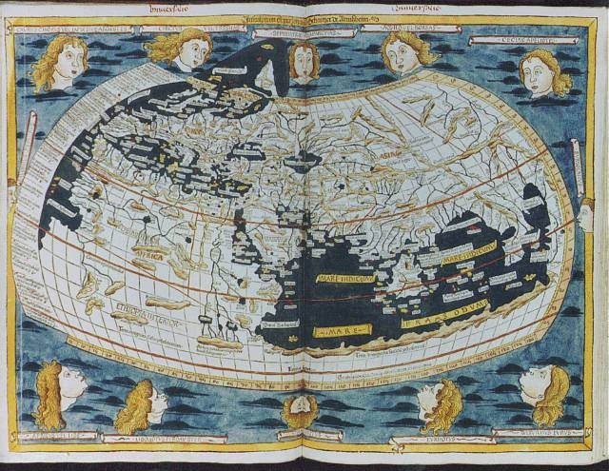
Essential Question
What are the effects of political and economic expansion?
On the explorers?
On the conquered?
Map of the World from a European view - 1482

Slide 3
Why does it matter?
The connections European explorers made between Europe and the rest of the world were crucial to forming the world we live in today.
European explorers were driven by a variety of motives and should not be typecast:
Wealth
Political Ambition
Religious Zeal and Missionary Calling
The Call of Adventure

Slide 4
Lesson Vocabulary
Caravel
A small, fast, maneuverable ship that had a large cargo hold and usually three masts with lateen sails. Developed by Prince Henry of Portugal.
Colony
A settlement of people living in a new territory, linked with a parent company or state by trade and government control.
Conquistador
A leader in the Spanish conquest of America

Slide 5
Motives and Means
From 1500 – 1800…
First Portugal, then Spain, followed by the Netherlands, England, and France.
Europe was fascinated with Asia.
Marco Polo had made overland journeys to China in the late 13th century.
The phrase “Gold, glory, and God” suggests the three key motives for European expansion.

Slide 6
Motives and Means
From 1500 – 1800…
Motives
Desire to convert indigenous people
Grandeur and glory (political gain)
Economic interest (trade and gold)
Chasing a spirit of adventure

Slide 7
Motives and Means
From 1500 – 1800…
Means – New Technologies
The Caravel sailing ship was developed in Portugal by Prince Henry the Navigator.
It made long sea voyages possible and… profitable (cargo hold).
Advances in cartography (mapmaking).
Advances in navigation.
Astrolabe.
Magnetic compass.
Knowledge of wind patterns (prevailing winds).

Slide 8
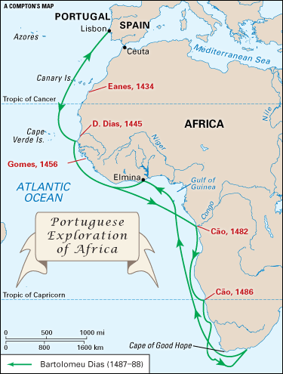
A Race for Riches
How were Spain and Portugal able to take the lead in discovering new lands?
Portugal took the lead, sailing southward along the African coast.

Slide 9
A Race for Riches
Portuguese, sponsored by Prince Henry, soon discovered a new source of gold from the African continent.
The southern coast of West Africa soon became known as the Gold Coast to Europeans.

Slide 10
A Race for Riches
The goal was to find a sea route to the Orient.
1487 - 88, Bartolomeu Dias reached the tip of Africa – the Cape of Good Hope – and returned to Portugal.
Vasco da Gama made it around Africa to India and returned to Portugal.

Slide 11
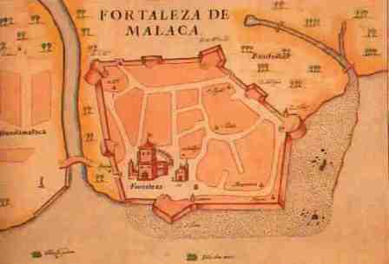
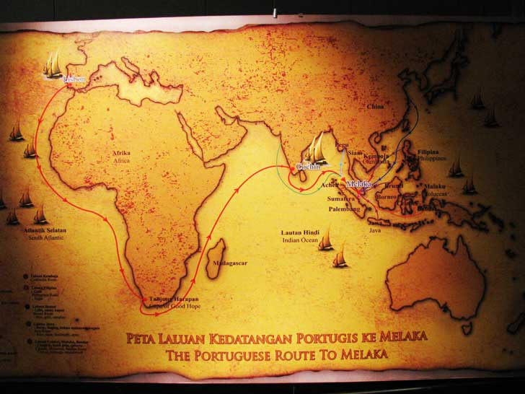
A Race for Riches
The Portuguese soon
had destroyed Arab control of the spice trade in the Indian Ocean and
established a limited empire of trading posts on the coasts of India and China.

Slide 12
A Race for Riches
Spanish Explorers
As the Portuguese sailed east around Africa to the Orient, Spain sailed west across the Atlantic Ocean to find a trade route to India.
Christopher Columbus (Italian) persuaded Queen Isabella of Spain (yes, the same one) to finance a voyage westward.
In 1492, he was the first European since the Vikings to reach the Americas.
He made four voyages, reaching all the major Caribbean islands and Central America. He believed they were islands off of India and called them, the Indies.

Slide 13
A Race for Riches
New Lands to Explore
Treaty of Tordesillas
1494
Brokered between Portugal and Spain, two Catholic nations, by the pope.
Basically split the known world in two, giving half to each nation.

Slide 14
A Race for Riches
New Lands to Explore
England gets into the game
1497
John Cabot (an Italian), explored New England, claiming it for the English crown.
Portugal lands in Brazil in 1500.
Amerigo Vespucci chronicled many Portuguese voyages to the New World. His letters popularized a new name for the new lands – America (after Amerigo).

Slide 15
The Spanish Empire
What were the results of Spanish & Portuguese conquests in the Americas?
Spanish conquerors were known as conquistadors.
Fresh off the success of the Reconquista of the Iberian Peninsula from Muslim forces.
The Spanish Empire was quite different than the trading post empire the Portuguese had built.

Slide 16
The Spanish Empire
Conquest of the Aztec
Hernan Cortes defeated the ancient Aztec empire of Mexico.
Made alliances with Aztec enemies.
Superior military technology (horses, armor, firearms, cannons, steel swords and halberds).
Disease

Slide 17
The Spanish Empire
Conquest of the Inca
Francisco Pizarro defeated the ancient Incan empire of South America.
Took advantage of a civil war.
Superior military technology (horses, armor, firearms, cannons, steel swords and halberds).
Disease

Slide 18
European Rivals
Which other European countries explored and settled in the Americas?
By the end of the sixteenth century…
The Dutch had settled in the northeast and named it New Netherland.
Established a trading empire.
Fell to the rival French and English after 1660.
In 1664, the English seized New Netherland and renamed it New York.

Slide 19
European Rivals
17th century, the French colonized much of Canada and Louisiana.
The English colonized much of the eastern seaboard of North America and set up sugar plantations in the Caribbean.

Slide 20
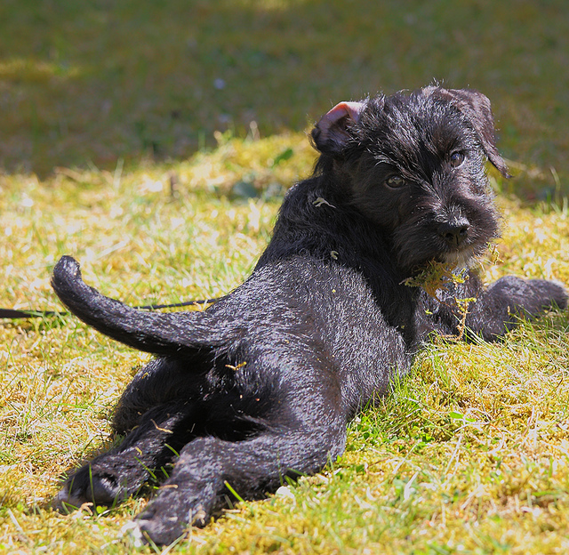
Looking back…

Slide 21
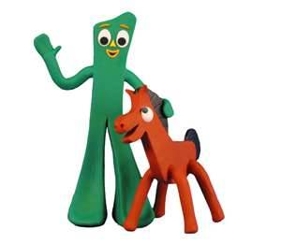
The use of movable type was pioneered by German printer
Johannes Gutenberg

Slide 22
