Slide 1
Conflict and Absolutism in Europe 1550-1715 Chapter 12
Mr. Wyka - World History

Slide 2
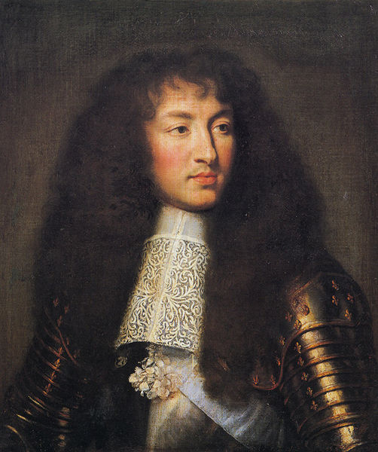
Essential Questions
What effect might social, economic, and religious conflicts have on a country?
How would the exercise of absolute power affect a country?
King Loius XIV of France – the Sun King

Slide 3
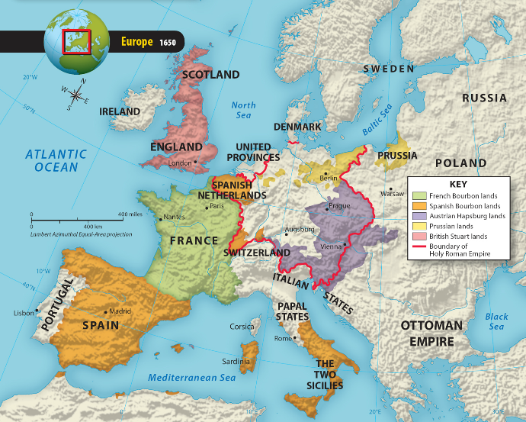

Slide 4
12.1 Lesson Vocabulary
heretic
One who does not conform to established religious doctrine.
armada
A fleet of warships.
inflation
A rapid increase in prices.

Slide 5
Spain’s Conflicts
Reconquista completed in 1492.
Spanish Jews expelled.
The Spanish king Philip II
Militantly Catholic
Inherited a large European kingdom from his father, Charles V, the Holy Roman Emperor.
Reigned from 1556 to 1598 (imagine having a single president for 42 years!)
Ushered in an age of Spanish greatness.
Led a Holy League against a Turkish invasion of Europe and defeated the Turks in the Battle of Lepanto in 1571.

Slide 6
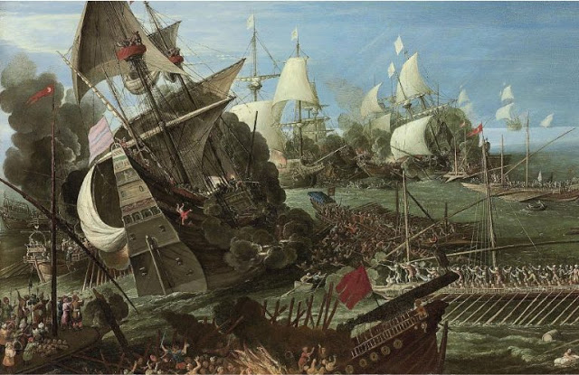
Battle of Lepanto by Andries van Eertvelt

Slide 7
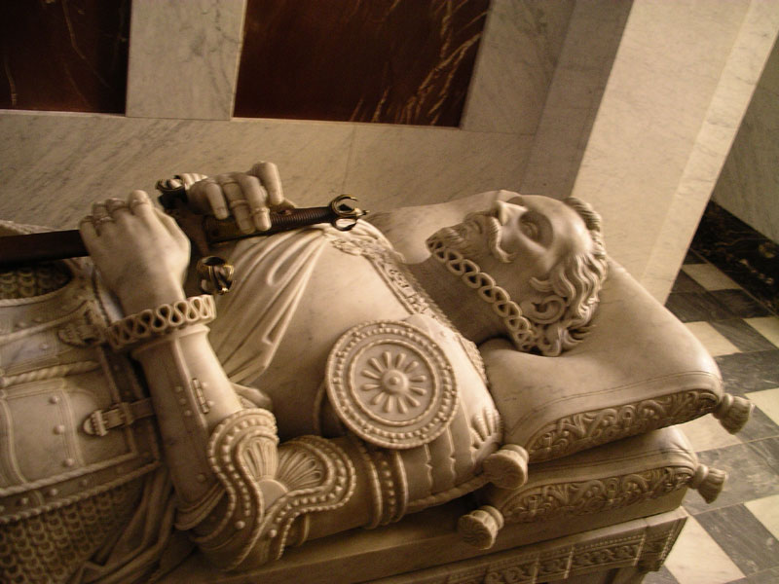
The tomb of Don Juan of Austria, hero of Lepanto, in San Lorenzo de El Escorial

Slide 8
Spain’s Conflicts
Spanish Netherlands
One of the richest parts of Philip’s empire.
The Calvinist Netherlands revolted against Spanish Catholic rule.
The struggle lasted from 1566 to 1609.
The truce that ended the war also allowed the provinces of the Netherlands to coalesce, forming the core of the modern Dutch state.

Slide 9
Catholic Spain vs. Protestant England
Elizabeth Tudor became English queen in 1558.
England became firmly Protestant under her reign.
Act of Supremacy made her “supreme governor” of both church and state
Does this sound like an example of absolutism to you?
Philip II of Spain
In 1588, sent an armada to invade England with the goal of
Overthrowing Protestantism in England, and
Destroying the rising power of England.
The Spanish armada was destroyed by the English fleet.
After this defeat, the balance of power in Europe shifted to England and France.

Slide 10
French Wars of Religion
1562-1598
Catholics vs. Huguenots (French Calvinists)
Motivations were both religious and political.
War raged until a Huguenot, Henry of Navarre, succeeded to the throne as Henry IV.
He converted to Catholicism to unite France.
Henry IV issued the Edict of Nantes in 1598, recognizing Catholicism as the state religion but giving Huguenots the right to worship and freedom of political office.

Slide 11
Crises in Europe & the Thirty Years’ War
Growing population led to increased demand for food and land and drove up prices for both – inflation.
Witchcraft Trials
A powerful belief in the supernatural permeated the European concept of the natural world.
Ordinary events – bad harvest, illness, etc., were blamed on agents of the devil.
A mob hysteria ensued, fanning the flames further.

Slide 12
Crises in Europe
Growing population led to increased demand for food and land and drove up prices for both – inflation.
Witchcraft Trials
A powerful belief in the supernatural permeated the European concept of the natural world.
Ordinary events – bad harvest, illness, etc., were blamed on agents of the devil.
A mob hysteria ensued, fanning the flames further.

Slide 13
The Thirty Years’ War
The Peace of Augsburg between Catholics and Lutherans did not include Calvinists.
The war pulled in all major European powers except England.
Motivations were political masked by religious.
The Peace of Westphalia of 1648 brought an end to the conflict and divided the Holy Roman Empire into independent states.

Slide 14
12.2 Lesson Vocabulary
Divine right of kings
The belief that a king received his right to rule from God and was subject only to God.
Puritans
English Protestants inspired by Calvinism; wanted the Church of England to be strictly Protestant with no vestiges of Catholicism remaining.

Slide 15
12.2 Lesson Vocabulary
Cavaliers
Supporters of the English king; also known as Royalists
Roundheads
Parliamentary forces opposed to the Cavaliers. Under Cromwell, they proved victorious in the English Civil War of 1642.
Natural rights
Rights with which all humans are born. This idea was put forth by John Locke in 1690 and inspired the American founders.

Slide 16
Revolutions in England
In the 17th century, disagreements between the Stuarts and Parliament led to the English Civil War, a period of military rule, and a troubled restoration of the monarchy.
The death of Queen Elizabeth I in 1603 brought the end of the Tudor dynasty and the beginning of Stuart rule.
In 1628, Parliament passed a Petition of Right to place limits on the king’s authority, but after initially accepting it, King Charles I later ignored it.
During England’s civil war, the parliamentary forces, or Roundheads, defeated the Royalists, or Cavaliers.
Cromwell eventually dispersed Parliament and set up a military dictatorship.
During the Restoration, religion caused tension between Parliament and the kings.
England’s “Glorious Revolution” laid the foundation for England’s limited, or constitutional, monarchy.
English nobles invited William of Orange to invade England.
Parliament’s Bill of Rights established the foundation for a constitutional monarchy; it helped create a government based on the rule of law.
The divine – right theory of kingship was destroyed during the “Glorious Revolution;” as a result, English monarchs rule by the grace of Parliament.
The political thought of Thomas Hobbes and John Locke reflected concerns with order and power.
In his treatise entitled Leviathan, Thomas Hobbes argued that rulers required absolute power to preserve order in society.
John Locke argued that government existed to protect life, liberty, property, and other natural rights.
Though Locke was not an advocate of democracy, his ideas can be found in the American Declaration of Independence and the U.S. Constitution.

Slide 17
12.3 Lesson Vocabulary
absolutism
A system in which a ruler holds total power; tied to the divine right of kings.
boyar
The Russian nobility; crushed by Czar Ivan (the Terrible) in the 16th century.
Czar
The Russian word for caesar, and the title of the absolute ruler of Russia.

Slide 18
France Under Louis XIV
Louis XIV’s reign is considered the best example of absolutism in the seventeenth century.
Cardinal Richelieu, minister to Louis XIII, and Cardinal Mazarin, minister to Louis XIV, helped to preserve the authority of the monarchy.
Louis XIV established both a royal court and a state office at Versailles, where he lived lavishly.
To achieve military glory and strengthen his dynasty, the Sun King created a large army and waged four wars, but when he died, France was surrounded by enemies.

Slide 19
The Spread of Absolutism
Out of the more than three hundred German states in existence after the Thirty Years’ War, Prussia and Austria emerged as two great European powers.
Frederick William built a huge, efficient standing army, and he also set up the General War Commissariat to levy taxes, oversee the army, and govern the state.
The Hapsburg dynasty failed to create an empire in Germany; however, it formed the new Austrian Empire.
The core of the new empire, which did not become a highly centralized state, consisted of lands in present-day Austria, Hungary, and the Czech Republic.

Slide 20
Peter the Great
Ivan the Terrible was Russia's first czar.
Peter the Great viewed modernization of the army as an important step in making Russia a great power.
Peter formed Russia’s first navy and introduced Western manners, practices, and customs to the people of Russia.
He divided Russia into provinces to strengthen the rule of the central government.
In 1703, Peter began construction of St. Petersburg, which became Russia’s most important port and was the Russian capital until 1918. This city was to be Peter’s “Window to the West”.

Slide 21
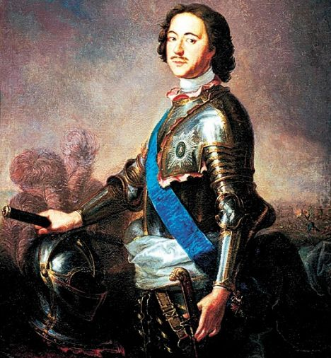
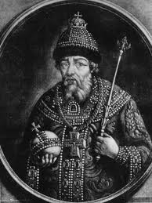
Peter Ivan

Slide 22
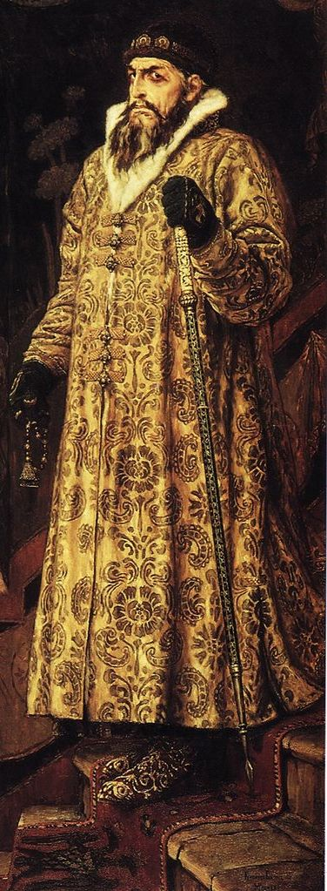
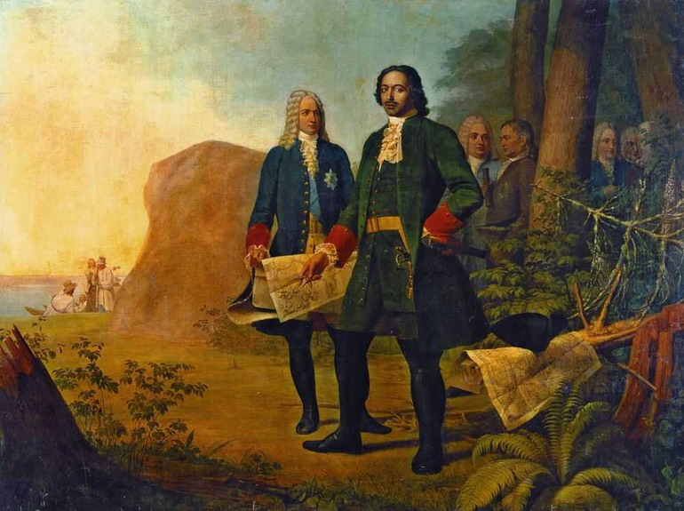
Ivan
Peter

Slide 23
Closing Question
How did the rise of absolutism differ in France and England?

Slide 24
Looking back…

Slide 25
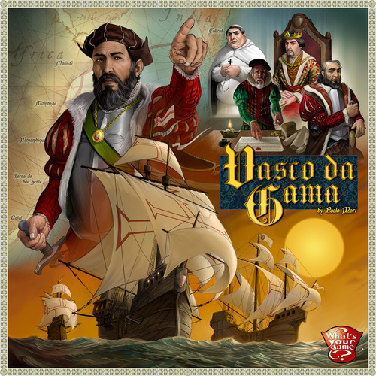
Which European nation is given credit for first rounding Africa, creating a water-route to India?
Portugal

