Slide 1
Chapter 13.3 The Early Caliphates
Mr. Wyka – AP World History

Slide 2
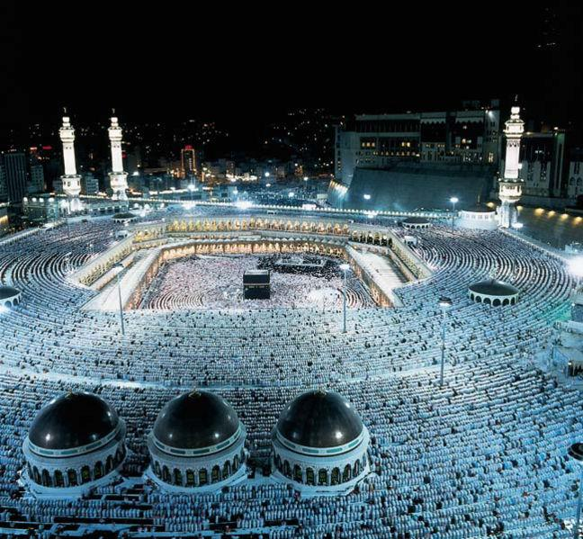
Essential Questions
How did Islam change from the desert based movement of Muhammad to the worldly and powerful caliphates?
The Annual Hajj. The Kaaba is in the background of the picture.

Slide 3
Umayyad Caliphate
The Umayyad family came to power after the assassination of Ali, the son-in-law of Muhammad and the 4th caliph.
Established their capital at Damascus, Syria (outside of Arabia).
Emphasized Arab ethnicity over adherence to Islam.
Respect for Jews & Christians as People of the Book.
Lived luxuriously, which prompted riots among the people.
These riots led to the overthrow of the Umayyad family and the rise of the Abbasid dynasty.
One Umayyad family escaped to establish the Caliphate of Cordoba in Spain, in Europe.

Slide 4
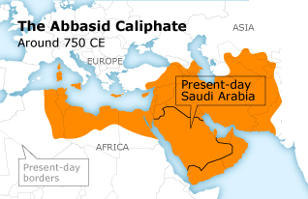
Abbasid Dynasty
Established their capital at Baghdad (Iraq)
Converts to Islam granted equal status despite ethnicity.
Established much of what we think of as Muslim today:
Arabesque, Minarets, The Arabian Nights literature, Arabic numerals from India.

Slide 5
The Abbasid Dynasty
Found their vast empire difficult to govern.
Local leaders called sultans gained more power and virtual independence.
A Persian sultan took control of Baghdad in 945 but the Persian sultanate had to ally itself with the Seljuk Turks (also Muslims) who threatened.
By the mid 11th century, the Seljuks controlled Baghdad.
The Abbasid dynasty limped to an end by the 13th century with the execution of the Abbasid caliph by Mongol invaders (the exception).

Slide 6
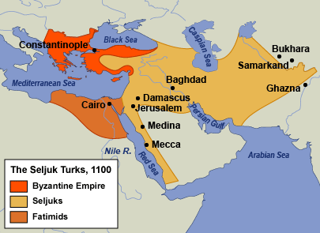
The Seljuks and the Crusades
The Seljuk Turks from central Asia converted to Islam through their contact with the Abbasid dynasty.
It was the Seljuk takeover of Jerusalem that prompted the First Crusade in 1095.

Slide 7
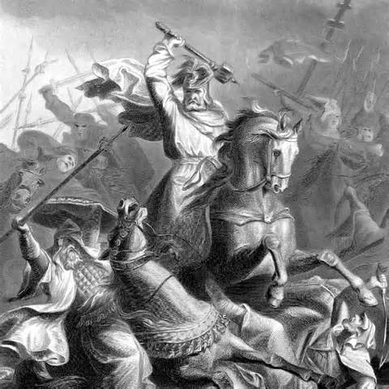
Al-Andalus – Muslim Spain
Islamic culture flowered in Spain
In 711, Berbers from North Africa conquered the Iberian Peninsula and invaded France.
Stopped at the Battle of Tours in 732 by Charles Martel and an army of Franks.
The Islamic advance into Europe was stopped.

Slide 8
Islam in India and Southwest Asia
Between the 7th and 12th centuries, Muslims expanded their influence from northwest India to the Indus Valley and a large portion of northern India.
The Delhi Sultanate controlled northern India from 1206 to 1526.
In Southeast Asia, Traders spread Islam to Malaysia and Indonesia (today, the largest Muslim nation by population).

Slide 9
Islam in Africa
Jihad – holy war – brought Islam to north Africa in the eighth century.
Did not find much success in finding converts in the interior of Africa.
North Africa (north of the Sahara), and eastern Africa were strongholds.
The east African coast converted to Islam in large part due to Islamic traders plying the waters of the Indian Ocean trade routes.
Mogadishu, Mombasa, Kilwa

