Slide 1
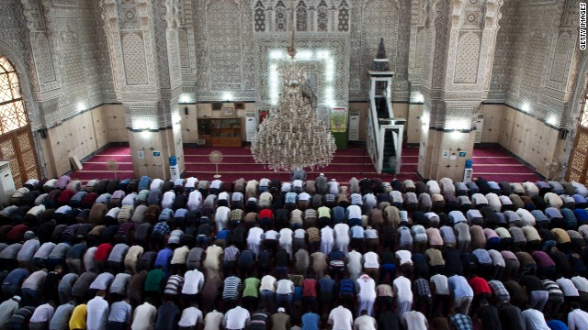
Bellringer, February 9th
Turn in your 5 Pillars of Islam homework and any late work you’ve completed.
Pick up a 5 Things bellringer from the front table and begin working it before the bell rings.

Slide 2
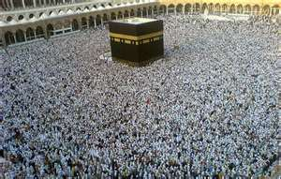
Chapter 13, lesson 1 The First Muslims
Mr. Wyka – AP World History
The Kaaba, in Mecca, Saudi Arabia, during the Hajj
When? A.D. 600
Where? Southwest Asia – Arabian Peninsula

Slide 3
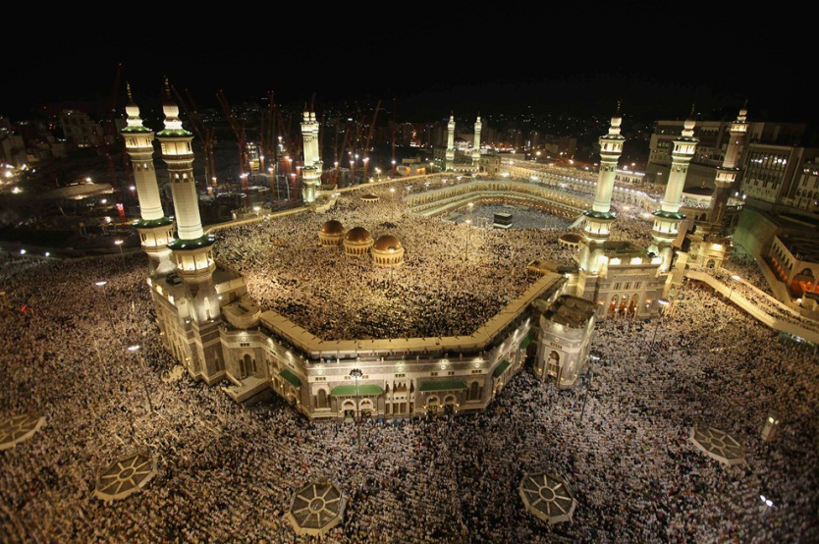
Essential Questions
How can religion influence the development of an empire?
How might religious beliefs affect society, culture, and politics?
The Annual Hajj. The Kaaba is in the background of the picture.

Slide 4
Why does it matter?
From a humble beginning of polytheists in the Arabian desert, Arab culture and religion has literally transformed much of the world. Islam is a worldwide religion, second only to Christianity in the number of adherents.
And…
There will be a quiz after this presentation.

Slide 5
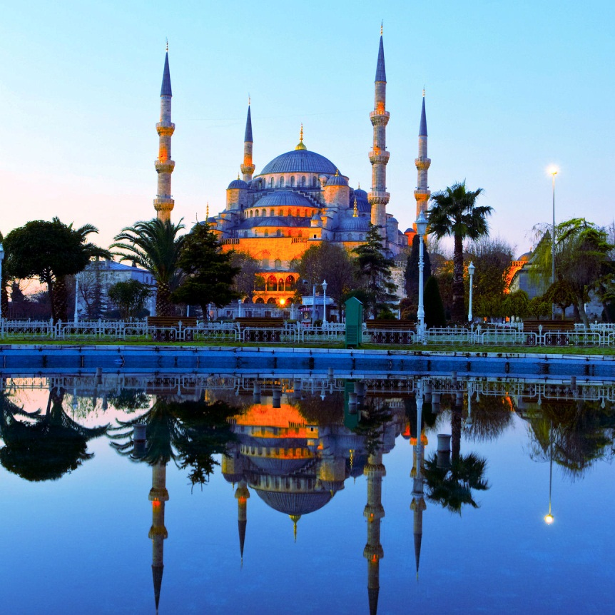
Lesson Vocabulary
sheikh
Quran
Muslim
bedouin
Five Pillars of Islam
shari’ah
Allah
Islam
Hijrah
hajj
polytheistic
The Blue Mosque, Istanbul, Turkey

Slide 6
The Arabs – A.D. 600
Arabs are a Semitic language speaking people, like the Israelites.
They lived on the Arabian Peninsula (present day Saudi Arabia & Yemen) and lived a nomadic, pastoral lifestyle.
Arab society was tribal, with each tribe ruled by a sheikh.

Slide 7
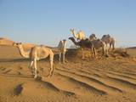
The Arabs – A.D. 600
But you ask: “How could the Arabs live a nomadic lifestyle, which involves moving about, in a hostile, harsh, desert environment?”
The secret was …
The domestication of the humble camel.
in Arabia between 3000 – 2500 B.C.
Opened up much of the desert to the Arab nomads and expanded trade routes into formerly impassable regions.

Slide 8
Early Arabs – Before Islam
Before Islam, most Arabs were polytheistic
Allah was a chief god among many
Symbolized by a sacred stone. Each tribe had their own sacred stone.
The Black Stone, a massive black meteorite, was worshiped by ALL tribes in common. It’s shrine in Mecca was (and is) called the Kaaba.
The Arabian Peninsula became a nexus for trade in times when the usual trade routes (ie. Silk Road) became dangerous.

Slide 9
The Life of Muhammad
Muhammad was of the merchant class, married to an older, wealthy widow.
Claimed revelations from God through the angel Gabriel.
Muhammad claimed to be the final prophet in a line of prophets including Moses and Jesus.
Muslim’s have a very different understanding of Jesus than Christians do.

Slide 10
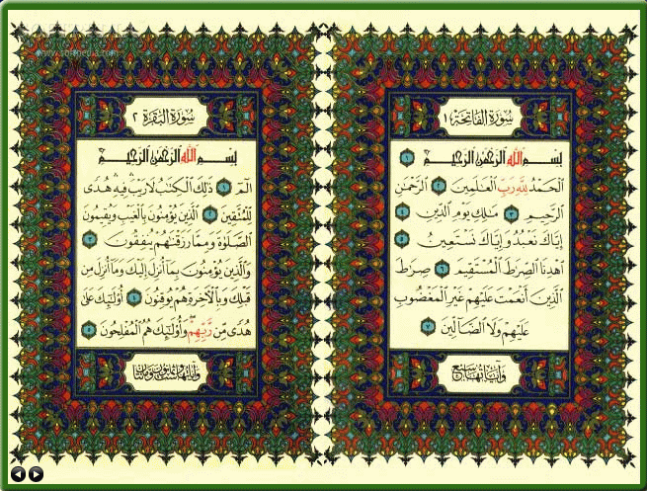
The Life of Muhammad
Muhammad’s messages were eventually written down by his followers after his death.
These messages formed the Quran, the holy book of Islam.
The principle teaching of the Quran is that there is only one God, named Allah, and Muhammad is his prophet.

Slide 11
The Life of Muhammad
Muhammad and his small band of followers were not accepted in his home town of Mecca (Makka).
His journey from Mecca to Medina in A.D. 622 is known as the Hijrah and is very important to Muslims.
Muslims date their calendar from the Hijrah, which became year 1.
Islam sees no separation between political and religious authority. As such, Muhammad was both a political and religious leader.
In 630, he returned to Mecca with an army. The Meccans submitted to the will of Muhammad.

Slide 12
The Teachings of Muhammad
Islam is monotheistic
Allah is all powerful
The Five Pillars of Islam direct the life of a faithful Muslim
Shahada – True Belief (“There is only one God, Allah, and Muhammad is his prophet.”)
Salah – Prayer 5 times a day kneeling toward Mecca
Zakat – Charity to the poor
Saum – Fasting during the lunar month of Ramadan.
Hajj – Pilgrimage to Mecca once in a lifetime.

Slide 13
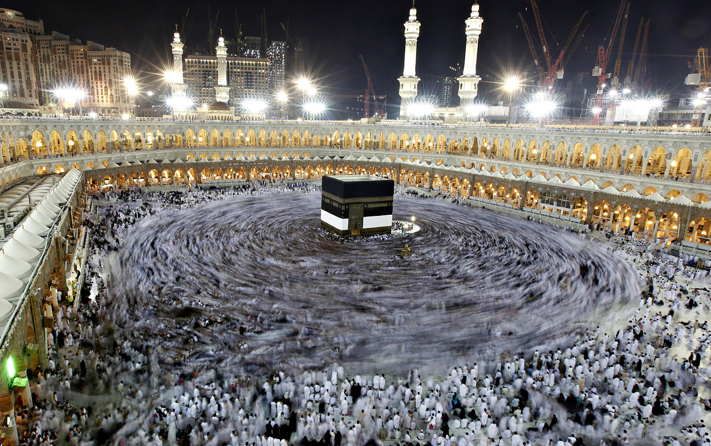
Saudi Arabia said the number of pilgrims in 2012 between 3.16 to 3.65 millions, blaming the inaccuracy on the enormous number of unregistered pilgrims.

Slide 14
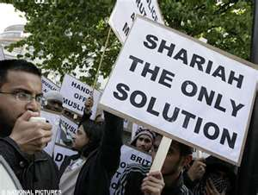
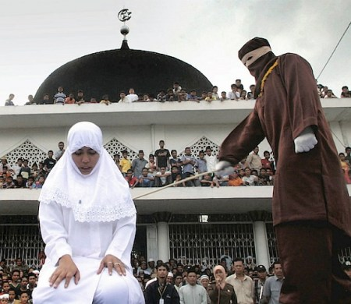
Shari’ah Law
Shari’ah refers to a code of law that regulates a Muslim’s daily life.
Shari’ah is based on an interpretation of the Quran by Islamic scholars.
Public caning of a woman who violated the dress code according to Shari’ah Law.

Slide 15
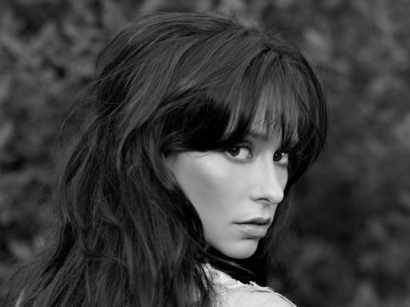
Looking back…

Slide 16
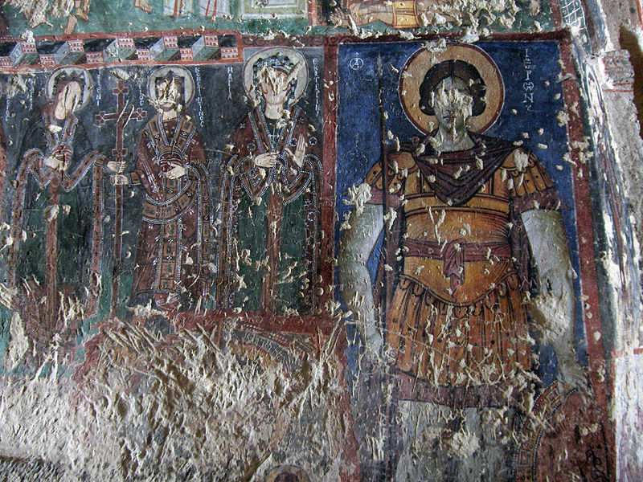
What does iconoclast refer to?
A person who believes that the use of icons, or religious art, is idolatry and pursues this to its logical end – the destruction of religious art.

Slide 17
Iconoclast
Iconoclasm was a phenomenon in the Orthodox Church of the Byzantine Empire, not the Catholic Church of Western Europe. An iconoclast believed that religious art was idolatry, or false worship.
Can you deduce from the map WHY iconoclasm might have taken root in the Christian East, but NOT the Christian West?

Slide 18
Can you deduce from the map WHY iconoclasm might have taken root in the Christian East,
but NOT the Christian West?

