Slide 1
Today’s Bellringer – September 9, 2014
Enter quietly and begin your bellwork BEFORE the tardy bell rings.
Turn in any late work.
Write down today’s Essential Question and attempt to answer it.
China’s history is one of decentralization followed by periods of centralization. What dynasty set the precedent for imperial, centralized rule?
Write down the W.O.D. and definition.
Nebulous – vague; misty; lacking a fully-developed form
Please remember to date your entry.
Notes:
WHAP

Slide 2
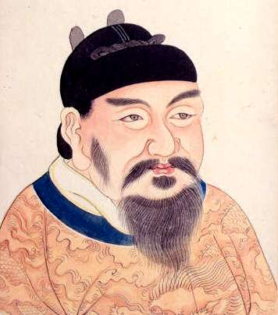
Chapter 14 The Resurgence of Empire in East Asia (a.k.a. China)
Mr. Wyka - World History
3rd Emperor - Tang Gaozong (Li Zhi) ~ [650 to 683 CE]

Slide 3
Essential Questions
How can invasion change the lives of people in conquered lands?
Think on your own life a moment. Think of how peaceful your life has been. There’s been no foreign armies marching through your backyard, no soldiers throwing you out in the street so they can take your home, no imperial guards forcing you into the emperor’s army to cook, clean, or fight. But life in ancient China was often just that, until the long, stable rule of the Tang.

Slide 4
Why does it matter?
In 581 C.E., forty-one years before the birth of Mohammad, the Sui dynasty unified China for the first time in hundreds of years beginning a long period of stability, relative peace, and technological advancement.

Slide 5
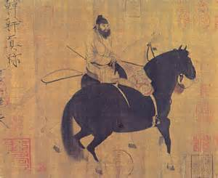
Lesson Vocabulary
Scholar-gentry
dowry
dynasty
Khanate
Neo-Confucianism
Porcelain
silk

Slide 6
Three Dynasties
Guiding Question:
How did the Sui, Tang, and Song dynasties bring order to China between periods of chaos and instability?

Slide 7
The Sui Dynasty
After the Han dynasty fell in 220, China experienced disorder and civil war for the next three hundred years.

Slide 8
The Sui Dynasty
Although it didn’t last long, the Sui Dynasty brought stability back to China after this period of war.
(581-618)
The 2nd Sui emperor was cruel, forced his people to work on his pet projects and bitterly taxed them. This caused a rebellion, Sui Yangdi was murdered and the Sui dynasty ended.

Slide 9
The Tang Dynasty
After the fall of the Sui…
The Tang lasted for nearly 300 years.
618-907
Land redistribution
Merit based civil service exams
Controlled Tibet
Korea paid tribute

Slide 10
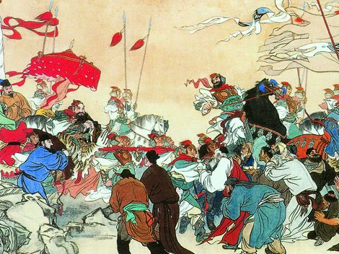
The Tang Dynasty
Plotting and government corruption led to the downfall of the Tang.
Unrest and revolts resulted.

Slide 11
The Song Dynasty
Followed the Tang…
Lasted for more than 300 years.
960-1279
Period of prosperity and cultural achievement
Mongols, nomads from the north, invaded China forcing the Song to move their capital south.

Slide 12
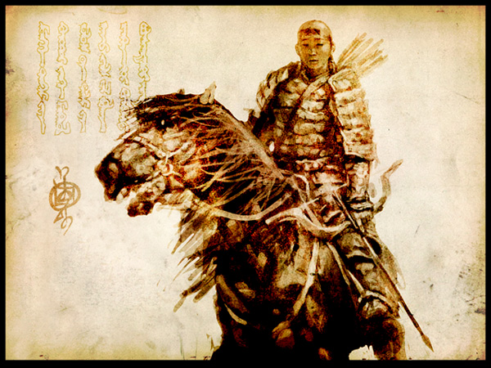
The Song Dynasty
The Song eventually were conquered by the Mongols.

Slide 13
Advancements under the Three Dynasties
Steel weapons
Cotton
Gunpowder
Paper Money
Long distance trade
The Silk Road spread not only goods but ideas.

Slide 14
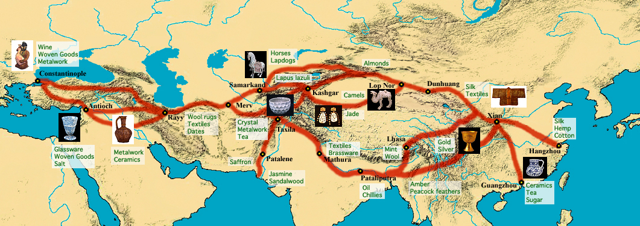
The Silk Road

Slide 15
Chinese Society
Based on Confucian principles of duty and service.
Female children less important than male children.
Most Chinese were peasant farmers.
Land controlled by the rich, scholar-gentry.

Slide 16
https://www.youtube.com/watch?v=ylWORyToTo4
2000 Years of Chinese Dynasties clip

Slide 17
Hey, Hey, We’re the Mongols!
Understand what a khanate is. A khanate is one of several separate territories into which Genghis Khan’s empire was split, each under the rule of one of his sons.

Slide 18
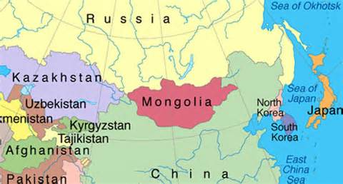
The Mongols
Pastoral people from Mongolia

Slide 19
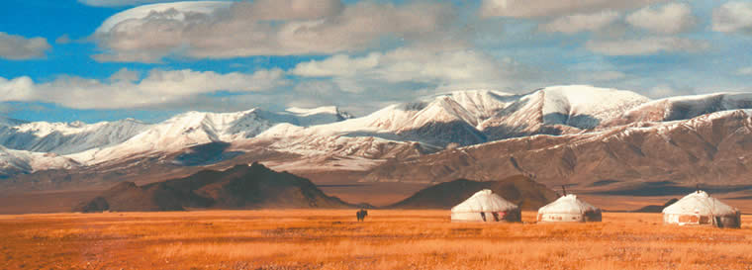
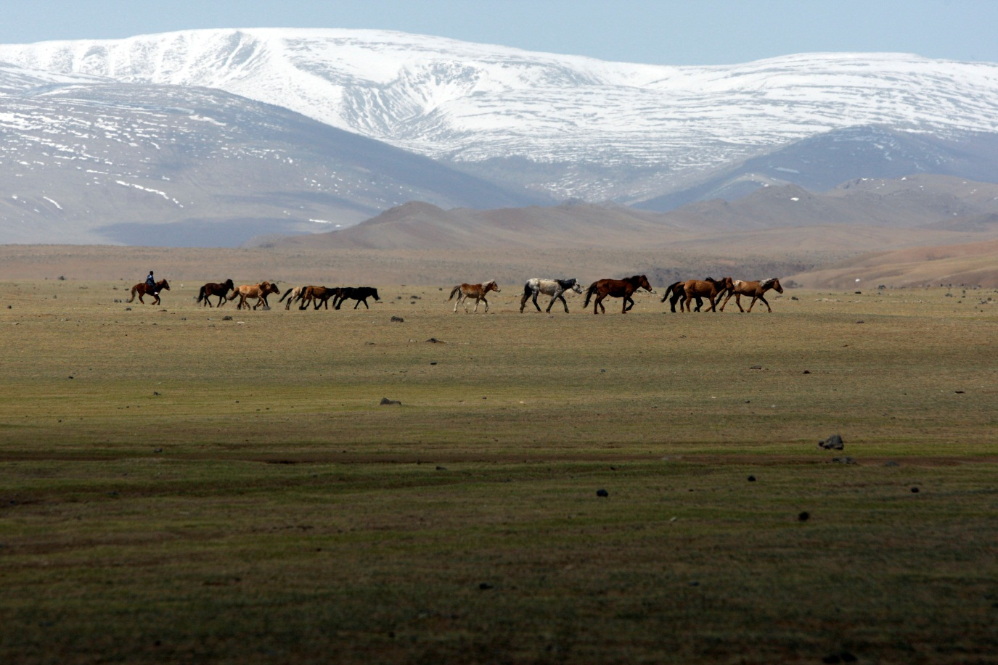

Slide 20
Mongols
Quickly rose to power in Asia.
Created the world’s largest land empire.

Slide 21
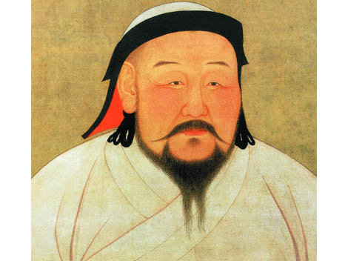
Temujin (Genghis Khan)
Gradually unified the clans.
Elected Genghis Khan by the clan warriors (Genghis Khan means strong ruler.)
Conquered through military tactics, ferocity, technology, and fear.

Slide 22
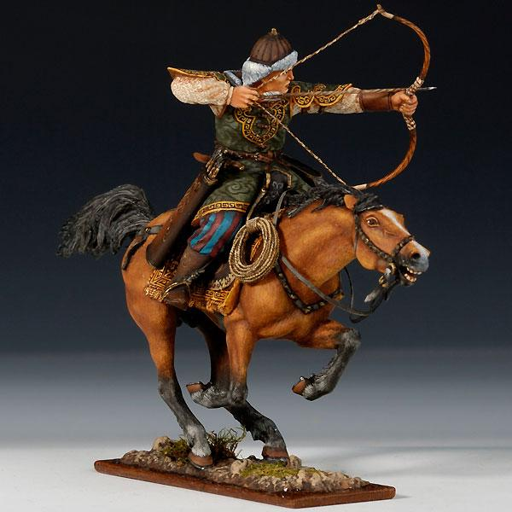

Slide 23
Mongol Empire
After Genghis Khan’s death, the empire was divided into khanates.
Each territory ruled by a son.

Slide 24
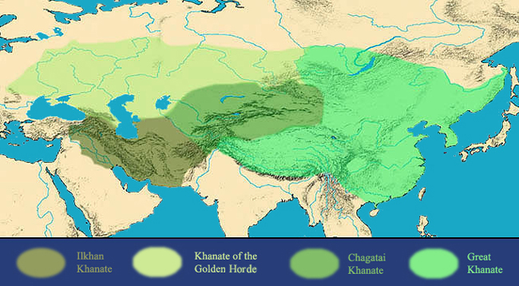

Slide 25
Empire Built Through Conquest
Many of the great empires of the day fell before the Mongols.
Abbassid Muslims of Baghdad
Islamic sultan of Persia
Song dynasty of China
The Kievan Rus (Russia)
However, they were repulsed on two separate occasions when they tried to invade Japan.

Slide 26
Yuan China
Genghis Khan’s grandson, Kublai Khan, ruled China.
This non-Chinese dynasty was called the Yuan and lasted 70 years.
Yuan were defeated in 1368, and a new Chinese dynasty was born – the Ming.

Slide 27
https://www.youtube.com/watch?v=szxPar0BcMo
Wait for it… The Mongols!

Slide 28
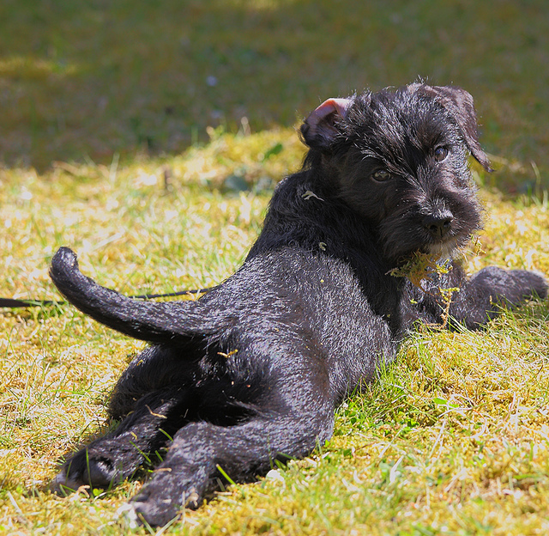
Looking back…

Slide 29
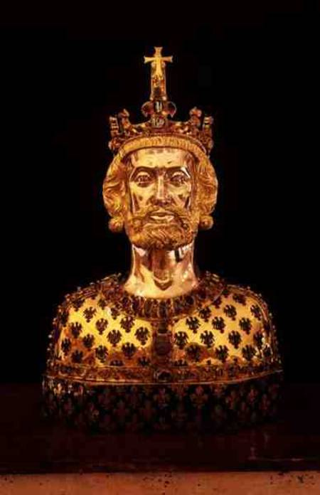
The Frankish king who was crowned emperor by the pope on Christmas day, 800.
Charlemagne

Slide 30
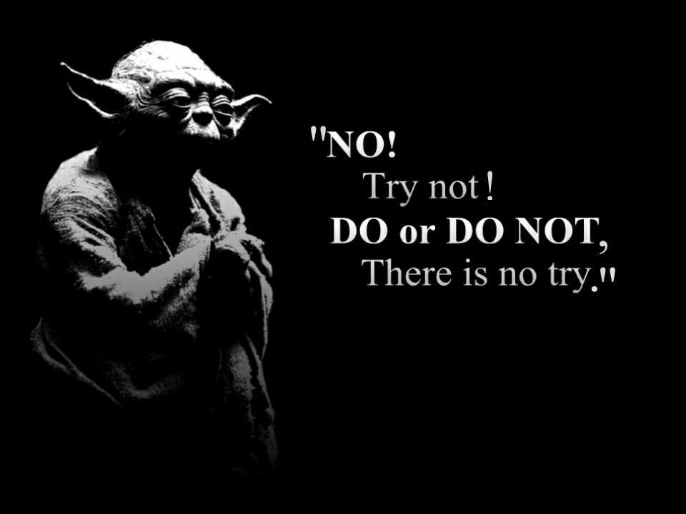
Quiz Time You may use your notes from this lecture, and only your notes.

