Slide 1
Today’s Bellringer – September 22, 2014
Enter quietly and begin your bellwork BEFORE the tardy bell rings.
Turn in Ibn Battuta vs. Marco Polo if you are finished.
Write down today’s Essential Question and attempt to answer it.
Where and How did Islam gain a foothold in India?
Write down the W.O.D. and definition.
Please remember to date your entry.
Notes:
WHAP

Slide 2
September 22, 2014
Essential Question:
Where and How did Islam gain a foothold in India?
Islam gained a foothold in Northern India through conquest (Delhi Sultanate) and along the east coast of India by merchant (the Indian Ocean trade network).
Notes:
WHAP

Slide 3
Chapter 15 – Key Points to Remember
India influenced its surrounding societies just as Greece, Rome, Constantinople, and China did.
However, the great difference between India and these four civilizations was that no centralized Indian state developed after the Mauryan Empire, whereas…
The Greeks were centralized under Alexander the Great
Rome in the Roman Empire
Constantinople (eastern Roman Empire) in the Byzantine Empire
China under subsequent dynasties especially the Han and the Tang.

Slide 4
Merchants were the primary force spreading Indian ideas of religion and politics to southeast Asia.
Hinduism and Islam became the dominant religions in Islam.
Buddhism had greater success outside of its home.
Islam took hold in the north due to conquest and along the trading cities (emporia) of the east coast due to trade.
Islam was embraced by many in the lower castes? Why?

Slide 5
Sufis – Islamic missionaries who didn’t represent Islam as an exclusive faith.
Bhakti movement attempted to erase the distinction between Hinduism and Islam; and tried to show a way in which these two religions could coexist.

Slide 6
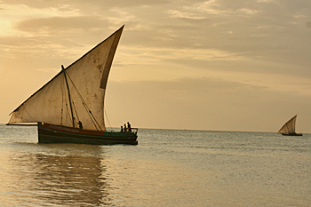
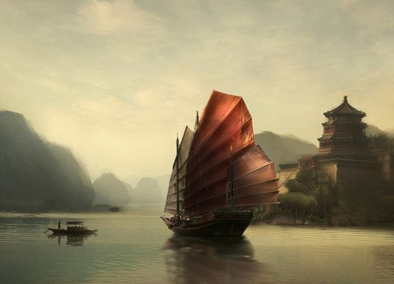
Cross Cultural Trade in Indian Ocean basin
Arabic Dhows
Chinese Junks

Slide 7
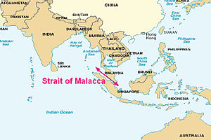
Cross Cultural Trade in Indian Ocean basin
Emporia – Indian port cities and cosmopolitan centers, served as clearinghouses of trade.
They were warehouses for merchants from Africa, Asia, Europe, and China.
The Importance of Melaka
Primarily Muslim

Slide 8
Cross Cultural Trade in Indian Ocean basin
What was traded?
Silk and porcelain from China
Spices from Southeast Asia
Pepper, gems, pearls, and cotton from India
Incense and horses from Arabia and Southwest Asia
Gold, Ivory, and slaves from east Africa
What was produced?
High quality cotton textiles
Sugar, leather, stone, carpets, iron, and steel

Slide 9
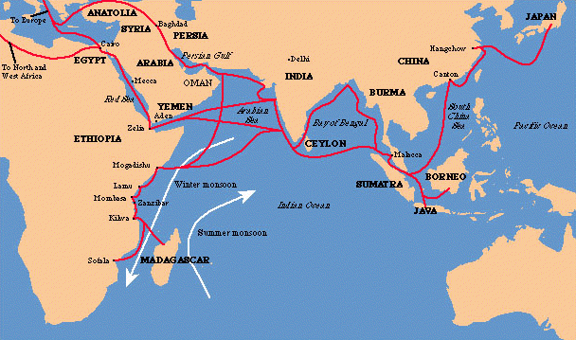
Cross Cultural Trade in Indian Ocean basin

Slide 10
Cross Cultural Trade in Indian Ocean basin
Indian Ocean Trade Network remained the LARGEST trade network in the world until the 1600s.
Why?
The Age of Exploration by that time had opened up the HUGE markets of North and South America.

Slide 11
John Greene time
https://www.youtube.com/watch?v=a6XtBLDmPA0&list=PLBDA2E52FB1EF80C9&index=18

