Slide 1
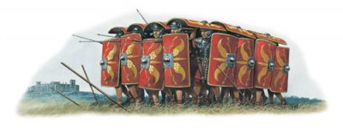
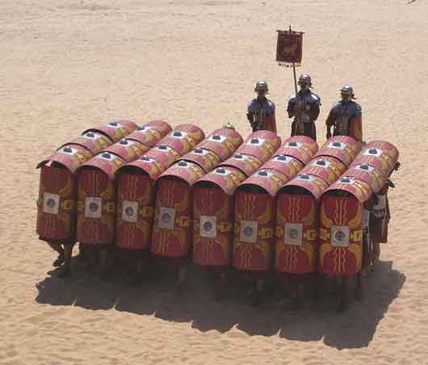
Chapter 1, lesson 1 The World of the Romans
Mr. Wyka - World History
Roman “Turtle” Formation
When? 264 B.C. – A.D. 476
Where? Europe and the Mediterannean Sea

Slide 2
The goal of this presentation is to give you a strong background before we move forward.
Please pay careful attention.
For note taking, just write down and words or concepts you don’t understand or have a question about and bring them up for discussion.

Slide 3
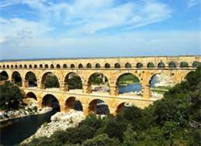
Essential Questions
How impact did Rome have on Western Civilization?

Slide 4
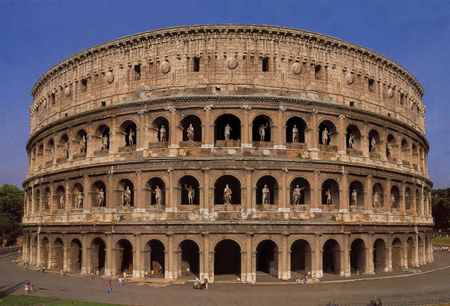
Lesson Vocabulary
Procurator
republic
Octavian
Caesar
Carthage
Julius Caesar
Early Christian Catacomb, Budapest, Hungary

Slide 5
Rome becomes a Power
The people of the little village of Rome expanded throughout Italy between 509 B.C. and 264 B.C.
They united almost all of Italy.
This was the time of the Roman Republic.
Rome wasn’t ruled by a king, but by a group of privileged noblemen. This is called on oligarchy.

Slide 6
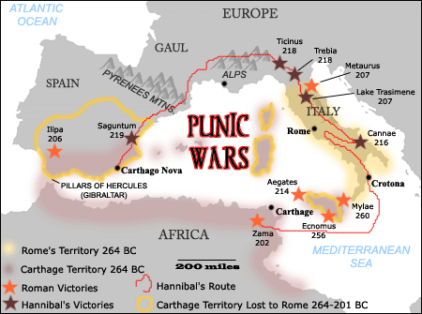
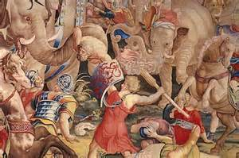
Rome becomes master of the Mediterranean Sea
Rome fought a war against Carthage for mastery of the Meditteranean.
And won!

Slide 7
Military Leaders Gain Power
Military leaders such as Pompey, Crassus, and Julius Caesar fought bloody civil wars to gain control of Rome.
Octavian, a general, finally defeated a coalition of forces under Marc Antony and Cleopatra of Egypt and grabbed sole power of Rome.
The Senate named him Augustus.
Augustus (Octavian) became the first emperor of Rome.

Slide 8
Roman Legacy
Political ideas – Republic, stability, citizenship
Roads, roads, and more roads
Law
Romance Languages
Architecture – archway, Circus Maximus, concrete, aquaducts
Preserved the art and legacy of Greece
Constantine declared official tolerance of other religions.

Slide 9
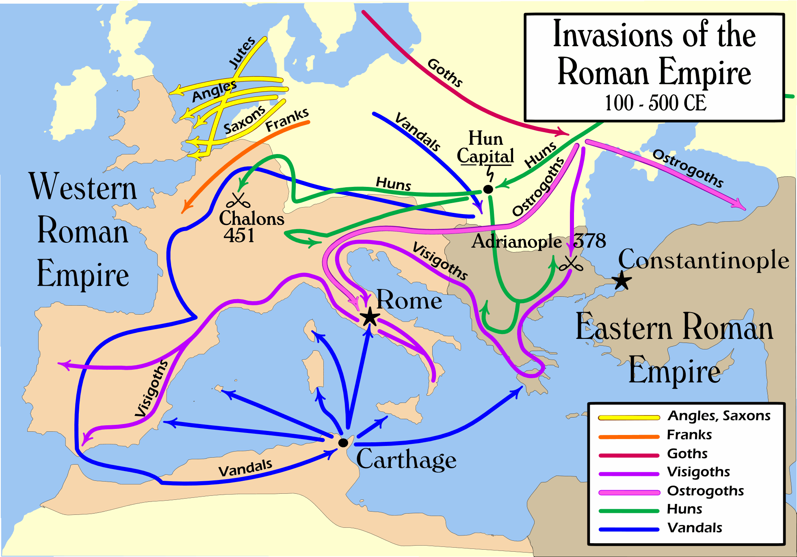
Decline and Fall of Rome
Civil Wars
Constant invasions by Germanic and other barbarians
Brutal taxation
Slavery
Caused unemployment of the lower classes
Western Rome fell in A.D. 476

