Slide 1
Economic Systems
Chapter 2

Slide 2
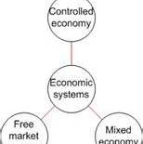
KEY CONCEPTS
Economic system—how society uses resources to satisfy people’s wants
Three basic systems:
Traditional
Command
Market economies
Mixed economies have features of more than one type of system

Slide 3
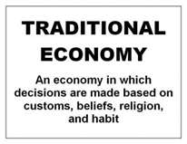
Traditional Economy
System that is shaped by custom or religion
Advantages – 3 economic questions easily answer (what, how, and for whom)
Disadvantages - resistant to change, less productive, may prevent people from doing what they are best suited

Slide 4
Centrally Planned Economy / Command Economy
System in which all resources are government-owned and production is coordinated by the government.
All resources government-owned
Production coordinated by the central plans of government
Sometimes called communism
Use visible central planners

Slide 5
Reading
Read final paragraph on pg. 42
Imagine if you lived in a Centrally planned economy.
What would everyday life be like?

Slide 6
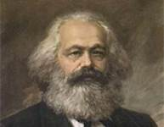
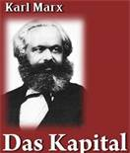
Marx influence
Karl Marx influenced some societies to adopt command economies
Marx lived during Industrial Revolution
Argued factory owners used workers as resource
exploited workers by keeping wages low to increase profits
workers would rebel, establish classless society
Wrote The Communist Manifesto (with Friedrich Engels), Das Kapital
socialism—government owns some of the factors of production
communism—no private property; little political freedom
Authoritarian system requires total obedience to government
communism is authoritarian socialism

Slide 7
Government Controls
EXAMPLE: Government Planning
In all societies, government exerts some control over people’s lives
In centrally planned economy, government exerts great control
determines businesses to operate, amount produced each month
determines who is employed, work hours, pay scales

Slide 8
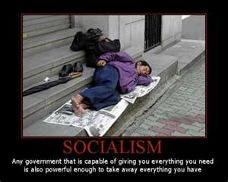
Problems with Centrally Planned Economies
Consumers get low priority
Little freedom of choice
Central planning can be inefficient
Resources owned by the state are sometimes wasted
Environmental damage

Slide 9
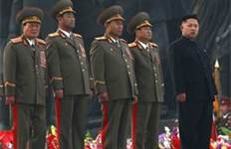
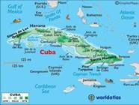
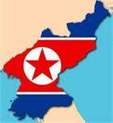
Command Economies Today
No pure command economies today
modern telecommunications bringing about change
Some economies still have mostly command elements

Slide 10
Links
http://www.cleanvideosearch.com/media/action/yt/watch?videoId=UXGdjxw_xjA – road back to free market (1:00)

Slide 11
Pure Market Economy
System with No government involvement. Private businesses decides for all production.
All resources are privately owned.
Coordination of economic activity is based on the prices generated in free, competitive markets.
Any income derived from selling resources goes exclusively to each resource owner.

Slide 12
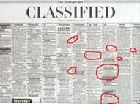
Think About…
Selling something outside of usual retail channels.
Such as EBay or a want ad.
What are the features of this transaction?

Slide 13
Fundamentals of a Market Economy
FEATURE 1: Private Property and Markets
Private property rights must be defined and protected by law
Buyers must be sure sellers have right to sell products they offer
Sellers must be sure they will be paid for their products
FEATURE 2: Limited Government Involvement
Laissez faire—government should not interfere in economy
Capitalism—system having private ownership of factors of production
says producers will create products consumers demand
(Actual market economies all have some government involvement)

Slide 14
Fundamentals of a Market Economy
FEATURE 3: Voluntary Exchange in Markets
Voluntary exchange—traders believe they get more than they give up
In market economy, most trade is exchange of product for money
Profit—financial gain from business transaction
FEATURE 4: Competition and Consumer Sovereignty
Competition—sellers’ efforts to get business by offering best deal
Consumer sovereignty—buyers choose products, control what is produced
Competition controls self-interested behavior
sellers offer low price or high value to please consumers, make profit
FEATURE 5: Specialization and Markets
Specialization—people concentrate their efforts in the activities they do best
encourages efficient use of resources
leads to higher-quality, lower-priced products

Slide 15
Impact of Market Economies
Advantages
Individuals free to make economic choices, pursue own work interests
Less government control means political freedom, less bureaucracy
Locally made decisions mean better use of resources, productivity
Profit motive ensures resources used efficiently, rewards hard work
resulting competition leads to higher-quality, more diverse products

Slide 16
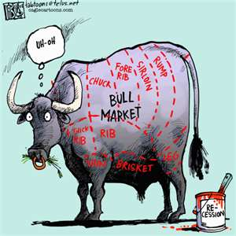
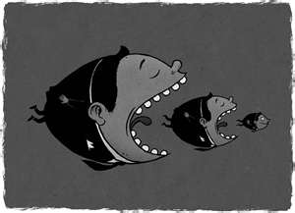
Problems with Pure Market Economies
Difficulty enforcing property rights
Some people have few resources to sell
Does not give security to sick or disadvantaged
Some firms try to monopolize markets
No public goods
Externalities (3rd parties-ex. Pollution)

Slide 17
https://www.youtube.com/watch?v=xSMd4BuuXB8&list=PLIBtb_NuIJ1w_5qAEs5cSUJ5Bk0R8QLaY&index=11

Slide 18
Mixed Economy
System that mixes central planning with competitive markets.

Slide 19
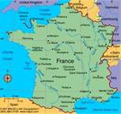
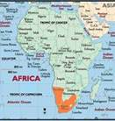
Today’s Mixed Economies
Types of Mixed Economies
Most economies emphasize one type; U.S. basically has market system
Many European countries greater mix of market and command elements
France—government controls some industries; provides social services
Sweden—state owns part of all companies; lifelong benefits, high taxes
Namibia—traditional; state supports market, foreign investment

Slide 20
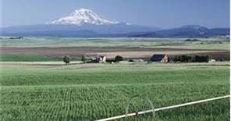
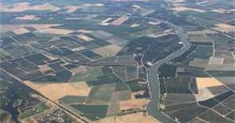
Today’s Mixed Economies
Life in a Mixed Economy
Family farming in U.S. serves as example of mixed economy
traditional: all members of family help bring in harvest
command: affected by government—public school, roads, Social Security
market: own land, sell their products in competitive market

Slide 21
Government in your lives
How did you get to school?
Been to a restaurant lately?
Did you buy anything the last few days?
What are other ways in which we have government in our lives?

Slide 22
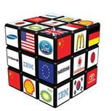
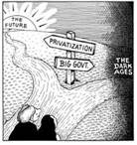
Trends in Modern Economies
TREND 1: Changes in Ownership
Economies in transition often go through changes in ownership
To nationalize is to change from private to government ownership
To privatize is to change from government to private ownership
TREND 2: Increasing Global Ties
Growth of global economy—economic actions across national boundaries

Slide 23
Who decides what goods and services will be produced?
Should it be the government or should it be the market?

Slide 24
Draw a horizontal line. Label the left side of the line “Pure Market Economy” and the right side “Pure Centrally Planned Economy.” Place each of the following nations on your line at a place that you think accurately represents the current state of the economy.
United States
China
North Korea
Sweden
Russia
Mexico

Slide 25
One example – with modifications

Slide 26
Key Concepts
traditional economy
command economy / centrally planned economy
market economy
socialism
communism
laissez faire and capitalism
specialization and profit
mixed economy
nationalize
privatize

Slide 27
https://www.youtube.com/watch?v=nZeYaJ8xJLA&list=PLlOCkpyjIlHHY3hqk6iMogeUTEzxKTd-e&index=12

