Slide 1
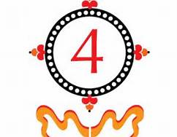
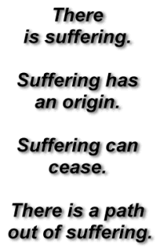
Preview
What culture, religion, or philosophy does these symbols represent?

Slide 2
CHAPTER 20 WORLDS APART: THE AMERICAS AND OCEANIA In a Nutshell Ch 20 Bentley
Mr. Wyka – AP World History Honors

Slide 3
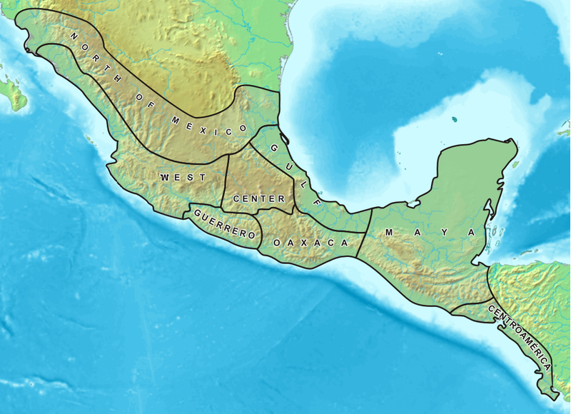
What is Mesoamerica?
Mesoamerica is a region and cultural area in the Americas within which a number of pre-Columbian societies flourished before the Spanish colonization of the Americas in the 15th and 16th centuries.

Slide 4
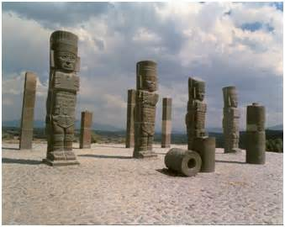
Toltecs and Aztecs
Beginning in the ninth century, two major societies appeared in Mesoamerica and North America: the Toltec and the Mexica (or Aztecs.)

Slide 5
Toltecs
The Toltec emerge in the 800s after the collapse of Teotihuacan, and between the mid‐tenth and mid‐twelfth centuries establish a large state with a powerful army. The capital city of Tula was a center of trade and the Toltec had close relations with Gulf coast societies and the Maya.
In 1125 civil strife hit the capital and after 1175 nomadic invaders led to the decline of the Toltec.

Slide 6
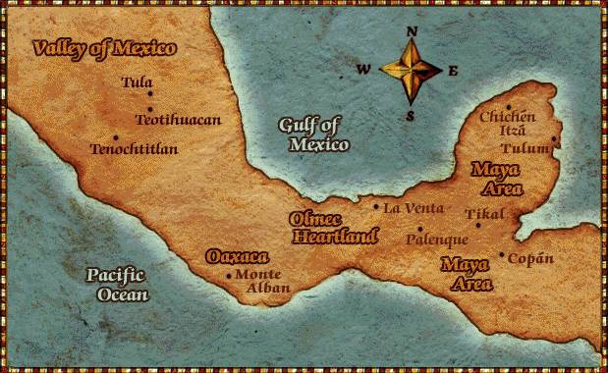
Tula, the capital city of the Toltecs.
Tenochtitlian, capital city of the Aztecs.

Slide 7
The Mexica (Aztecs)
The Mexica arrive in central Mexico in the mid‐thirteenth century and this warrior society established their capital at Tenochtitlan (modern Mexico City).
The Mexica developed a unique style of agriculture called the chinampas that produced large amounts of food.
They soon launched military campaigns against their neighbors and by the 1400s had built an empire of some 12 million people encompassing most of Mesoamerica.

Slide 8
Mexica – Aztec Society
Mexica society was a rigid society drawn from the aristocracy with a warrior elite at the top. This group enjoyed great wealth and privileges.
Women had no public roles but were honored for being the mothers of the warriors and had a role in commerce.
Some Mexica elite were priests who not only acted in a religious capacity, but also advised the rulers.
Another group that enjoyed a certain prestige were the artisans, especially those who produced luxury goods.
Most of the Mexica were farmers, working the chinampas, or the lands of the wealthy.
Others provided public labor or were slaves, working as domestic servants.
Mexica religion adopted deities from the earlier cultures and engaged in human sacrifice.

Slide 9
North America
In North America there were numerous tribes in vastly different climates and conditions.
The Pueblo and Navajo in the southwest were primarily agricultural peoples who erected some stone and adobe buildings.
In the east, there were the Five Iroquois Nations, a woodland society, as well as the mound‐building peoples from the area around what is now Illinois and Ohio.

Slide 10
South America
In South America the dominant society was the Inca.
In 1438, after the Inca settled around Lake Titicaca, they launched military campaigns against their neighbors and soon had an empire running 4,000 kilometers from north to south. Their capital at Cuzco had as many as 300,000 people living there and was ruled by military elite.
Inca society had a hereditary aristocracy with a chief ruler, the Inca, who was said to be descended from the sun, owning everything on Earth.
They also had a priest class, but the majority of the Inca were peasants who farmed and provided the labor for public works.

Slide 11
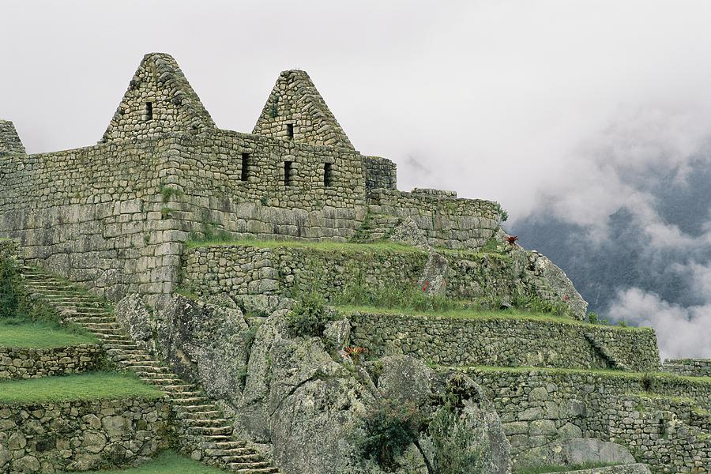

Slide 12
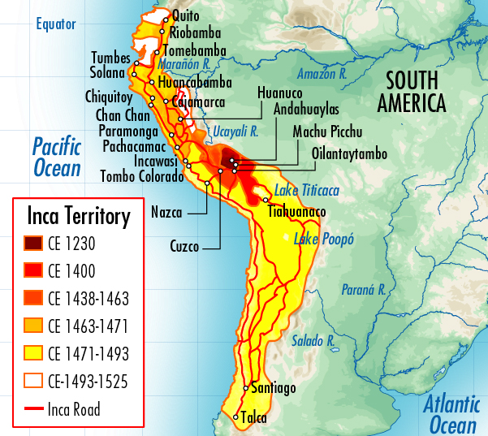

Slide 13
Oceania
Also separated for thousands of years from other cultures were the many different peoples of Oceania.
In Australia the people were nomadic foragers who traded with each other and had limited contact with peoples of New Guinea. They practiced a religion tied very closely to nature and the environment, with many stories and myths related to geographical features.

Slide 14
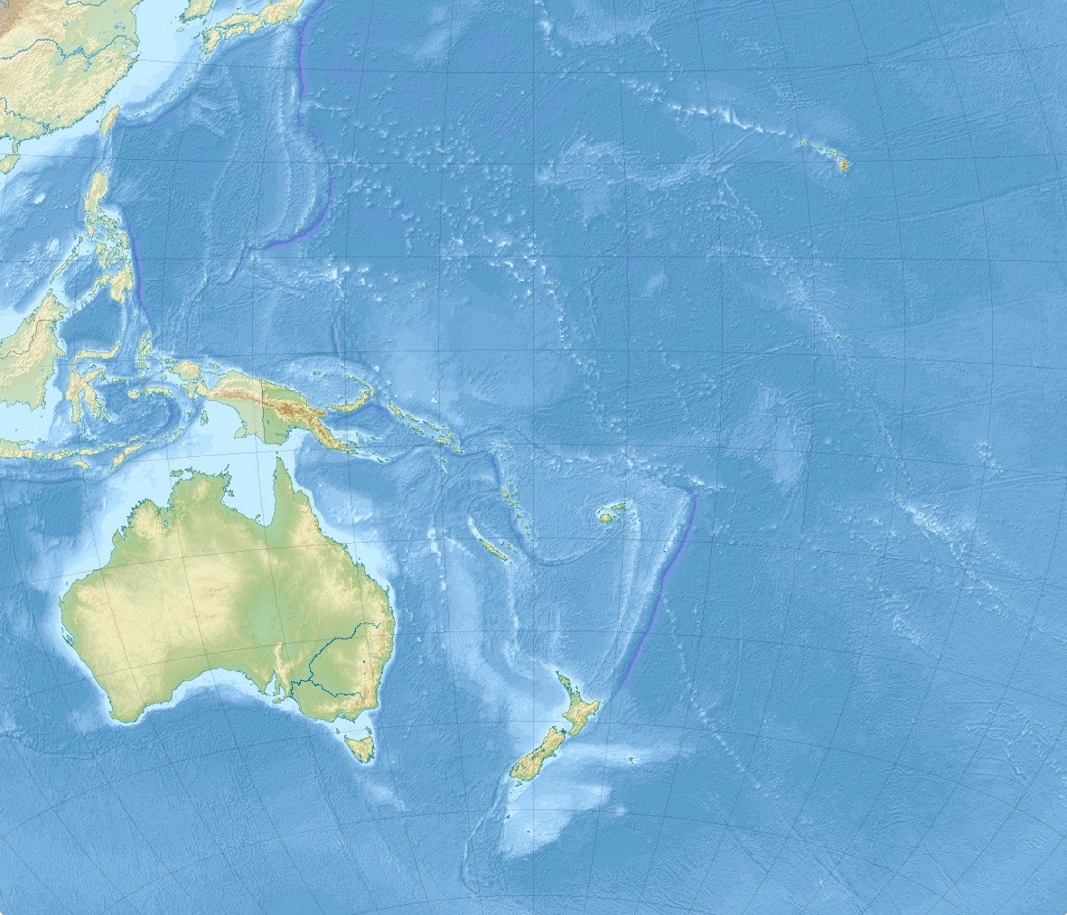

Slide 15
Oceania
The Pacific Islands were involved in extensive maritime trade. The Polynesian mariners not only reached Easter Island, but sweet potatoes may well have come from their contact with South America. They also settled Hawai’i in the early centuries C.E.

