Slide 1
One reason that Russia evolved into a nation-state while the Islamic Gunpowder empires declines is that between 1450-1740, only Russia
Modernized its army
Focused on becoming a sea power
Showed tolerance toward ethnic minorities
Had absolutist, charismatic leaders
Which of the following was most directly a result of these 3 causes?
European nations fighting among themselves
The breakup of the Mongol khanates
Tamerlane’s conquests in Central Asia & the Middle East
The rise of gunpowder as an important trade commodity
The rise of religious disputes between Jews, Christians, and Muslims
The decline of the Islamic Gunpowder Empires
The rise of the Islamic Gunpowder Empires

Slide 2
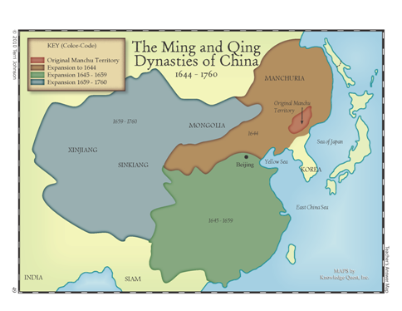
Chapter 20 Amsco East Asia meets Western Traders 1450-1911
Mr. Wyka – AP World History

Slide 3
How far have we gone thus far?
Shang
Zhou
Qin
Han
Sui
Tang
Song
Yuan*
Ancestor Worship Mandate of Heaven
Qin – brutal, short lived, ruled by Legalist principles
Han through Song ruled by Confucian Principles
- Bureaucracy of Merit
- Civil Service Exams
- Male Patriarchy
Sui, like the Qin, was brutal and short lived.
The Yuan was not a Chinese dynasty at all, but Mongol.

Slide 4
Ming Dynasty 1368-1644
Came to power after the overthrow of the Yuan.
Sought to return to the past and erase the memory of the Mongols.
Saw the arrival of the Portuguese and other Europeans who sought to force themselves into the Asian trade network.

Slide 5
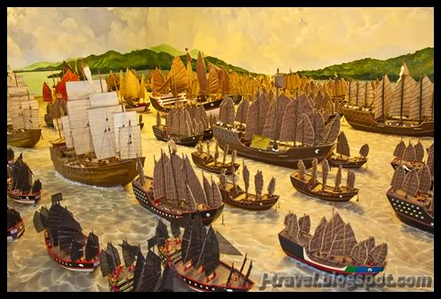
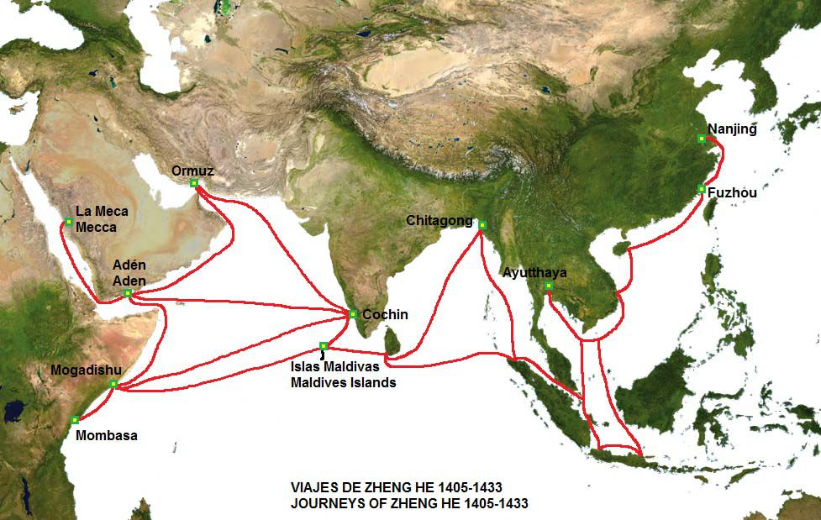
Ming Dynasty 1368-1644
With the exception of emperor Yongle, who sent Zheng He on 7 voyages to display the might of China, the Ming were xenophobic.

Slide 6
Ming and the Portuguese
Chinese naval exploration ended in 1430 with Zheng He’s final voyage.
Portuguese arrived in 1514 and established a trading post empire in the Indian Ocean.
How? With the destruction of Zheng He’s fleet, Portuguese ships were unmatched in technology, especially cannon.

Slide 7
Qing Dynasty 1644-1911
Seized power from the Ming.
Not really a Chinese dynasty, the Qing were from Manchuria, in the north.
Imposed Manchu culture over the Chinese.
Kept some Chinese practices like Confucianism and the Civil Service Exam.

Slide 8
Qing Dynasty 1644-1911
While Europe was entering the Industrial Revolution and modernizing, the Qing remained a proto-Industrial society (some industry but mostly agriculture).

Slide 9
Ming & Qing and the role of Women
Women continued to have a lower status than men throughout both the Ming and Qing dynasties.
Formal education was for men only and divorce was not permitted.
Widows who committed suicide were honored.
The practice of foot binding spread.

Slide 10
Korea
Korean culture continued to be strongly influenced by China.
Tributary status with China gave Korea trade privileges and China’s military protection.
Military conquered by the Qing dynasty of China.

Slide 11
Be nice today to someone you ordinarily wouldn’t even notice…. Just because.

Slide 12
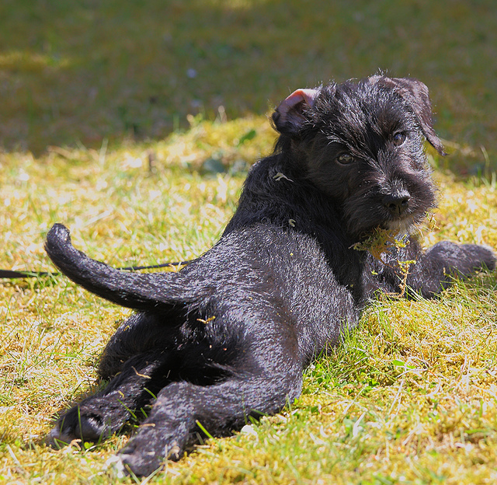
Looking back…

Slide 13
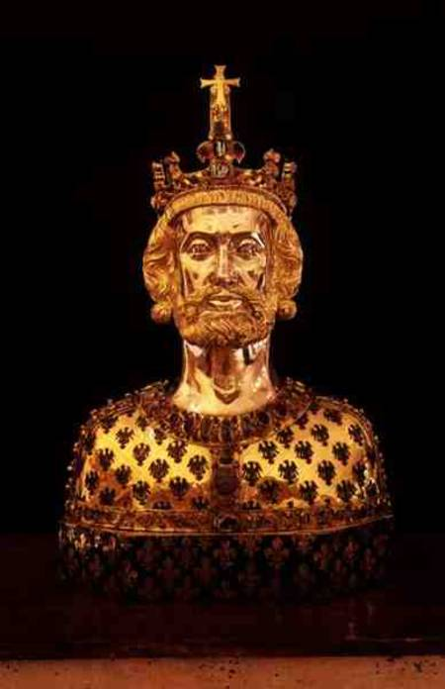
The Frankish king who was crowned emperor by the pope on Christmas day, 800.
Charlemagne

Slide 14
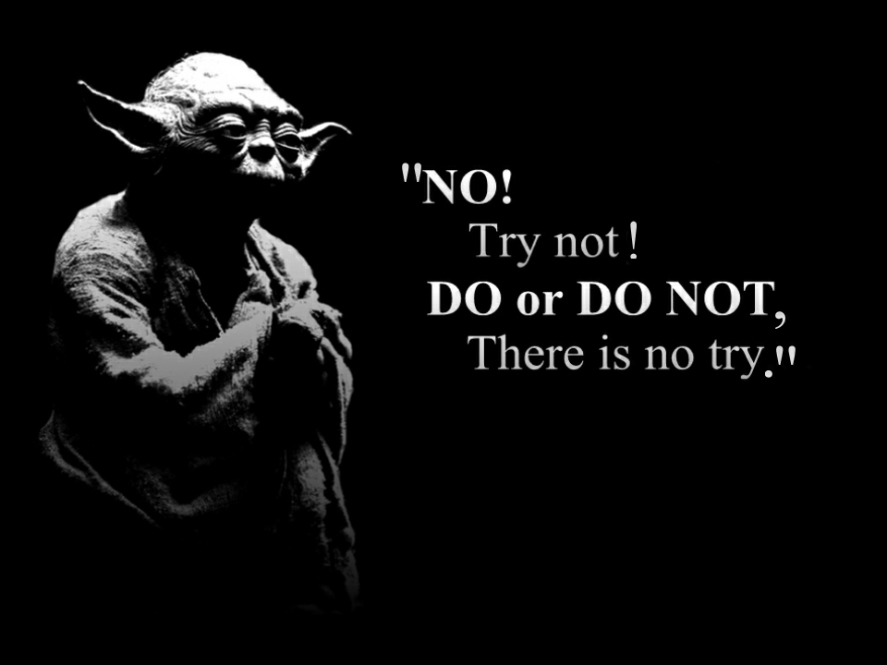
Quiz Time Open Book, Chapter 20 Amsco.

