Slide 1
The Age of Exploration 1500-1800 The First Global Economic Systems
Mr. Wyka – AP World History

Slide 2
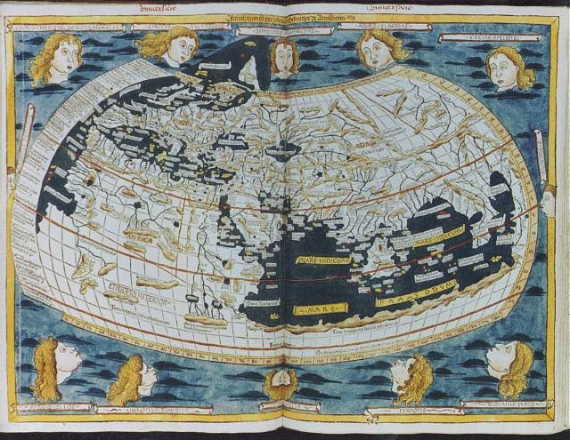
Essential Question
What are the effects of political and economic expansion?
On the explorers?
On the conquered?
Map of the World from a European view - 1482

Slide 3
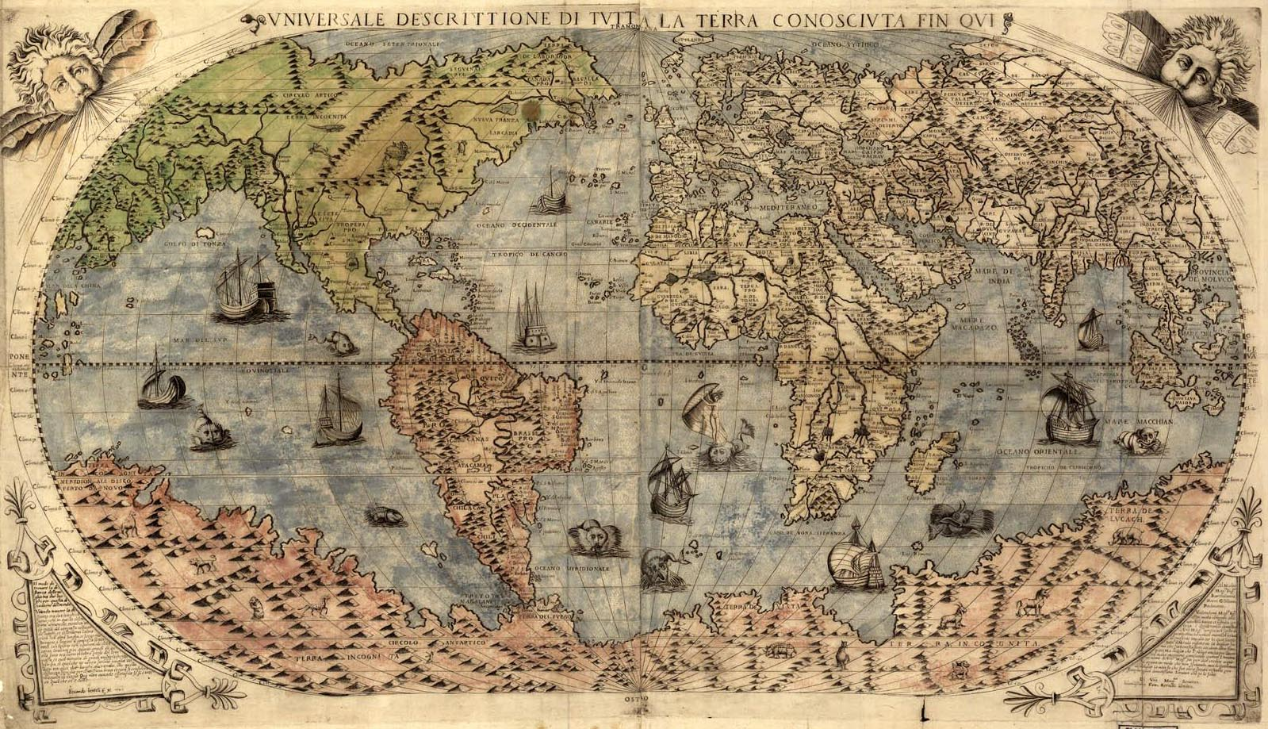
Early 1500s

Slide 4
Why does it matter?
The interaction between worlds brought a transfer of goods and people. In the case of the people making the journey, some did so willingly, some not.
These exchanges had a lasting effect on the world.

Slide 5
Lesson Vocabulary
mercantilism
Principles that dominated economic thought in the 17th century, holding that the prosperity of a nation depended on a large supply of gold and silver.
plantations
A large agricultural estate.
Middle Passage
The forced voyage of enslaved Africans across the Atlantic Ocean to the Americas.

Slide 6
Trades, Colonies and Mercantilism
The effects of European exploration…
In the Americas and the Spice Islands it led to the destruction of local cultures and the establishment of European colonies.
In Africa and mainland Asia, local regimes were left intact and some grew rich in trade with Europe.
Europe prospered and a true “world economy” developed for the first time.
The theory of mercantilism dominated European economic thought in the 17th century. Gold + silver = national prosperity.

Slide 7
Trades, Colonies and Mercantilism
Nations sought a positive balance of trade.
Exports are of greater value than the value of imports.
Colonies were used as a source of raw materials and also as markets for exports of goods manufactured from those same raw materials.

Slide 8
The Columbian Exchange
The exchange of plants and animals (and people) between Europe and the Americas.
The far reaching effects were both good and bad.
Imagine the life of a Plains Native American before the 1st horses arrived. Imagine how life changed for them with the arrival of horses.
Effects were felt as far away as China.
Europeans exported American crops (maize and sweet potatoes) to China, encouraging a population explosion in the mid 17th century.

Slide 9
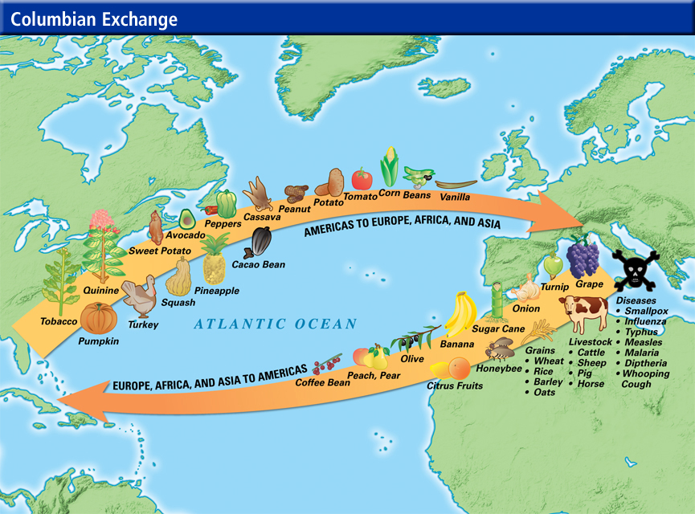

Slide 10
The Columbian Exchange
The Catholic Church prohibited enslaving the native peoples, which affected all of the holdings of the Spanish and Portuguese.
However, the Spanish crown established the encomienda for settlers. This granted Spanish settlers the right to use Native Americans as laborers. In return, the holders of an encomienda were obligated to care for, educate, and be an advocate for the Native Americans.
This did not always happen and many Spaniards abused the encomienda privilege, resulting in virtual slavery for many.

Slide 11
European Rivals in the East
The Dutch, English, and French expanded into Asia.
Companies were established, such as the British East India Company and the East India Company (Dutch) to pursue their nation’s economic interests in the East.
The British defeated the French in the Seven Years’ War, forcing French withdrawal from India.
Eventually, Britain, through the British East India Company, would gain complete control of India.

Slide 12
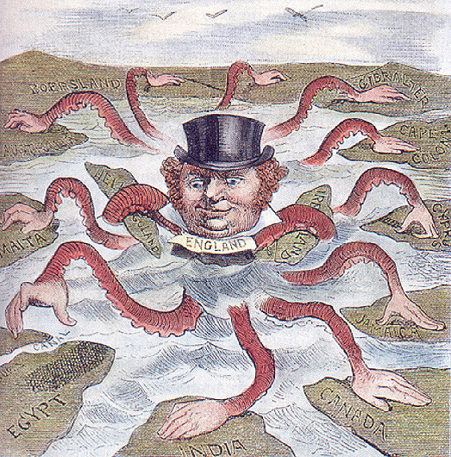

Slide 13
The Atlantic Slave Trade
Europeans did not start the African slave industry.
Slavery had been practiced in Africa since ancient times.
Before the first European slave ship brought Africans to the Americas in 1518, Islamic slavers had dominated the African slave industry for six hundred years.
European expansion led to a dramatic increase in the slave trade.

Slide 14
The Atlantic Slave Trade
Local populations were decimated by disease. Workers were needed for the sugar plantations in South America and the Caribbean and later, cotton and tobacco plantations in North America.
The Catholic Church condemned the practice and some Protestant churchmen spoke against it.
However, the economic forces proved stronger than spiritual forces as the Reformation had weakened Christianity.

Slide 15
The Triangular Trade
The Slave Trade was one component of a trading system known as the Triangular Trade.
European ships took manufactured goods to Africa where they were traded for enslaved people.
Enslaved Africans were sent to the Americas and sold.
Raw materials from the Americas were then shipped to Europe and the process began again.
A slave’s journey from Africa to the Americas became known as the Middle Passage – the middle portion of the Triangular Trade route.

Slide 16
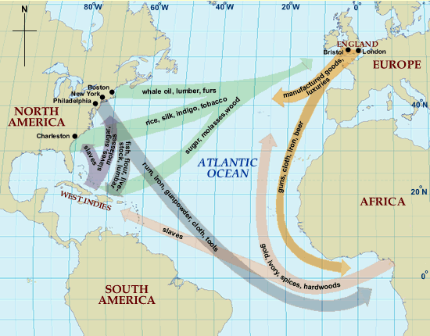
The Triangular Trade Route

Slide 17
Effects of the Atlantic Slave Trade
Ripped families asunder.
Deprived many regions of their strongest and healthiest workers and warriors.
Warfare increased in Africa as one tribe sought to capture another tribe’s people to sell to the traders.
Many cultures were eclipsed.
What was the effect on Europeans? How would “owning” another human being effect someone?

Slide 18
Closing Question
How did epidemics among the Native American populations contribute to an increase in the trade of enslaved Africans?

Slide 19
Looking back…

Slide 20
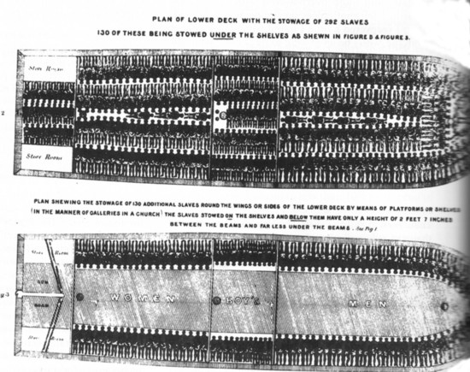
A slaves journey from Africa to the Americas became known as ____________.
the Middle Passage

Slide 21
