Slide 1
Bellringer, November 12
The Protestant Reformation
In your own words, and on your own paper, define the following terms from your pre-existing knowledge. There is no opting out.
If you don’t know the meaning of a word, make an educated guess.
Schism Protestantism
Pope Martin Luther
Predestination Salvation
Reform Revolution

Slide 2
The Reformation in Europe 1517-1600 Chapter 23.1 The Spread of Protestantism
Mr. Wyka - World History

Slide 3
Schism Happens!

Slide 4
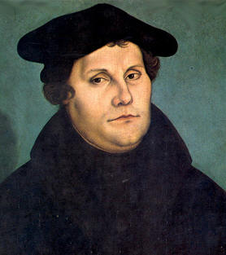
Essential Questions
What conditions can encourage a desire for reform?
Is a reform different than a revolution?
Martin Luther, 1529

Slide 5
Why does it matter?
Today’s Christianity was shaped by the events of the Protestant Reformation.
Christian Europe’s ability to respond to outside threats was affected by the dis-unifying effect of the Reformation.
The Catholic Church reformed and codified its doctrine as a result of the Protestant Reformation.

Slide 6
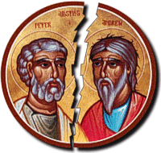
Lesson Vocabulary
Schism
Christian humanism
Salvation
Indulgence
Lutheranism
Fundamental
External
valid

Slide 7
Lesson Vocabulary
justification
predestination
annul
ghetto
publish
community

Slide 8
The Background
For 1000 years, Christianity had been essentially united.
In 1054, the Western and Eastern Churches split (schism).
Catholic (western), Orthodox (eastern)
In the early 1500s, several groups broke from (schism) the Catholic Church. These became the first Protestant churches.

Slide 9
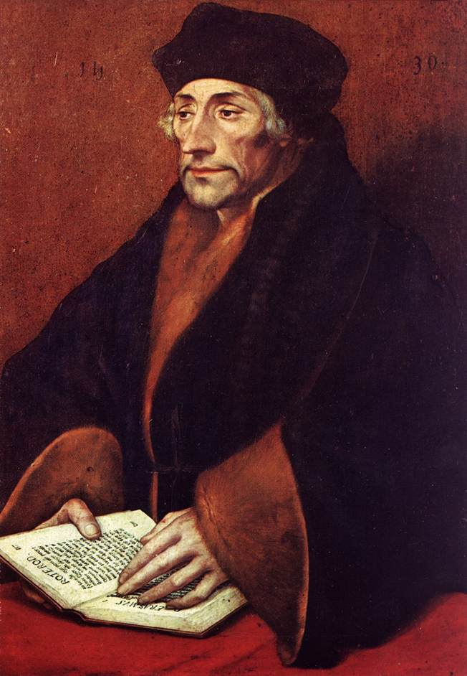
Leading to Reformation
Christian Humanism paved the way for the Protestant Reformation in Europe.
Erasmus was the best known of the Christian Humanists. He wanted to reform the Church, not break from it.

Slide 10
Need for Reform
Popes and bishops involved in politics rather than tending the spiritual needs of their people.
Emphasis on external manifestations of Faith rather than Faith itself.
Sale of indulgences.
Freedom from (all or part of) the punishment due to sin.
Does not forgive the sin itself, just remits the punishment.

Slide 11
Martin Luther and the 95 Theses
Luther was a Catholic monk.
Upset at the sale of indulgences.
In 1517, Nailed 95 Theses (challenges) to the Cathedral door of Wittenberg.
Traditional way for scholars and theologians to challenge one another.
This is considered the beginning of the Protestant Reformation.

Slide 12
Martin Luther’s Reformation
By 1520, emboldened by his leadership position, Luther urged German princes to overthrow the pope in Germany and created a new church.
With the involvement of the princes, who lusted after valuable Church property, the movement became part political and part spiritual in motivation.

Slide 13
Schism Happens!

Slide 14
The Two Fundamental Protestant Beliefs in opposition to Catholicism
Faith Alone saves. Good works merits nothing.
Sola Scriptura. Scripture alone should be a Christian’s guide.

Slide 15
As already mentioned….
Things got complicated when the German princes supported Martin Luther against Emperor Charles V and the pope.
Political motives and greed mixed with religious motives.
The result…

Slide 16
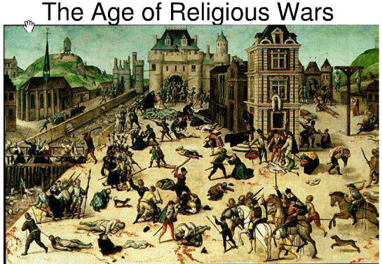
WAR
Religious war broke out between the German princes who supported Luther and Charles V, who supported Catholicism.

Slide 17
Peace of Augsburg
Ended religious warfare in Germany – 1555.
Officially ended Christian unity in Europe
German rulers were free to choose between Catholicism and Lutheranism.
The people weren’t free to choose, just the rulers.

Slide 18
Schisms within Protestantism
Zwingli
Leader of Protestants in Zurich, Switzerland
Removed all religious imagery
New church service replaced the Mass.
Zwingli was killed in a battle between Catholics and Protestants.

Slide 19
John Calvin
Leader of Protestantism in Switzerland upon the death of Zwingli
His writings spread widely due to the printing press
Preached predestination – that God had determined in advance who would be saved and who would be damned.
Undercut free will but emphasized God’s supremacy.
Created a theocracy in Geneva, Switzerland

Slide 20
Discussion Break
“The rule remains with the husband, and the wife is compelled to obey him by God’s command. He rules the home and the state, wages war, defends his possessions, tills the soil, builds, plants, etc. The woman on the other hand is like a nail driven into the wall.”
- Martin Luther, from Lectures on Genesis
What might Luther mean by comparing a woman to a nail in the wall?

Slide 21
Bellringer – November 13
If we had a “pop” quiz after the tardy bell, could you answer the following questions?
Which Protestant leader is most associated with predestination?
What event politicized the Protestant Reformation in Germany?
Who was the first Protestant reformer?
What was the first Protestant church?
What treaty brought peace between Catholics and Lutherans in Germany?

Slide 22
Reformation in England
A political reformation
The pope would not grant English King Henry VIII (the 8th) an annulment from his first wife, so he declared himself Head of the Church of England.
The Church of England is the Anglican Church. In the U.S., it is called the Episcopal Church.

Slide 23
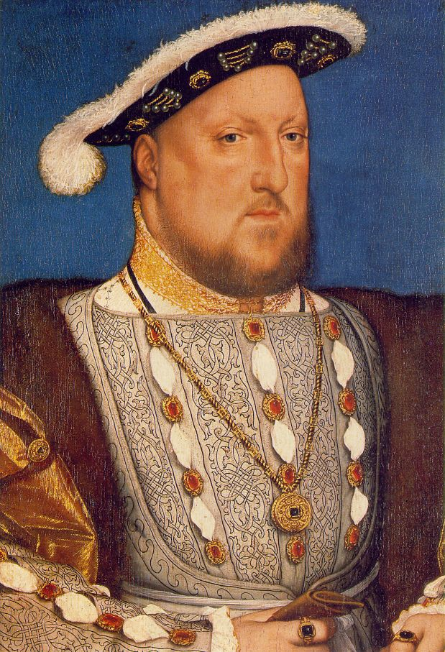
Henry VIII (1491 - 1547) was the King of England and
besides his six marriages, Henry VIII is known for his role
in the separation of the Church of England from
the Roman Catholic Church.

Slide 24
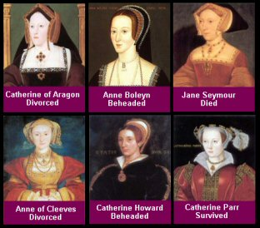
Henry VIII six wives.

Slide 25
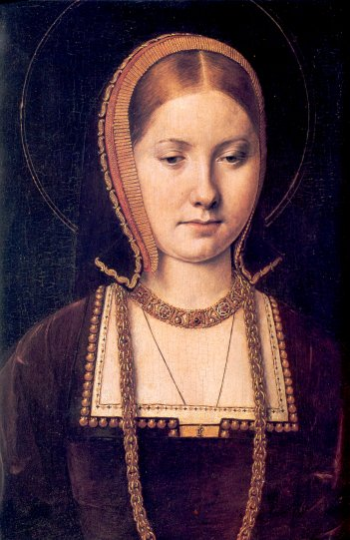
Catherine of Aragon was the youngest child of Ferdinand and Isabella. She was Henry VIII’s 1st wife, the mother of Mary Queen of Scots, and her divorce resulted in the separation of England from the Roman Catholic Church.

Slide 26
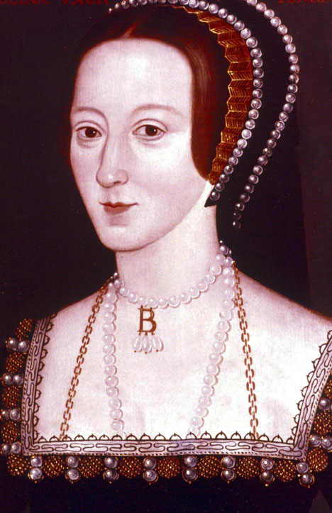
Anne Boleyn was Catherine of Aragon’s Queen consort,
Henry VIII’s 2nd wife, mother of Queen Elizabeth I, and
was beheaded at the Tower of London for adultery.

Slide 27
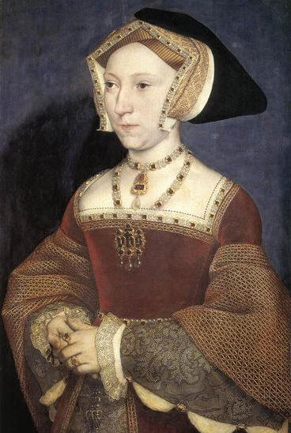
Jane Seymour married Henry VIII 10 days after
Anne Boleyn’s execution, died two weeks after the
birth of Edward VI, was the only wife to receive
a queen’s funeral, and was buried beside Henry VIII.

Slide 28
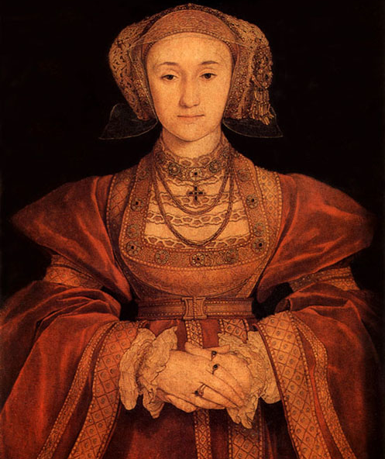
Anne of Cleves was Henry VIII’s 4th wife. She was German and he married her from a portrait, but when she showed up he thought she was ugly. Fearing for her life, she agreed to a divorce.

Slide 29
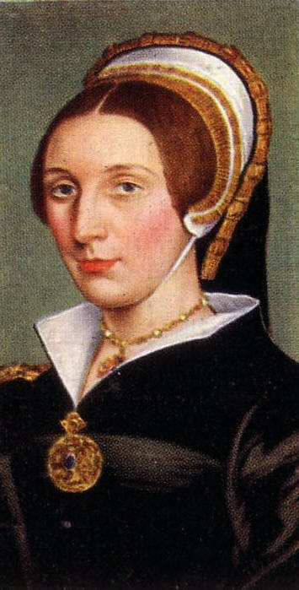
Catherine Howard married Henry VII’s 20 days after his divorce from Anne of Cleves. She was Anne Boleyn’s cousin and was beheaded in less then two years for adultery.

Slide 30
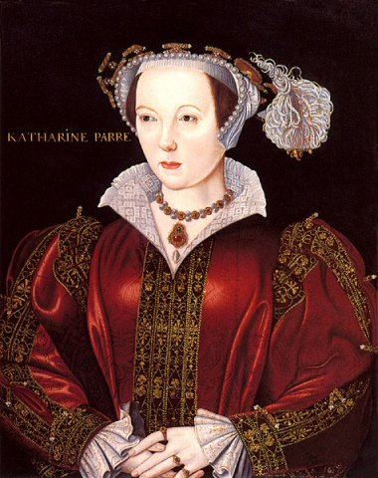
Catherine Parr was Henry VIII’s 6th and final wife. She
was the first queen of Ireland and was the most married
English queen - she had four husbands.

Slide 31
Anabaptists
Unlike other protestant groups, Anabaptists separated themselves from the state and politics.
Preached a return to primitive Christianity.
Considered radical even by other Protestants.
Joint army of Catholics and Protestants captured and killed Anabaptist leaders in 1535.

Slide 32
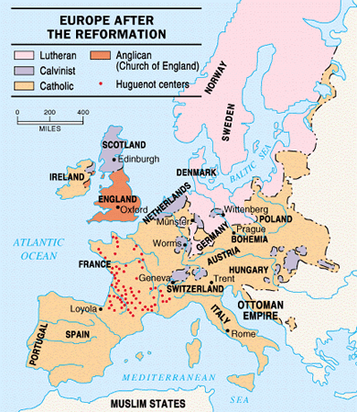

Slide 33
The Catholic Response
The Catholic Reformation revitalized the Church in the 16th century.
Three elements supported the Catholic Reformation:
Establishment of the Jesuits
Reform of the Papacy
The Council of Trent

Slide 34
The Jesuits
Officially called the Society of Jesus
Founded by Ignatius of Loyola
Obedient to the pope
Used education to spread the Gospel, countered Protestantism and established schools.
Active in missionary work as far away as China and Japan

Slide 35
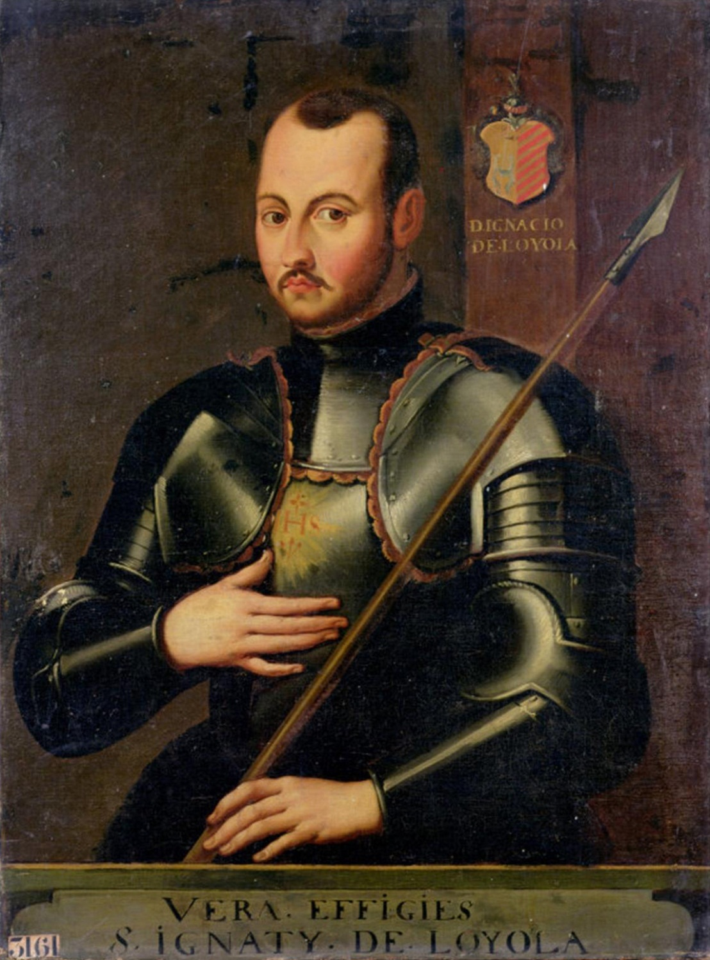

Slide 36
Papal Reform
Instituted by a pope, Pope Paul III
Reformed the papacy and pointed it in a more spiritual direction.
Pope Paul III called a new Church council, the Council of Trent.

Slide 37
Council of Trent
Reaffirmed traditional Catholic teaching in opposition to Protestant beliefs.
Declared both Faith and Good Works are important for salvation. (not just Faith alone)
Upheld the importance of the seven sacraments
Selling of indulgences was prohibited (something Luther wanted all along).

Slide 38
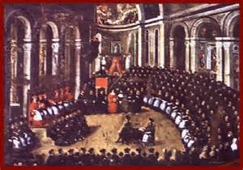

Slide 39
Schism Happens!

Slide 40
What’s Next?
Quiz time.
Do your own work.
Use your notes.

