Slide 1
Bellringer
Begin BEFORE the tardy bell rings.
Pick up a brown World History & Geography book from the bookshelf and read chapter 14.1, pages 247-255.
As you read, create a comparison / contrast chart with three columns:
Ming
Both
Qing
Fill out your chart as you read. I recommend you turn your paper sideways (landscape) .

Slide 2
Mr. Wyka’s AP World History
Comparing the Chinese Dynasties
Ming vs. Qing

Slide 3
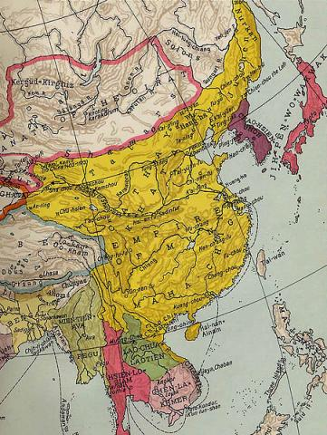
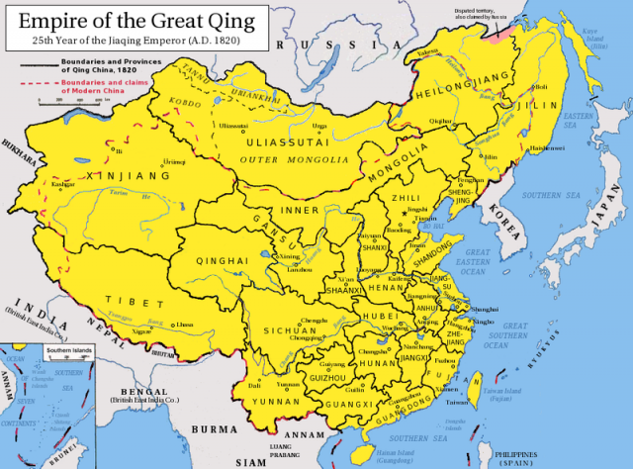
Qing Empire 1644 to 1912
Ming Empire
1368 to 1644

Slide 5
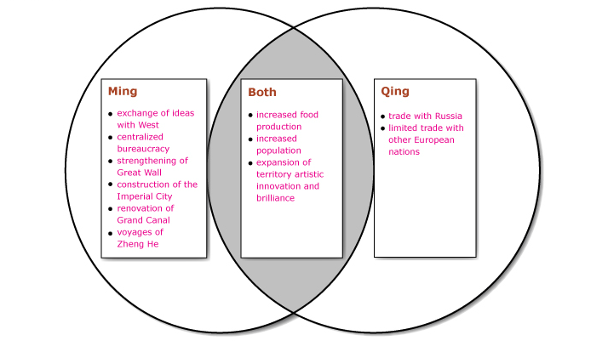

Slide 6
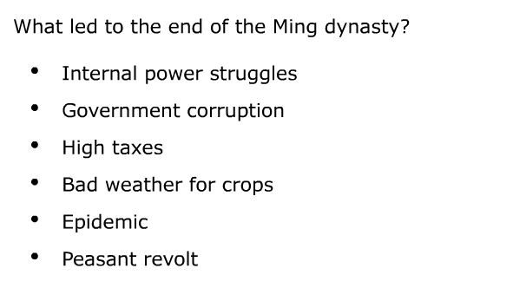

Slide 7
Your Task Now…
Write a comparison/contrast essay on the Ming and Qing dynasties.
Your essay must
10 pts. Be at least 400 words
10 pts. Be factually accurate
25 pts. Include a minimum of 4 points of similarity
25 pts. Include a minimum of 4 points of difference
10 pts. Include the role of women in each dynasty
20 pts. Describe the reasons for the fall of each dynasty and what each dynasty was replaced with

Slide 8
Sources
Chapter 14 (pg 247 +) of the World History & Geography textbook.
Chapter 26 of the AP Traditions textbook, pages 572 + and 574 +.
Chapter 20 of the AMSCO review book
Your notes from Mr. Wyka’s lecture.

