Slide 1
CHAPTER 28 REVOLUTIONS AND NATIONS STATES IN THE ATLANTIC WORLD 1500-1914 in a nutshell
Mr. Wyka – AP World History

Slide 2
Change is in the air
Protestant Reformation & Catholic Reformations – 1500s
Scientific Revolution – 17th & 18th centuries
The Enlightenment – 17th & 18th centuries
American Revolution – 1776
French Revolution – 1789
Haitian Revolution – 1791
Latin American Independence Movements – 1800s
Decline of Qing China – 1800s
Feminism, Marxism, Socialism – 1800s to 1900s

Slide 3
Scientific Revolution – 17th & 18th centuries
Copernicus, Galileo, Kepler, Bacon and Newton were the Giants
Copernicus first proposed a heliocentric universe (sun centered)
Encouraged a skeptical approach to learning and advocated empirical research based on observations of data.

Slide 4
The Enlightenment
Application of human reason to improve society.
Belief that humans were basically good and that education and reason could improve humans even further.
Contrasted with traditional Christian view of fallen man.
Philosopher John Locke inspired American Revolution.
Adam Smith inspired modern economics.

Slide 5
With the Enlightenment, there was a major change in political thinking.
The idea of a monarch’s “divine right” to rule gave way to the idea of contractual government wherein both the monarch and the people have rights. In this type of government, the government was given its rights and responsibilities by the consent of the governed.
There were increased demands for social and political equality, at least for white males.
These ideas were to have global impact.

Slide 6
The American Revolution

Slide 7
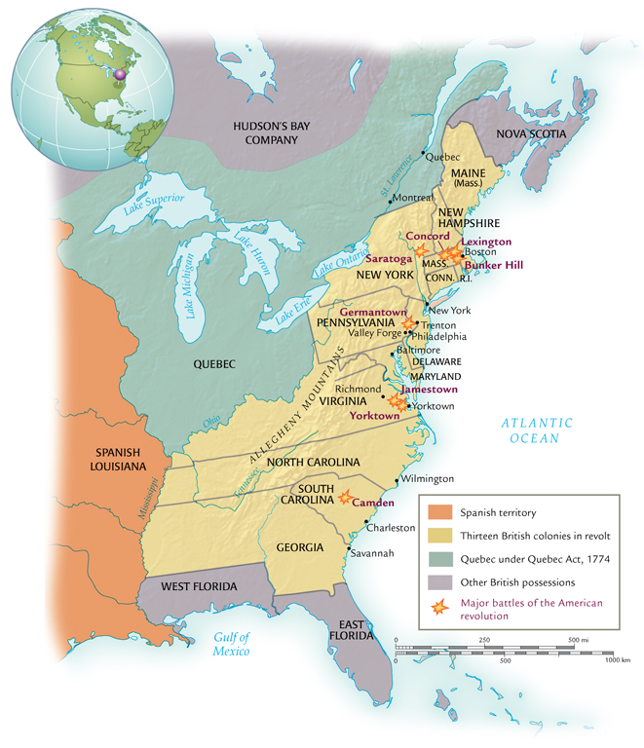
In America, the tension between the colonists and the British government over taxes and representation in Parliament brought about the American Revolution (1775–1781).
Enlightenment principles are reflected in the U.S. Constitution - principles of
freedom,
equality, and the
idea of popular sovereignty.

Slide 8
French Revolution

Slide 9
In France, it was an internal rather than external struggle.
In 1789 Louis XVI attempted to gain support for new taxes that led to a call for political reforms and eventually revolution.
The new National Assembly abolished the feudal system, changed the role of the Catholic Church, and became a constitutional monarchy in 1791.
The continuing struggle for power and the threat of outside invasion led to the abolition of the monarchy, the creation of a republic, and the death (by guillotine) of the king and queen.

Slide 10
The political battles within France continued until 1799 with the rise of Napoleon and a period of stability.
As emperor, he made peace with the Catholic Church, extended religious freedom, put in place political freedom for all adult men, but also enforced restrictions on the press and speech.
His military prowess extended the empire into Iberia, Italy, Netherlands and then in 1812 into Russia, the sight of his first major defeat.
Napoleon was forced to abdicate, was exiled to the island of Elba, and returned to France to again take control. He was defeated again at Waterloo (1815), and finally exiled to St. Helena where he died.

Slide 11
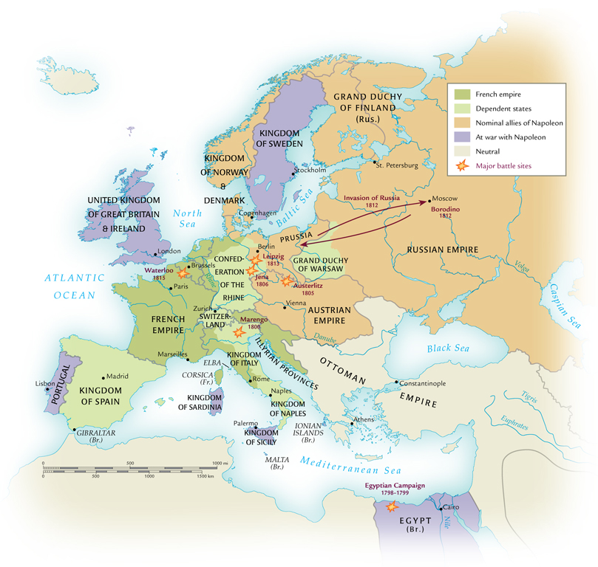
Napoleon’s Empire in 1812

Slide 12
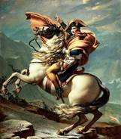
Napoleon rose to power BECAUSE of the tumult of the French Revolution.
Can you think of another leader whose rise to power was made possible because of national turmoil?

Slide 13
There were also revolutions in South and Central America during this era.
The world’s only successful slave revolt occurred in Saint‐Dominque, Haiti, led in part by free blacks who had fought in the American Revolution.
In 1791, led by Toussaint Louverture, slaves rebelled and in 1804 established the Republic of Haiti.
In Latin America, many of the revolts were against the peninsulares and were often along class lines.
Mexico was partially freed from Spanish control by Napoleon’s invasion of Spain in 1807. Mexico had a series of revolutions, a brief military dictatorship, and then established a republic in 1822.

Slide 14
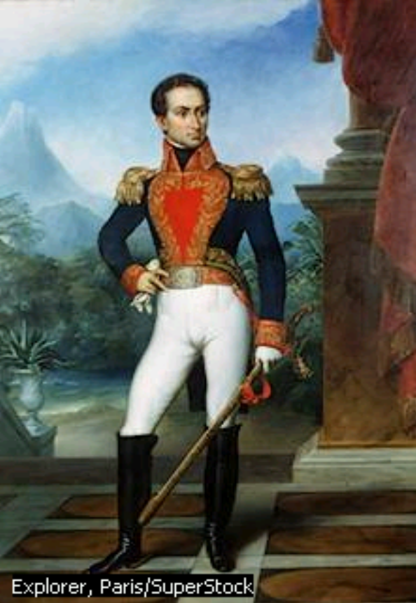
In South America, Simon Bolivar, inspired by George Washington, led Creole forces against the Spanish first in Colombia and then across the rest of the north.
Bolivar’s cooperation with revolutionary leaders in other countries helped him defeat the Spanish by 1824.
Brazil gained independence from the Portuguese in 1821.

Slide 15
Review?
What revolutionary leader is most associated with the South American independence movement?
Simon Bolivar
Who rose to power in France as emperor after the tumult of the French Revolution?
Napoleon Bonaparte

Slide 16
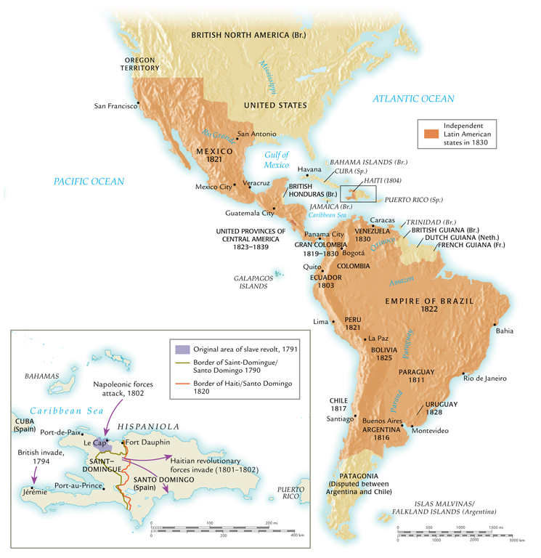
Latin America in 1830

Slide 17
These revolutions also brought the beginnings of political ideology, notably conservatism and liberalism.
These revolutions brought about a drive to end first the slave trade, and then slavery. By the late 1800s slavery was abolished in the Atlantic world.

Slide 18
Freedom did not always mean political equality.
The struggle for women’s rights both within the family and in society continued during these revolutions. Women had been involved in revolutionary movements in various roles, but will not gain political equality until the 1900s.

Slide 19
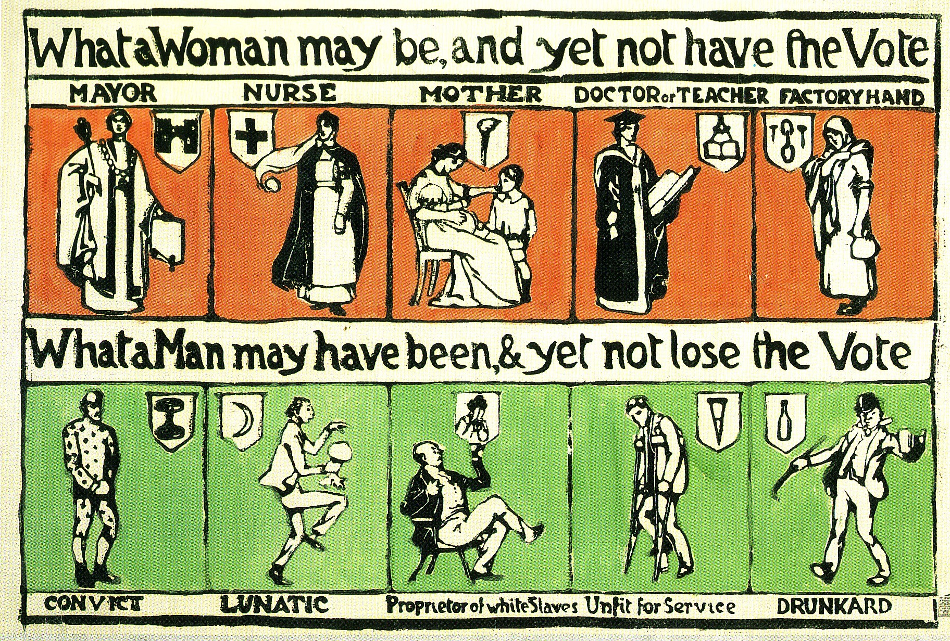

Slide 20
AP Review Time
The American and French Revolutions were alike in all of the following ways EXCEPT
They both brought increased political power for women
They were prompted by issues of taxation
They both involved representation in their respective legislatures
They produced document that defined similar natural rights
They were based on Enlightenment thought

Slide 21
The Haitian revolution was the only revolution of the period 1750-1900 that was initiated and fought by
Creoles
Mestizos
Slaves
Foreign mercenaries
Elite classes

Slide 22
The Brazilian independence movement
Resulted in the abolition of slavery
Produced a republic for Brazil
Involved a prolonged struggle with Portugal
Followed a pattern similar to that of other Latin American independence movements
Was the result of the Napoleonic wars

