Slide 1
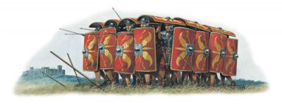
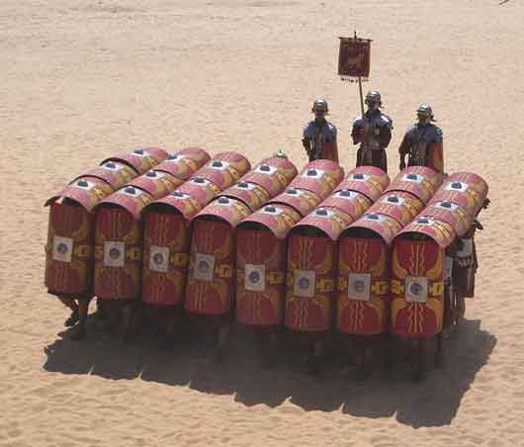
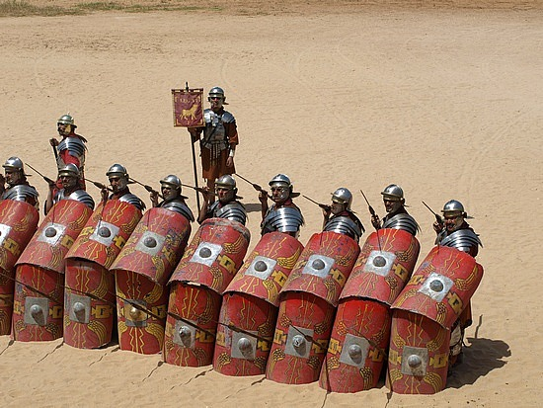
Chapter 2, lesson 1 The First Christians
Mr. Wyka - World History
When? A.D. 50-800
Where? Europe
Roman “Turtle” Formation

Slide 2
Essential Questions
How can religion impact a culture?
What factors lead to the rise and fall of empires?

Slide 3
Why does it matter?
A new civilization was born – European civilization – from the ashes of the Western Roman Empire. Three major elements came together to form this new world:
The Germanic peoples,
The legacy of the Romans, and
The Catholic Church.

Slide 4
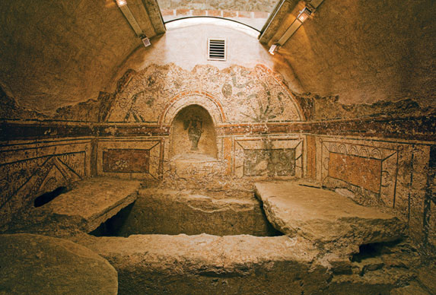
Lesson Vocabulary
Procurator
Clergy
Laity
Transformation
Structure
Early Christian Catacomb, Budapest, Hungary

Slide 5
Judaism in the Roman Empire
Judaea was a Roman province by A.D. 6 controlled by a procurator.
Unrest was widespread.
Four primary Jewish religious groups at the time:
Sadduccees priests who favored cooperation with Rome.
Pharisees strictly observed Jewish law and ritual.
Essenes lived apart from society, waiting for a Messiah from God to save Israel from oppression.
Zealots called for the violent overthrow of Roman rule.
Zealots led an unsuccessful revolt in A.D. 66 which was crushed by Rome to the extent that even the Jewish Temple was razed in A.D. 70.

Slide 6
This is the world into which Jesus of Nazareth was born, traveling and preaching throughout Judaea around the years A.D. 30 – 33.

Slide 7
The Rise of Christianity The Teachings of Jesus
Jesus was a Jew who called for a transformation of the inner person, not just an adherence to rituals & regulations.
His first commandment was to “love God” with one’s entire being. His second commandment was to “Love your neighbor as yourself.”
Among other reasons, Jesus is important because these commandments, and the concepts of humility, charity, and love toward others shaped the value system of Western Civilization.

Slide 8
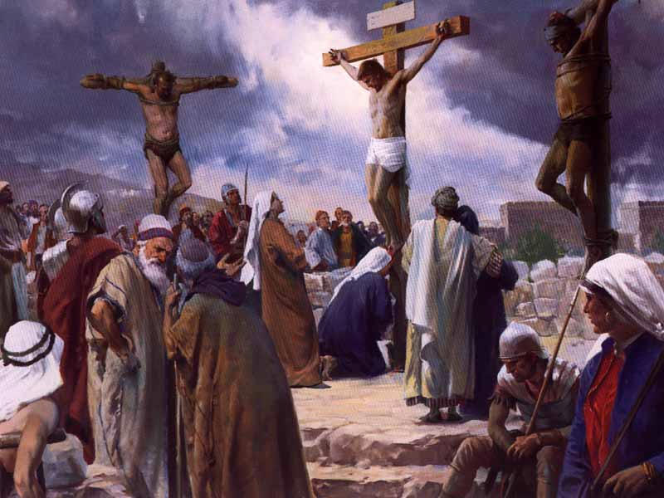
The Rise of Christianity The Teachings of Jesus
Jesus was turned over to the Roman procurator, Pontius Pilate, by some of the Jewish authorities.
He was put to death by crucifixion.
His followers, Christians, believe he rose from the dead and appeared to them after his death.

Slide 9
Christianity Spreads Throughout the Empire
Jesus chose twelve men from his disciples, to be apostles. The apostles were leaders of the early Christian Church.
Peter, a humble fisherman, was the leader of the apostles.
Paul, a Jew, converted to Christianity and became an apostle. He had been a persecutor of Christians. Paul is known as the “Apostle to the Gentiles” because he, more than any other apostle, spread Christianity to non-Jews.

Slide 10
The central teaching of the apostles and the early church was that Jesus, the Christ (from Christos, the Greek word for Messiah), could save people from their sins and reconcile them to God.
The Christian message was very appealing. One of the principle reasons for the spread of early Christianity was that salvation was available to ANYONE, rich, poor, slave, free.

Slide 11
The original message of Christianity was passed on orally, by the apostles and other disciples.
Teachings were eventually written down and certain writings, especially those written by apostles, came to be considered inspired by God. These writings formed the basis of the New Testament.
Christians accept the Jewish scripture (they call it the Old Testament) as inspired as well.

Slide 12
The Gospels (good news) are the first four books of the New Testament. They are accounts of Jesus’ life and teachings.
The epistles are letters written by the apostles to various churches to bolster their faith and sometimes correct doctrinal or moral errors.
The Acts of the Apostles is a history of the early church immediately after Jesus’ resurrection.
The last book of the New Testament stands alone. It is the Book of Revelation, written by the apostle John. It is a work of apocalyptic prophesy and is rich in symbolism.

Slide 13
Roman Persecution
Roman authorities mistrusted the new sect.
Christian values were markedly different than those of the pagan world.
Christians refused to offer worship to the state gods and emperors.
This was seen as an act of treason.
Christian rituals were secret. Only baptized believers were permitted to attend the full ritual, called Eucharist (giving thanks).

Slide 14
Roman Persecution
The secretive nature of the early church gave rise to wild rumors in Rome about what really went on in Christian rituals.
Roman persecution of Christians began under the emperor Nero (A.D. 54-68), just 20 some odd years after the death of Jesus.
Persecutions continued off and on through the emperor Diocletian.

Slide 15
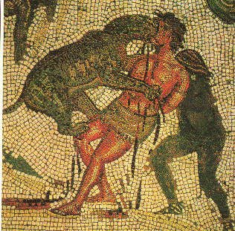
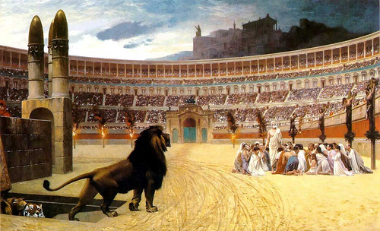

Slide 16
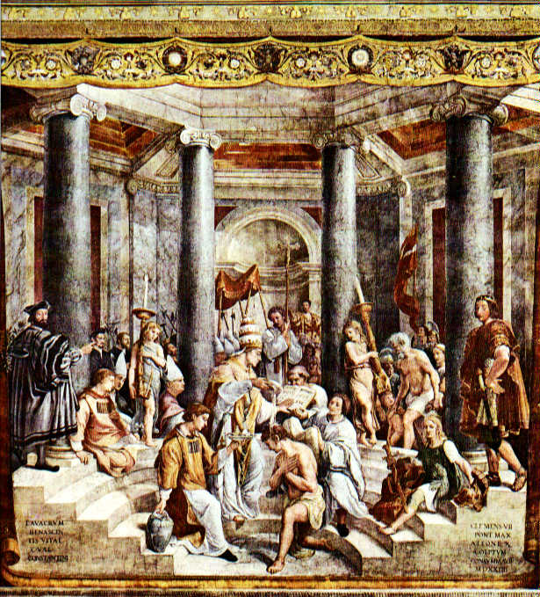
Christian Rome
Christianity gained a permanent place in the empire with the rise to power of Constantine in A.D. 312
In A.D. 313, Constantine issued the Edict of Milan, officially proclaiming Roman tolerance of Christianity.

Slide 17
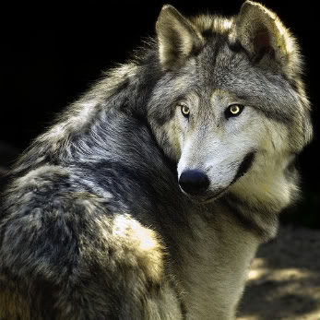
Looking back…

Slide 18
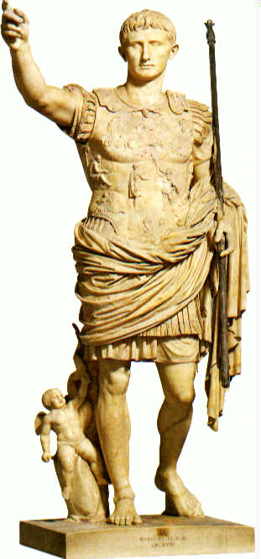
First Roman emperor?
Julius Caesar
Hannibal of Carthage
Alexander the Great
Augustus

Slide 19
This Jewish group favored cooperation with the Romans
Pharisees
Sadducees
Essenes
Zealots

Slide 20
Now let’s quiz on what we’ve learned.
You may collaborate.
Your quiz is based on the presentation.
You may use your textbook and your notebook.
This is a timed quiz so please be efficient in your use of this time.
When done, please turn your quiz into the DropBox.

