Slide 1
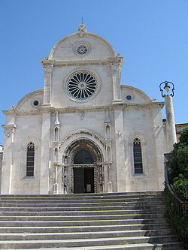
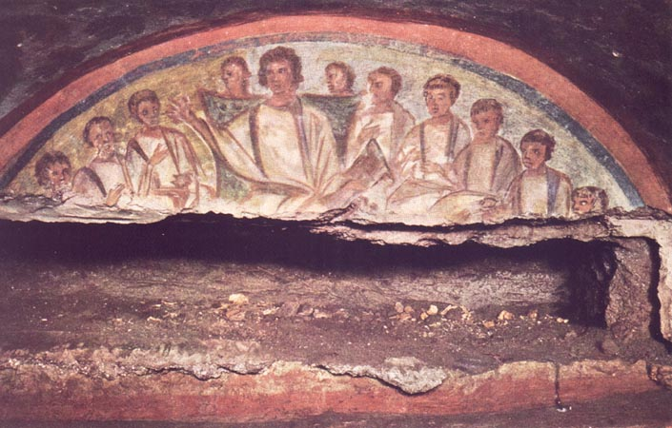
Chapter 2, lesson 3 The Early Christian Church
Mr. Wyka - World History
When? A.D. 313 - 800
Where? Europe
From catacombs to cathedrals

Slide 2
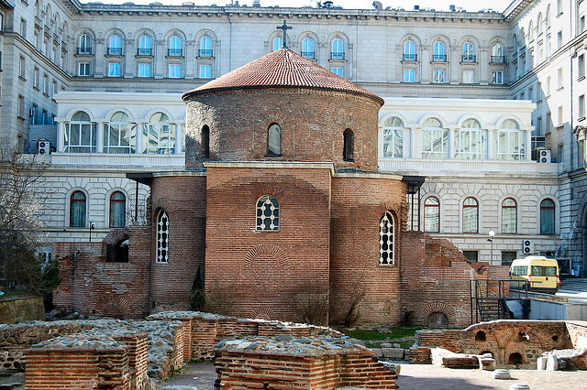
Essential Questions
How can religion impact a culture?
How was the Christian Church organized by the fourth century?
Sofia, Bulgaria, 4th century A.D.

Slide 3
Why does it matter?
The Catholic Church filled the vacuum left after the fall of the Roman Empire, playing an increasingly important role in the growth of a new European civilization.

Slide 4
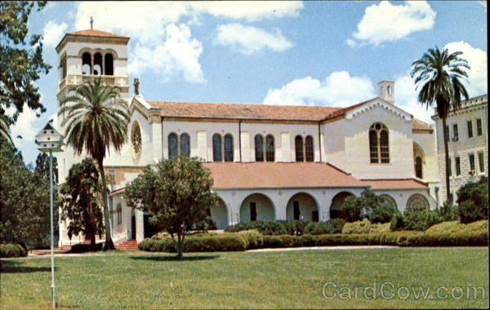
Lesson Vocabulary
bishopric
monk
monasticism
nun
abbess
pursue
conversion
primacy
succession
The abbey church of the Benedictine monastery of St. Leo in San Antonio, Florida.

Slide 5
Organization of the Church
Priests led local Christian communities called parishes.
A group of parishes was headed by a bishop.
The bishops considered themselves successors of the apostles.
A bishop’s territory was called a bishopric, or diocese.
The bishops of the four most ancient cities of Christianity, Rome, Jerusalem, Alexandria, and Antioch, claimed descent (not by blood, but by succession) from one or more of the original apostles.
The bishop of Rome, being the successor of Peter, the chief of the apostles, took on a primacy, or first place, among the bishops.

Slide 6
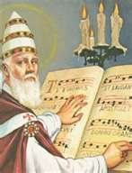
Pope Gregory the Great
Bishop of Rome
A.D. 590 to 604
Strengthened the papacy
Used the monastic movement to convert many of the non-Christian peoples of Germanic Europe.
Also gave the world Gregorian chant.

Slide 7
The Monastic Movement
A monk is one who seeks to live a life apart from society in order to pursue God.
A monk is different than a friar.
A monk may be a priest, but need not be.
The practice of living a monk’s life is monasticism.
Monks take vows of obedience, chastity, and poverty.
The largest monastic order in the world, in ancient times and now, is the Benedictine Order.
An abbot (father) is the leader of a Benedictine monastery.

Slide 8
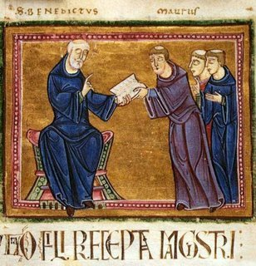
The Monastic Movement
Benedict of Nursia, A.D. 480-543, founder of western monasticism
Benedict fled the excesses of the city and became a hermit.
His pious life attracted followers and throughout his life he founded 12 monasteries.
He is known for his Rule of Benedict, a guide book governing monastic life.
Benedictine monasteries today still use the Rule and recite a passage from it each day at supper.
St. Benedict delivering his Rule to his brother monks.

Slide 9
The Monastic Movement
Monks spread Christianity throughout Europe.
A missionary seeks the conversion of non-Christian peoples.
Women played a large role in the missionary work of the church and in the preservation of ancient learning.
Women monastics are called nuns.
Nuns live in convents headed by abbesses.
Abbesses and nuns during this time became very powerful and influential in church affairs and politics.

Slide 10
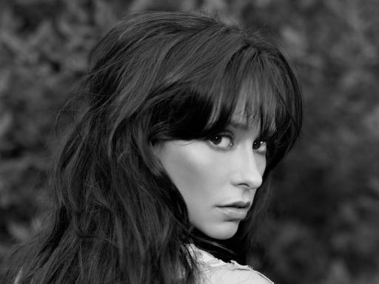
Looking back…

Slide 11
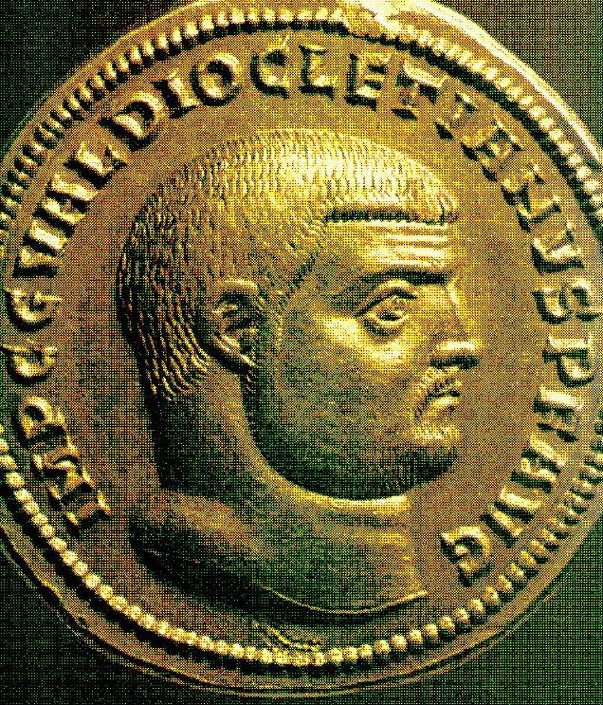
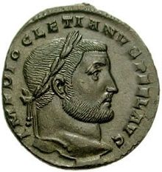
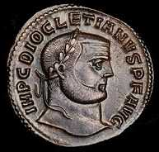
This emperor divided the empire into four prefectures before retiring:
Julius Caesar
Caesar Augustus
Romulus Augustulus
Diocletion

Slide 12
The first civilizations (that we know of) developed in:
Mesoamerica
Mesopotamia
Greece
North Africa

