Slide 1
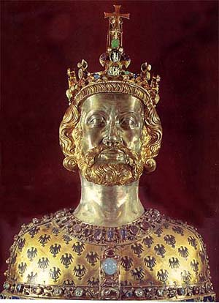
Chapter 2, lesson 4 The Age of Charlemagne
Mr. Wyka - World History Honors
When? A.D. 768 to 814
Where? Europe
Charles the Great

Slide 2
Essential Questions
How can religion impact a culture?
What factors lead to the rise and fall of empires? (Specifically for this unit, what factors led to the rise and fall of Charlemagne's empire?)

Slide 3
Why does it matter?
Although Christianity was becoming the dominant religion in Europe during the Early Middle Ages, Germanic tribes became the dominant political force. Ultimately a new empire emerged that was linked to the idea of a lasting Roman Empire.

Slide 4
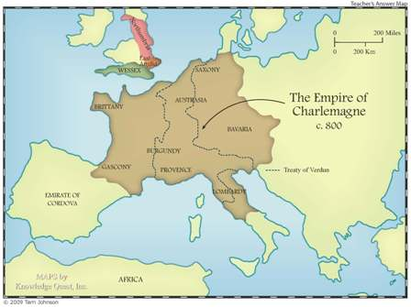

Slide 5
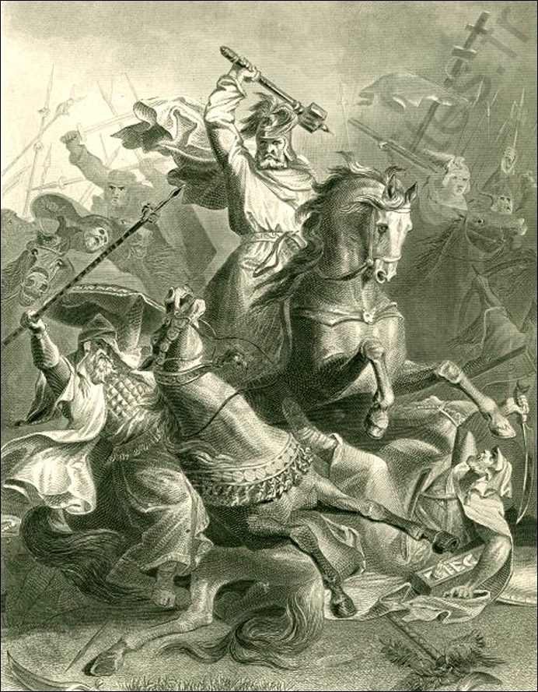
Lesson Vocabulary
wergild
ordeal
excluded
ensure
Clovis
Renaissance
Charles Martel
Charlemagne
Battle of Tours
Charles Martel at the Battle of Tours, A.D. 732

Slide 6
The New Germanic Kingdoms
See textbook page 34 for a map of Germanic territories

Slide 7
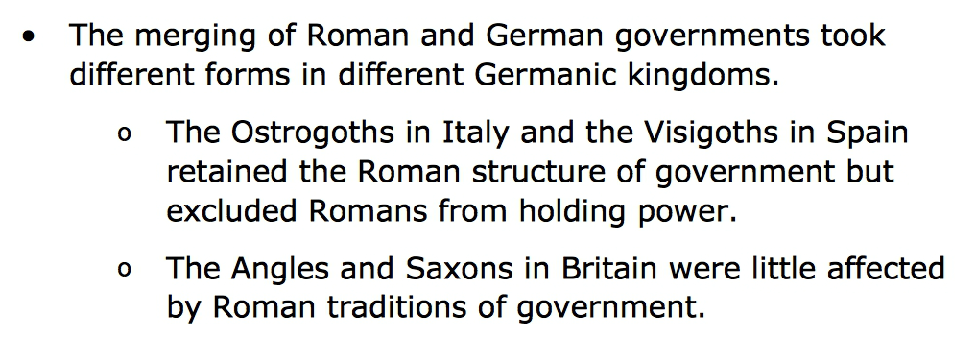
The New Germanic Kingdoms

Slide 8
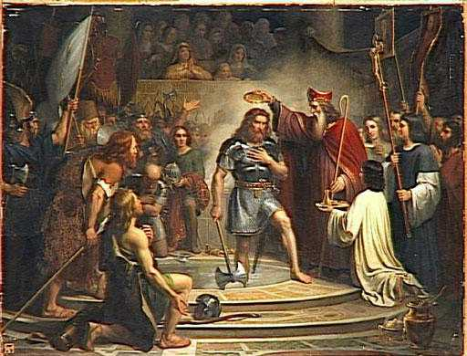
The Kingdom of the Franks
Only one of the German state proved long lasting, the kingdom of the Franks.

Slide 9
The Carolingian Empire
In the early 700s, the Muslims who had recently taken over the Iberian Peninsula, crossed the Pyrenees Mountains into France.
The Frankish kings proved inept against this threat.
The mayor of the palace, Charles the Bastard, gathered as many Frankish knights, warriors, and peasants as he could and met the invaders at Tours.
Although outnumbered, the Franks prevailed and pushed the Islamic army back to Spain.
After this, Charles the Bastard gained a new name – Charles Martel, or Hammer.

Slide 10
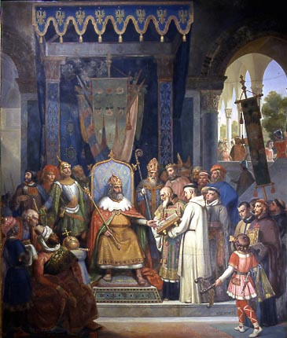
The Carolingian Empire
Charles Martel’s son, Pepin, assumed the kingship and the last of the Merovingian kings retired to a monastery.
Upon his death, Pepin’s son Charles, assumed the throne in A.D. 768 and ruled until 814.
Charles and Alcuin

Slide 11
The Carolingian Empire

Slide 12
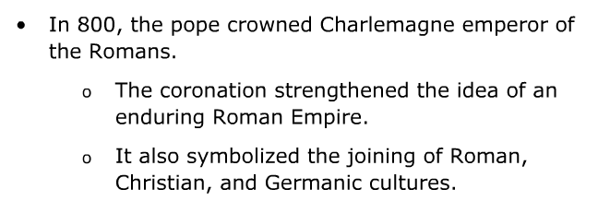
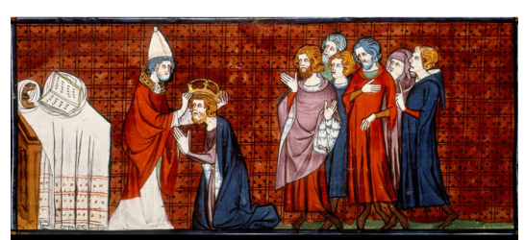
The Carolingian Empire

Slide 13
In Germanic law, the term for the amount paid by a wrongdoer to the family of a person he or she had injured or killed:
wergild

Slide 14
A means of determining guilt in Germanic law based on a physical trial (ie. holding a red hot iron) in which it was believed that divine forces would intervene on behalf of the innocent, not allowing an innocent person to be harmed.
The Ordeal

