Slide 1
American Free Enterprise System
Economics Chapter 3

Slide 2
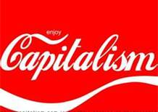
Basic Idea
KEY CONCEPT
Free enterprise system is another name for capitalism. This name is used because anyone is free to start a business or enterprise.
anyone is free to start a business or enterprise
private ownership of factors of production

Slide 3
How a Free Enterprise System Works
EXAMPLE: Profit in Rocks
1975 pet rock fad; packaged with care manual
highly popular and profitable gag gift during holiday season
In early 1976, consumers stopped buying
owner quit the business

Slide 4
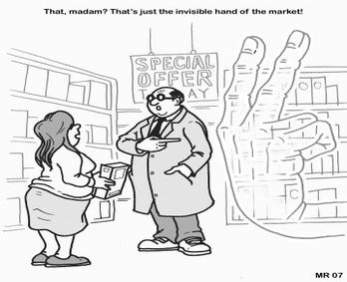
Adam Smith again
Remember the “invisible hand” that guides the market!

Slide 5
How a Free Enterprise System Works
EXAMPLE: Competition over Books
Demand for books high; competition driving out small booksellers
Before 1995, small chain stores and independents dominant
1995, large chains offered discounted prices, appealing atmosphere
Now online booksellers open with huge number of titles, low prices – but what about delivery?
small stores now offer personal service, local or specialized topics

Slide 6
How a Free Enterprise System Works
KEY CONCEPTS
System gives right to own and exchange private property voluntarily
Open opportunity—ability to enter, compete in market of one’s choice
Legal equality—everyone has same economic rights under the law
Free contract—right to decide which legal agreements to enter into
Profit motive—incentive to gain from economic activities

Slide 7
http://www.youtube.com/watch?v=5tF6W4OR5yU&feature=plcp – markets (4:30)

Slide 8
The Roles of Producers and Consumers
EXAMPLE: Consumers Vote with Their Wallets
Consumers help allocate resources through their choice of products
their choices guide producers to provide what consumers will buy
Early 2000s, low-carbohydrate diets became popular
food producers moved some resources into low-carb market
In 2004, producers cut back when consumer interest faded

Slide 9
Government in the U.S. Economy
KEY CONCEPTS
Government important but with limited role in U.S. economy
Modified free enterprise economy:
government protections, provisions, regulations adjust capitalism

Slide 11
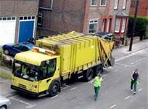
KEY CONCEPTS
Public sector—branches of government that make production decisions
Market failure—outsiders benefit from or pay for marketplace interaction
Public goods—products provided by government, consumed by public
Public goods funded with taxes

Slide 12
Private goods and Public goods
Private goods—goods with two features
1. the amount consumed by one person is unavailable to others
nonpayers can easily be excluded
Public goods—goods that, once produced, are available to all, but nonpayers are not easily excluded.
Think about spraying for mosquitos here in CC.
Available for all to consume, regardless of who pays and who doesn’t.

Slide 13
Free Riders
No incentive for business to produce public goods—people will not pay
Free rider—person who benefits but does not pay for good or service
Only way to have public goods is for government to fund with taxes
examples: July 4 fireworks, law enforcement

Slide 14
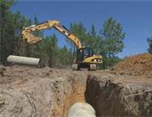
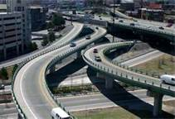
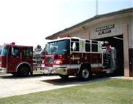
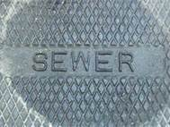
Infrastructure—goods and services needed for society to function
examples: highways, mass transit, water, sewer, health care, fire

Slide 15
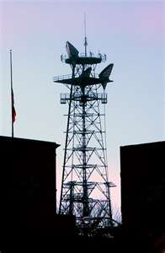
Quasi-public and Open-access goods
Goods that are nonrival but exclusive are called quasi-public goods.
Think about radio and TV. (non-cable)
Goods that are rival but nonexclusive are called open-access goods.
Fishing in the ocean, water-front views

Slide 16
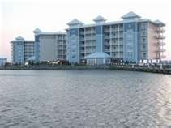
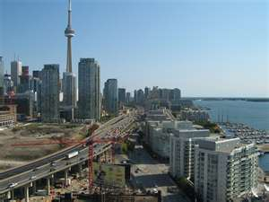
Location, Location, Location
What if you had an older building that used to have a view of the waterfront, but now that a new condo has been built you lost this view? Would you be upset?
This is the idea of open-access goods.

Slide 17
Positive Externalities
Positive externalities occur when the by-products of consumption or production benefit third parties.
Education generates positive externalities.
Inoculations for diseases

Slide 18
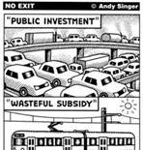
Subsidy—government payment to help cover cost of economic activity
subsidy to drug company to make flu vaccine yields fewer sick people

Slide 19
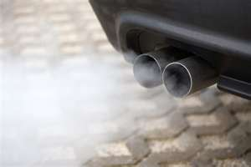
Negative Externalities
Negative externalities generally are by-products of production or consumption that impose costs on third parties.
Government restrictions can improve the allocation of open-access resources.
Antipollution laws
Water quality restrictions
Noise restrictions
Local zoning laws

Slide 20
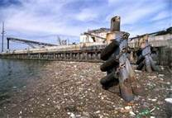
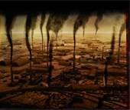
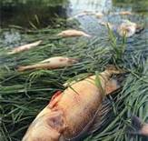
Managing Externalities
Paying for Negative Externalities
Factory owners—little incentive to pay to cut industrial pollution
People of region pay cleanup cost, have illnesses and medical bills
Government limits negative externalities through taxes and fines
offset medical costs, provide incentives to reduce pollution

Slide 21
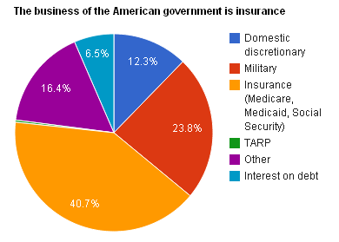
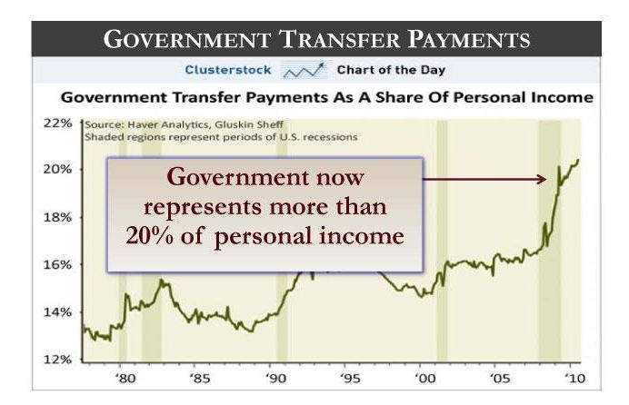
Redistributing Income
Transfer payments move income from person or group to another
recipient does not provide product in return
Public transfer payment—made by government with tax money
Most public transfer payments in area of social spending
usually go to poor, aged, disabled, or people who lose their jobs

Slide 22
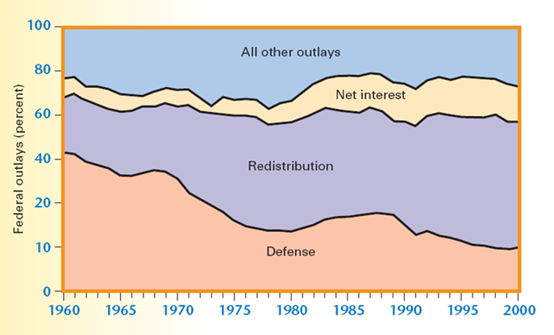
Help to others – effects on gov’t

Slide 23
Programs to Help the Poor
Social insurance programs are designed to help make up for the lost income of people who worked but are now
Retired
Temporarily unemployed
Unable to work because of disability or work-related injury
Social Security
Medicare
Unemployment insurance
Worker’s compensation

Slide 24
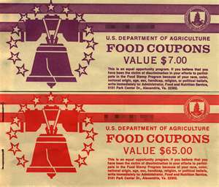
Income-Assistance Programs
Income-assistance programs provide money and in-kind assistance to poor people.
Cash transfer programs
In-kind transfer programs
“means tested programs” such as food stamps, housing, etc.

Slide 25
Poverty rates
The federal government determines the official poverty level and adjusts this benchmark over time to account for inflation.
The U.S. official property level of income is many times greater than the average income for most of the world’s population.
How do we determine the poverty rate?

Slide 26
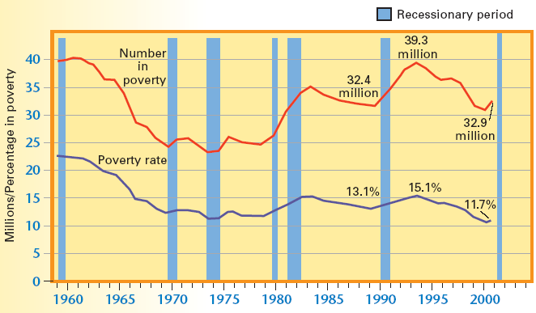
Number and Percentage of U.S. Population in Poverty: 1959–2001

Slide 27
Poverty and Marital Status
Poverty rates among female-headed families are five to six times greater than rates among married couples.
Poverty rates among female-headed families are two to three times greater than those for male-headed families.
Since the mid-1990s poverty rates have trended down for all types of families, before rising slightly in the recession year of 2001.

Slide 28
Reviewing Key Concepts
Explain the relationship between the terms in each of these pairs:
market failure and free rider
negative externality and positive externality
subsidy and positive externality
safety net and public transfer payment

Slide 29
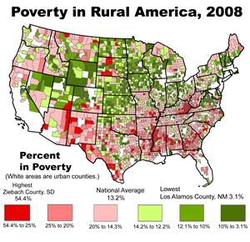
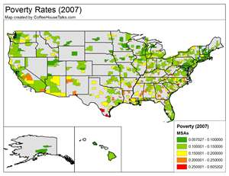
Card Activity
If you were the head of a household of four, are you considered in poverty with the amount you had?
A family of four is officially classified as poor if its annual cash income, before taxes, is $22,314 or less. For a two-person household, the threshold is $14,218

Slide 30
Links
http://www.youtube.com/watch?v=yC5R9WPId0s&list=UU_xHLAJ_zqPHkmC2aY2MdcA&index=13&feature=plcp – Externalities (7:30)

