Slide 1
Classical Civilizations in Greece and Persia Period 2 – 600 B.C. to A.D. 600 Amsco World History pgs. 50-65
Mr. Wyka – AP World History

Slide 2
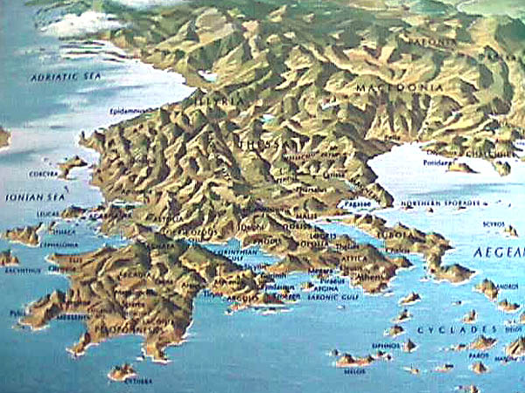
Essential Question
What about Greece’s geography encouraged the Greeks to become a seafaring, trading and colonizing people?
Ancient Greece

Slide 3
The Big Picture
The 1200 years between 600 B.C. and A.D. 600 saw the rise and fall of great empires that became the foundations of later civilizations.
Rome – Persia – Mauryan and Gupta India – Qin and Han China – Maya (Central America) – Moche (South America)
Birth and growth of belief systems that would change the world.
Judaism spread – Christianity was born – Chinese philosophy was born – Vedic religion of India

Slide 4
Early Mediterranean Civilizations
The Minoans of Crete
Grew rich through trade throughout the Mediterranean.
Spread many of their ideas to the Greeks.
The Mycenaeans of mainland Greece
Influenced by the Minoans
Traded with the Minoans
Both cultures declined by 750 B.C., but are important because the ideas they spread continued on in later Mediterranean cultures.

Slide 5
Rise of the Greek City-States
Geography of Greece made seafaring and trade important.
Received and spread New ideas and technology. (i.e. adopted the Phoenician alphabet).
Geography also shaped Greek politics.
Sovereign city-states called poleis (singular, polis).
Polis citizenship restricted to free males.
Poleis government was varied – monarchy, oligarchy, and even democracy.

Slide 6
Sparta
Military society
Women enjoyed more rights (own property, education, not secluded in their homes, etc.) than other poleis like Athens.
Spartan society relied on slaves – helots – to do the work.
Helots outnumbered Spartans
Government structure was an oligarchy.

Slide 7
Athens
Early governments were monarchies in which aristocrats held all of the power.
Then popular uprising led by tyrants overthrew the nobles and led reforms.
Finally, the tyrants were overthrown during the 500s B.C. and a period of democracy ensued.

Slide 8
Democracy
After the overthrow of the tyrants, due to their abusing their power, most of the poleis returned to monarchies and aristocracies.
However, Athens and others turned to democracy.

Slide 9
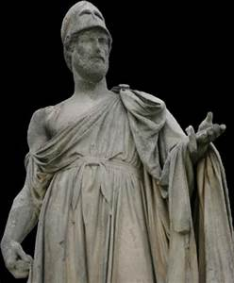
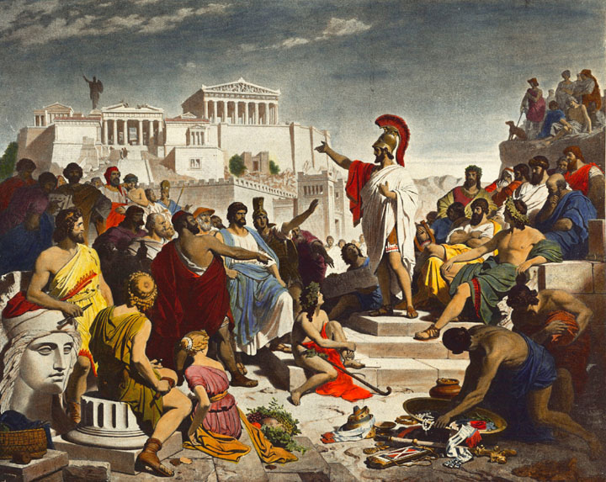
Pericles
Associated with the Golden Age of Athens
461-429 B.C.
Athenian reformer and leader.

Slide 10
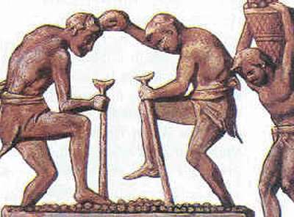
Athenian Economy
Based on slavery
Slaves were often prisoners of war (many times from other Greek cities)
Life was grueling

Slide 11
Women in Athens
Considered inferior physically and intellectually.
No voting rights or rights to own property.
Women were isolated from society.

Slide 12
Athenian Philosophy
Socrates – questioning to arrive at answers
Put to death in Athens for questioning the state religion
Plato – kept Socrates ideas alive
Described an ideal society in The Republic
Aristotle – student of Plato
The Golden Mean (avoiding extremes in behavior)
Learning through observation (empiricism)

Slide 13
Athenian Religion and Culture
Greek religion became syncretic (combined elements from other sources) as the Greeks increased contact with other peoples.
Greek myths taught morality.
Greek Religion was closely connected to Greek literature, architecture, and even athletic competitions
Literature:
Greek comedies – plays in which a character triumphs over hardship
Greek tragedies – dramas the deal with war, death, justice and relationships
Architecture - Parthenon – Athenian temple
Athletic Competition - Olympic games

Slide 14
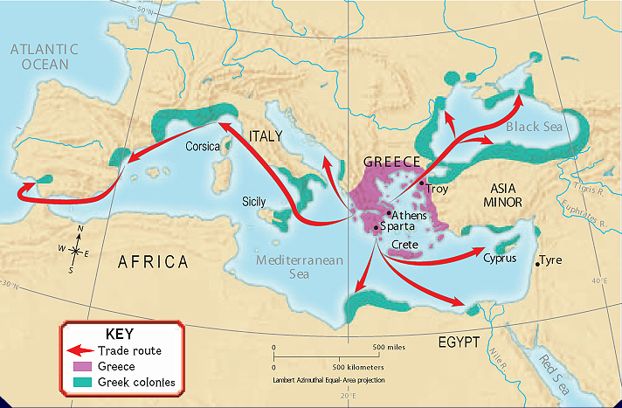
Greek Colonies
Colonized around the Mediterranean
Why? Population outstripped the food supply
Autonomous but linked by a shared culture with its home polis.

Slide 15
Persian Empire
Cyrus the Great – 559 B.C.
Achaemenid Empire
Rulers claimed the divine right to rule (like rulers in Egypt and China)
Tolerant – allowed minority groups to retain national identity and religion.

Slide 16
Persians
How do you keep a BIG EMPIRE together?
Royal Road tied the empire together
Satraps (governors) ruled provinces and were responsible only to the emperor
Common Currency

Slide 17
Persian Wars
Persia vs. Greece
Began in Asia Minor when Greek colonies were occupied by Persia.
They rebelled.
Greek poleis united to repel the Persians led by Athens and Sparta.

Slide 18
Athens vs. Sparta
After the Persian Wars….
Athens assert mastery over the other poleis.
Led by Sparta, the other poleis rebelled.
Peloponnesian War
Sparta and allies won. Athens lost.
Result? Sparta became the dominant power but Greece was weakened from nearly 30 years of war.

Slide 19
Macedonia
The Persian Wars and the Peloponnesian Wars made the rise of Macedonia possible.
Phillip II conquered and united the Greek poleis.
The first king to do so.
Upon his death, his son, Alexander, took control and used the Greek hatred for Persia to lead a campaign against Persia.
He defeated Persia and continued conquering.

Slide 20
Hellenism
As a result of Alexander’s conquests, Greek language, architecture, mythology, and philosophy became widespread.
The Death of Alexander
323 B.C. at the age of 32
Generals battled for control.
Alexander’s mighty empire divided up by the victors.

Slide 21
