Slide 1
Chapter 3.2 and 3.3 The Arab Empire and the Caliphates & Islamic Civilization
Mr. Wyka - World History Honors

Slide 2
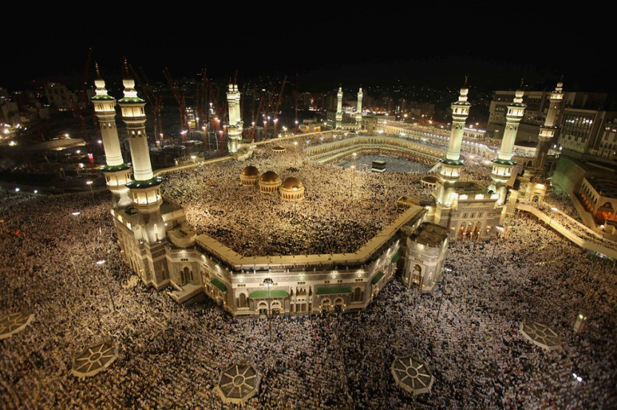
Essential Questions
How can religion influence the development of an empire?
How might religious beliefs affect society, culture, and politics?
The Annual Hajj. The Kaaba is in the background of the picture.

Slide 3
Why does it matter?
The successors to Muhammad were known as caliphs, rulers who became the secular and spiritual leaders of the Islamic movement. As the empire grew, caliphs became more like kings or emperors, which was an indication of the strength and power of the growing Arab Empire.

Slide 4
3.2 Lesson Vocabulary
caliph
Shia
vizier
caliphate
jihad
Sunni
sultan
Abu Bakr
Ali
Yarmuk
Mu’awiyah
Umayyad dynasty
Abbasid dynasty
Seljuk Turks
Hussein
Abu al-Abbas
Fatimid dynasty

Slide 5
Creation of an Arab Empire
Muhammad had no sons and never named a successor, leaving his followers with a problem: Who would leave the new community of Islam?
Abu Bakr was chosen to be the first caliph in 632, by Muhammad’s “inner circle”.
Wealthy merchant
Muhammad’s father-in-law
Muhammad’s companion on the Hijrah
Muhammad’s chief advisor

Slide 6
Creation of an Arab Empire quiz
Abu Bakr accompanied Muhammad on the Hijrah. Do you remember what the Hijrah was?
The journey of Muhammad and his small band of followers from Mecca to Medina in 622. (Year 1 in the Muslim calendar.)
Abu Bakr was the first caliph. What’s a caliph?
The successor to Herb Froman’s sausage empire.
The spiritual leader of all of Islam
The king of the Arabs
Religious and political successor to Muhammad

Slide 7
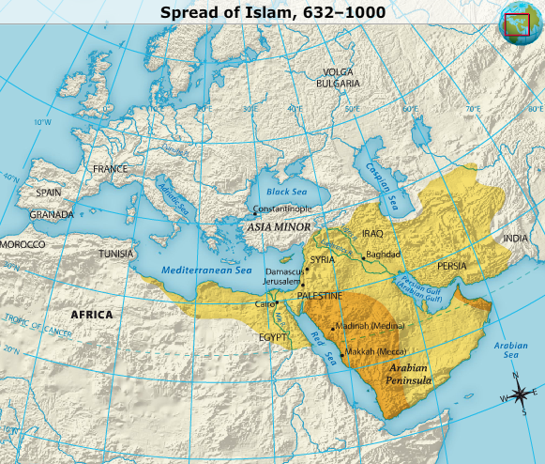
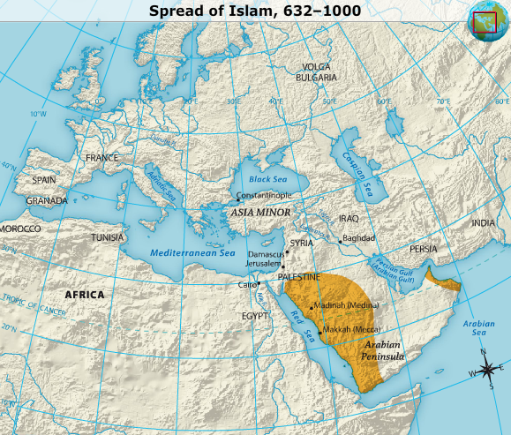
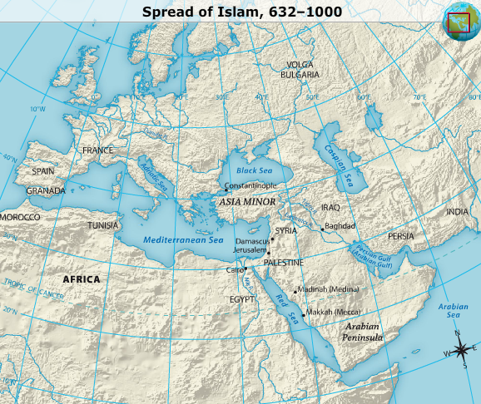
The Spread of Islam
Abu Bakr was extraordinarily successful
Spread of Arab Empire at
Muhammad’s death 632
Islamic expansion under
Abu Bakr 632-656

Slide 8
The Spread of Islam
Islam spread so quickly for a couple reasons:
The competent leadership of the first caliph – Abu Bakr.
Early generals were brilliant.
Islam’s major foes, the Byzantine Empire and Persia, were beaten down from constant war.
Warriors were promised a place in paradise if they died in battle, elevating war to Holy War.
Jihad.

Slide 9
The Concept of Jihad from the Quran
“Jihad” appears explicitly 41 times in the Quran.
[8.65] O Prophet! urge the believers to war; if there are twenty patient ones of you they shall overcome two hundred, and if there are a hundred of you they shall overcome a thousand of those who disbelieve,..
[4.74] Therefore let those fight in the way of Allah, who sell this world's life for the hereafter; and whoever fights in the way of Allah, then be he slain or be he victorious, We shall grant him a mighty reward.
[4.76] Those who believe fight in the way of Allah, and those who disbelieve fight in the way of the Satan. Fight therefore against the friends of the Satan...

Slide 10
The Concept of Jihad from the Quran
[9:30] And the Jews say: Ezra is the son of Allah; and the Christians say: The Messiah is the son of Allah; these are the words of their mouths; they imitate the saying of those who disbelieved before; may Allah destroy them; how they are turned away!
[2:191-193] And slay them wherever ye find them, and drive them out of the places whence they drove you out, for persecution [of Muslims] is worse than slaughter [of non-believers]... but if they desist, then lo! Allah is forgiving and merciful. And fight them until persecution is no more, and religion is for Allah.

Slide 11
Creation of an Arab Empire
Just as with Muhammad’s death, Islam faced a problem of succession after Abu Bakr died.
The first two caliphs after Abu Bakr were assassinated.
The 3rd caliph, Ali, was Muhammad’s son-in-law.
One of the first converts
Assassinated after ruling for five years.
The Shi’ite branch of Islam (Shia) accept only the descendants of Ali as true caliphs (spiritual and religious rulers of Islam).

Slide 12
The Split in Islam
Islam split into two groups, Sunni and Shia (or Shi’ite).
Sunni Muslims are the largest branch of Islam.
They accepted the caliphs who were not related to Ali.
Shi’ite (Shia) Muslims accept only the descendants of Ali as true caliphs.
As such, the split is a result of a difference in who should be the ruler of Islam.

Slide 13
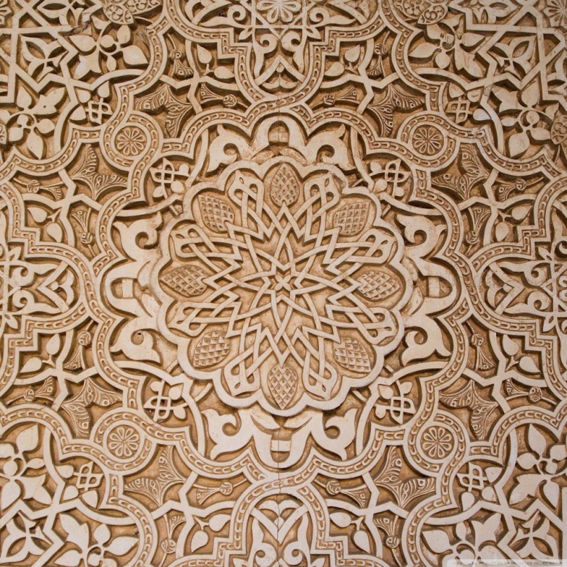
3.3 Lesson Vocabulary
bazaar
astrolabe
minaret
dowry
arabesques
muezzin
Arabesque Tile

Slide 14
Prosperity in the Islamic World
During the early centuries of Islamic civilization, urban centers (cities) in the empire flourished and trade networks reached to China, Europe, Africa, and India.
The bazaar, or covered market, was a crucial trading center in every Muslim city or town.

Slide 15
Social Structure
In Islam, all Muslim men are theoretically equal. In practice, this didn’t work out quite like that.
Muslim could not enslave other Muslims.
Muslim women were considered inferior creations.
Non-Muslims were not equal to Muslims and therefore could be enslaved.

Slide 16
Non-Muslims
Jews and Christians were sometimes tolerated and sometimes persecuted (depending on the ruler at the time).
When not persecuted, Jews and Christians paid a special tax – the dhimmitude – and were barred from certain jobs and schools.
What about other faiths?

Slide 17
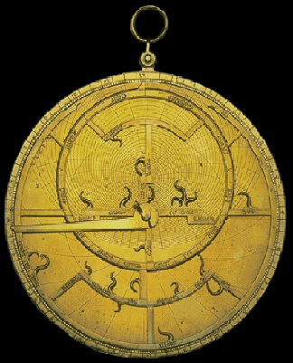
Philosophy, Science, and History
During the 700s, Islamic scholars translated the Greek works of Plato and Aristotle.
Perfected the astrolabe.
Navigation instrument
Expanded medical knowledge.

Slide 18
Literature, Art, and Architecture
Islamic art often used repeating geometric patterns called arabesques.
Islamic art was careful NOT TO depict Allah or Muhammad.
Early Islamic art did not create pictures of any living beings. Why would this be?
Muhammad had warned that creating pictures of living beings was imitating God.

Slide 19
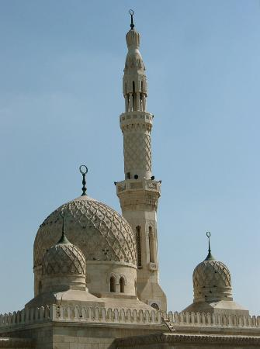
Mosques and the Call to Prayer
Muslims worship in mosques.
Many mosques have minarets. Minarets are tall towers from which the muezzin calls the faithful to prayer, five times a day.
Vocabulary: Muezzin – the crier who calls the faithful to prayer.

Slide 20
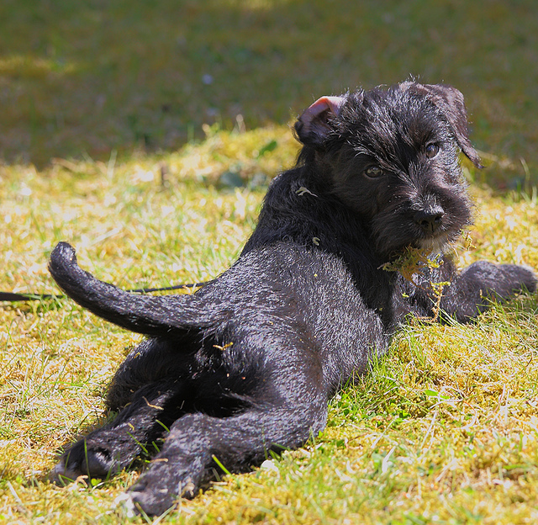
Looking back…

Slide 21
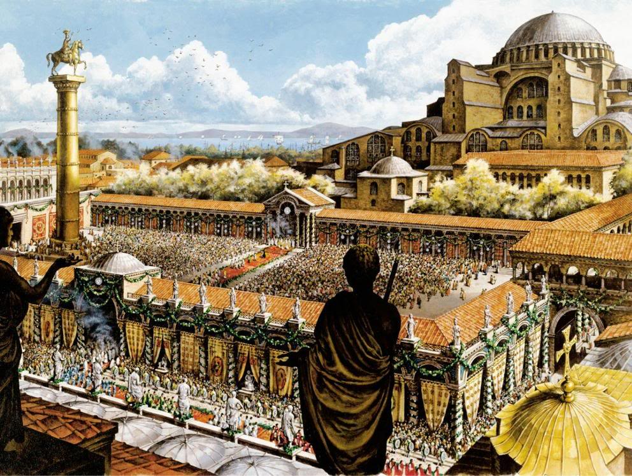
In the Catholic Church, the pope is the bishop of Rome. In the Orthodox Church of the Byzantine Empire, the head of the church is the patriarch of what city?
Rome
Constantinople
Jerusalem

Slide 22
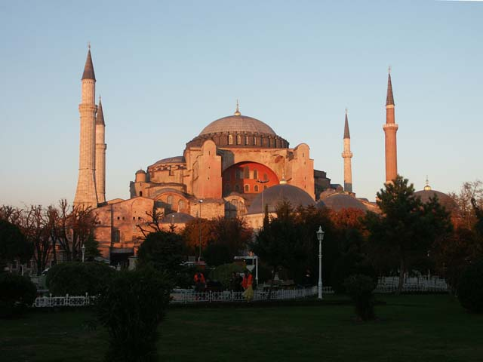
The Church of Hagia Sophia, Constantinople
Byzantine Empire
Today, a mosque, in Istanbul, Turkey

Slide 23
