Slide 1
The Age of Islam Chapter 3 Review
Mr. Wyka - World History

Slide 2
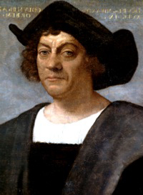
Who is it?
Christopher Columbus

Slide 3
Who is the final prophet of Islam?
Muhammed
Who was the first successor of Muhammad? Abu Bakr
What was his title? caliph

Slide 4
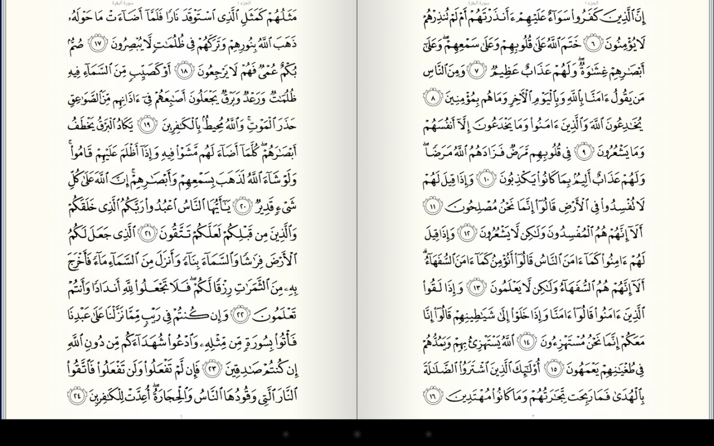
What is the name of Islam’s holy book?
Quran

Slide 5
Which of the following apply to Abu Bakr, the first caliph? (Check off all that apply.)
__X___ Wealthy merchant
__X___ Muhammad’s father-in-law
__x__ Muhammad’s companion on the Hijrah
__x___ Muhammad’s chief advisor

Slide 6
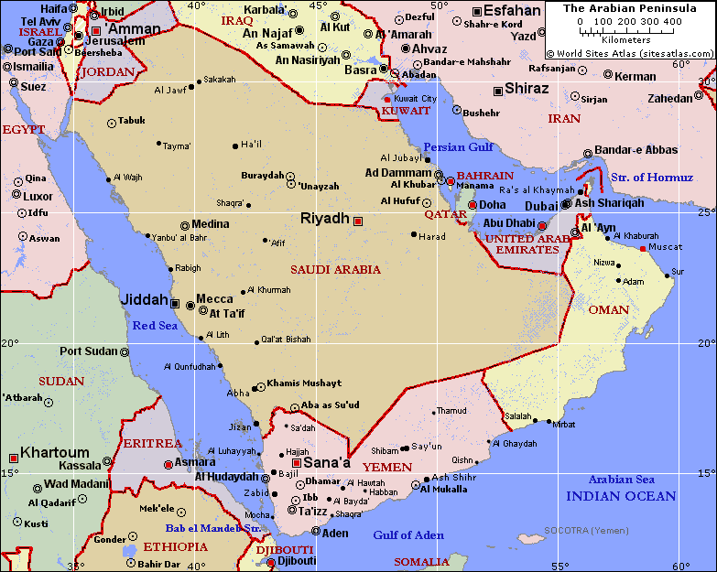
5. Arabs lived on the Arabian Peninsula in present day Saudi Arabia .
6. Arab society, before Islam, was tribal, with each tribe ruled by a sheikh.

Slide 7
Muhammad, the prophet of Islam, claimed revelations from God (Allah) through an angel. What was the angel’s name?
Gabriel
Before Islam, most Arabs were monotheistic. Is this statement true? False
How did Muhammad view Jesus?
As a prophet.

Slide 8
True or False. Muhammad’s messages were written down immediately after each revelation from the angel Gabriel.
False
What is the Islamic holy book called?
Quran

Slide 9
The principle teaching of the Quran is that there is only one God named Allah and Muhammed is his prophet.
13. Was Muhammad and his followers accepted in his hometown (Mecca)? No

Slide 10
The journey from Mecca to Medina in A.D. 622 is known as the Hijrah .
15. The beginning of the Islamic calendar is dated from what event? Hijrah
True or False. Muhammad was a religious leader, but not a political or military leader.
False

Slide 11
Islam is monotheistic. What does that mean?
Islam teaches that there is only One God.
18. What are the five pillars of Islam (English please):
1. True Belief 2. Pilgriimage – Hajj 3. Fasting during Ramadan
4. Prayer (5 times daily) 5. Charity

Slide 12
19. What is Arabic word for the pilgrimage to Mecca Muslims must take once in their lifetimes? The Hajj.
20. Would an iconoclast be “ok” with a religious statue? Absolutely Not!
21. What’s a caliph?
a. The successor to Herb Froman’s sausage empire.
b. The spiritual leader of all of Islam
c. The king of the Arabs
d. Religious and political successor to Muhammad
e. A governor of an Islamic province

Slide 13
22. Early Muslim warriors were promised a place in paradise if they died in battle.
23. What happened to the first two caliphs after Abu Bakr? They were assassinated.
Who was the 3rd caliph, Muhammad’s son-in-law?
Ali

Slide 14
25. What are the two main branches of Islam?
Sunni and Shia (Shi’ite)
26. Which branch of Islam accepts only the descendants of Ali as true caliphs?
Shia or Shi’ite
27. Which is the largest branch of Islam? Sunni

Slide 15
The split between the two branches of Islam is a result of:
a disagreement over who should be leader or caliph
29. The covered market, or BAZAAR was a crucial trading center in every Muslim city or town.
30. Choose the year most closely associated with the first caliph, Abu Bakr:
313 632 800 33 B.C. 120 B.C.

Slide 16
31. Jews and Christians in Muslim territory paid a special tax and were often barred from certain jobs and schools. This status was called the
dhimmitude
32. Repeating geometric pattern art is called arabesque.
33. In Islam, is it acceptable to have a statue of Muhammad in a mosque?
NAY! NAY!

Slide 17
34. Where do Muslims worship? A Mosque
35. What are the tall towers attached to Muslim houses of worship called?
minarets
36. What is the crier who calls the faithful to prayer called? muezzin

Slide 18
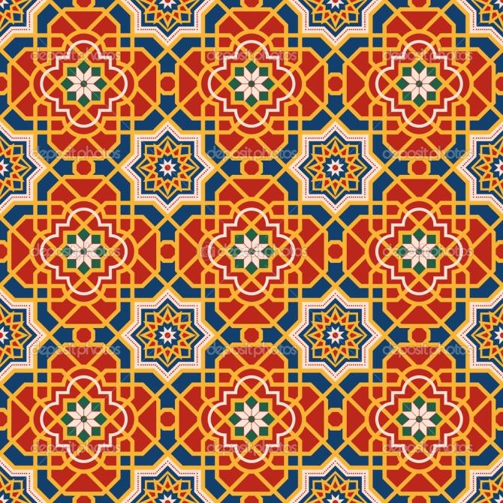
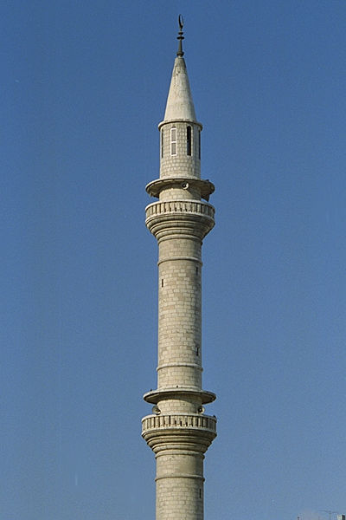
What type of art is represented in this picture?
Arabesque
38. What is represented in the picture below?
a minaret

Slide 19
What is the term for the amount paid by a wrongdoer to the family of a person he had injured or killed?
Weregild

