Slide 1
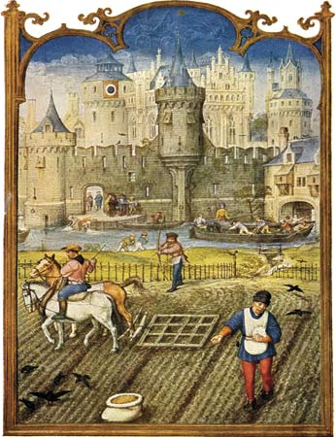
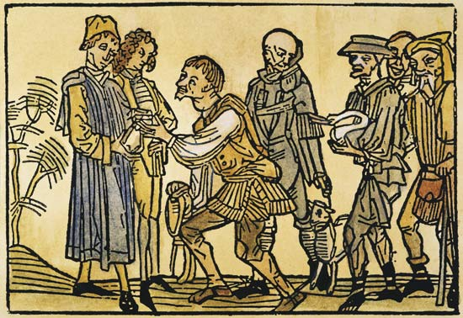
Chapter 4, lesson 1 FEUDALISM
Mr. Wyka - World History

Slide 2
Essential Questions
How can change to political systems impact economic activities?
How is society influenced by changes in political and economic systems?

Slide 3
Why does it matter?
Charlemagne’s long reign was an error of peace and centralized authority for his subjects. However, after his death, the Carolingian Empire was weakened. Local nobles become more important as people turned to them for the protection that the empire could no longer provide. The system that developed from this, was feudalism.
To sum up: Feudalism grew out of the break up of the Carolingian Empire.

Slide 4
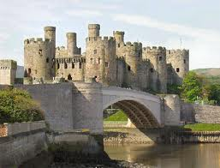
Lesson Vocabulary
feudalism
knight
feudal contract
chivalry
vassal
fief

Slide 5
The End of the Carolingian Empire
Guiding Question:
What internal and external factors after Charlemagne’s death weakened kingdoms in Europe?

Slide 6
The End of the Carolingian Empire
Less than 30 years after Charlemagne’s death in 814, his empire was divided among his grandsons.
The West Frankish lands
The East Frankish lands
The Middle Kingdom

Slide 7
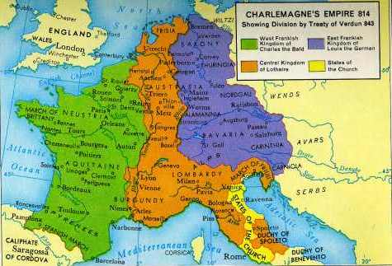
After Charlemagne’s Death

Slide 8
In the 9th and 10th centuries, Western Europe was beset by a wave of invasions.
The Vikings, or Northmen, of Scandinavia were the most far-reaching of these invaders.
Vikings were traders as well as raiders.
After a century of raiding, Viking groups began to settle in the areas they raided.
The most famous example of this was in 911, when a band of Vikings under Rollo were given a strip of land along the English Channel by the west Frankish king.
The land they settled came to be known as Normandy (land of the Northmen) and the people there, Normans.
The Frankish policy of settling the Vikings and converting them to Christianity worked.

Slide 9
Remember the Guiding Question: What internal and external factors after Charlemagne’s death weakened European kingdoms?
The Viking invasions.
Were they an internal factor or an external factor?
External
The fighting between the heirs of Charlemagne.
Internal factor or an external factor?
Internal

Slide 10
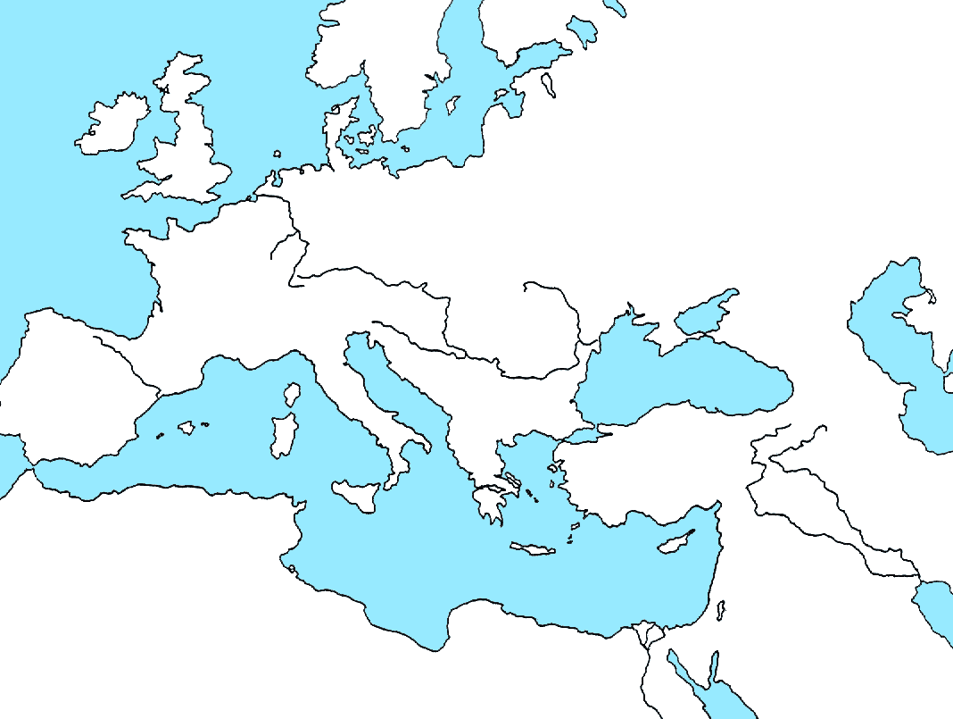
Where did the Vikings come from?
Scandinavia
Denmark
Norway
Sweden

Slide 11
The Development of Feudalism
Guiding Question:
Why did the collapse of governments lead to a new political and social order – feudalism?

Slide 12
The Development of Feudalism
The Empire had collapsed.
Europe was beset by invaders.
To survive, people turned to landed aristocrats, or nobles, for protection.
It became important to find a powerful lord who offer protection in return for service.
This exchange, protection for service, led to FEUDALISM, a new political and social order.
At the heart of the feudal order was the idea of vassalage.

Slide 13
Knights and Vassals
By the 8th century, a warrior who served a lord in return for a fief was known as a vassal.
In return, the lord took care of the vassals needs.
Two technological advances led to the introduction of a new warrior, the armored knight.
Introduction of larger horses.
Invention of the stirrup.
Knights dominated warfare in Europe for nearly 500 years.

Slide 14
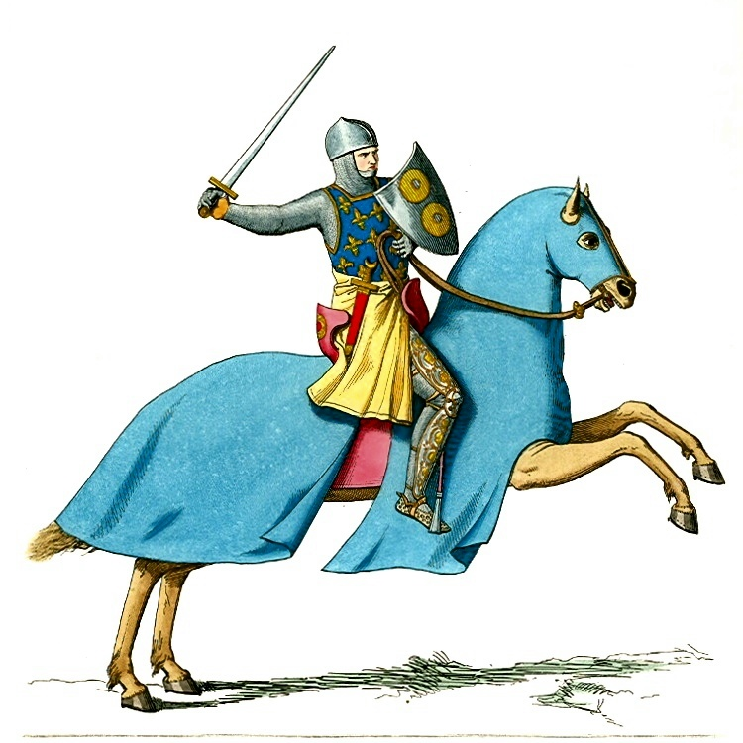

Slide 15
Knights and Vassals and the Feudal Contract
In the Early Middle Ages, wealth was based primarily on…
LAND
A powerful lord would grant his vassals a parcel of land of their own.
In return, the vassals (knights) agreed to fight for the lord.
This grant of land made to a vassal was known as a fief.

Slide 16
The Feudal Contract
What was the chief virtue in feudal society?
Loyalty to one’s lord.
The relationship between a lord and his vassal was an unwritten set of mutual obligations known as
The Feudal Contract
The vassals primary obligation was military service when summoned (usually 40 days / year).
The lord granted the vassal his fief, defended him militarily, and took his side in disputes.

Slide 17
Remember the Guiding Question: Why did the collapse of governments lead to the new political and social order known as feudalism?
People needed protection from invaders and lawlessness and turned to the only means of protection available, the landed (land owning) aristocracy (nobles). In return, the nobles expected service from the people.

Slide 18
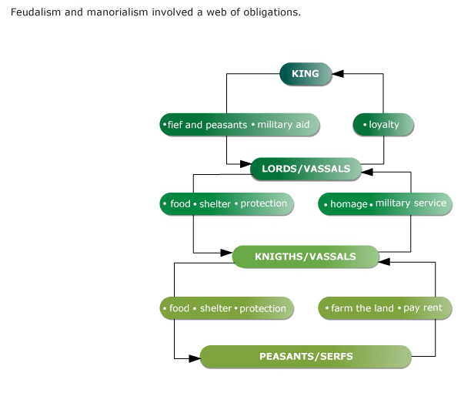

Slide 19
The Nobility of the Middle Ages
Guiding Question:
How was European feudal society structure?

Slide 20
Nobility
European feudal society was dominated by warriors.
Men whose chief concern was warfare.
The tournament grew out of this situation.
The Catholic Church promoted the idea of CHIVALRY.
A code of ethics knights were supposed to uphold.
Among it’s ideals was a higher status for women. For example, women were to be treated with tenderness and respect, not as property.

Slide 21
Women in the Early Middle Ages
Women could legally hold property.
Aristocratic women grew in power as their husbands were more and more away.
The Lady of the Castle was responsible for the day-to-day functioning of a vast estate, essentially a large business.
Women were expected to be subservient to men (although this didn’t always happen), but lords and knights were expected (chivalry) to treat women respectfully.
The Middle Ages also saw the spread of the idea of Romantic Love.

Slide 22
Remember the Guiding Question: How was European feudal society structured?
Society was dominated by warriors and power, political and economic, was held by the nobility – kings, dukes, counts, barons, even bishops. Women had rights of property ownership and ideally, were respected and upheld, but were considered subservient to men.

Slide 23
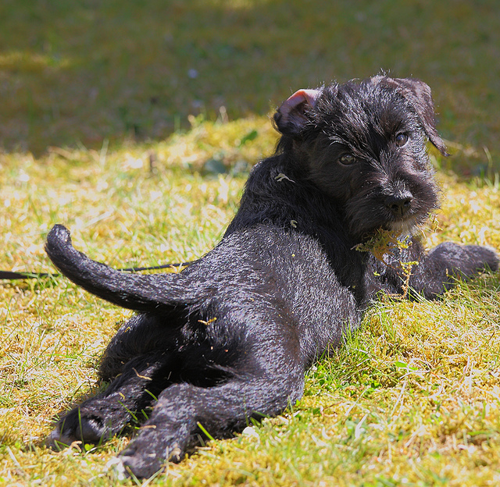
Looking back…

Slide 24
The Arabic name for the journey of Muhammad and his followers to Medina (Madinah) from Mecca (Makka).
Hijrah

Slide 25
