Slide 1
Chapter 4, lesson 3 The Growth of European Kingdoms
Mr. Wyka - World History

Slide 2
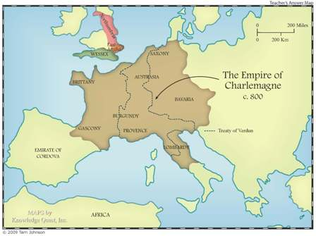
Europe in the Age of Charlemagne the Emperor, c. 800

Slide 3
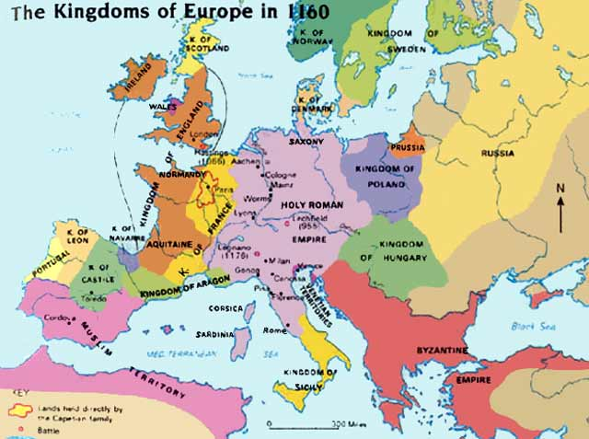

Slide 4
Essential Questions
How can change to political systems impact economic activities?
How is society influenced by changes in political and economic systems?

Slide 5
Why does it matter?
The domination of European society by the nobility reach its high point between 1000 and 1300 – the High Middle Ages.
During this time, monarchs (kings) began extending and centralizing their power, creating larger European kingdoms out of which grew the modern nation-states of Europe.

Slide 6
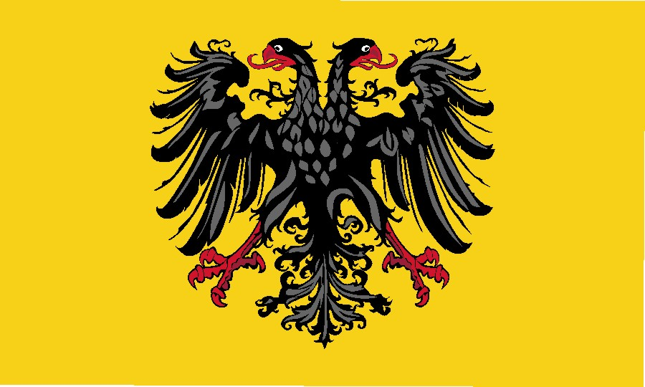
Lesson Vocabulary
common law
Magna Carta
Parliament
estate
Crest of the Holy Roman Empire

Slide 7
England
Guiding Question:
What HUGE event in 1066 changed English society, law, and the course of English history?

Slide 8
Anglo-Saxon England
From the 800s to 1066, England had been ruled by Anglo-Saxon kings.
Angles and Saxons – Germanic tribes who had invaded England in the 400s.
England - derived from the Old English name Englaland which means "land of the Angles"

Slide 9
Here come the Normans
Do you remember this from our presentation on Feudalism?
… in 911, a band of Vikings under Rollo was given a strip of land along the English Channel by the west Frankish king.
The land they settled came to be known as Normandy (land of the Northmen) and the people there, Normans.
The Frankish policy of settling the Vikings and converting them to Christianity worked.

Slide 10
The Norman Conquest
In 1066, William of Normandy crossed the English Channel at the head of an army of heavily armed knights.
The invasion of England
Defeated the Anglo-Saxon King Harold.
Harold had just come from a battle in which he defeated an army of invading Vikings.
English land was divided among Norman nobles and knights.

Slide 11
Effects of the Norman Conquest
Anglo-Saxon and French (the language spoken by the Normans) merged to form a new English language.
Middle English.

Slide 12
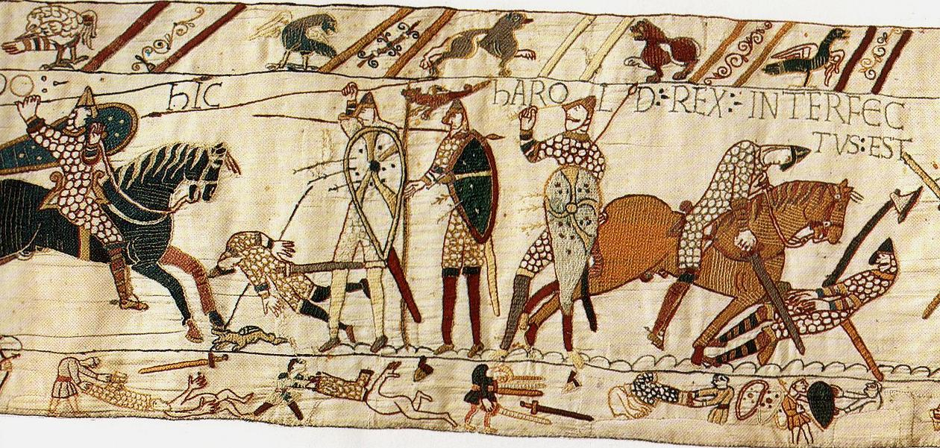
A section of the Bayeux Tapestry detailing the Norman invasion of England.

Slide 13
Remember the Guiding Question: What HUGE event in 1066 changed English society, law, and the course of English history?
The Norman invasion

Slide 14
King Henry II
1154 to 1189
Increased the power of the English Monarchy
Established Royal Courts throughout England.
Created a body of “Common Law” – law the was common to the whole kingdom.
Why would a “common law” of the kingdom be better than each county having its own law?

Slide 15
Henry II and the Church
Tried to impose royal control on the Catholic Church.
Opposed by Catholic bishops
Archbishop Thomas a Becket
Murdered by knights of the king.
King was forced to back down from his battle against the Church.

Slide 16
Magna Carta
King John of England forced to sign the Great Charter in 1215.
Limited king’s power over nobles.
Set the precedent that a monarch’s power was NOT absolute.
Did nothing for the common folk.

Slide 17
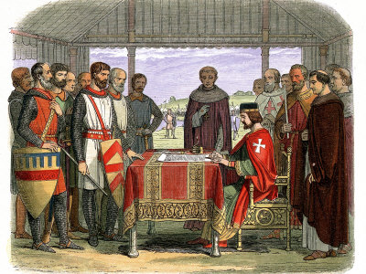

Slide 18
English Parliament
Emerged in the 13th century.
Early institution of representative government.
Granted taxes, discussed politics, passed laws.
Limited the kings’ powers.

Slide 19
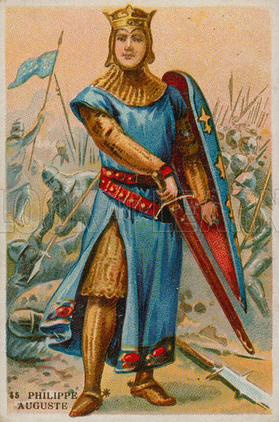
France in the High Middle Ages
King Philip II Augustus
1180 to 1223 (spanning King Henry II and King John of England’s reigns)
Expanded the power of the French monarchy.
Fought wars with England to reclaim French land..

Slide 20
France in the High Middle Ages
Philip IV
1285-1314
Created the Estates General (French version of Parliament)
First Estate – Clergy
Second Estate – Nobles
Third Estate – townspeople & peasants

Slide 21
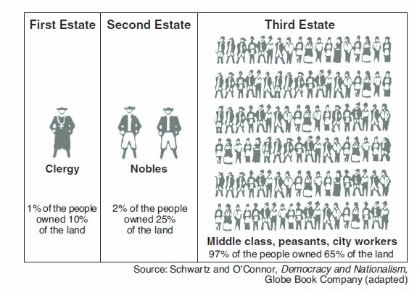

Slide 22
The Holy Roman Empire
Grew out of the eastern Frankish kingdoms
Otto crowned emperor of the Romans in 962
1st time title used since Charlemagne in 800.
The German emperors were weak and reliant on the power of German princes and nobles.
Power struggles with the Church and ambitious nobles kept the emperor weak.

Slide 24
Central and Eastern Europe
Slavic peoples settled in Eastern Europe and eventually formed kingdoms.
Catholic Christianity converted the peoples of the western portion of Eastern Europe
Poland
Hungary
Czechs
Orthodox Christianity converted the eastern portion of Europe
Kievan Russia

Slide 25
To Sum Up
The High Middle Ages – 1000 to 1300 – saw kings grow in power in France and England while the Holy Roman Emperor held little real power.
The Catholic Church experienced a schism (break) between the western Church (Catholic) and the eastern Church (Orthodox).
Early representative government institutions were established in England (Parliament) and France (Estates General).

Slide 26
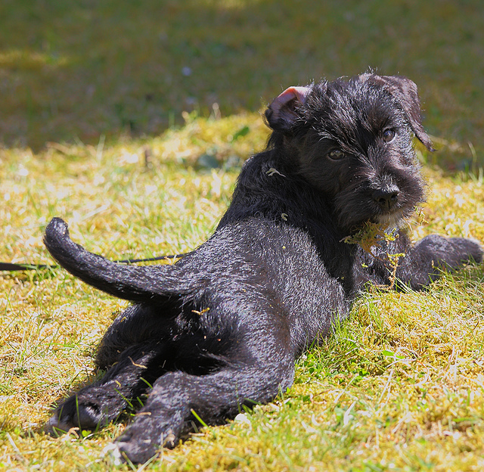
Looking back…

Slide 27
The western Roman Empire fell in A.D. 476, but the eastern Roman Empire, centered in Constantinople, continued for another 1000 years. What do historians call the eastern Roman Empire?
The Byzantine Empire

