Slide 1
Can you Describe in detail, three similarities between the Roman and Han Empires, using complete sentences ?
Here’s a great example of one similarity. It has a main idea and supporting details: “One similarity between the Roman and Han empires was that the family was headed by an all-powerful patriarch. The values first learned in the family were obedience, respect for superiors, piety, and a strong sense of duty and honor.”
Can you add two more?

Slide 2
Classical Civilizations in India and China Period 2 – 600 B.C. to A.D. 600 Amsco World History chapter 5
Mr. Wyka – AP World History

Slide 3
Emperor Ashoka
Emperor of Mauryan India
Converted to Buddhism (from Hinduism)
Became tolerant and non-violent
Instead of sending armies abroad to conquer violently, he sent Buddhist missionaries abroad to spread the Buddhist message.
Stone pillar edicts.
Stupas

Slide 4
Emperor Ashoka
Shares similarities with the early Persian emperors Cyrus and Darius.
Tolerant of other religions within the empire

Slide 5
Buddhism
Although born in India, it eventually became more popular outside of its country of origin.

Slide 6
Jainism
All creatures are part of a larger soul, or Bhrahma.
Unique from Buddhism and Hinduism but shares aspects of both.
Jainism’s ethical standards influenced later generations.

Slide 7
Hinduism & Buddhism
Comparison: Both teach that individuals go through repeated cycles of birth and death.
Contrast: Buddhism does not acknowledge the Caste System of Hinduism.
Would this make Buddhism MORE or LESS appealing to Lower Caste Indians?

Slide 8
Gupta Dynasty
India
Time of Technological advancement
However, role of women declined
Sati
Numerical symbols we use today, 0 to 9, were learned from Gupta India.
Much smaller and decentralized than the earlier Mauryan Empire.

Slide 9
Pax Romana
The Peace of Rome
The idea that, while Rome might be at war on the frontiers, peace & trade reigns within the empire.
Pax Sinica
The Peace of China
The idea that, while China might be at war on the frontiers, peace & trade reigns within the empire.

Slide 10
Daoism
Peace and harmony with the natural world
Contrasts most highly with Legalism

Slide 11
Confucius
Most concerned with creating and maintaining a good, orderly society.
The way to do that is through proper relations, or treating others properly within your station in life (social standing).

Slide 12
Early American Civilizations Amsco World History chapter 6
Mr. Wyka – AP World History

Slide 14
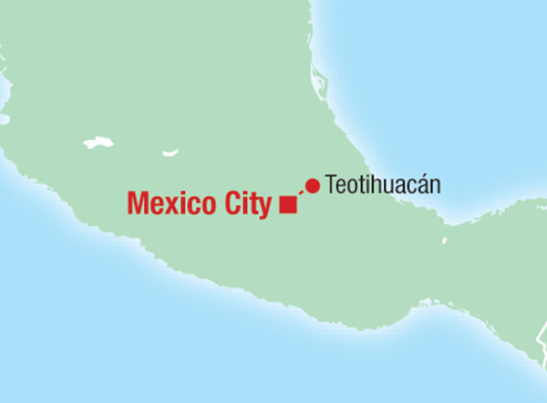
City of Teotihuacan
City arranged on a grid pattern (a sign of a strong, centralized gov’t).
Most of the people lived in one large city, rather than many small cities (like the Maya).

Slide 15
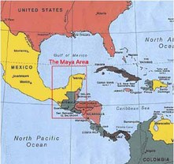
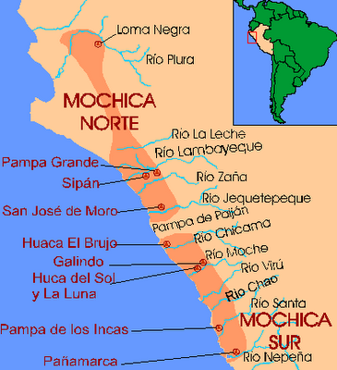
Moche vs. Maya
Similar in that both cultures emphasized the idea of communal work.

Slide 16
Moche Social Structure
Organized around ayllus.
Small communities based on the idea of communal work.
A woman could belong to both her husband’s ayllus and her birth family’s.

Slide 17
MesoAmerica vs. South America
Mesoamerica – Mexico and Central America.
Aztec, Teotihuacan, Olmec, Mayan
South America
Moche, Inca, Chavin
These cultures share similarities such as strong, centralized imperial governments and ritual sacrifice to the gods.
Llamas however, were unique to South America and were used to produce wool and as a light pack animal.

Slide 18
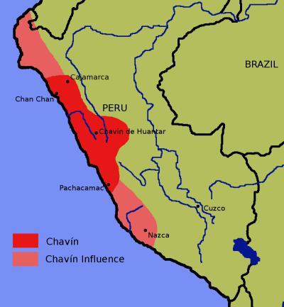
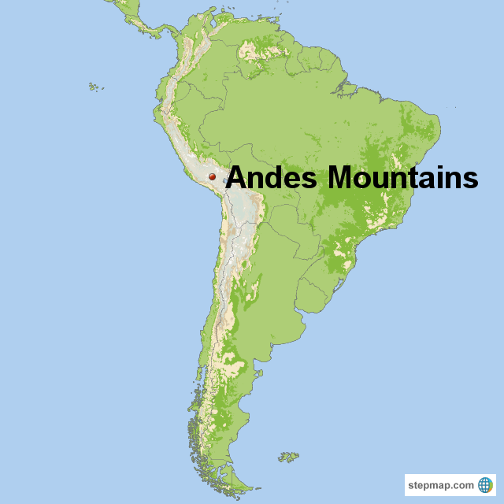
Chavin and Moche
Both cultures lived in the high elevations of the Andes mountains in South America.

Slide 19
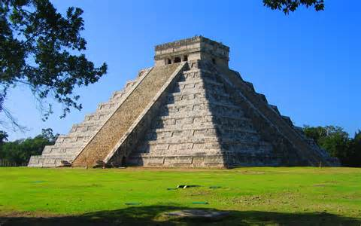
Megalithic Architecture
BIG BUILDINGS
Mayan
Shows the ability of a society to organize a large labor force. Implies a strong centralized government or a strong leader.

Slide 20
How did the pyramids of the Mayans differ from those of the Egyptians?

Slide 21
Mayan Culture
By the Tenth Century (900s C.E.), people were abandoning the cities of the Yucatan Peninsula for the countryside.

Slide 22
Can you locate on a map?
Han China
The Gupta Empire
The Mayan civilization
The Mauryan Empire
The city of Teotihuacan
The Chavin culture.

