Slide 1
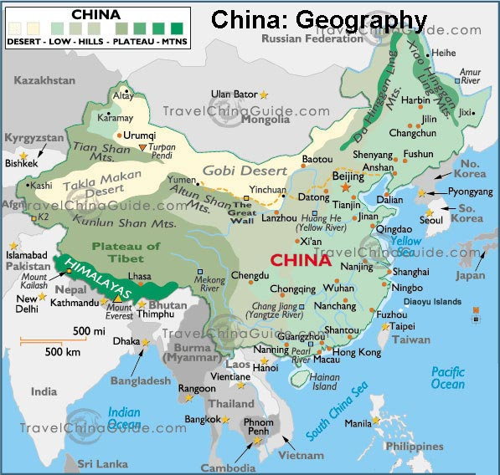
Ancient China
Mr. Wyka – AP World History
When? 1750 B.C.E. to 220 C.E.
Where? East Asia
Physical Geography of China

Slide 2
Today and tomorrow, we will continue our study of ancient China.
There will be an open notes quiz after we complete our discussion of Ancient China. If you are absent any of these days we cover China, you will still take the quiz.
It’s on the Weebly.

Slide 3
Main Ideas
Chinese dynasties followed a rise and fall pattern.
Three schools of philosophy emerged – Confucianism, Daoism, and Legalism – seeking to spell out principles that would create stability and order in society.

Slide 4
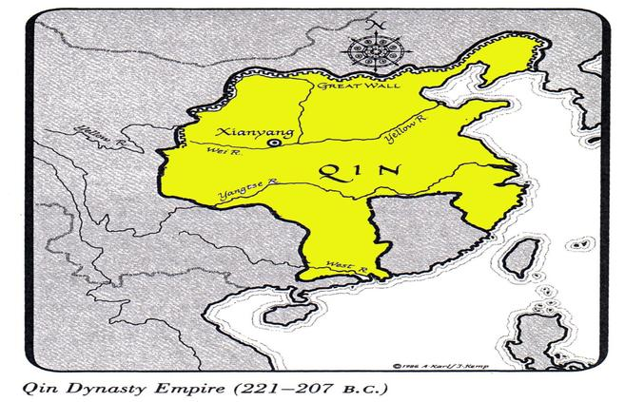
The Geography of China
Two great rivers dominated the growth of Chinese civilization.
The Huang He, or Yellow River
The Chang Jiang, or Yangtze River

Slide 5
The Shang Dynasty 1750 – 1122 B.C.E.
Little is known about the dynasty preceding the Shang – the Xia (SYAH) dynasty.
China under the Shang was a mostly farming society ruled by an aristocracy whose major concern was war.
Political Structure:
Monarchy – powerful king responsible for defending the realm.
Aided by a aristocratic families.
Comparison:
Like rulers in Mesopotamia and Egypt, early Chinese kings were buried with the corpses of their faithful servants in the royal tombs.

Slide 6
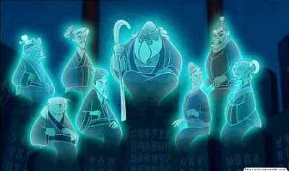
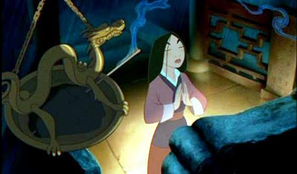
The Shang Dynasty 1750 – 1122 B.C.E.
Religion and Culture:
Strong belief in life after death.
Veneration of ancestors (“ancestor worship”) grew from this.

Slide 7
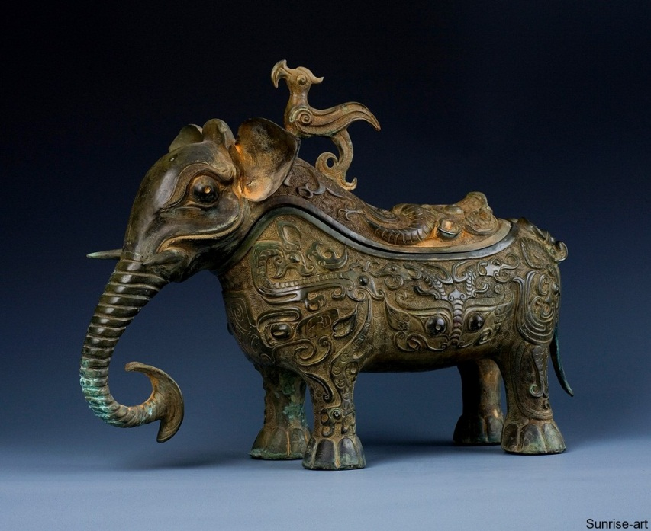
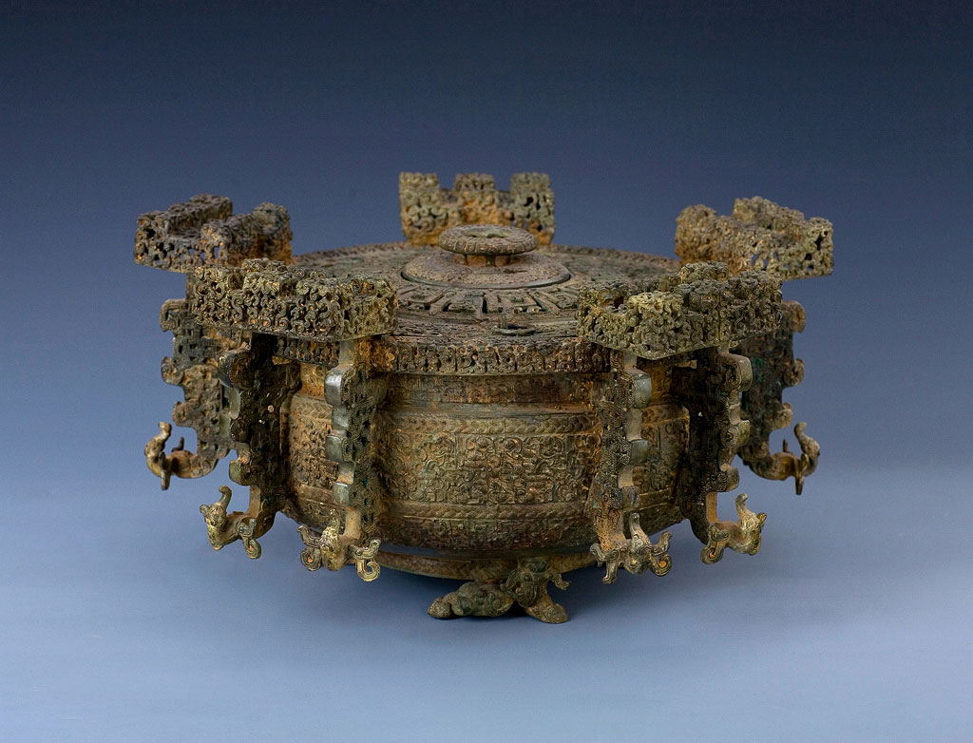
The Shang Dynasty 1750 – 1122 B.C.E.
Early Masters of Bronze casting
Copper & Tin alloy

Slide 8
The Zhou (Joe) Dynasty 1045-256 B.C.E.
Rulers of the state of Zhou rebelled against the last Shang emperor believing him wicked and that Heaven no longer favored him (Mandate of Heaven).
Longest lasting dynasty in Chinese history.
Political Structure:
Monarchy – powerful king responsible for defending the realm.
Governing officials were members of the aristocracy.
Essentially the same as the Shang

Slide 9
The Zhou (Joe) Dynasty 1045-256 B.C.E.
Mandate of Heaven
Zhou kings claimed they ruled by authority from Heaven.
King was expected to rule according to the proper “Way” – the Dao.
Double edged sword – presupposes a “right of revolution” to overthrow a ruler who has lost Heaven’s Mandate.

Slide 10
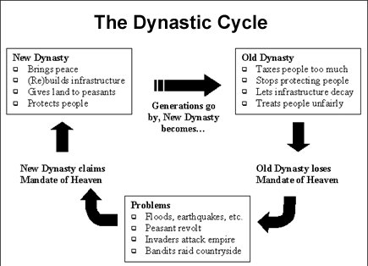

Slide 11
The Fall of the Zhou
Later Zhou rulers became corrupt and more interested in their palace pleasures than ruling wisely.
Rebellion followed.
Period of the Warring States
Almost 200 years of civil war.
Power reverted to local lords (feudalism)
Hundreds of new philosophies were born trying to make sense and order out of chaos.
Daoism, Confucianism, and Legalism
The state of Qin defeated its enemies and united China.

Slide 12
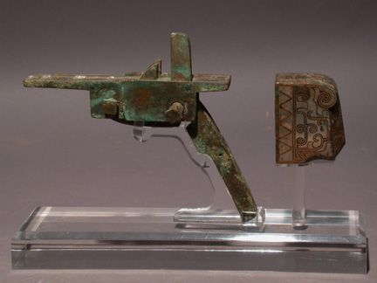
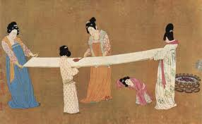
New Technologies
By the Period of the Warring States:
Iron replaced bronze in weapons.
Powerful crossbow invented.
Large scale irrigation & Iron plowshares increased food production leading to ….
A population explosion
Long Distance Trade
Chinese SILK monopoly
Important trade item.
Found as far away as Greece during this early period.

Slide 13
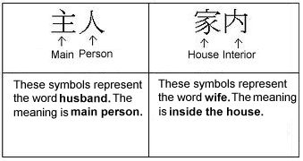
Family in Ancient China
The Family was the basic economic and social unit.
Symbol of the entire social order.
Filial Piety – Duty of family members toward the male head of the family.
Filial Piety is an important concept in Confucianism.
Male supremacy
Women subordinate.

Slide 14
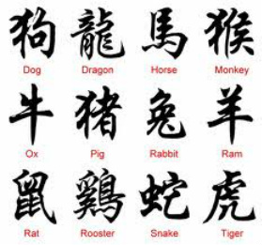
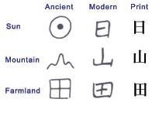
Chinese Written Language
Pictographic and ideographic
Symbols represent an object or idea
Different than phonetic alphabetic systems

Slide 15
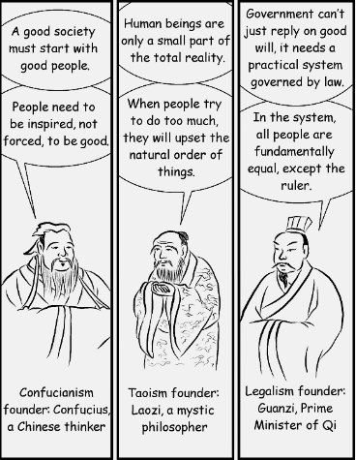
Chinese Philosophies
Difference:
Hindus and Buddhists (Indian systems) focused on freeing the soul from the cycle of rebirth.
Chinese philosophies focused on the immediate world and how to create a stable societal order.

Slide 16
Confucianism
Enduring part of Chinese culture.
Studied by every Chinese student until the communist take-over in the mid 20th century.
Ethical system, not spiritual
Two elements stand out:
Duty and humanity
Duty - Family, society, and the emperor are more important than self.
Humanity – compassion and empathy for others.

Slide 17
“If there is righteousness in the heart, there will be beauty in character. If there is beauty in the character, there will be harmony in the home. If there be harmony in the home, there will be order in the nation. If there be order in the nation, there will be peace in the world.”
- Confucius

Slide 18
Confucianism
Confucian political thought:
The idea that government should not be limited only to those of noble birth, but should be open to men of superior talent.
A radical idea at the time.
Opened the door to the “Civil Service” exams used in later dynasties to find qualified bureaucrats.

Slide 19
Daoism
Tries to set forth proper forms of behavior for Chinese.
In this way, similar to Confucianism
Difference
Confucians believe hard work is a duty.
Daoists believe the true way to follow the will of Heaven is not action, but inaction.
Harmony with nature.

Slide 20
Legalism
Differences from Confucianism and Daoism:
Humans are evil by nature
Can only be brought to follow the correct path by harsh laws and stiff punishments.
Advocated a strong ruler and a rigid set of laws.

Slide 21
Let’s hear what John Green has to say about the Mandate of Heaven.

Slide 22
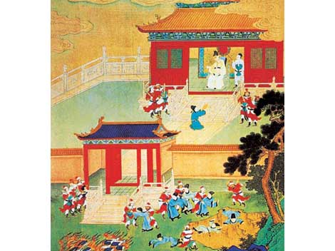
Ancient China The Qin and the Han
Mr. Wyka – AP World History
When? 221 B.C.E. to 220 C.E.
Where? East Asia
As a Chinese ruler looks on, books are burned and scholars are killed.

Slide 23
Main Ideas
The short lived Qin and the longer lived Han dynasties established strong, imperial central governments that set the precedent for future Chinese dynasties.
The nearly 400 year Han dynasty was contemporaneous with the Roman Empire.

Slide 24
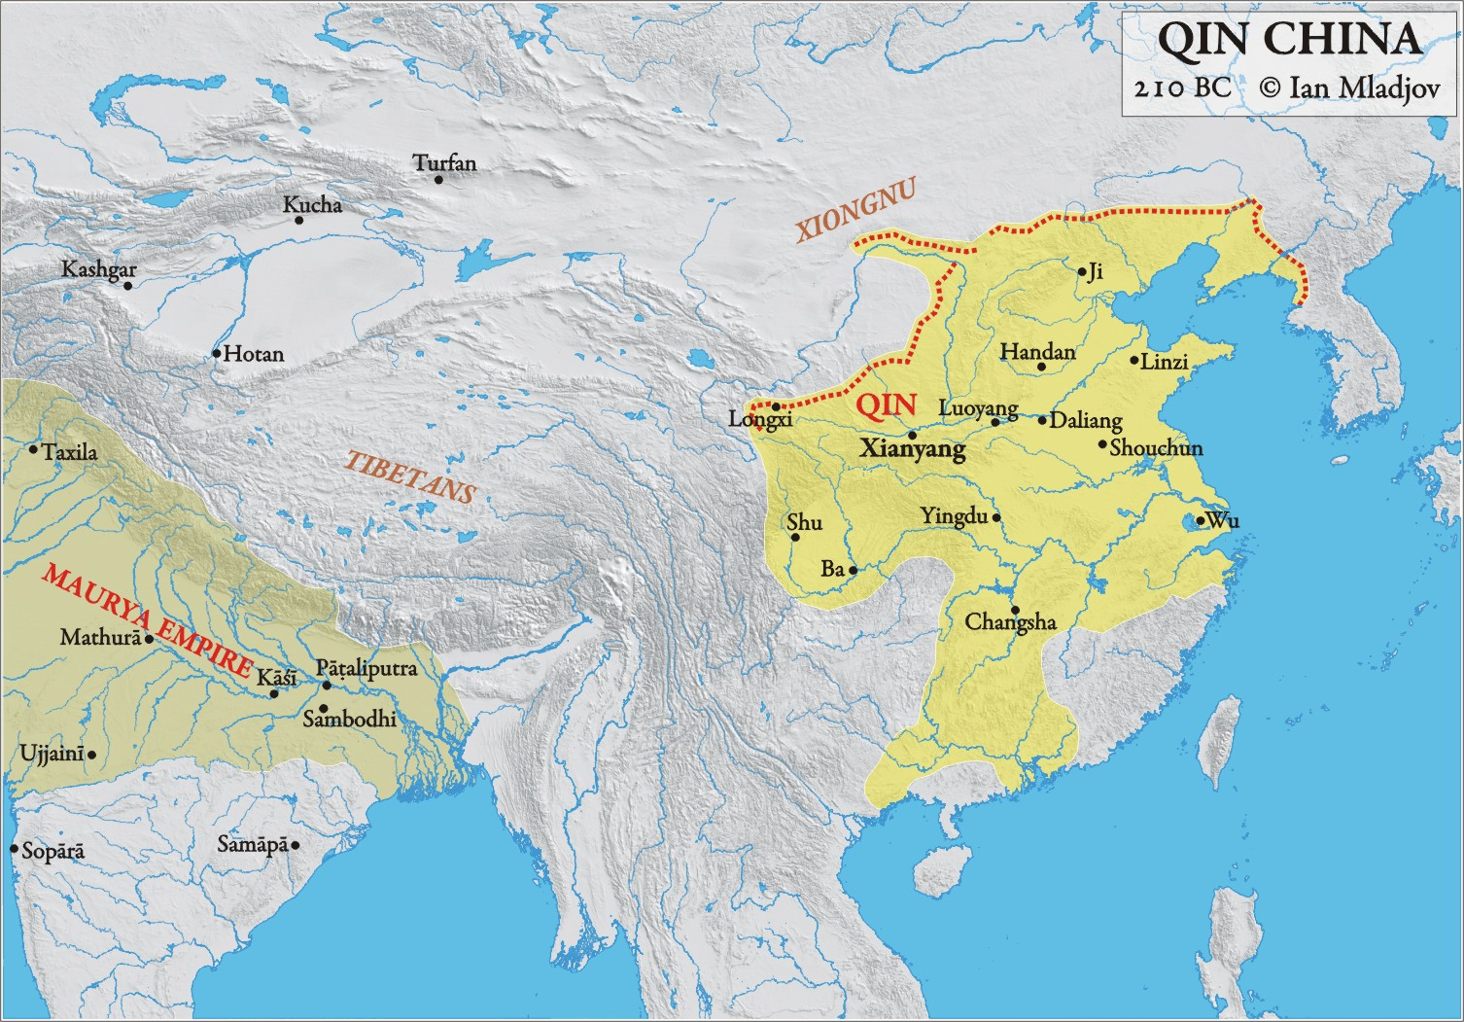

Slide 25
Rise and Fall of Dynasties
Shang
Zhou
Period of Warring States
Qin
Han

Slide 26
Emergence of the Qin
For 200 years, China was embroiled in Civil War – the Period of Warring States.
The state of Qin gradually defeated its rivals and declared that the Mandate of Heaven was upon it.
A new dynasty was born – the Qin (Chin).

Slide 27
Changes under the Qin
Adopted Legalism as the govt’s official idealogy.
Opposition views were treated harshly
Executions, land seizures, book burnings.
Highly centralized state
Multi layered bureaucracy
Qin Shihuangdi unified (by force) the Chinese world.
Single monetary system
System of roads

Slide 28
Qin Works
System of roads
Canal running north and south to connect the great rivers.
Later dynasties would expand this.
Expanded the northern defensive walls - the Great Wall
Built upon by later dynasties
To defend against the Xiongnu, nomadic steppe horsemen.

Slide 29
Qin Shihuangdi – the First Emperor
Chinese historian Sima Qian wrote of Qin Shihuangdi, that aristocrats and Confucian intellectuals, as well as common people, groaned under the censorship of speech, harsh taxes, and forced labor projects.
“He killed men as though he thought he could never finish, he punished men as though he were afraid he would never get around to them all, and the whole world revolted against him.”
His dynasty was overthrown 4 years after his death.

Slide 30
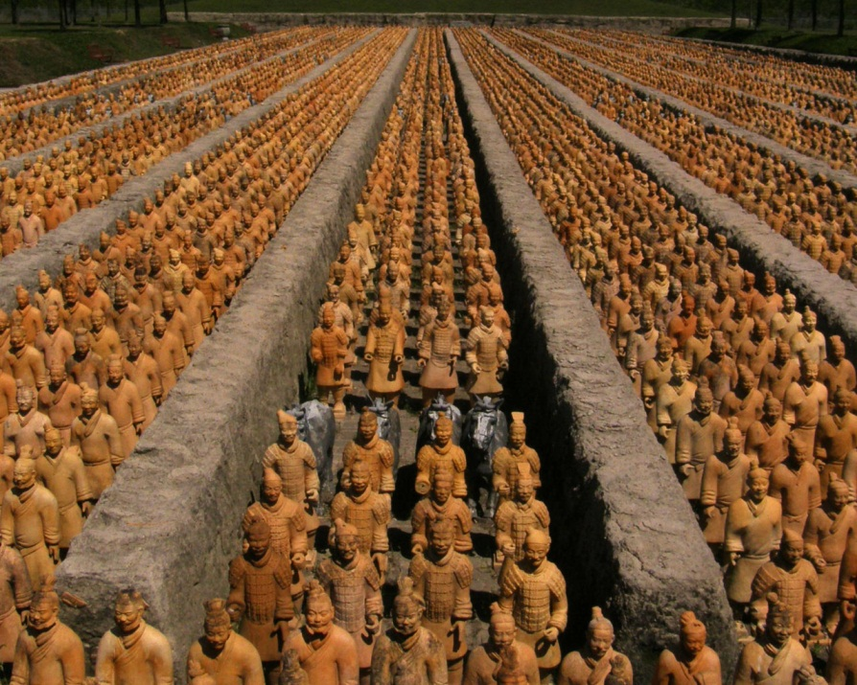
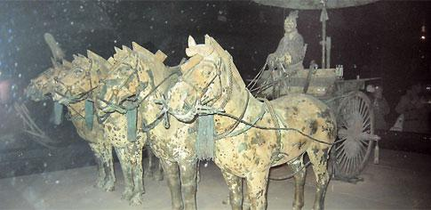
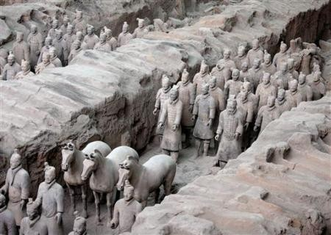
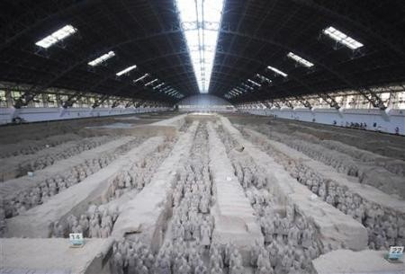
His Power – Even in Death

Slide 31
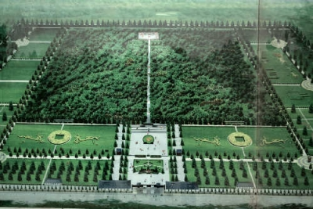
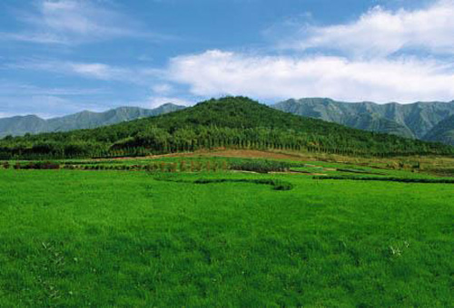

Slide 32
Swap Notes with a Neighbor. Skim your neighbor’s notes. Is there anything you missed? Is there anything he or she is missing?

Slide 33
Fall of the Qin
The harshness of Qin Shihuangdi’s rule angered many Chinese and his dynasty was overthrown.
It had lasted less than 20 years but is remembered as the first dynasty to truly set the precedent for strong, imperial, centralized rule.
Important!

Slide 34
The Han Dynasty 202 B.C.E. – 220 C.E.
Liu Bang - founder
Of peasant origin
Political Structure
Discarded the harsh policies of the Qin
But kept the Qin structure of gov’t
Divided into 3 bureaucracies – military, civil service, and censorate
Confucian principles replaced Legalism
Introduced the Civil Service Examination and schools for these candidates.
Influenced Chinese civilization for 2000 years.
Important!

Slide 35
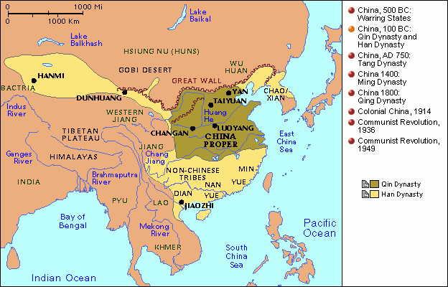
Expansion of the Han
By its nature, an empire must continue to expand to survive.
Han emperors expanded the empire to new boundaries
Parts of Korea were added to the empire.
Han Wudi (Martial Emperor of the Han) added territory as far south as Vietnam.

Slide 36
Han Society
Han period one of great prosperity
Taxes relatively light but military service and forced labor for up to one month per year were required.
Population tripled
This reduced the size of family farms to about 1 acre / person, barely enough to survive
Many farmers sold their land and became tenant farmers (similar to European serfs).
Land once again came to be held by a minority of rich, landed aristocrats.

Slide 37
The Role of Women in the Han Dynasty
Women in the Han Dynasty were viewed as inferior to men.
Women were not allowed to be educated.
The primary role of women was childbearing, raising children, and household duties such as cooking and cleaning.
Women had no say in any family matters except those related to child raising.
The exceptions to this rule were the empresses of the Dynasty. If they succeeded in getting their young son to the throne, they could act as a de facto emperor

Slide 38
Han Technologies
Advances in
Textile manufacturing (cloth)
Water mills (grinding grain)
Iron casting
Paper making
Invention of the rudder and fore and aft rigging allowed ships to sail into the wind for the first time
Expanded trade as far away as India and the Mediterranean.

Slide 39
Fall of the Han
As with the Zhou, weak rulers were more interested in palace amusements than ruling.
Imperial power declined and the noble families filled the vacuum.
Corruption
Raids from the northern nomads
China plunged into a period of civil war that would last 400 years.
Question: What happens when centralized power crumbles?

Slide 40
Looking back…

Slide 41
Name two religions native to India…
Hinduism and Buddhism

Slide 42
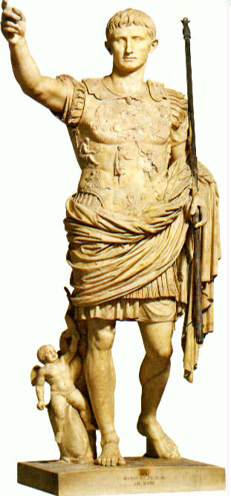
First Roman emperor?
Julius Caesar
Hannibal of Carthage
Alexander the Great
Augustus (Octavian)

