Slide 1
The Renaissance in Europe 1350-1600 Chapter 9, lesson 1 The Italian States
Mr. Wyka - World History

Slide 2
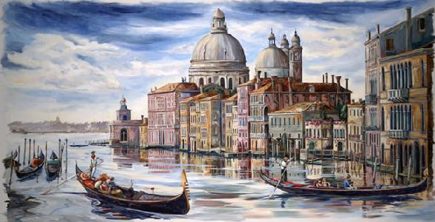
Essential Questions
How can trade lead to economic prosperity and political power?
What innovations of the Renaissance have affected our lives today?
Renaissance Venice

Slide 3
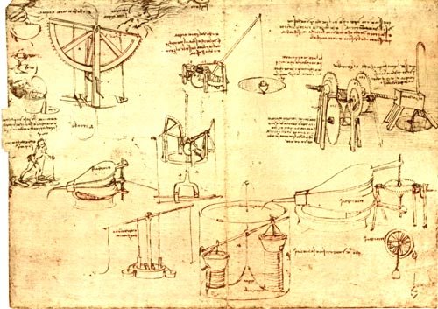
Why does it matter?
The Renaissance serves as a bridge between the Middle Ages and the modern world in which we live.

Slide 4
Lesson Vocabulary
Mercenary
Soldier who fights primarily for money.
Burgher
European urban social class including the shopkeepers, artisans, guild masters, and guild members.
Republic
A state in which the leader(s) is elected by some of the people to represent them.
Urban
Pertaining to a city

Slide 5
The Major Italian States
Three factors made Italy perfect as the birthplace of the Renaissance.
Italy in the late Middle Ages (leading up to the Renaissance):
Italy lacked a centralized governing monarch.
Italy was much more urban than the rest of Europe.
A thriving trade network was based in Italian cities.
This network encouraged an exchange of ideas missing in other areas of Europe (and the world).

Slide 6
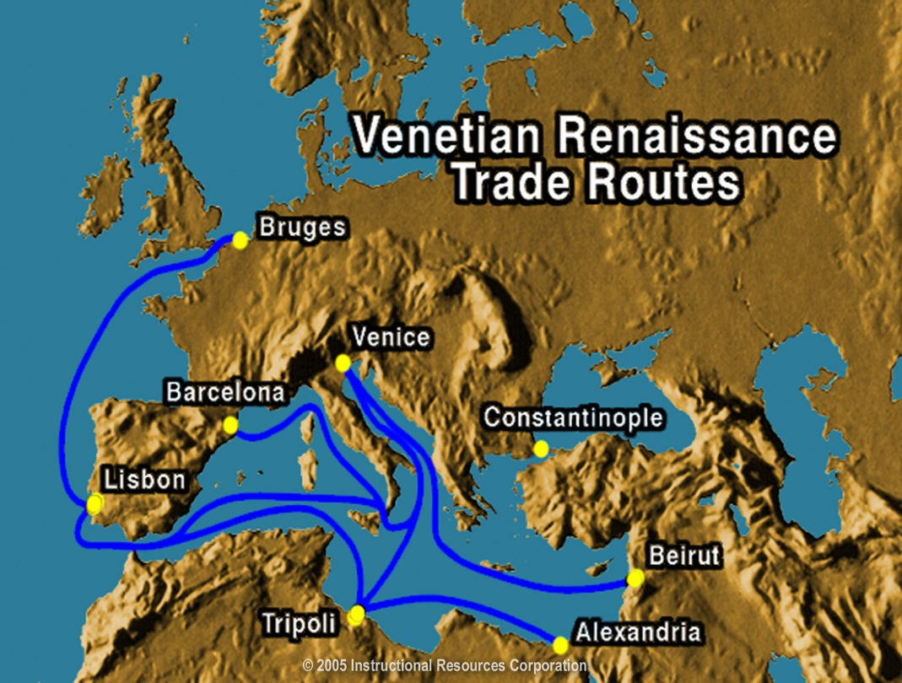
The Major Italian States
Trading Network
Italian merchant ships traded widely and a network of trade developed. Italian merchants traded with
Islamic traders
Byzantine traders
Chinese traders
England traders
Dutch traders

Slide 7
Lack of a centralized Italian monarchy
The lack of a single ruler made it possible for a number of city-states in northern and central italy to remain independent.

Slide 8
Lack of a central monarchy
By the early 15th century, five major territorial states dominated Italy.
Milan
Venice
Florence
The Papal States
Kingdom of Naples
Because of the economic power they wielded, these states played crucial roles in Italian politics and culture.

Slide 9
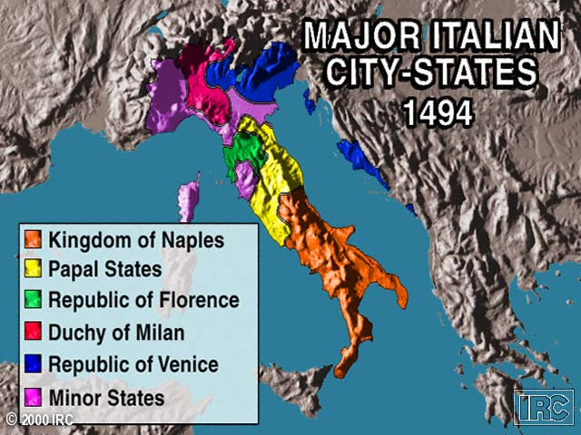

Slide 10
Milan
Northern Italy
Visconti Family ruled until 1447
Sforza used mercenaries to overthrow them and became the duke.
Milan prospered from trade and an efficient tax system.

Slide 11
Venice
Served as commercial link between Asia and Western Europe.
Officially it was a republic with an elected leader, the doge.
In reality, it was an oligarchy ruled by a small group of wealthy merchant/aristocrats.

Slide 12
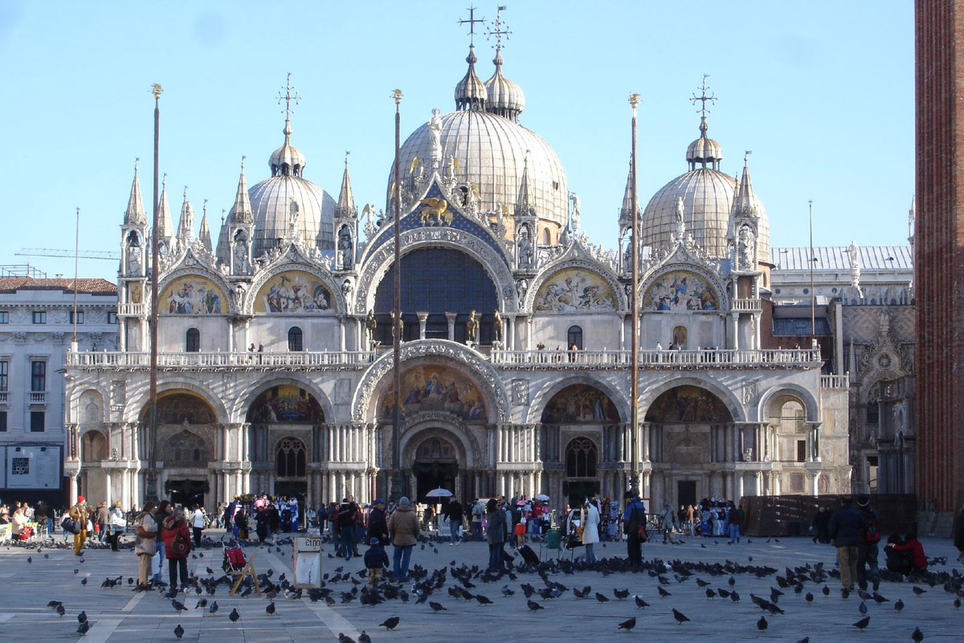
St. Mark’s basilica, Venice

Slide 13
Florence
Dominated by the Medici family.
Patrons of the arts.
Florence is considered the cultural CENTER of Renaissance Italy, due in large part to the patronage of the Medici family.

Slide 14
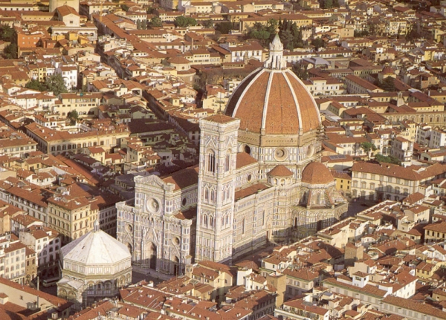
Florence, Italy

Slide 15
Florence
Economy, which was based on the manufacturing of cloth, began to decline in the late 1400s with increased competition from English & Flemish cloth merchants.
Savanarola, a Dominican, preached against the corruption of the ruling Medicis.
Citizens turned to Savanarola.
The Medicis were exiled after a French invasion in 1494.

Slide 16
Florence
Savanarola went too far, though.
He attacked the Church, making powerful enemies, and
Prohibited or regulated the Florentines gambling, horseracing, swearing, painting, music, and books.
That was the last straw.
The Medicis returned to power when Savanarola was convicted of heresy and sentenced to death.

Slide 17
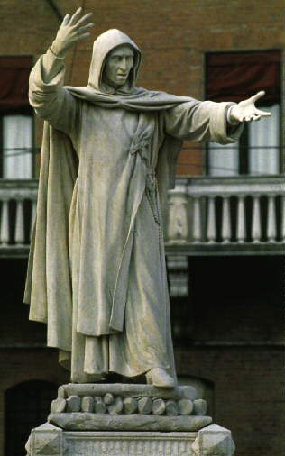
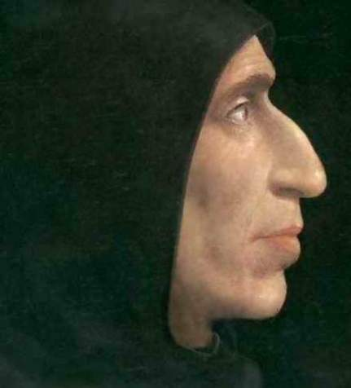
Friar Savanarola, OP

Slide 18
The Papal States & the Kingdom of Naples
Papal States – officially under control of the Catholic Church.
Kingdom of Naples was the only one of the five major Italian states ruled by a hereditary monarch.
Both states faced foreign occupation.

Slide 20
Niccolo Machiavelli
Wrote The Prince
One of the most influential works on political power in the Western world.
Central thesis of The Prince:
How to get – and keep – political power.
Rejected the Medieval notion of the moral ruler.
A prince must act on behalf of the state, and sometimes that means doing evil for the state’s sake.

Slide 21
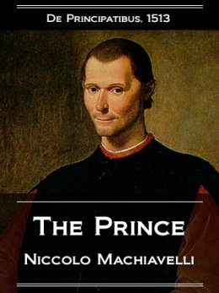
Niccolo Machiavelli

Slide 22
Renaissance Society
A new social class is born.
The Clergy
The Nobility
Peasants
The burghers
Middle class
Urban
Shopkeepers, artisans, guild masters and members.
Called the Bourgeoise in France.

Slide 23
Family and Marriage
Marriages were arranged to strengthen business or family ties.
Included a dowry, a payment from the wife’s family to the husband upon marriage.
Father / husband was the paterfamilias, the center of the Italian family.
Absolute authority over the children living in his home.
Women supervised the home and raised the children, especially morally.

Slide 24
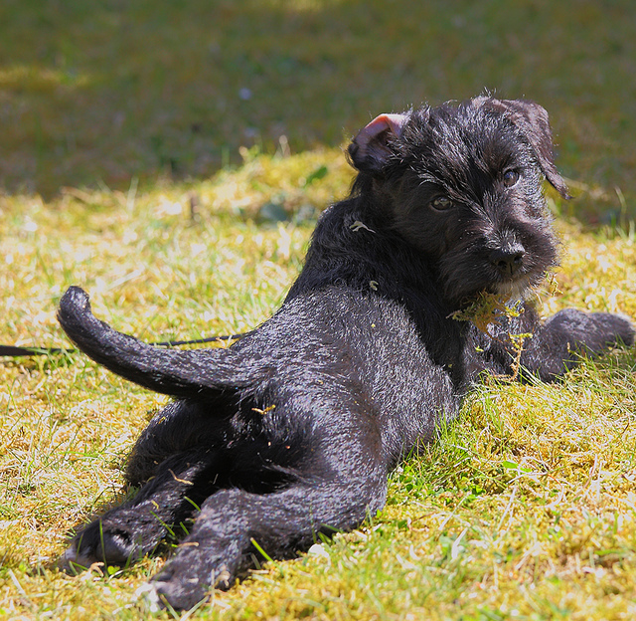
Looking back…

Slide 25
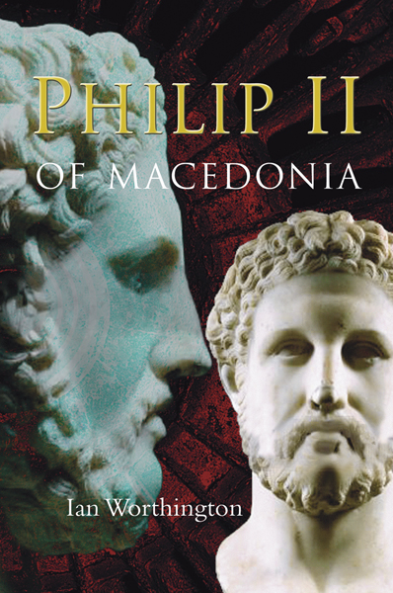
The Greek city-states were unified by this king, father of Alexander the Great.
Philip II of Macedon

Slide 26
