Slide 1
The Renaissance in Europe 1350-1600 Chapter 9, lesson 2 Ideas and Art of the Renaissance
Mr. Wyka - World History

Slide 2
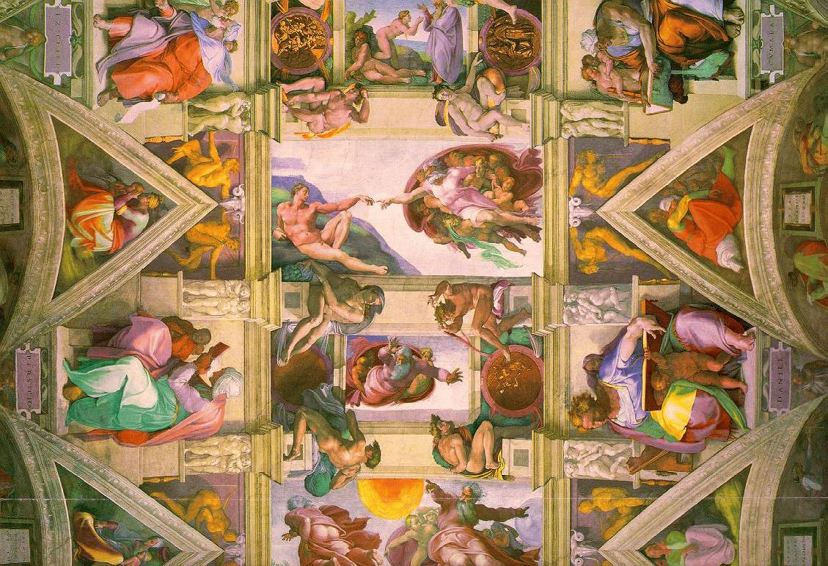
Essential Questions
How can ideas be reflected in art, sculpture, and architecture?
How can art influence culture?
Ceiling of the Sistine Chapel, Vatican, by Michelangelo

Slide 3
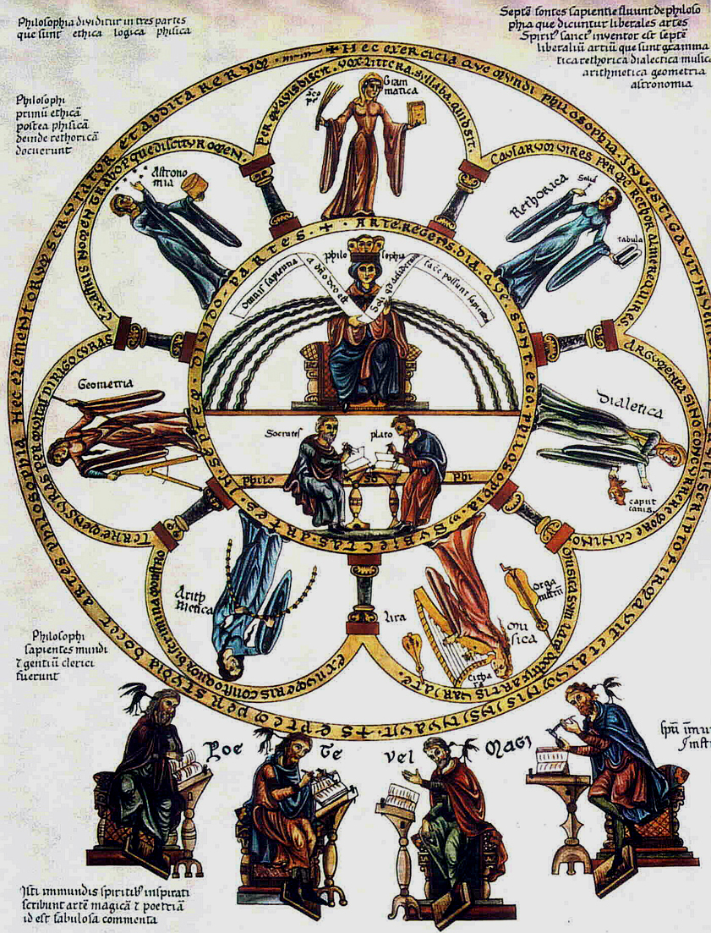
Why does it matter?
Today’s idea of educating the whole person was born in the Renaissance.
The Seven Liberal Arts

Slide 4
Lesson Vocabulary
Humanism - An intellectual movement of the Renaissance based on the study of the humanities (grammar, rhetoric, poetry, moral philosophy, and history)
Vernacular – the language of everyday speech
Fresco – a painting done on fresh, wet plaster with water based paints
Perspective – artistic techniques used to give the effect of three-dimensional depth to two-dimensional surfaces.

Slide 5
Humanism
A key intellectual movement of the Renaissance was humanism.
Based on the study of the classics (Greek and Roman literature).
Studied grammar, rhetoric, poetry, moral philosophy, and history.
Francesco Petrarch – father of Italian Renaissance humanism.

Slide 6
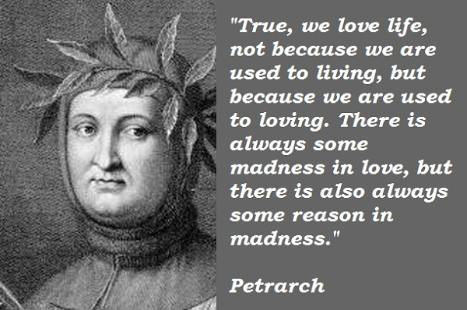

Slide 7
Vernacular Literature
Humanists emphasized classical Latin. However, some writers wrote in the vernacular – the local spoken language.
Dante – wrote the Divine Comedy in the vernacular (the Florentine dialect of Italian.)
Christine de Pizan – wrote The Book of the City of Ladies as a defense of women.
She was an Italian but lived in France and so wrote in the vernacular – French.

Slide 8
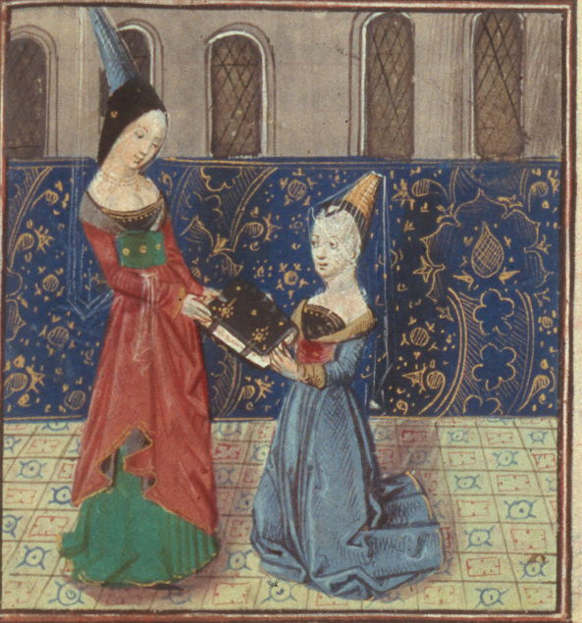
Christine de Pizan presents her book to Margaret of Burgundy

Slide 9
Renaissance Education
Education became increasingly secular.
Liberal studies were at the core of humanist schools.
The goal was to create a well rounded individual, body and mind.
Our modern educational system is based on these ideals.

Slide 10
Printing Press
Johannes Gutenberg developed the moveable type printing press.
The Bible was the first book printed on his press.
Began an Information Revolution even greater than the Internet Revolution.
Made the Protestant Reformation of the early 1500s possible.

Slide 11
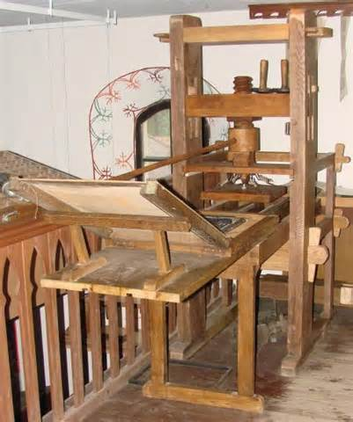
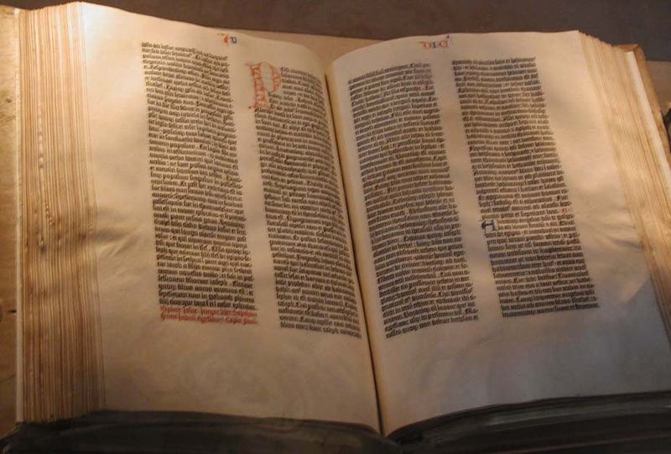
The Gutenberg press and a Gutenberg Bible

Slide 12
Italian Renaissance Art
Renaissance artists sought to imitate nature.
Giovanni – the first Renaissance master.
Called Masaccio
Painted frescoes. A fresco is a painting done on fresh, wet plaster with water based paints.
It is extremely difficult as the artist must complete his painting before the plaster dries.
Masaccio mastered perspective – an artistic technique that creates the illusion of three dimensions on a two dimensionial surface.

Slide 13
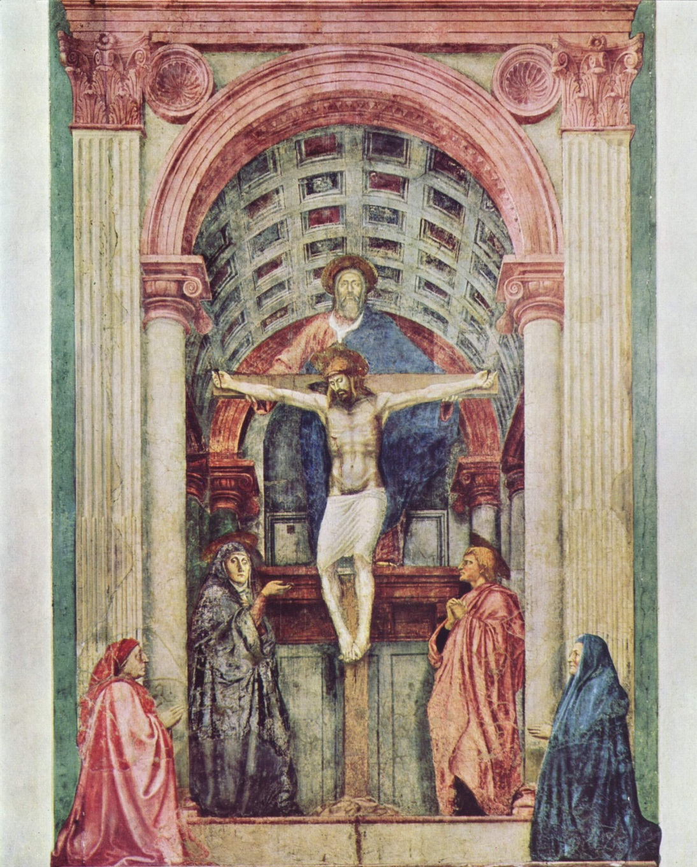
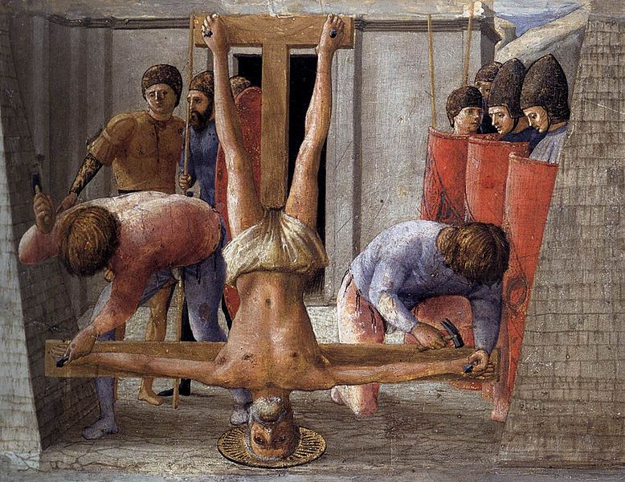
The Holy Trinity and The Crucifixion of St. Peter by Masaccio

Slide 14
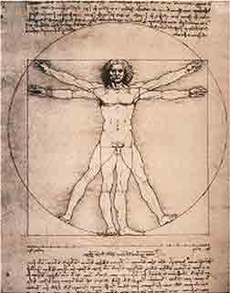
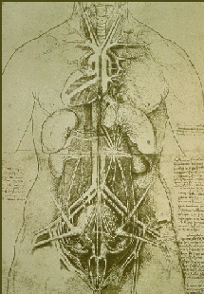
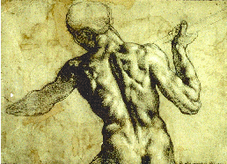
Italian Renaissance Art
Renaissance artists and sculptors studied human anatomy to create more realism.
Studies on the human form by Leonardo da Vinci

Slide 15
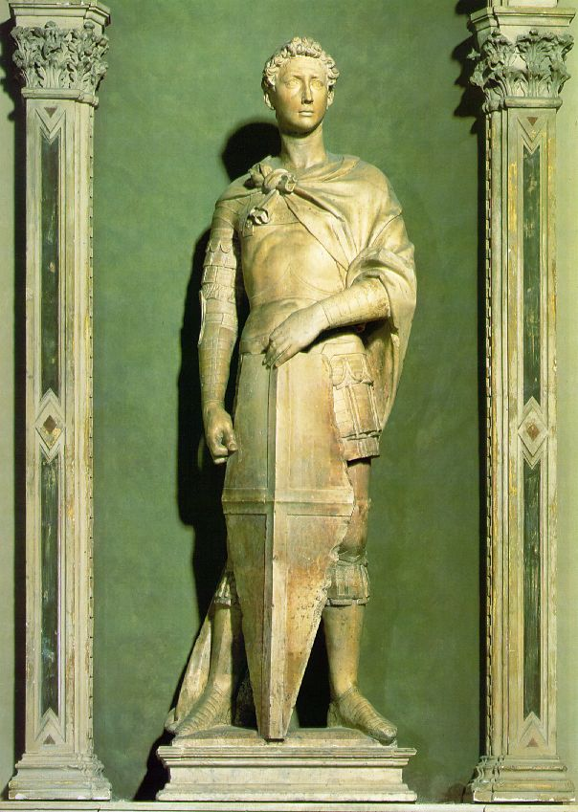
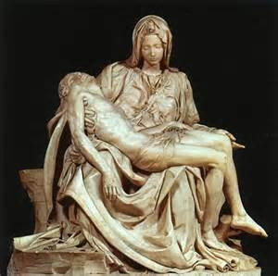
Realism in Renaissance Sculpture
Pieta by Michelangelo
St. George by Donatello

Slide 16
High Renaissance Masters
The Big Three
Leonardo da Vinci
Raphael Sanzio
Michelangelo Buonarroti
All three were Renaissance men in the sense that they mastered more than one discipline.

Slide 17
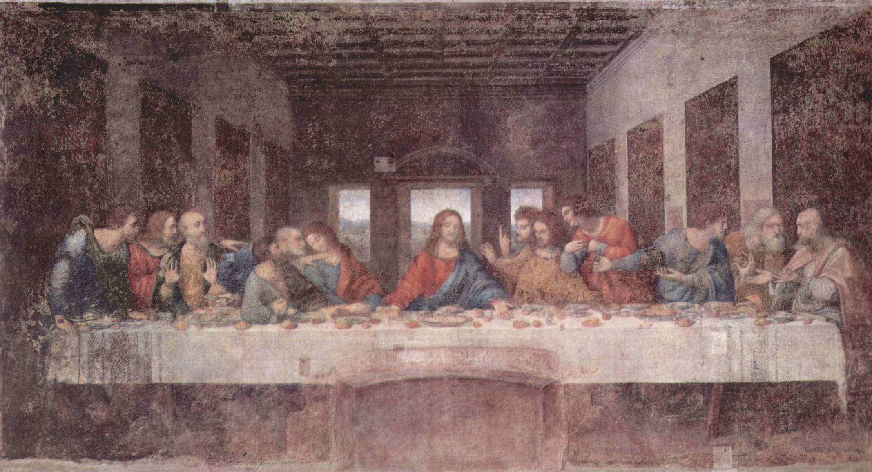
Leonardo da Vinci’s The Last Supper

Slide 18
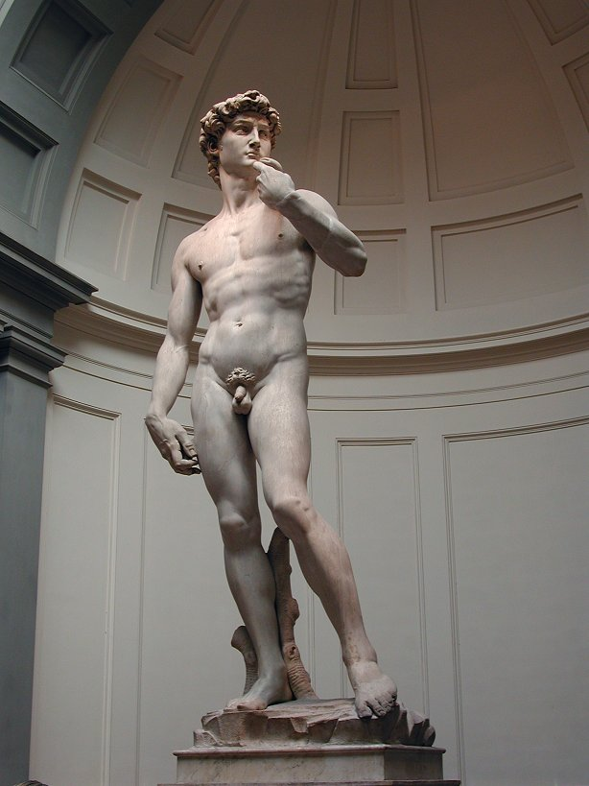
Michelangelo’s David

Slide 19
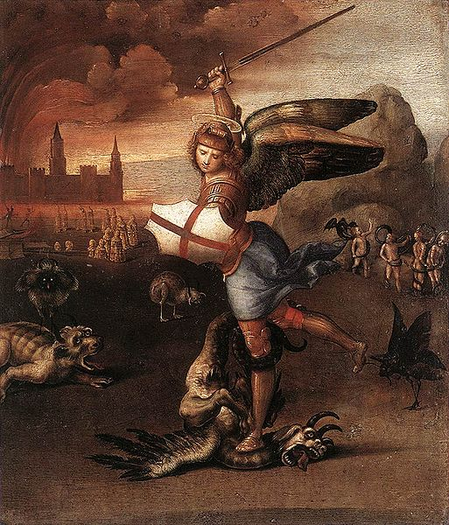
St. Michael by Raphael

Slide 20
Northern Artistic Renaissance
Northern European artists also sought to portray their world realistically.
However, they lacked the huge wall spaces of Italian churches that encouraged fresco painting.
As such, Northern Renaissance artists used smaller spaces such as windows and altar pieces as their canvasses.
This encouraged innovations in technique and tools.
Artists such as van Eyck perfected the technique of oil painting.

Slide 21
Why did Northern Renaissance Artists paint in smaller spaces?
They lacked wall space (in contrast to the Italian artists who had gobs and gobs of churches in which to paint).
How’d they respond to this challenge?
They painted in smaller spaces and developed techniques such as oil painting to meet this challenge.

Slide 22
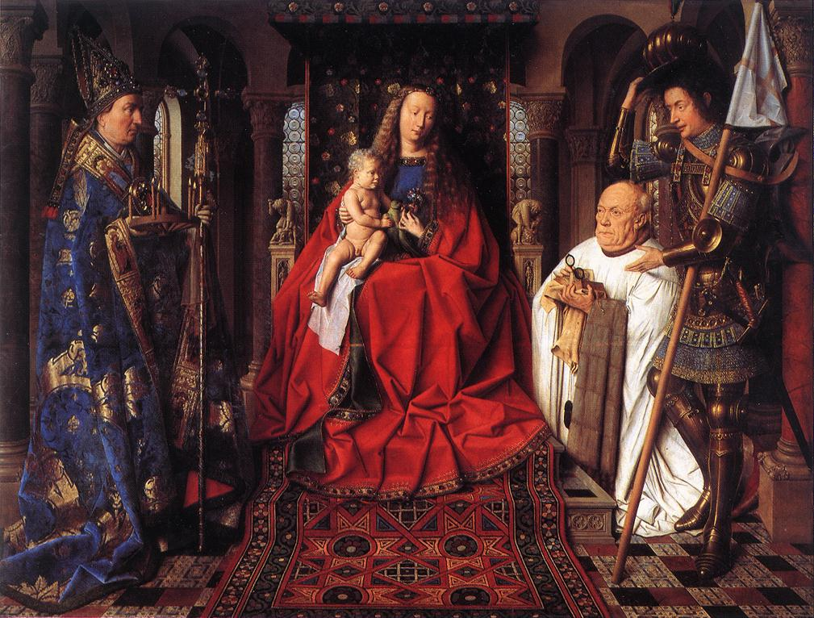
Jan Van Eyck, The Madonna with Canon van der Paele

Slide 23
The Northern Artistic Renaissance
Flemish (Flanders, in modern day Netherlands) artists typically placed their subject among everyday objects.
The Big Three of the Northern Artistic Renaissance
Campin
Jan van Eyck
Durer

Slide 24
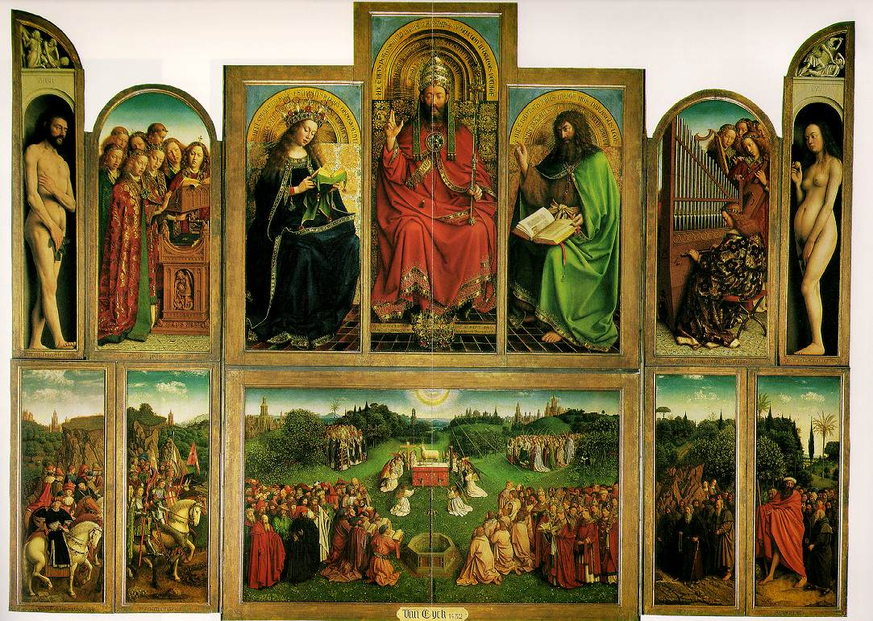
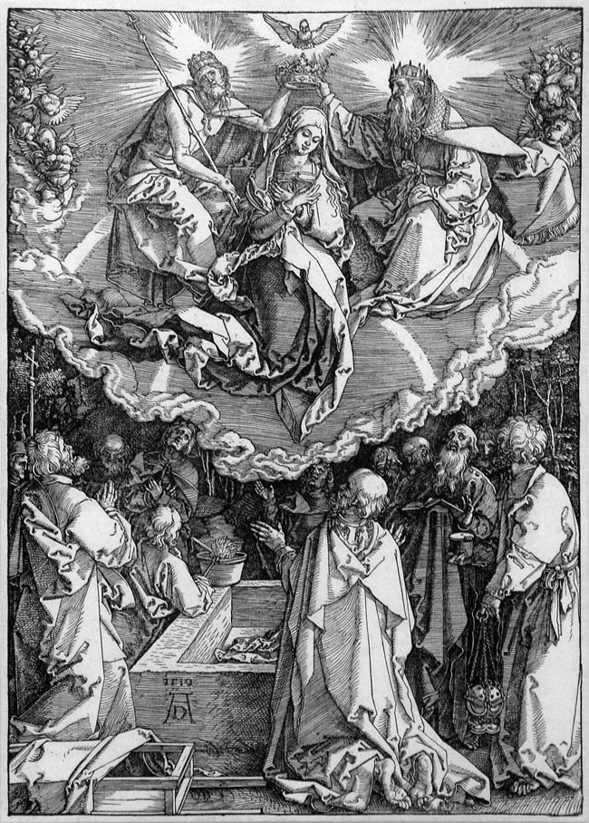
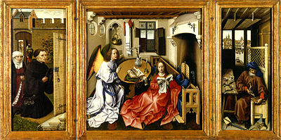
Van Eyck
Durer
Robert Campin

Slide 25
What’s the Theme?
In all of the art featured in this presentation (and in almost ALL Renaissance art) there is an overwhelming theme. What is it?

Slide 26
