Slide 1
Chapter 8 Section 1
I. The Federal Court System

Slide 2
A. The American Court System
1. A Dual Court System
A. There are valid state courts and valid federal courts.
2. Jurisdiction
A. The authority to hear and decide a case.
B. Exclusive Jurisdiction – the sole right to hear a case.
C. Concurrent jurisdiction – refers to cases that fall under both state and federal jurisdiction.
D. Plaintiff – person making the legal complaint.
E. Defendant – the person against whom the complaint is filed.

Slide 3
B. Structure of the Federal Court System
Judiciary Act of 1789
A. Proposed a three-tiered structure for the federal courts.
1. District Court
A. Spread throughout the country and serve as the trial courts of the federal system.
2. Courts of Appeals
A. Hear appeals from district courts and also from those federal agencies that have rule-making and rule-enforcement powers.
3. The Supreme Court
A. Occupies the top tier of the federal court system.

Slide 4
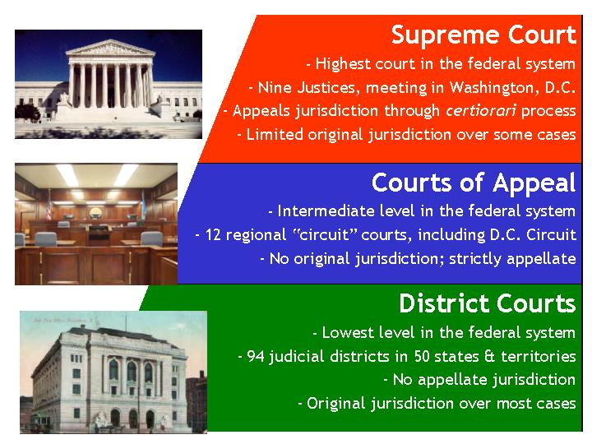
B. Structure of the Federal Court System
4. Other Courts
A. Over the years Congress has created a number of other courts.

Slide 5
C. Appointing Federal Judges
1. Legal Expertise
A. Constitution has not required it, but most federal judges have been trained lawyers.
B. American Bar Association (ABA) issued reports on the integrity and professional competence of federal judicial nominees since 1952.
2. Party Affiliation
B. Presidents usually nominate judges with whom they share a party affiliation.

Slide 6
C. Appointing Federal Judges
3. Judicial Philosophy
A. Comes down to where judges lands on a spectrum with judicial restraint on one end and judicial activism on the other end.
B. Judicial restraint - the concept that a judge should interpret the Constitution according to the Framers’ original intention.
C. Judicial activism – that judges can adapt the meaning of the Constitution to meet the demands of contemporary realities.
D. Precedent – previous court rulings on given legal question.

Slide 7
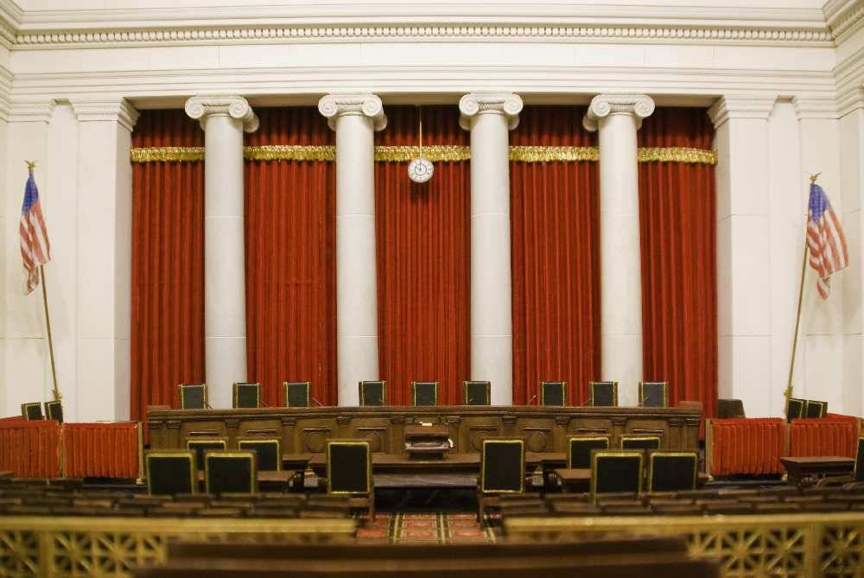
C. Appointing Federal Judges
4. Opinions of the Senate
A. Senatorial courtesy – A senator from the same state as the nominee and the same political party as the president can block a nomination for virtually any reason.

Slide 8
D. Checks and Balances
1. Judicial Review
A. The primary judicial check on the legislative and executive branches is the power of judicial review.
2. Checks on the Judiciary
A. Giving people a say, through their elected representatives, on who will be their judges.
B. Congress has the power to impeach and remove judges from office.

Slide 9
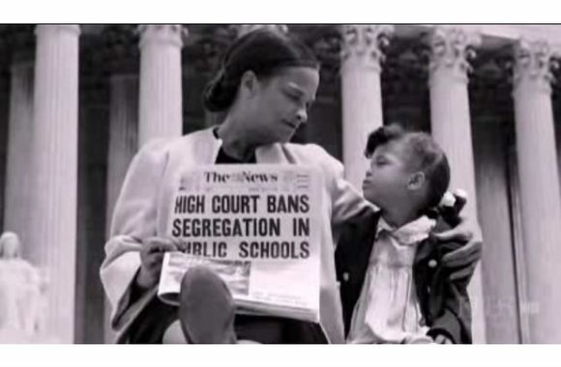
Two Important Court Rulings
Marbury v. Madison - established the Supreme Court's power to review acts of Congress or state laws to see if they were constitutional or not.
Brown v. Board of Education of Topeka, Kansas – ruling called for the desegregation of public schools.

Slide 10
Chapter 8 Section 2
II. Lower Federal Courts

Slide 11
A. Federal District Courts
1. The Jurisdiction of District Courts
A. grand juries - A jury, normally of twenty-three jurors, selected to examine the validity of an accusation before trial.
Bankruptcy – A legal proceeding involving a person or business that is unable to repay outstanding debts.
2. Court Officials
A. magistrate judges – District courts also have officials who are known.
B. misdemeanor – minor criminal cases punishable by one year or less of prison.

Slide 12
A. Federal District Courts
3. Other Courtroom Officials
A. public defenders – appointed by the panel of the judges who make up the court of appeals.
B. marshals – provide security and police protection at federal court house.

Slide 13
B. Federal Courts of Appeal
1. Purpose of Court Appeals
A. Hear cases on appeal from the district courts within their circuit.
B. Hear appeals from various administrative agencies of the federal government.
2. Appeals Court Procedure
A. appellant – person who files an appeal
B. briefs – panel reviews trail court record and reads written arguments from both sides in the case.

Slide 14
B. Federal Courts of Appeal
3. After the Ruling
A. Usually the final word in a particular case.
4. The Federal Circuit
A. In 1982, Congress created the Courts of Appeals for the Federal Circuit.
B. Has nationwide appellate jurisdiction for cases involving certain areas of law.

Slide 15
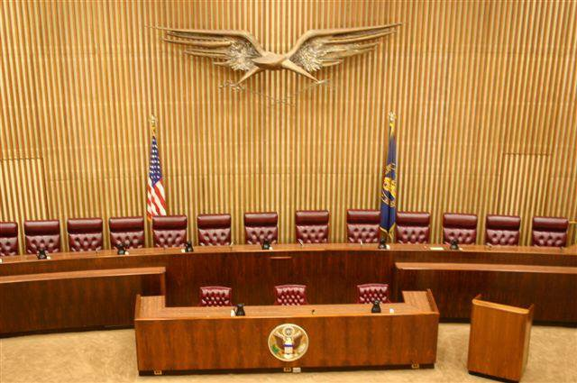
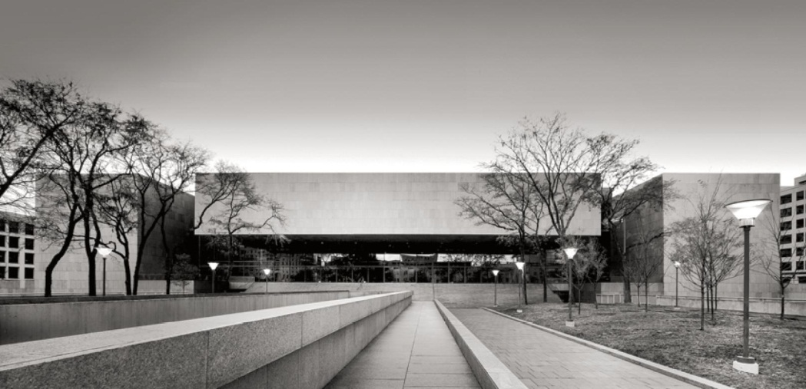
C. Other Federal Courts
1. U.S. Court of International Trade
2. U.S. Tax Court
3. U.S. Court of Appeals for Veterans Claims
4. U.S. Court of Federal Claims

Slide 16
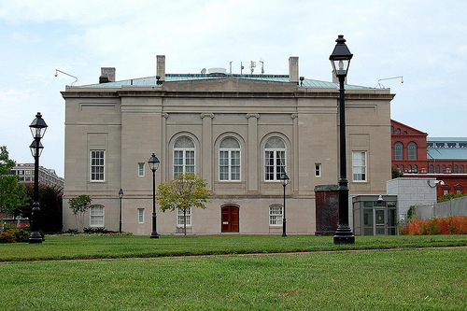
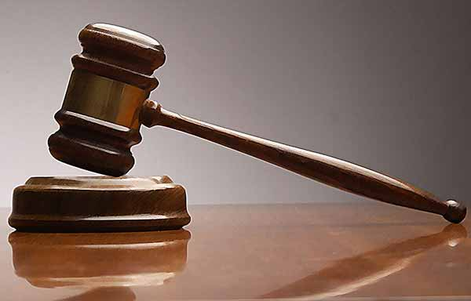
C. Other Federal Courts
5. U.S. Court of Appeals for the Armed Forces
6. National Security Courts
7. Military Commissions
8. Washington, D.C., and Territorial Courts

Slide 17
Chapter 8 Section 3
III. The Supreme Court

Slide 18
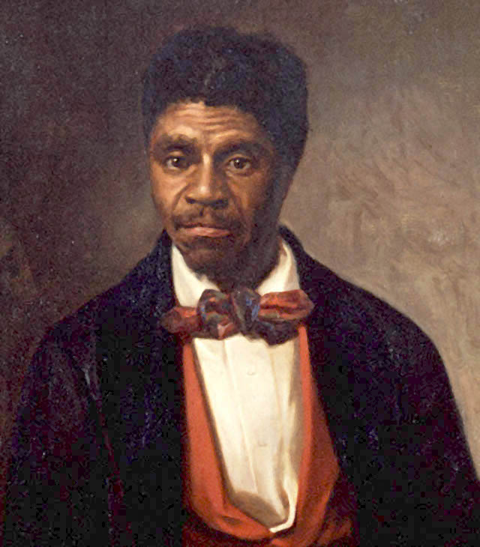
A. Highlights of Supreme Court History
1. Early Visions
A. Alexander Hamilton wrote the Federalist and his writings became a touchstone for constitutional scholars.
2. The Marshall Court
A. Marbury v. Madison - established the Supreme Court's power to review acts of Congress or state laws to see if they were constitutional or not.
3. Dread Scott 1857
A. Dred Scott v. Sandford – Scott sued for his freedom, and lost.

Slide 19
A. Highlights of Supreme Court History
4. From Reconstruction to Plessy
A. Republicans became the leading political party for 60 years after the Civil War.
B. The 13th, 14th, and 15th amendments were created.
5. From the 1950s to the Present.
A. Brown v. Board of Education of Topeka, Kansas – ruling called for the desegregation of public schools.
B. Gideon v. Wainwright & Miranda v. Arizona – expanded the rights to people accused of crimes.

Slide 20
B. Choosing Supreme Court Justices
1. Choosing a Nominee
A. Legal enterprise, party affiliation, judicial philosophy, and a sense of the nominee’s acceptability to the Senate.
B. Most have served as federal judges, few state govs., or in other government posts.
2. Confirmation Hearings
A. Usually televised.
B. Nominee often faces intense direct questioning.

Slide 21
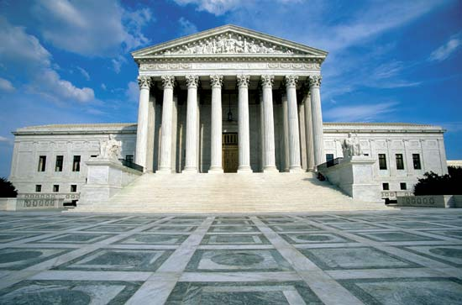
C. Supreme Court Procedures
1. The Terms Begins
A. First Monday of October go until June or July.
2. Selecting Case
A. writ of certiorari – an order seeking review of the lower court case.
B. docket – lists of cases to be heard.
C. Cases come from three categories.

Slide 22
C. Supreme Court Procedures
3. Briefs and Oral Arguments
A. First step is reading briefs, then the justice listens to oral arguments.
B. Briefs – written arguments prepared and submitted by each side in the case.
4. Opinions
A. majority opinion – one that is signed by at least five of the nine members of the Court.
B. concurring opinions – agree with overall conclusion in the case but stress something different or additional.

Slide 23
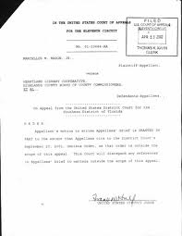
C. Supreme Court Procedures
C. Dissenting opinions – are those held by the minority of the justices who do not agree with the ruling in the case.
5. Court Orders
A. plenary review – The Court’s full review of cases.

