Slide 1
FEUDALISM
Mr. Wyka – AP World History

Slide 2
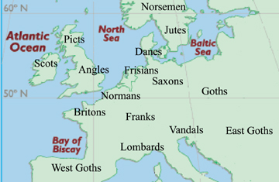
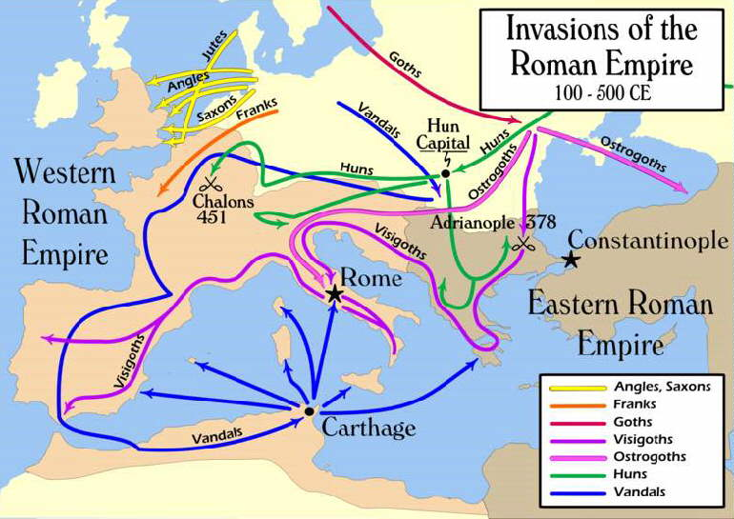
Setting the Table…

Slide 3
The New Germanic Kingdoms
Red Sauce

Slide 4
The Battle of Tours A Historical Nexus Point
In the early 700s, the Muslims who had recently taken over the Iberian Peninsula, crossed the Pyrenees Mountains into France.
The Frankish kings proved inept against this threat.
The mayor of the palace, Charles the Bastard, gathered as many Frankish knights, warriors, and peasants as he could and met the invaders at Tours.
Although outnumbered, the Franks prevailed and pushed the Islamic army back to Spain.
After this, Charles the Bastard gained a new name – Charles Martel, or Hammer.

Slide 5
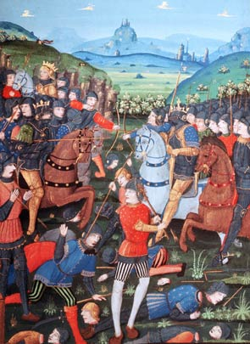
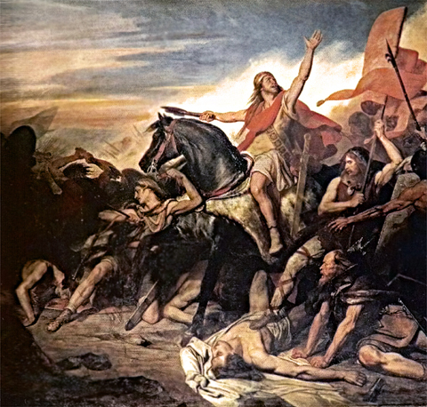

Slide 6
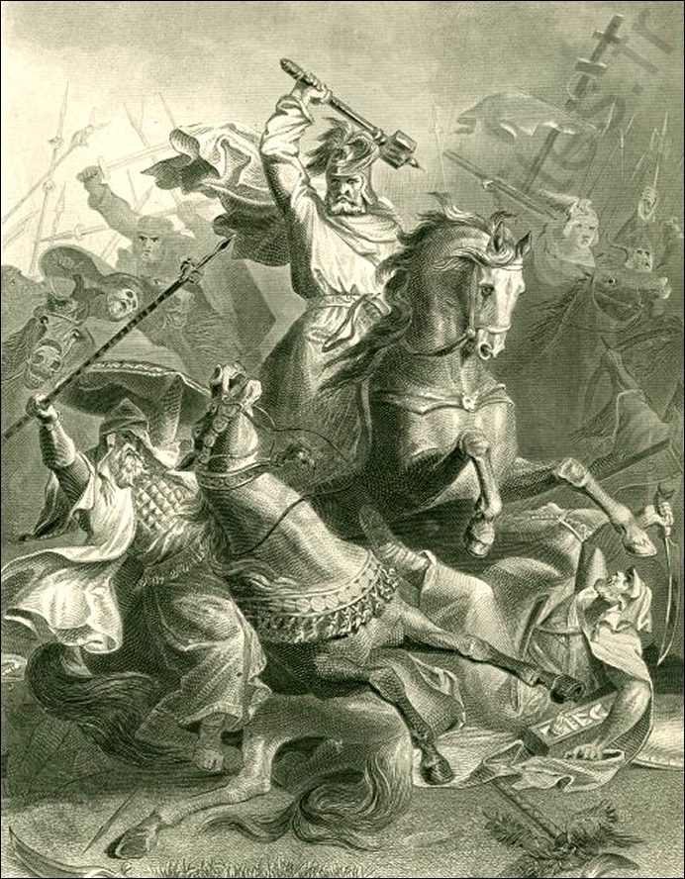
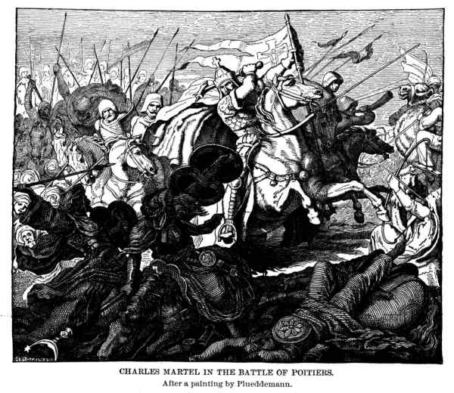

Slide 7
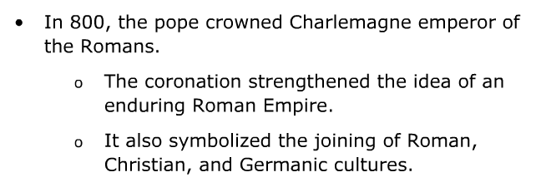
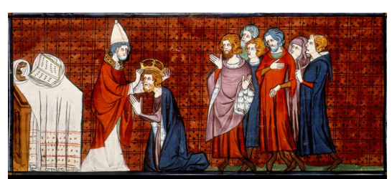
The Carolingian Empire
Important Stuff. Consider it all in red.

Slide 8
Essential Questions
How can change to political systems impact economic activities?
How is society influenced by changes in political and economic systems?

Slide 9
Why does it matter?
Charlemagne’s long reign was an era of peace and centralized authority for his subjects. However, after his death, the Carolingian Empire was weakened. Local nobles (landed aristocrats) become more important as people turned to them for the protection that the empire could no longer provide. The system that developed from this, was feudalism.

Slide 10
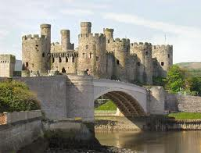
Lesson Vocabulary
feudalism
knight
feudal contract
chivalry
vassal
fief

Slide 11
The End of the Carolingian Empire
Guiding Question:
What internal and external factors after Charlemagne’s death weakened kingdoms in Europe?

Slide 12
The End of the Carolingian Empire
Less than 30 years after Charlemagne’s death in 814, his empire was divided among his grandsons.
The West Frankish lands
The East Frankish lands
The Middle Kingdom

Slide 13
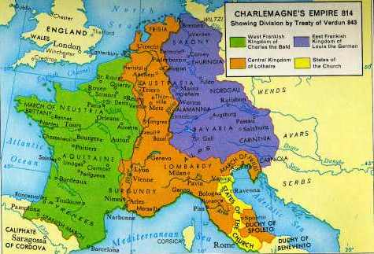
After Charlemagne’s Death

Slide 14
In the 9th and 10th centuries, Western Europe was beset by a wave of invasions.
The Vikings, or Northmen, of Scandinavia were the most far-reaching of these invaders.
Vikings were traders as well as raiders.
After a century of raiding, Viking groups began to settle in the areas they raided.
The most famous example of this was in 911, when a band of Vikings under Rollo were given a strip of land along the English Channel by the west Frankish king.
The land they settled came to be known as Normandy (land of the Northmen) and the people there, Normans.
The Frankish policy of settling the Vikings and converting them to Christianity worked.

Slide 15
Remember the Guiding Question: What internal and external factors after Charlemagne’s death weakened European kingdoms?
The Viking invasions.
Were they an internal factor or an external factor?
External
The fighting between the heirs of Charlemagne.
Internal factor or an external factor?
Internal

Slide 16
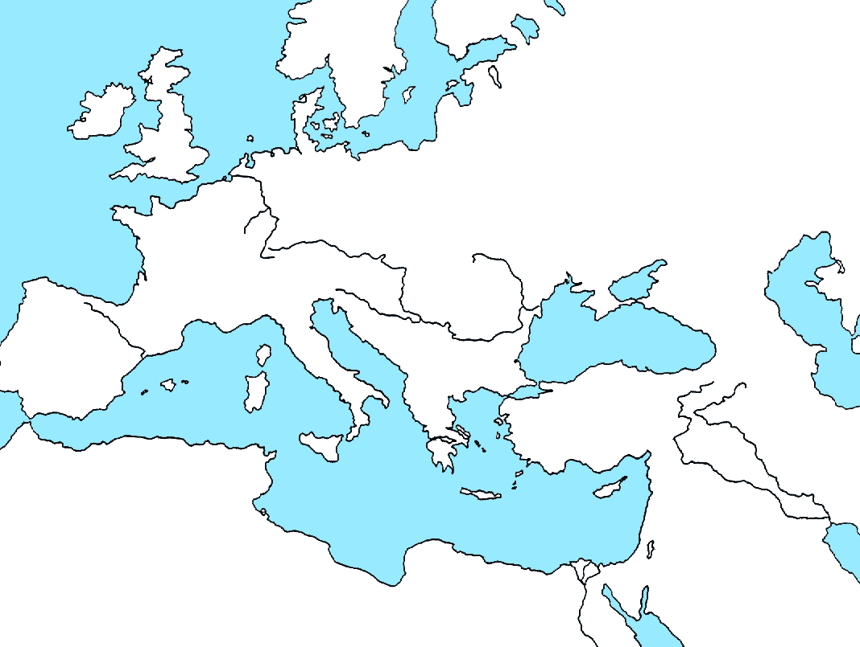
Where did the Vikings come from?
Scandinavia
Denmark
Norway
Sweden

Slide 17
The Development of Feudalism
Guiding Question:
Why did the collapse of governments lead to a new political and social order – feudalism?

Slide 18
The Development of Feudalism
The Empire had collapsed.
Europe was beset by invaders.
To survive, people turned to landed aristocrats, or nobles, for protection.
It became important to find a powerful lord who offer protection in return for service.
This exchange, protection for service, led to FEUDALISM, a new political and social order.
At the heart of the feudal order was the idea of vassalage.

Slide 19
Knights and Vassals
By the 8th century, a warrior who served a lord was known as a vassal.
In return, the lord took care of the vassals needs.
Two technological advances led to the introduction of a new warrior, the armored knight.
Introduction of larger horses.
Invention of the stirrup.
Knights dominated warfare in Europe for nearly 500 years.

Slide 20
Knights and Vassals and the Feudal Contract
In the Early Middle Ages, wealth was based primarily on…
LAND
A powerful lord would grant his vassals a parcel of land of their own.
In return, the vassals (knights) agreed to fight for the lord.
This grant of land was known as a fief.

Slide 21
The Feudal Contract
What was the chief virtue in feudal society?
Loyalty to one’s lord.
The relationship between a lord and his vassal was an unwritten set of mutual obligations known as
The Feudal Contract
The vassals primary obligation was military service when summoned (usually 40 days / year).
The lord granted the vassal his fief, defended him militarily, and took his side in disputes.

Slide 22
Remember the Guiding Question: Why did the collapse of governments lead to the new political and social order known as feudalism?
People needed protection from invaders and lawlessness and turned to the only means of protection available, the landed (land owning) aristocracy (nobles). In return, the nobles expected service from the people.

Slide 23
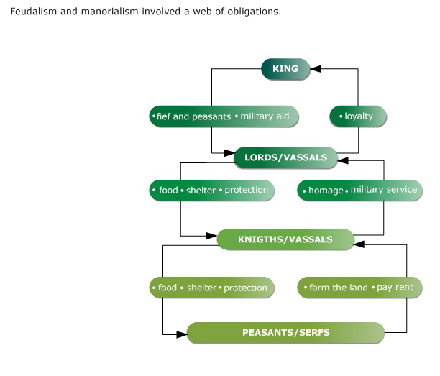

Slide 24
The Nobility of the Middle Ages
Guiding Question:
How was European feudal society structure?

Slide 25
Nobility
European feudal society was dominated by warriors.
Men whose chief concern was warfare.
The tournament grew out of this situation.
The Catholic Church promoted the idea of CHIVALRY.
A code of ethics knights were supposed to uphold.
Among it’s ideals was a higher status for women. For example, women were to be treated with tenderness and respect, not as property.

Slide 26
Women in the Early Middle Ages
Women could legally hold property.
Aristocratic women grew in power as their husbands were more and more away.
The Lady of the Castle was responsible for the day-to-day functioning of a vast estate, essentially a large business.
Women were expected to be subservient to men (although this didn’t always happen), but lords and knights were expected (chivalry) to treat women respectfully.
The Middle Ages also saw the spread of the idea of Romantic Love.

Slide 27
Remember the Guiding Question: How was European feudal society structured?
Society was dominated by warriors and power, political and economic, was held by the nobility – kings, dukes, counts, barons, even bishops. Women had rights of property ownership and ideally, were respected and upheld, but were considered subservient to men.

Slide 28
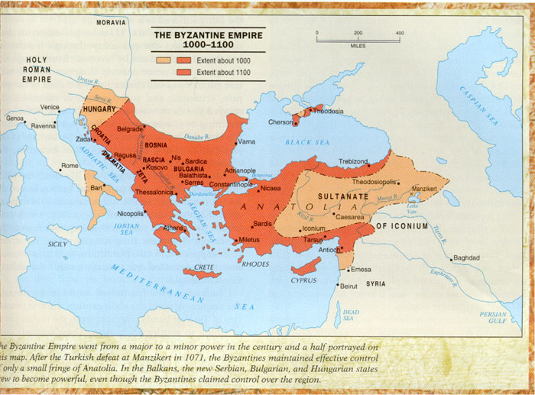
While western Europe DE-volved into Feudalism after the fall of the Carolingian Empire, the Byzantine Empire (eastern Roman Empire), centered in its capital city of Constantinople, continued the traditions of the old western Roman Empire.

Slide 29
Constantinople & the Byzantine Empire
In fact, from the fall of Rome to the 12th century, the Byzantine Empire was the political and economic powerhouse of the Mediterranean region.
Tomorrow, we will explore western Europe vs. eastern Europe in depth.

Slide 30
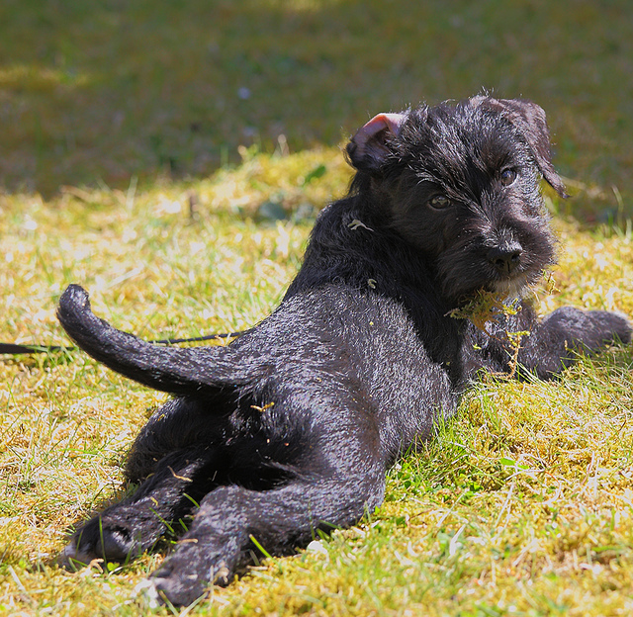
Looking back…

Slide 31
The Arabic name for the journey of Muhammad and his followers to Medina (Madinah) from Mecca (Makka).
Hijrah

Slide 32
Who was the Moroccan explorer of Berber descent, known for his extensive travels, accounts of which were published in the Rihla (lit. "Journey")? Over a period of thirty years in the 14th century, he visited most of the known Islamic world as well as many non-Muslim lands.
Ibn Battuta
Bonus Question: What was Ibn Battuta’s full name?
ʾAbū ʿAbd al-Lāh Muḥammad ibn ʿAbd al-Lāh l-Lawātī ṭ-Ṭanǧī ibn Baṭūṭah

Slide 33
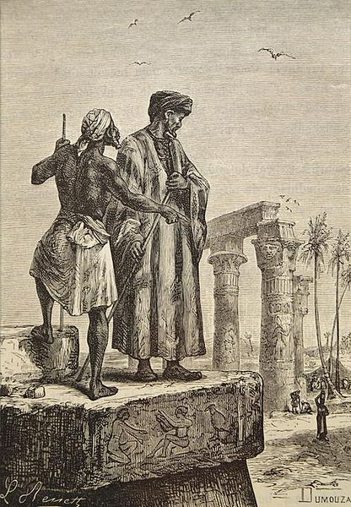
Ibn Battuta in Egypt, 19th century lithograph

Slide 34
