Slide 1
Mid Course Review 1
Mr. Wyka
World History
Citrus High School

Slide 2
Propaganda
During World War I and World War II, the U.S. government used propaganda in the forms of posters and news reals to urge citizens to
Fight
Ration
Buy War Bonds
What purpose would War Bonds serve?
Helped fund the very expensive wars.

Slide 3
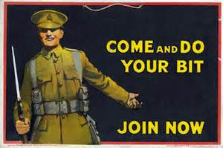
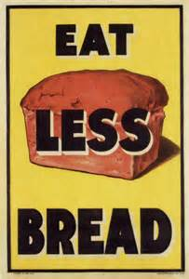

Slide 4
Mohandas Gandhi
In the mid twentieth century (20th), Gandhi worked peacefully to bring about an India free of British colonial rule.
He believed that he could bridge the gap between Hindu and Muslim Indians and bring about an India for both Hindus and Muslims.
When Britain did give up colonial control, India was partitioned into India for the Hindus and Pakistan for the Muslims.
Is this in line with Gandhi’s beliefs and hopes or in contrast to his beliefs and hopes?

Slide 5
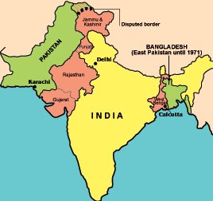

Slide 6
The Renaissance lead to the Enlightenment
How?
By encouraging scholar’s beliefs in human reason.

Slide 7
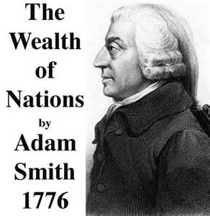
Do you know Adam Smith?
Let me introduce you….
Economic philosopher
Wrote about laissez-faire
Invisible hand
Foundation of modern capitalism

Slide 8
Consent of the Governed
Consent of the Governed is an idea put forth by our friend, John Locke, who we know inspired so many of our nation’s founders like Ben Franklin and Thomas Jefferson.
The People must approve of their government in order for the government to be legitimate.
This principle was put into action when the Constitution was sent to the states to be approved (or not).
This “approval by the people” gave the new government legitimacy.

