Slide 1
Final Course Review 2
Mr. Wyka
World History
Citrus High School
Notes:
Questions 7-10

Slide 2
Do you know Baron de Montesquieu?
Enlightenment thinker
Inspired the writers of the Constitution and the Declaration of Independence
Put forth the idea that there should be a SEPARATION of POWERS in the government so no one branch of government becomes too powerful.
Neat idea!

Slide 3
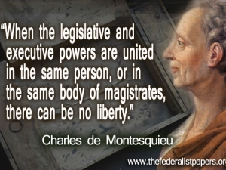

Slide 4
What is Popular Sovereignty?

Slide 5
The idea of Popular Sovereignty is shown in the founding documents of both the United States and France.
The United States: We the people of the United States, in order to form a more perfect union,… do ordain and establish this Constitution for the United States of America. - From the Preamble to the U.S. Constitution, 1789
France: No body nor individual may exercise any authority which does not proceed directly from the nation.
- Article 3 of the Declaration of the Rights of Man, 1789

Slide 6
Enlightenment Ideas
Many American colonial leaders, such as Thomas Jefferson and John Adams, considered themselves to be Men of the Enlightenment.
They used Enlightenment Ideas to justify the American Revolution.

Slide 7
Remember the French Revolution?
Some of the causes of this bloody revolution…
The 1st and 2nd Estates paid no taxes!
The 3rd Estate was ticked off about that.
The 1780s saw bad harvests leading to soaring food prices.
The monarchy lived lavish lifestyles that bankrupted the country and put it deeply into debt.

Slide 8
So since you know what caused the French Revolution…
Was the lavish lifestyle of French kings a cause?
Yep!
Was the anger of the 3rd Estate over the special privileges enjoyed by the 1st and 2nd Estates a cause?
Yep!
Was the Reign of Terror a cause?
Nay! The Reign of Terror was an EFFECT of the Revolution, not a CAUSE.

