Slide 1
Final Course Review 3
Mr. Wyka
World History
Citrus High School
Notes:
Questions 11-23

Slide 2
The Age of Independence Movements
You’ve been taught that the American fight for Independence from Great Britain (the Revolutionary War) inspired revolutions for independence around the world. For example….
Simon Bolivar
South American independence movement
Jose de San Martin
South American independence movement
Toussaint L’Ouverture
Haitian independence leader. Ended slavery in Haiti.

Slide 3
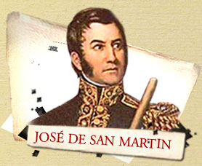
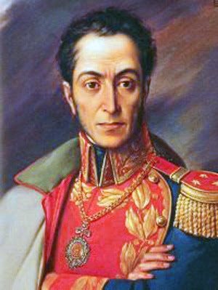
Simon Bolivar
South American Independence
Toussaint L’Ouverture Haitian Independence
South American Independence

Slide 4
The Industrial Revolution
Technological breakthroughs made the Industrial Revolution possible.
Just a few of these…
The Railroad
New Manufacturing methods
Interchangeable parts and the assembly line
Steam Powered Engines

Slide 5
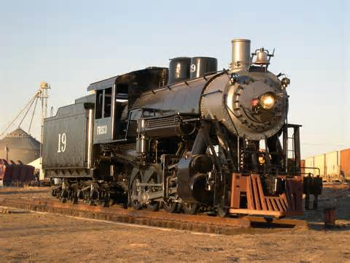
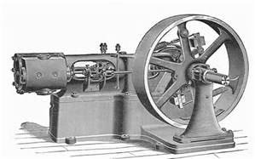
The Industrial Revolution, brought to you by
The Steam Powered Engine
Notes:
Question 12

Slide 6
The Industrial Revolution
The Earliest Nations & Regions to Industrialize were:
England
The United States
Western Europe
Japan
Which nation/region had the greatest challenges in industrializing?
Japan had greater challenges to overcome than the other nations because of its rocky, mountainous geography with so little natural resources.
This drove Japan to seek the natural resources of its neighbors.
Notes:
13

Slide 7
Workers Fought Back…
In order to marshal enough strength to fight against the powerful companies they worked for, workers formed
LABOR UNIONS
The Labor Unions fought to gain higher wages and better working conditions for their members during the early years of the Industrial Age.
Notes:
14

Slide 8
Industrialization and Colonialism
To fuel their Industrialization, Europe, America, and Japan needed raw materials (oil, rubber, wood, coal, iron, etc.).
Industrialized nations colonized non-industrialized nations that had an abundance of raw materials.

Slide 9
Adam Smith vs. Karl Marx The Fight of the Century!
Adam Smith
Economic systems benefited from the free exchange of goods and services.
Advocated for the private ownership of land and business.
Invisible Hand of the Market
Karl Marx
Economic Systems benefited from strict public (government) ownership.
Government owns the land and businesses.
Government controls the Market.
Notes:
15

Slide 10
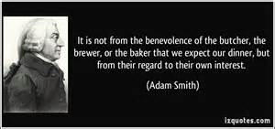
Adam Smith vs. Karl Marx

Slide 11
Imperialism = Spheres of Influence
“Spheres of Influence” is another way of saying Imperialism.
Europe, Japan, and the U.S. establish these “Spheres of Influence” in the late 1800s to
Claim Exclusive Economic Privileges in those countries under their control.
Notes:
17

Slide 12
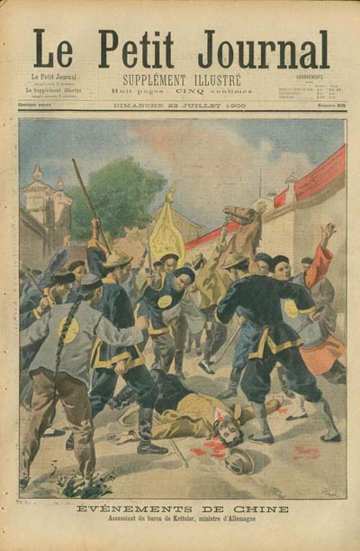
Boxer Rebellion
China
1899-1901
Sought to Expel (get rid of) FOREIGNERS!
Notes:
18

Slide 13
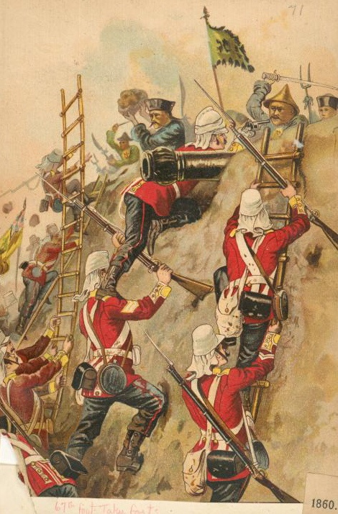
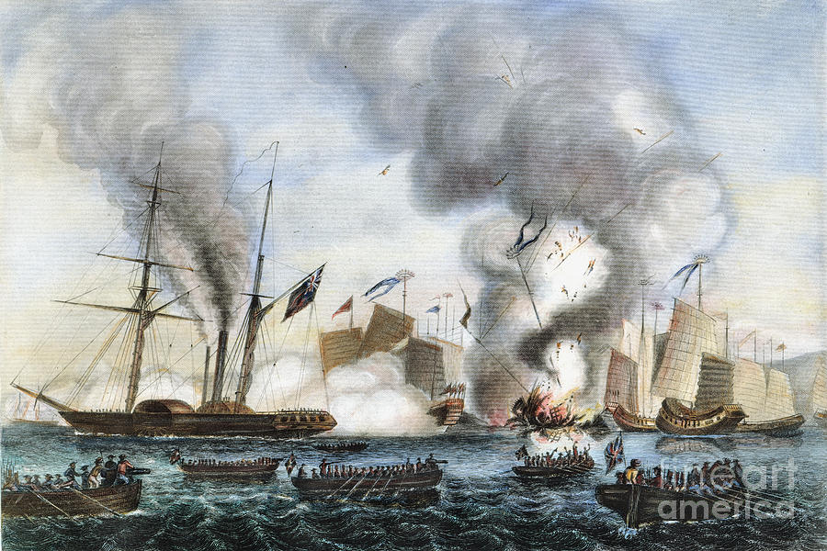
Opium Wars
China vs. Great Britain
Mid 1800s
Trade dispute
Led to MORE European Imperialism in China
Notes:
19

Slide 14
World War I
Nationalism was one of the causes of WWI because…
It led to increased competition among the nations of Europe.
World War I saw the use of chemical weapons.
Gas masks were invented to counteract the effect of poison gas.
Notes:
20-21

Slide 15
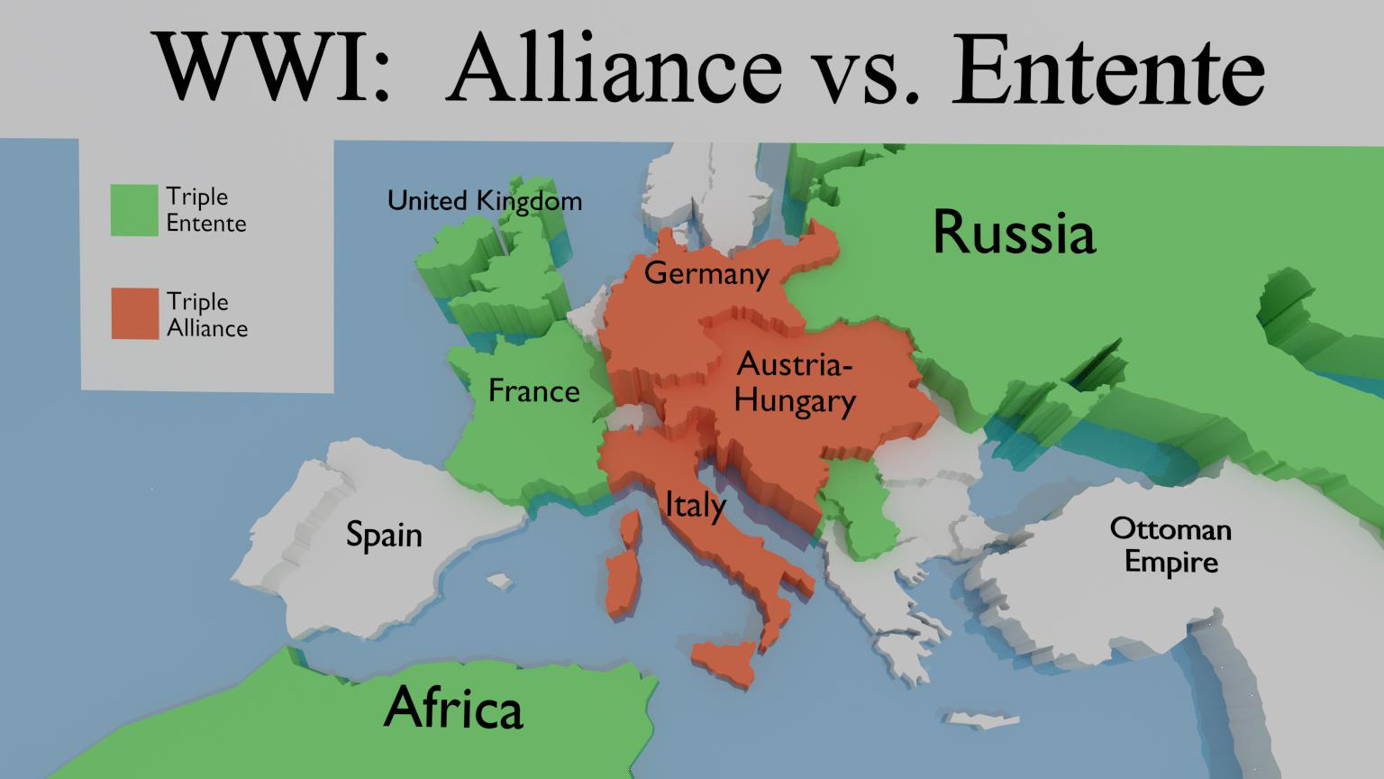
The Alliances of World War I
Notes:
22

Slide 16
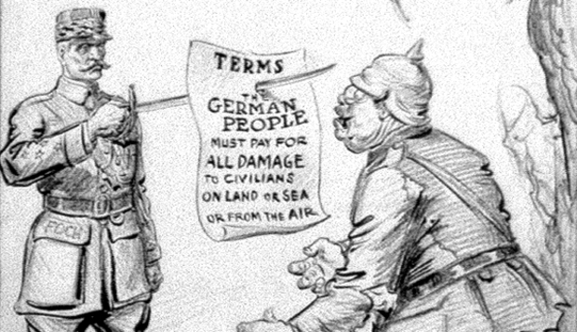
The Treaty of Versailles
Ended World War I
Forced Germany to pay crippling reparations
Angered Germans but they had no choice but to comply.
Notes:
23

