Slide 1
Final Course Review 4
Mr. Wyka
World History
Citrus High School
Notes:
Questions 24-

Slide 2
Two Important Effects of World War I
The End of the Romanov Dynasty
Russia had been ruled by the Romanov family of czars.
The Bolsheviks (communists) killed the last Romanov czar and his family.
The Treaty of Versailles
The Treaty that officially ended the war and dictated the terms of peace.
Notes:
24

Slide 3
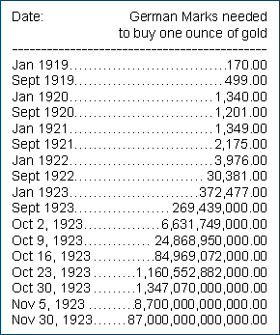
The Treaty of Versailles
Blamed Germany for the war
Demanded Germany pay reparations
Germany printed too much money to stimulate their economy to help pay the reparations
The result of this was run-away inflation called … HYPERINFLATION
Notes:
25

Slide 4
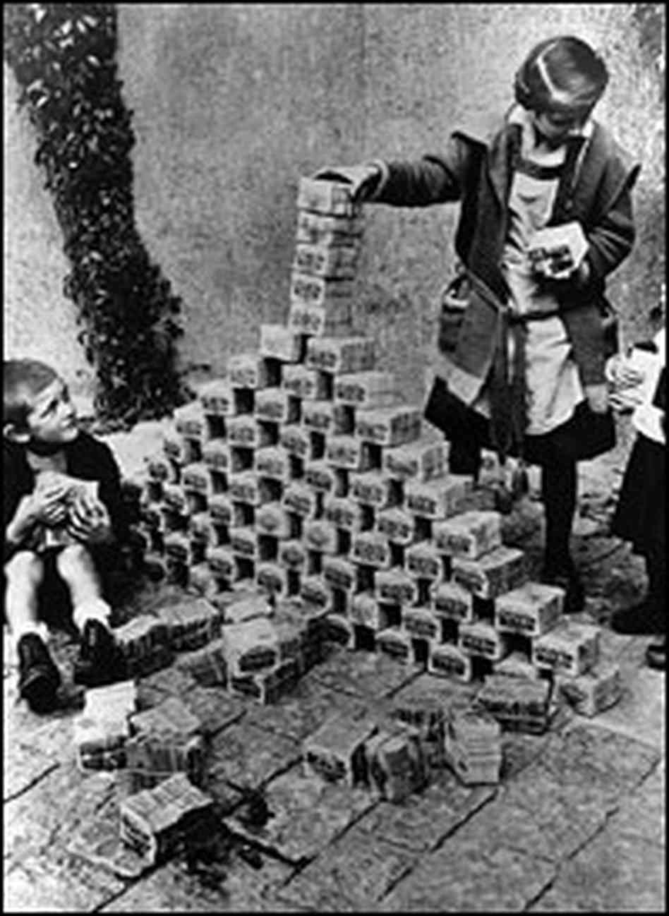
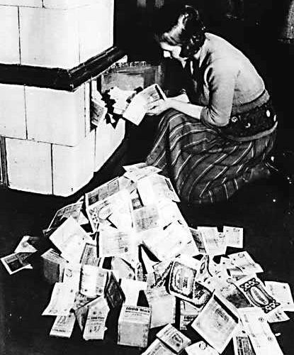

Slide 5
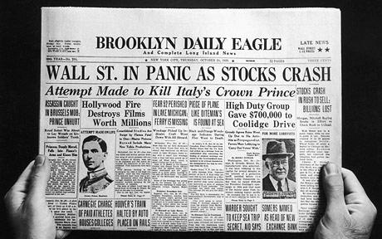
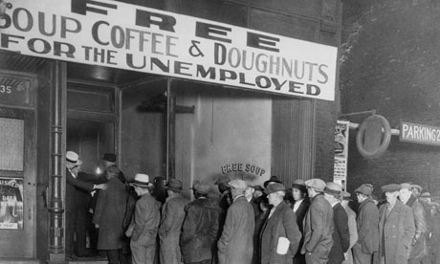
The Global Depression of the 1930s
Brought to you by the
Stock Market Crash of 1929
Notes:
Question 26

Slide 6
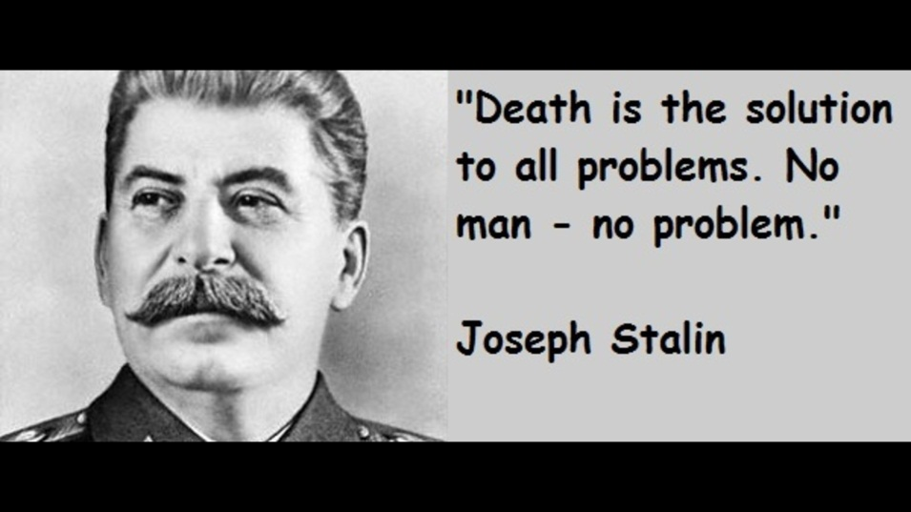
Russian Revolution
The successful Bolshevik (communist) revolution in Russia established a new, powerful communist state in 1921.
The communist dictator, Joseph Stalin, used his police forces to arrest any who opposed him, even those within his own party.
Notes:
27

Slide 7
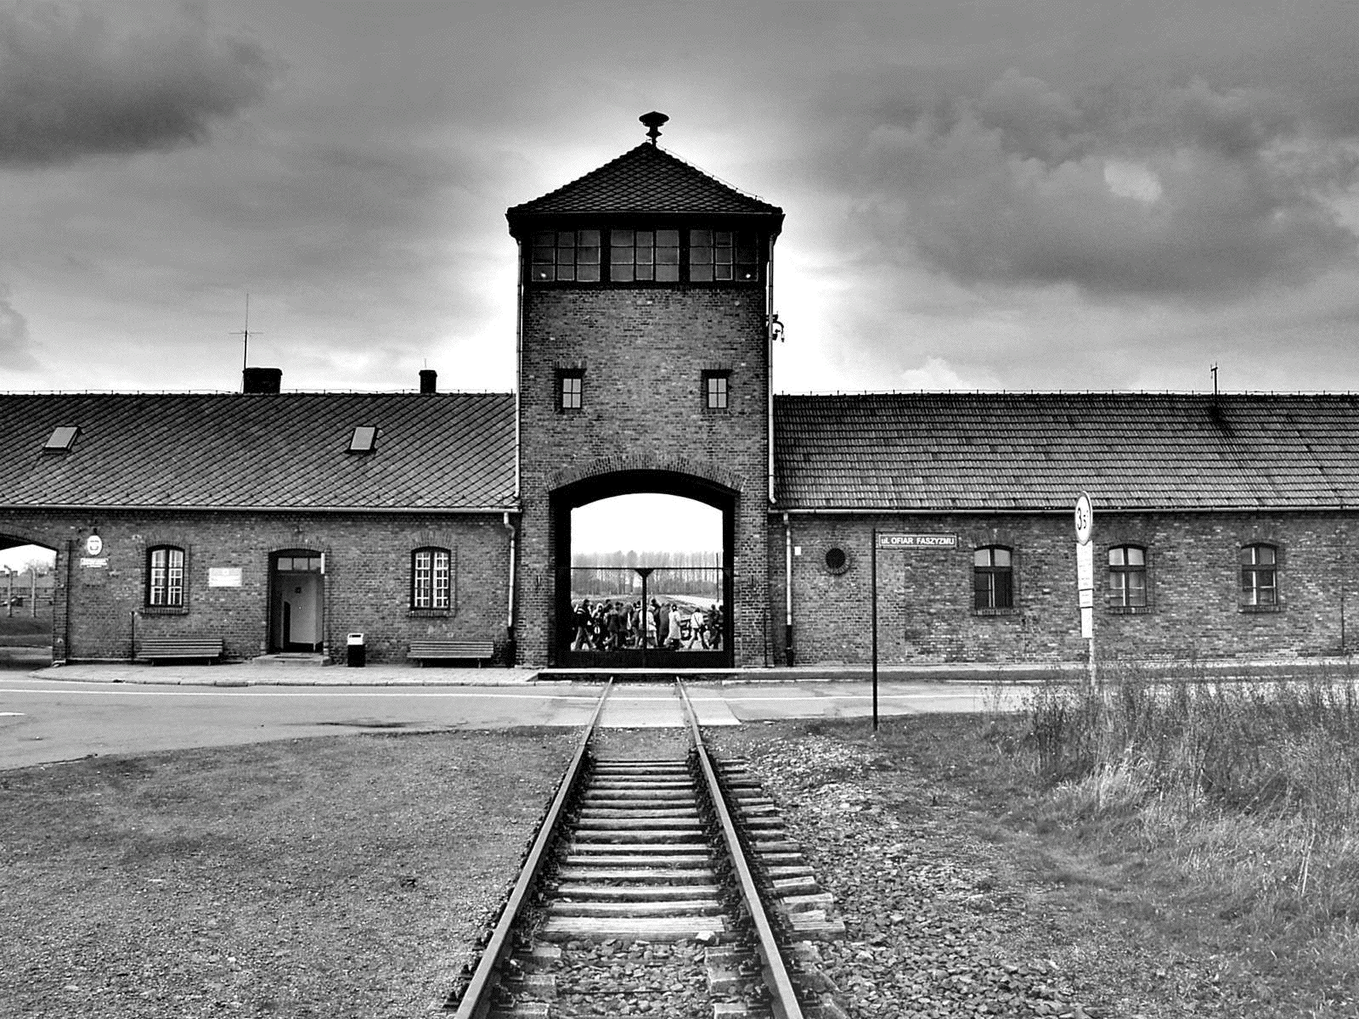
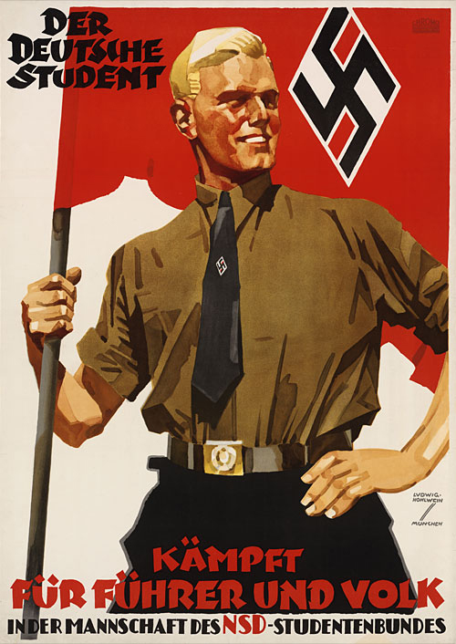
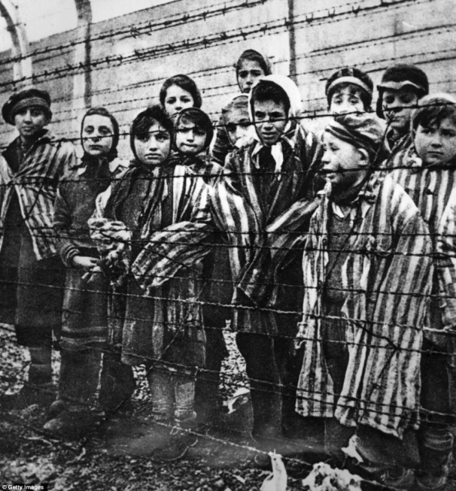
Adolf Hitler’s policy of Aryan Supremacy…
Affected the JEWS most deeply.
Notes:
28

Slide 8
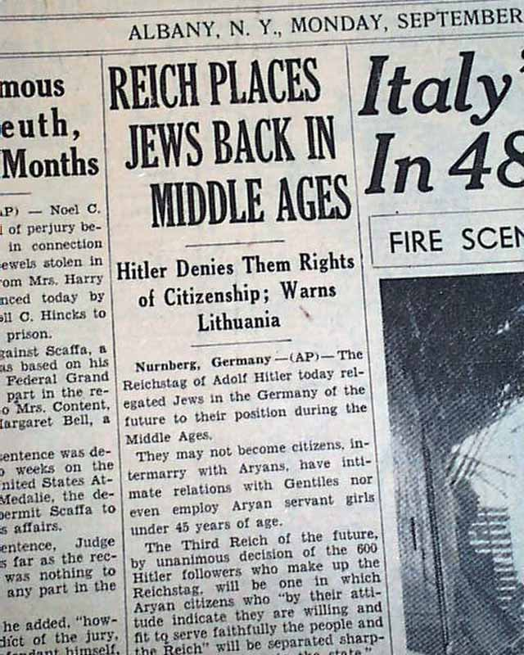
The Nuremberg Laws
Stripped German Jews of their citizenship in Nazi Germany.
Notes:
29

Slide 9
Causes of World War II
Weakness of the League of Nations
Worldwide Economic Depression
Harshness of the Treaty of Versailles
Failure of the Policy of Appeasement
Notes:
30

Slide 10
Prior to WWII, the U.S. Responded to Japanese aggression in Asia by…
Instituting a trade embargo of vital resources on Japan.
Limiting Japan’s access to resources through Embargo was a likely cause of the Japanese surprise attack on Pearl Harbor.
Notes:
31

Slide 11
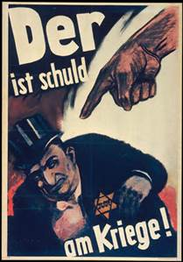
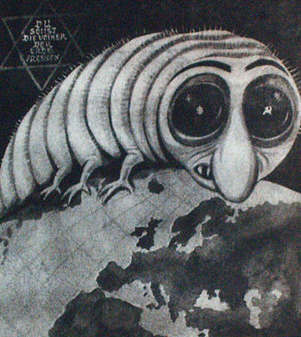
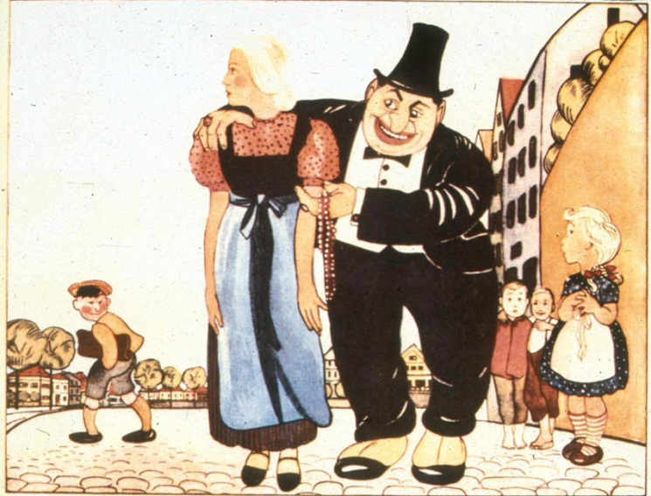
How were the Nazis able to get away with committing atrocities against the Jews?
Germans had been taught to view the Jews as sub-Human (i.e. not human).
Notes:
32

Slide 12
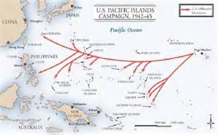
The Allies used an Island Hopping Strategy in the Pacific during WWII.
Why?
To cover vast distances while minimizing casualties.
Notes:
33

Slide 13
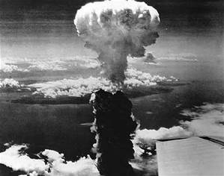
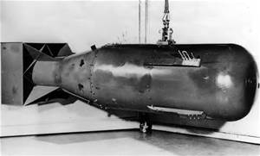
World War II
U.S. President Harry Truman made the difficult decision to use atomic bombs on Japan.
Notes:
34

Slide 14
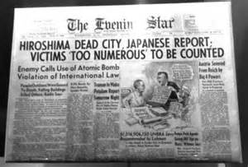
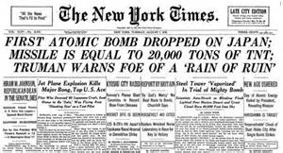
World War II
U.S. President Harry Truman made the difficult decision to use atomic bombs on the Japanese cities of Hiroshima and Nagasaki because an invasion of Japan would have cost millions of lives.
Notes:
35

Slide 15
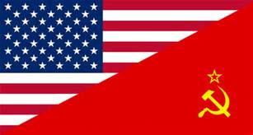
After World War II…
Two Nations emerged as SuperPowers
The United States The Soviet Union of America
Notes:
36

Slide 16
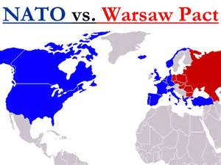
N.A.T.O. and the Warsaw Pact
Military Alliances of the two SuperPowers during the Cold War.
Notes:
23

Slide 17
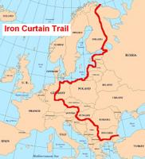
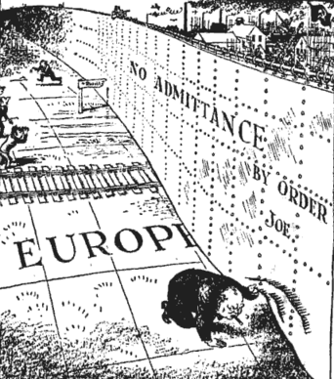
The Iron Curtain
The term “Iron Curtain” was coined to describe the sphere of influence of the communist Soviet Union on their Eastern European dependent states.

Slide 18
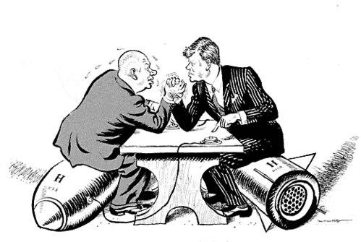
What is Brinksmanship?
Pushing dangerous events to the point of conflict in the belief that your opponent will back down.
Example:
Cuban Missile Crisis

Slide 19
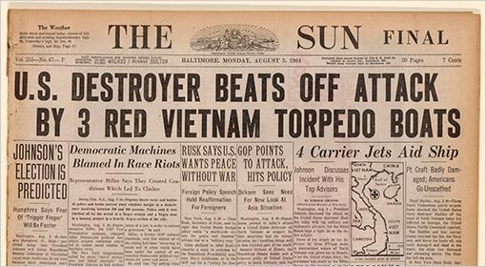
The Gulf of Tonkin & the Vietnam War
The Effect of The 1965 Gulf of Tonkin Incident:
President Johnson given BROAD war powers that he used to ESCALATE the War in Vietnam.

Slide 20
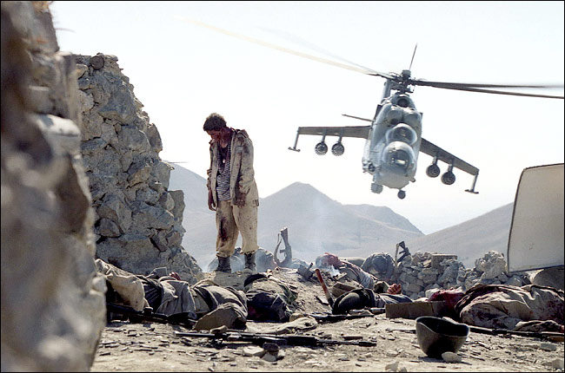
The Soviet Union in Afghanistan
From 1978-1992, the U.S.S.R. fought a war in Afghanistan, seeking to bring it under its communist umbrella of nations.
It failed.
The Afghanistan War contributed to the decline of the Soviet Union.
Notes:
41

Slide 21
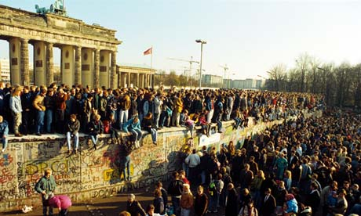
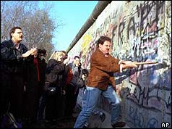
The Berlin Wall Falls
1989
Symbolized the End of Soviet Domination of Eastern Europe.
Notes:
42

Slide 22
Palestine - 1947
The United Nations votes to divide the land into two states, one Jewish, one Arab.
Jews accept the plan and Israel is reborn.
Arabs reject the plan and launch war against the new state of Israel.
Notes:
43

Slide 23
Factors leading up to the Creation of Israel
The Balfour Declaration
The Holocaust
Pogroms in Eastern Europe & Russia
Ethnic cleansing & Persecution of Jews
United Nations Partition Plan
Notes:
44

Slide 24
India’s Independence Movement
Peaceful
Vietnam’s Independence Movement
Violent
Notes:
45

Slide 25
Mahatma Gandhi
Mid 20th century Indian Independence leader
Leader of Indian National Congress
Advocated a policy of NON-VIOLENCE
Peaceful resistance
Ultimate goal was to achieve Indian Independence from Great Britain.

Slide 26
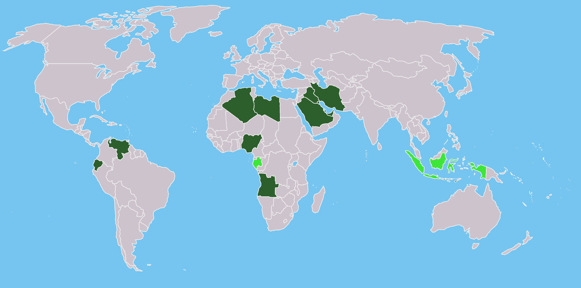
OPEC
OPEC is a trade cartel of nations which produce OIL.
It’s goal is to set global prices for oil for the advantage of its member states.

Slide 27
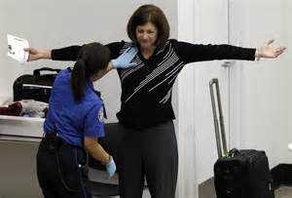
In response to Terrorism…
Security for international air travel has increased.

Slide 28
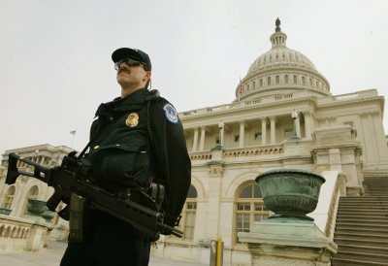
Dept. of Homeland Security
Added to the U.S. Government in 2002 to….
Defend the United States against Terrorism

