Slide 1
Letter to a Future AP World History Student
Quiz grade
“Dear future WHAP student,”
At least one full page
Address what you did wrong (what a future student should avoid doing).
Address what you did right (what a future student should do to succeed).

Slide 2
Turn in your Letter to a Future AP World History student if you’ve not done so already.

Slide 3
Wyka’s Word of the Day

Slide 4
Kindness – the state of being kind, generous, and just basically good toward others.

Slide 5
Kindness – the state of being kind, generous, and just basically good toward others.
In short, just do the right thing my students. Choose to do good and shun evil. Turn away from those things that breed hatred and hurt. Turn toward those things that make others smile. Be the best person you can be and be kind to others.

Slide 6
AP World History Final Review
If you pay attention, EVERYTHING you need to know to succeed on the final exam
Mr. Wyka’s Advanced Placement World History
Citrus High School

Slide 7
Take out a sheet of paper and take notes as we go through this review.

Slide 8
Word Association
Muhammad Ali
Francisco Pizzaro
Mansa Musa
d. Maximilien Robespierre
e. Akbar
_____1. Egypt, modernization, nationalism, industrialization
_____2. Mughal Empire, social harmony, “Divine Faith”, Rajputs
_____3. Reign of Terror, Jacobin, guillotine, National calendar
_____4. Conquistador, Inca, gold/silver, Atahualpa
_____5. Mali, Islam, Hajj, Timbuktu
A
E
D
B
C

Slide 9
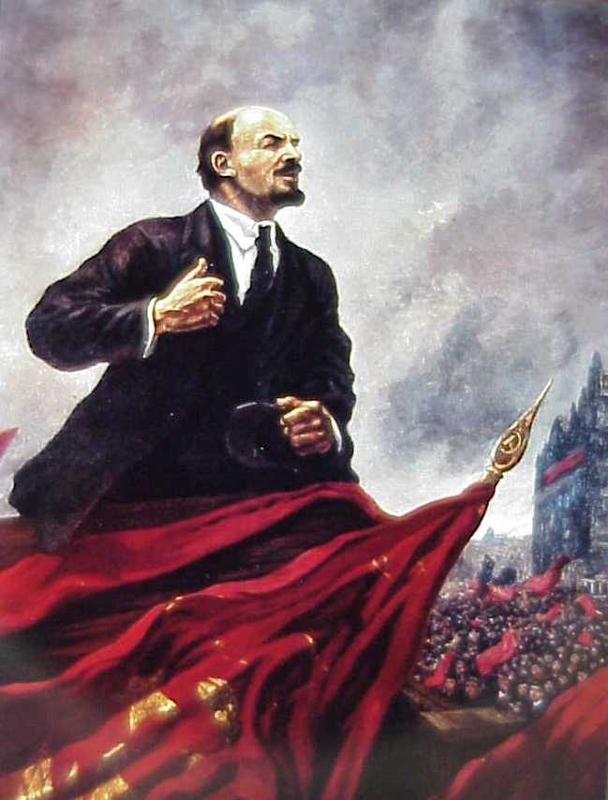
Who Am I?
I implemented a communist revolution in Russia in 1917 and arranged to end Russia’s involvement in World War I.
Vladimir Lenin

Slide 10
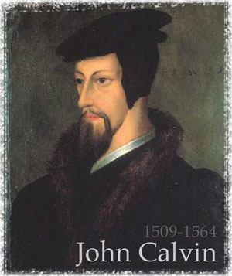
Who Am I?
I, and my followers, know that we were predestined to be part of God’s chosen elect. That’s why we created a theocracy in Geneva, Switzerland.
John Calvin

Slide 11
Vocabulary
_______________ is a social philosophy advocating the improvement of human genetic traits through the promotion of higher reproduction of people with desired traits (positive eugenics), and reduced reproduction of people with less-desired or undesired traits (negative eugenics).
Genetics
Eugenics
Euthanasia

Slide 12
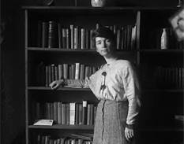
Who Am I?
A major proponent of birth control and eugenics, I became an influential leader in the movement to legalize birth control in the 1920s and 1930s.
Margaret Sanger

Slide 13
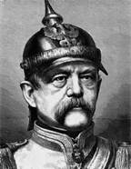
Who Am I?
I am the one responsible for making Germany into the nation it is today. After all, I led the push to unify German-speaking peoples and drove German colonization efforts in Africa.
Otto von Bismark

Slide 14
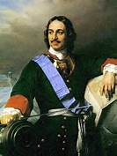
Who Am I?
I had the beautiful city of St. Petersburg built, as a “window to the west” and defeated Sweden in the Great Northern War.
Czar Peter the Great

Slide 15
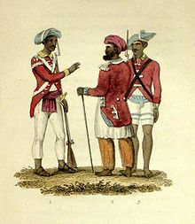
Though initially hired to enforce its rule, the ________________ eventually rebelled against the British East India Company, seeking to end ____________________ in India.
Jacobins, slavery
Gens de Coleur, slavery
Cossacks, mercantilism
Sepoys, colonialism

Slide 16
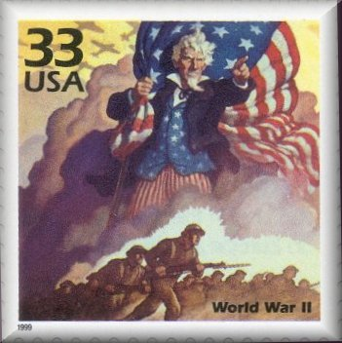
As part of the total war approach that nations adopted during the World Wars, military service became ____________ for able-bodied men.
compulsory
optional
illusory
understandable

Slide 17
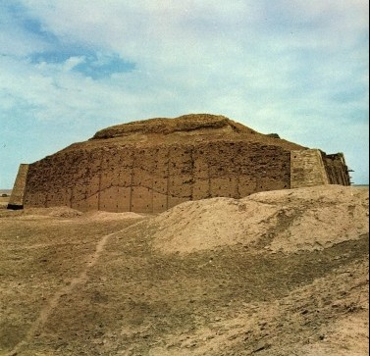
The ancient civilizations of Mesopotamia and Egypt were similar in that both cultures
established trade routes to China.
used the ziggurat form for their temples.
used a hieroglyphic writing system.
developed along rivers.

Slide 18
The posters above supports which of the following concepts?
a. Resistance is Futile: You Will Be Assimilated
b. Total Warfare
c. Abolitionism
d. Changing Artistic Styles
e. Increasing Union Membership in America

Slide 19
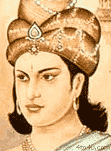
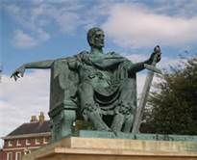
The Roman Emperor Constantine influenced the spread of Christianity in the way that the Mauryan Emperor Ashoka influenced the spread of
a. Judaism
b. Confucianism
c. Hinduism
d. Zoroastrianism
e. Buddhism

Slide 20
The religious split between Sunni and Shi’ite Muslims originated in a disagreement about
a. strategies for expansion of the faith.
b. whether or not Muhammad was a divine being.
c. the basis for succession of the caliph.
d. the location of the capital city of the caliphate.
e. the treatment of conquered peoples

Slide 21
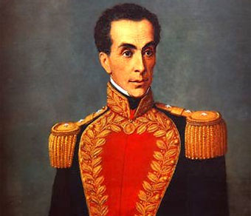
Which person is best associated with the early 19th century independence movement of northern South America?
a. Simon Bolivar
b. Mustafa Kemal Ataturk
c. François Mackandal
d. Maximilien Robespierre
e. Thomas Jefferson

Slide 22
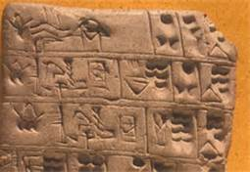
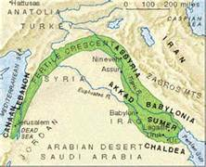
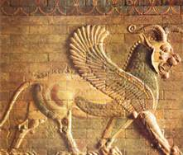
Civilization first began in
a. Egypt
b. Indus Valley
c. Mesopotamia
d. China along the Yellow River

Slide 23
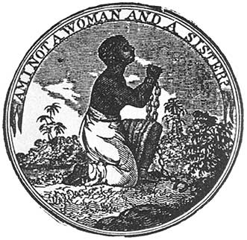
Among the major American social reforms of the 19th century were strong women’s rights movements, immigration restrictions, and ____________.
a. abolitionism
b. absolutism
c. mercantilism
d. Pan-Slavism
Abolitionism was a movement to end slavery, whether formal or informal. In Western Europe and the Americas, abolitionism was a historical movement to end the African slave trade and set slaves free.

Slide 24
The Four Noble Truths, the Eightfold Path, and the Wheel of the Law are identified with
a. Dravidian religion b. Jainism
c. Buddhism
d. Hinduism

Slide 25
The Great Depression was caused by
a. hyperinflation in Germany due to the Treaty of Versailles
b. global tariff’s designed to promote domestic industries and limit foreign competition
c. overproduction and irresponsible lending by banks
d. the Stock Market crash of 1929
e. all of the above

Slide 26
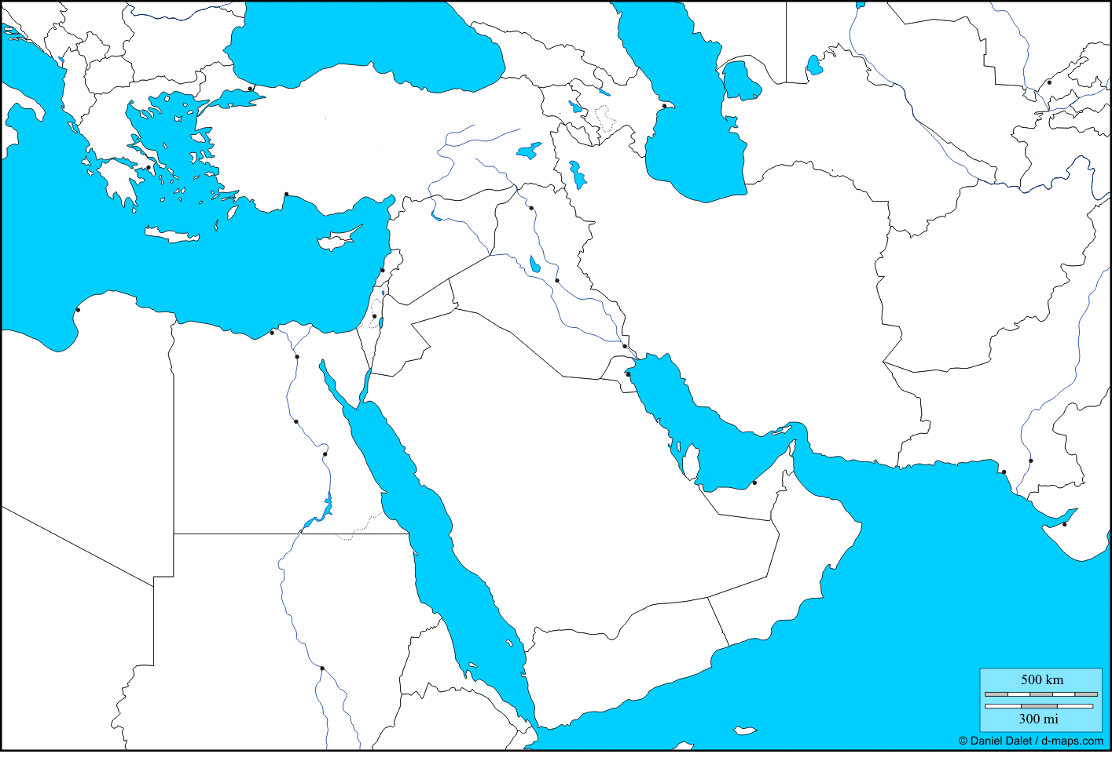
On this map, where would you place:
Upper Egypt
Sumer
Sparta
the Hellespont
Lower Egypt
Persia
4
3
2
5
6
1

Slide 27
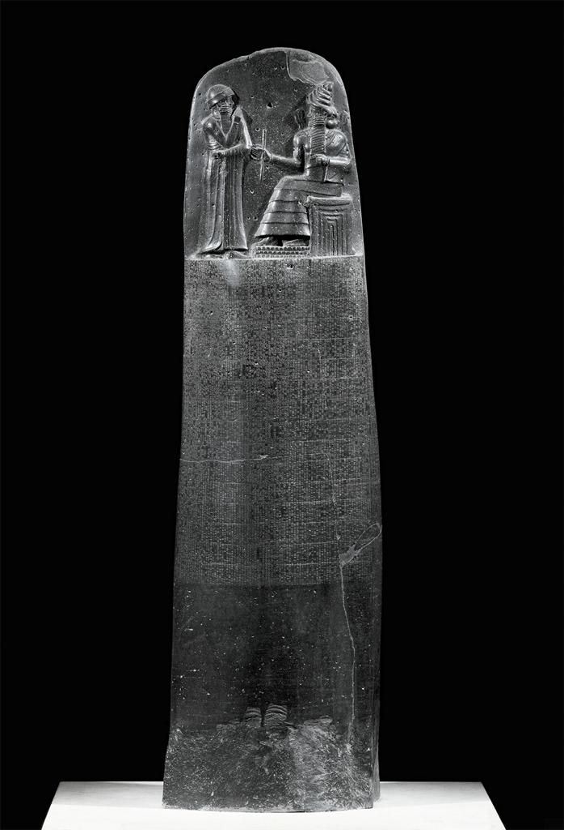
What does this picture show?
The Code of Hammurabi is a well-preserved Babylonian law code, dating back to about 1772 BC.
The Babylonian king, Hammurabi, enacted the code, and partial copies exist on a human-sized stone stele and various clay tablets.
The Code consists of 282 laws, with scaled punishments, adjusting "an eye for an eye, a tooth for a tooth" as graded depending on social status, of slave versus free man.
Nearly one-half of the Code deals with matters of contract, establishing for example the wages to be paid to an ox driver or a surgeon. A third of the code addresses issues concerning household and family relationships such as inheritance, divorce, paternity and sexual behavior. A handful of provisions address issues related to military service.
One nearly complete example of the Code survives today, on a diorite stele in the shape of a huge index finger, 7.4 ft tall. The Code is inscribed in the Akkadian language, using cuneiform script carved into the stele.

Slide 28
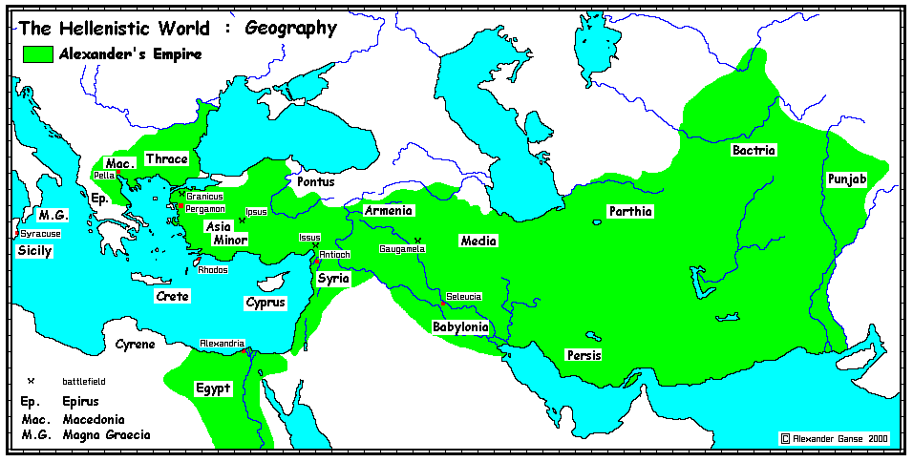
What does it mean to be “Hellenized”?
to be conquered by Greek forces
to form an alliance with a Greek power
to go to war against the Persians
to be powerfully influenced by Greek culture.

Slide 29
Which of the following illustrates a similarity between World War I and World War II?
a. Military alliances played an important role in both wars.
b. Both wars began due to an assassination and various underlying causes.
c. America immediately sided against the Germans in both wars.
d. Both wars ended in foreign occupation of Germany and the rise of fascist leaders.

Slide 30
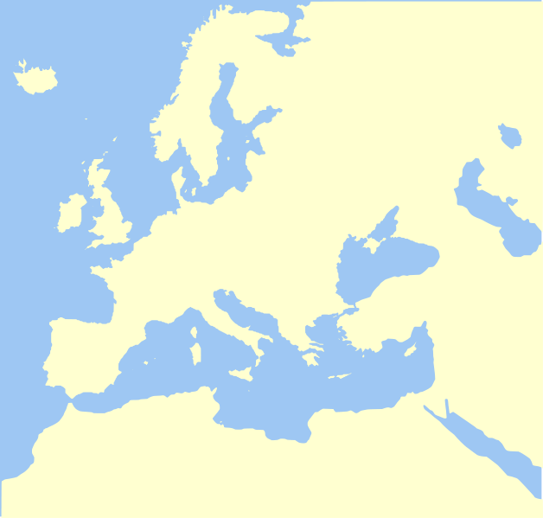
Match the place or region with the civilization or event.
Vikings
Constantinople
Rome
Greece
Kingdom of Israel
1
2
3
4
5

Slide 31
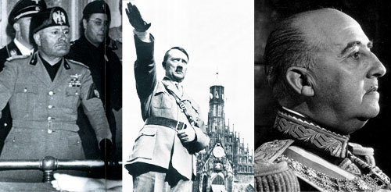
Benito Mussolini, Adolf Hitler, and Francisco Franco are all examples of
Fascist, totalitarian rulers
Socialist dictators
Democratically elected populists
Absolute monarchs

Slide 32
Which of the following did NOT play an important role in starting World War I?
a. Competitive notions created by European imperialism caused tensions between rival nations.
b. The German invasion of Poland in 1939.
c. Rampant militarism throughout Europe and rising nationalist fervor.
d. The assassination of Austro-Hungarian Archduke Franz Ferdinand.

Slide 33
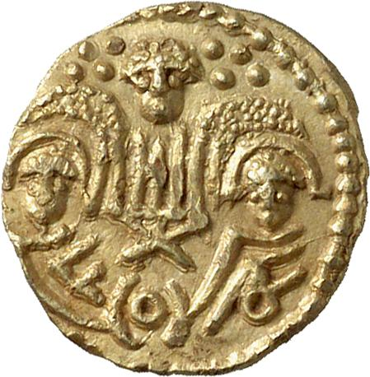
In medieval Germanic law, the amount of money paid by a criminal to the family of the person he had killed or injured is:
wergild
ordeal
stipend
dominus
tribute

Slide 34
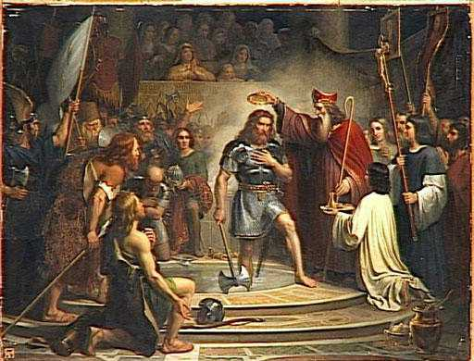
The Frankish kingdom was established by ________________, a strong military leader who around 500 became the first Germanic ruler to convert to ________________.
Charlemagne, Christianity
Clovis, Christianity
Pepin, Islam
Clovis, Islam
Beowulf, Paganism
The Baptism of Clovis I, King of the Franks by St. Remigius

Slide 35
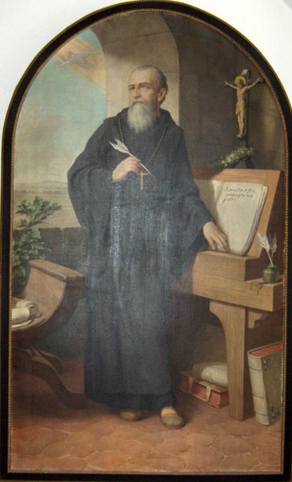
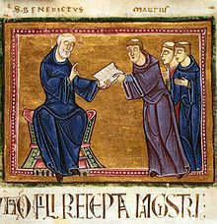
_________________ founded an order of monasticism.
St. Benedict
Charles the Great
Emperor Alexius I
St. Francis of Assisi
St. Ignatius of Loyola

Slide 36
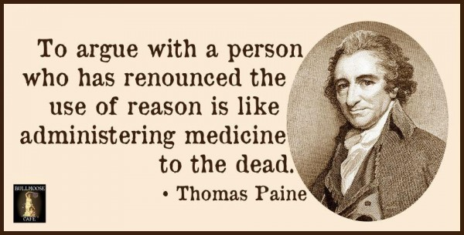
___________, the famous author of Common Sense, effectively used ______________ to persuade American colonists to continue their fight against the British crown.
a. Alexander Hamilton, patriotism b. Karl Marx, Utopian Socialism
c. James Watt, positivism d. Thomas Paine, rhetoric

Slide 37
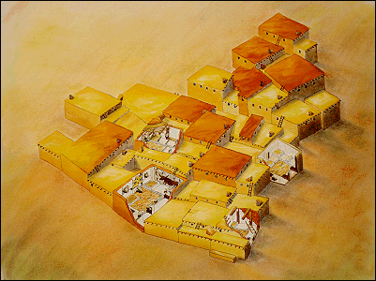
In this Neolithic farming town, residents entered their homes by climbing down ladders through a hole in the roof.
a. Gobekli Tepe c. Jericho
b. Uruk d. Catal Huyuk

Slide 38
Which event weakened the Greek city-states, paving the way for the conquest of Philip of Macedonia?
a. the Peloponnesian War b. the Persian Wars
c. the Punic Wars d. the Mycenaean invasion of Crete
e. formation of the Delian League

Slide 39
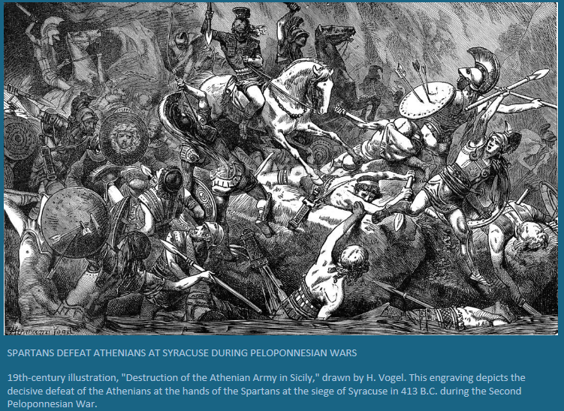

Slide 40
Which of the following statements regarding the tenets (beliefs) of Islam is accurate?
a. Muslims believe Muhammad was the divine son of Allah.
b. Muslims worship one god whose name is Allah.
c. Pilgrimage to Mecca commemorates the birth of Muhammad.
d. The Quran is meant to supplement Jewish and Christian scripture.
e. Friday is an obligatory day of rest for Muslims.

Slide 41
The cities of northern Italy saw their trade expand in the 13th century and enjoyed a virtual European monopoly on Eastern goods such as silk and spices. What ended that monopoly?
a. the invasion of the Mongols
b. development of an alternate trade route through Kievan Russia
c. the Portuguese maritime route to India around the horn of Africa
d. invention of the camel saddle which open up desert trade routes
e. Spanish discovery of the New World which brought spices & silk from the west to Europe

Slide 42
What important contribution did Nicholas Copernicus make to world history?
a. Copernicus, a Russian merchant, was the first member of the bourgeoisie
b. Copernicus founded a school of navigation and developed the caravel, a new type of sailing ship
c. Copernicus outlined the concept of the heliocentric universe, crushing popular beliefs that had existed for thousands of years.
d. Copernicus opened the world’s first shopping mall – Copernicus World – in Warsaw, Poland.
e. Copernicus was the founder of the Club of Rome, a precursor of the European Union.

Slide 43
“For the sake of the preservation of this entire creation, Purusha, the exceedingly resplendent one, assigned separate duties to the classes which had sprung from his mouth, arms, thighs, and feet.”
-- Code of Manu, circa 300 B.C.E.
The passage above most reflects which of the following cultural traditions?
(A) The concept of caste in the Vedic religions
(B) The Daoist emphasis on the balance between humans and nature
(C) Buddha’s teaching about the search for enlightenment
(D) Confucius’ teaching on social harmony
The correct answer is A. The passage reflects support for a strictly hierarchical society with separate tasks for each group, whose place in society was determined at birth. These ideas are closest to the Vedic religions of India.

Slide 44
Which of the following accurately describes the Mongol Empire’s role in facilitating trans-Eurasian trade?
(A) It imposed Mongol religious beliefs and practices on conquered peoples.
(B) It reestablished the Silk Roads between East Asia and Europe.
(C) It created a self-contained economic system by banning non-Mongol merchants from its territories.
(D) It developed a sophisticated bureaucracy staffed by talented Mongols.
The correct answer is B. The Mongol Empire was able to ensure a measure of peace and stability along the Silk Roads through its political control of the surrounding regions. This contributed to an increase in trade across Eurasia.

Slide 45
“What is recorded in the Buddhist scriptures is analogous to the teachings contained in the scripture of Laozi [the founder of Daoism] in China, and it is actually believed that Laozi, after having gone to India, instructed the barbarians and became the Buddha.”
--- Yu Huan, Chinese historian, circa 250 C.E.
In the fictionalized account of the origins of Buddhism outlined in the passage above, Yu Huan’s purpose was most likely to
(A) make it easier for his Buddhist readers to convert to Daoism
(B) hint at the existence of an alternate set of Buddhist scriptures that were different from the officially accepted ones
(C) demonstrate the extent of missionary and trade links between China and India
(D) assert the superiority of Chinese culture over non-Chinese cultures
The correct answer is D. Yu Huan’s account privileges Chinese over Indian culture
by incorrectly claiming that Buddhism was introduced into India from China.
Choice A may be true, but it is an unintended consequence of the account and is
therefore incorrect.

Slide 46
Which of the following statements best represents a nationalistic interpretation of the collapse of the Ottoman and Russian empires during and immediately after the First World War?
(A) Military weakness and political instability were the primary reasons for the collapse of these empires.
(B) The growing demands of various ethnic groups within these multiethnic empires were the primary reasons for the collapse.
(C) The slow pace of industrialization in these empires left them unable to compete militarily and politically with more developed countries.
(D) Religious differences between the Russian Empire and the Ottoman Empire led to their final collapse.
The correct answer is B. The historical interpretation described in choice B
suggests that the demand for political autonomy by various ethnic groups within
each multiethnic empire led to their collapse. Within the Russian and Ottoman
empires, the majority ethnic groups had tried to achieve greater political unity
by imposing their language and culture on other groups, which in turn had
led to greater nationalist tensions. This interpretation emphasizes the role of
nationalism, unlike the other choices.

Slide 47
The United States Declaration of Independence and the French Declaration of the Rights of Man and Citizen reflect a shared concern for
(A) physical elimination of the ruling class
(B) confiscation of church property
(C) protection of private property
(D) preservation of the monarchy
The correct answer is C. Both documents were heavily influenced by the writings of enlightenment thinker John Locke, who argued that natural law entitled people to the rights of life, liberty and property. The concerns mentioned in choices A and B occurred during the French Revolution but not the American Revolution, and choice D is antithetical to both documents’ objectives.

Slide 48
A historian researching the effects of Christian missionaries’ activities on local social structures in late-nineteenth-century Africa would probably find which of the following sources most useful?
(A) African accounts of converting to Christianity
(B) Fundraising speeches given in Europe by supporters of missionary efforts
(C) Data on the number of missionaries going to Africa
(D) Recruitment advertisements for missionaries in church newsletters in Europe
The correct answer is A. Among the types of sources listed in the answer choices, accounts by African converts to Christianity would provide the best insight into the features of African society that might be altered as a consequence of adopting new religious practices. The other choices provide evidence about the recruitment and funding of missionaries but not about their effects on African social structures.

Slide 49
AP World History Test
For those of you who worked hard throughout the semester, in class and on your own time, and mastered the AP World History test, your hard work is worth …
3 Credit Hours of Social Science course work, or
$626.04
Based on 2012 in-state tuition rates at U.S.F., Tampa campus.
Pretty good stuff, aye?

