Slide 1
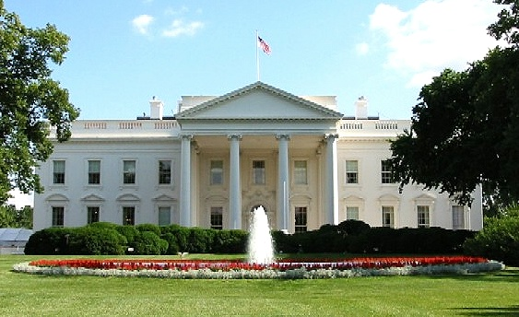
Unit IV: The Executive Branch

Slide 2
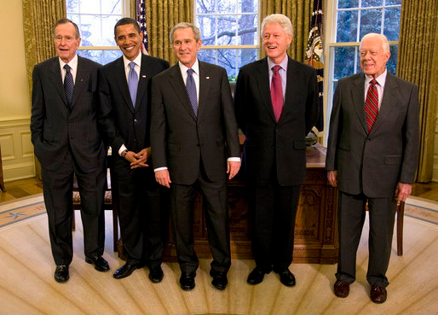
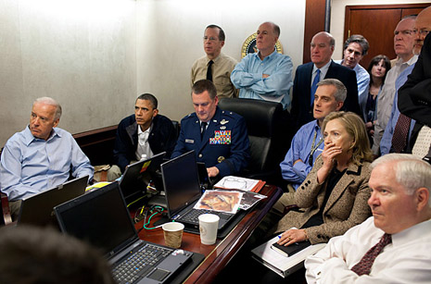
The President
A. Roles of the President
1. Chief Executive - The power to execute & carry out nation’s laws that are passed by Congress
2. Commander in Chief - Authority to order troops into action & recall them
a. Congress has power to declare war

Slide 3
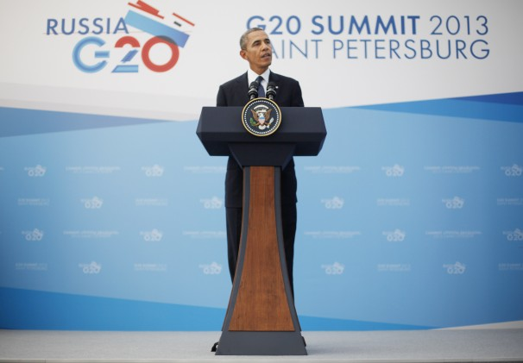
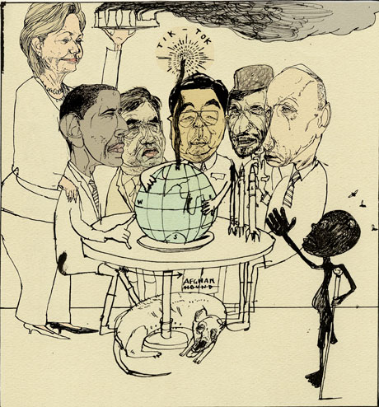
3. Foreign Policy Leader - Job of creating the nation’s plans for dealing with other countries
a. Diplomacy- Negotiating with foreign countries
4. Chief of State - The head of state, symbolic figurehead of the United States

Slide 4
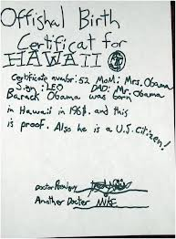
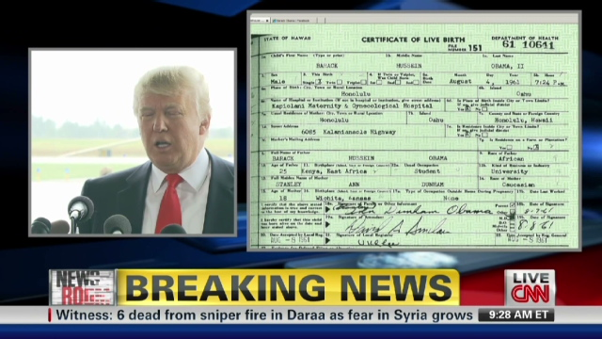
B. Holding Office
1. Official Qualifications
a. At least 35 years old
b. Lived in the country for 14 years
c. Natural-born citizen
- Born on U.S. soil
- Born of U.S. citizens outside U.S.

Slide 5
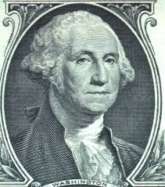
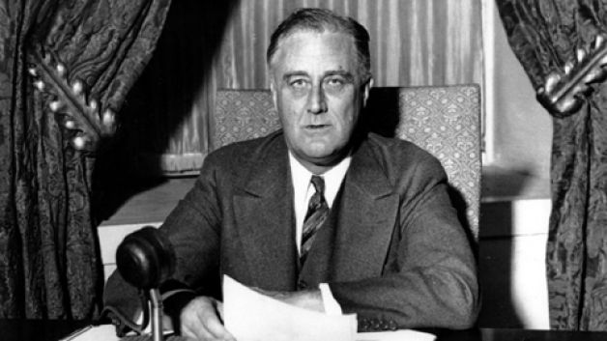
2. Term of Office
a. George Washington created the unofficial two-term limit
b. Franklin Roosevelt ran for & won a 3rd term in 1941. Died during his 4th term.
c. In 1951 the 22nd Amendment was ratified stating a president can only serve 2 terms total

Slide 6
The Electoral College
The Short Version!

Slide 7
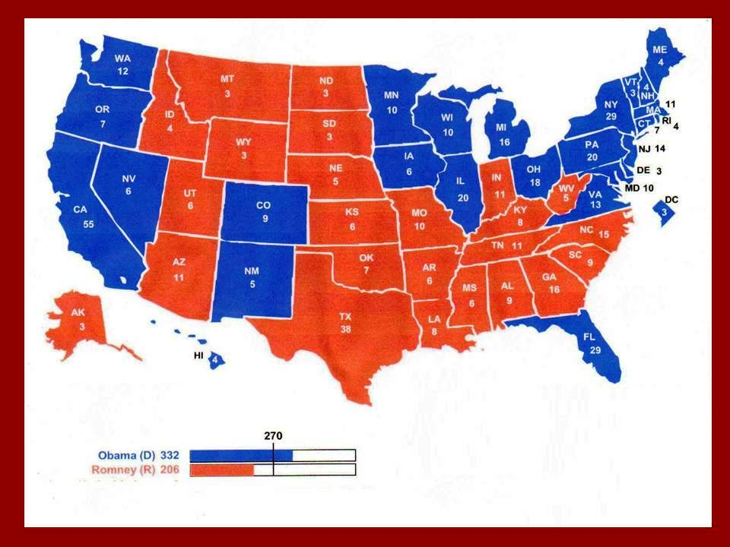
At first glance, Who Won?

Slide 8
Facts about Electoral College
Total Available: 538
Need 270 to Win
Number of electors based on the Congressional Representation of the state (senators + reps)
Electors selected by political parties.
Problems:
faithless electors
winner of popular vote can lose (2000)
tie is broken in the House of Reps.
WINNER TAKE ALL in 48/50 states

Slide 9
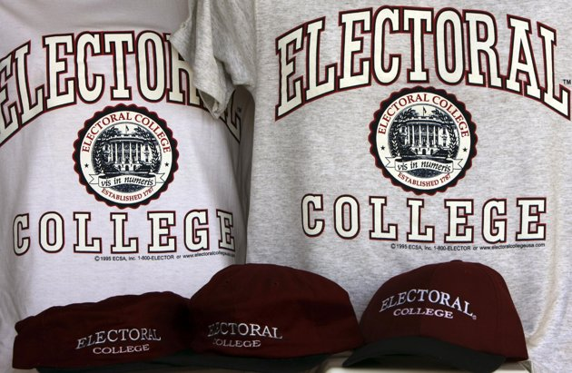
C. The Electoral College
1. Electors are selected by state political parties, the elector pledges to vote for party candidate
a. Primary elections
b. Party conventions
c. Named by campaign committees
* Names submitted at least 1 month before election

Slide 10
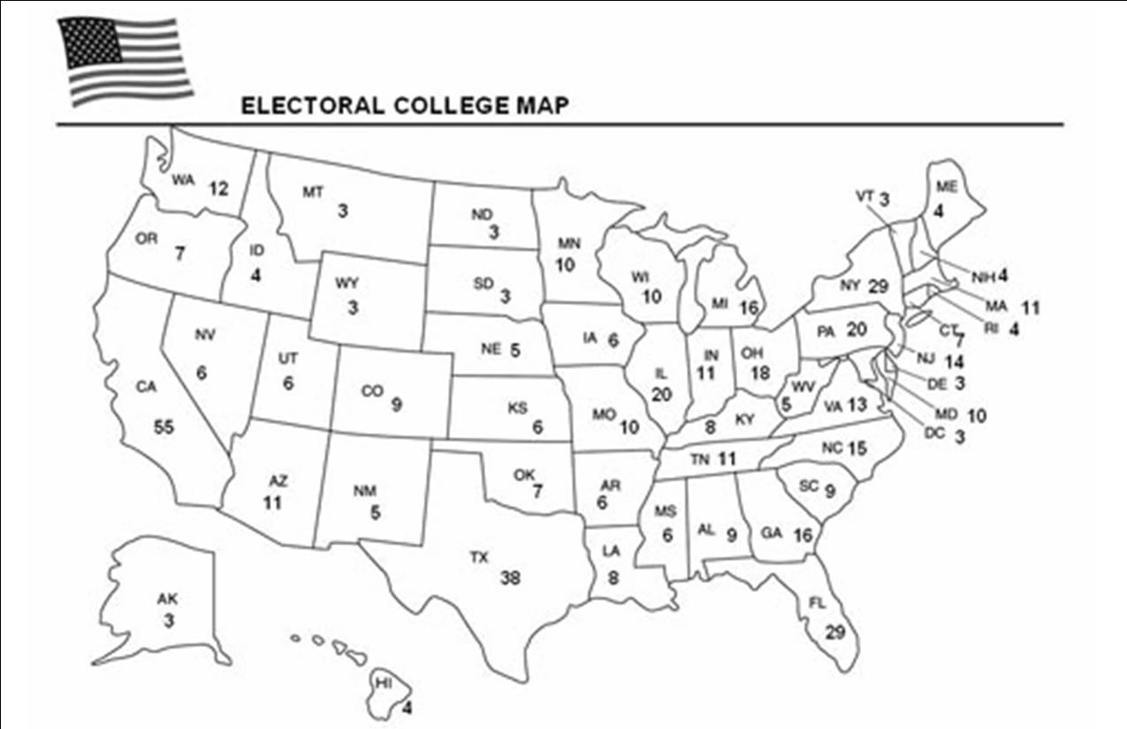
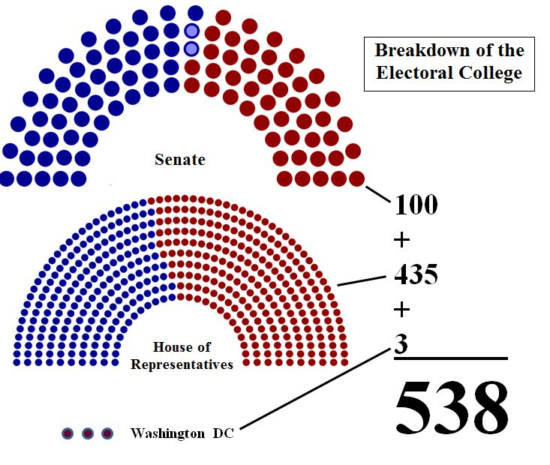
2. Voters cast ballots for president & vice pres.
a. The popular vote of the state determines which parties electors are selected
b. 48 states are winner take all…Maine & Nebraska can have split electoral votes
c. 538 electoral votes…270 needed to win

Slide 12
