Slide 1
Chapter 5, Section 2 The House of Representatives
Taking notes is highly recommended!
Mr. Wyka
U.S. Government
Citrus High School

Slide 2
Review
House of Representatives vs. the Senate
In the House, membership based on population.
Populous states have more members than small states.
In the Senate, every state gets 2 Senators regardless of size.

Slide 3
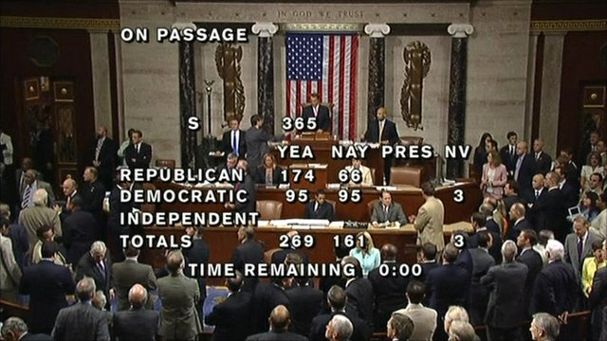
The House of Representatives
A. Membership in The House (435 members)
1. Elected directly by popular vote
2. 25 years old
3. U.S. citizen for at least 7 years
4. Resident of state he/she represents

Slide 4
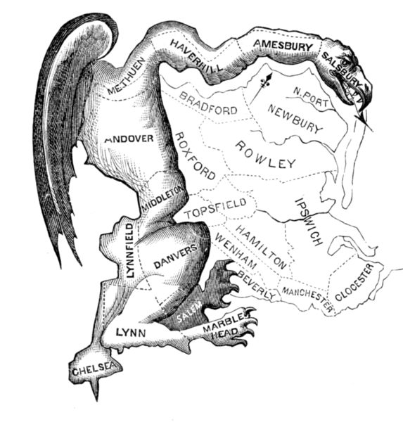
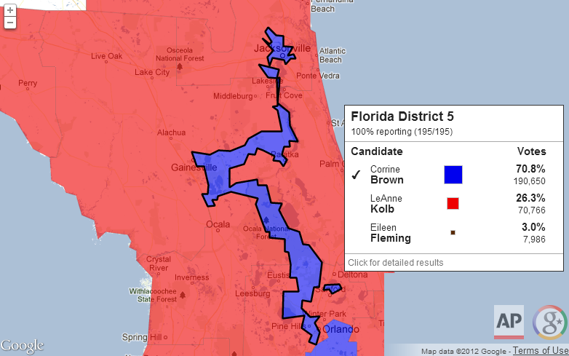
B. Reapportionment & Redistricting
1. Reapportionment- Every 10 years seats are redistributed to states based on the Census
2. Redistricting- States determine changes to districts w/in the state (political party in charge)
a. Gerrymandering- Drawing district boundaries for political advantage
In 1812 Mass. governor Elbridge Gerry signed a bill that redistricted Massachusetts to benefit his Party. When mapped, one of the contorted districts in the Boston area was said to resemble the shape of a salamander.

Slide 5
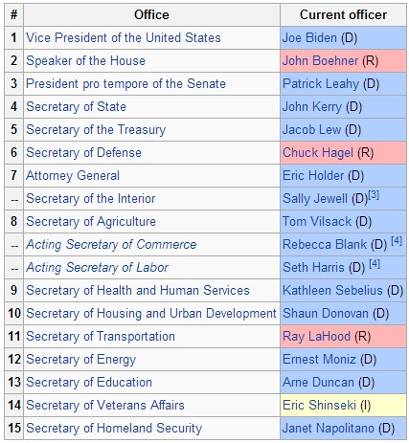
C. Leadership in the House
1. Speaker of the House- The most powerful member and presiding officer of the House
a. Elected by party in the majority
b. Presides over debates
c. Gives authority to speak on House floor
d. Assigns bills to various committees
e. 2nd in line for presidential succession

Slide 6
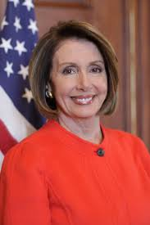
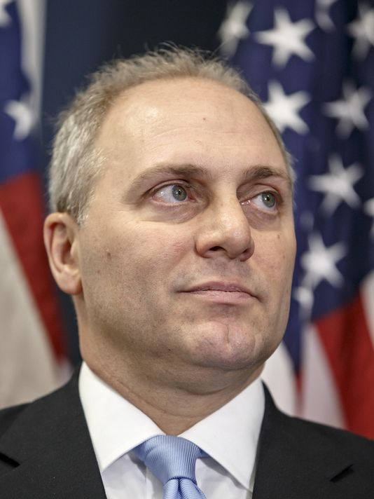
2. Floor Leaders- Help manage the actions & strategy of each party in the House
a. Floor leader of the majority party is the majority leader (assists speaker of the House)
b. Floor leader of the minority party is minority leader
3. Whips- Encourage House members to vote w/ the party leadership
Majority Leader
Rep. Kevin McCarthy
Minority Leader
Rep. Nancy Pelosi
Majority Whip
Rep. Steve Scalise
Democratic Whip
Rep. Steny Hoyer

Slide 7
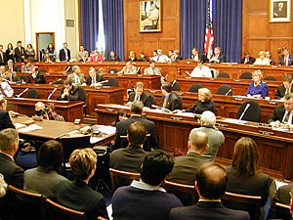
D. Committees
1. Standing Committees- 20 permanent committees dealing with major areas
a. Each standing committee has sub- committees to deal with more specific areas
2. Select Committees- created for the purpose of investigation
3. Committee Chair- head of a committee
Standing Committees
Agriculture, Nutrition, and Forestry
Appropriations
Armed Services
Banking, Housing, and Urban Affairs
Budget
Commerce, Science, and Transportation
Energy and Natural Resources
Environment and Public Works
Finance
Foreign Relations
Health, Education, Labor, and Pensions
Homeland Security and Governmental Affairs
Judiciary
Rules and Administration
Small Business and Entrepreneurship
Veterans' Affairs

Slide 8
Quiz Time!
Take out a sheet of paper.
Put your name on it.
Title the paper, House of Representatives Quiz.
Do your own work.
You may use your notes.
You don’t have to write the questions, just the answers.

Slide 9
How does one become a member of the House of Representatives?
a. Presidential appointment
b. Appointment by state governor
c. Popular Vote
d. Appointed by state legislatures

Slide 10
2. The process of redistributing House seats every 10 years based on population changes in the U.S. Census is called
a. gerrymandering
b. formal qualifications
c. reapportionment
d. caucus

Slide 11
3. The most powerful member of the House of Representatives and its presiding officer
a. Majority Whip
b. Speaker of the House
c. The Vice President
d. Minority Leader

Slide 12
How many senators does the Constitution allow each state?
a. One
b. Two
c. Three
d. Varies according to a state’s population

Slide 13
5. Each state’s Representation in the House of Representatives is based on
a. The Constitutional mandate of two Representatives
b. The population of each state
c. The decision of the National Election Committee
d. The decision of the Supreme Court

Slide 14
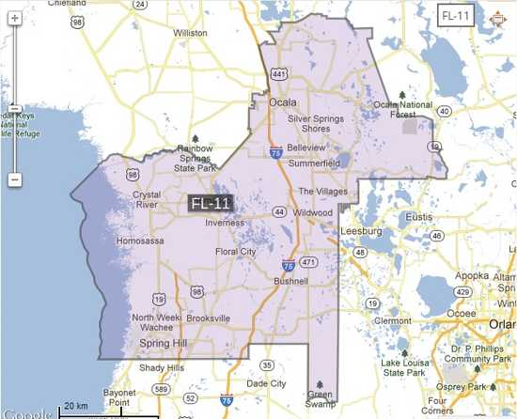
Drawing district boundaries for political advantage is called
a. Formal qualifications
b. Redistricting
c. gerrymandering
d. Fromanism

Slide 15
7. How many members of the House of Representatives are there?
a. 100
b. 76
c. 435
d. 276

Slide 16
8. How many senators are there?
a. 435
b. 176
c. 100
d. 200

