Slide 1
You’ll find this presentation on www.mrwyka.weebly.com.

Slide 2
Industrial Revolution

Slide 3
Industrial Revolution
1. Time period where machines were used to create most of the goods in the world instead of by hand.
2. Began in Great Britain
3. Late 1700s

Slide 4
Why Great Britain (pg 409-410)
Natural Resources and Geography
Coal
Abundant Rivers
Labor and capital
Lots of people
$$$ from colonial endeavors
Colonies provided a market for new goods
Entrepreneurs and Inventors
Favorable Climate for Business

Slide 5
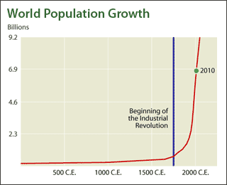
This Slide is not blank…

Slide 6
Factors of Production
What resources does it take to make an industrial country?
-Land
-Labor
-Capital (wealth)
-Entrepreneurship
The Big 4

Slide 7
Inventions that helped
Flying Shuttle and Spinning Jenny- made working with cotton faster and more productive; were originally used in the house
Factories- large buildings with machines in them to create goods. Built by rivers and streams, ‘cause the machines needed water power

Slide 8
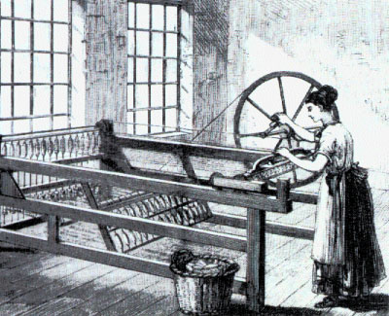
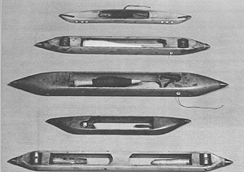
Spinning Jenny ~~~~~~>
<~~~~~~ Flying Shuttle

Slide 9
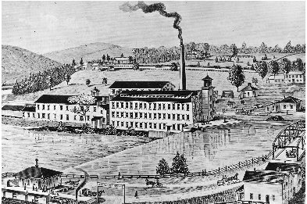
Click <HERE> to see an amazing picture of a real-life industrial revolution era factory.

Slide 10
Improvements in Transportation
Steam Engine- 1774 James Watt made the engine work more efficiently while burning less fuel
Steam Boat- Robert Fulton’s Clermont; first successful trip in 1807

Slide 11
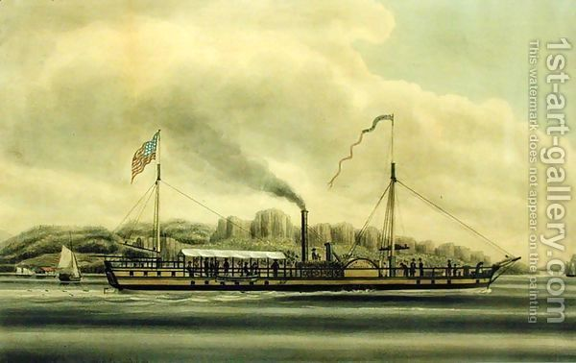

Slide 12
Steam Railroad
Gave manufacturers a cheap way to transport materials and finished product
Created new jobs for the railroad workers and miners
Tourism, as an industry, began to grow
Boosted fishing and agricultural industries who could now get their product farther, faster.

Slide 13
Effects of Industrialization

Slide 14
Urbanization
The construction of buildings and the Movement of people to cities
People wanted to live where the jobs were, and city folk earned more money than those on the farms
Crime, pollution, disease, etc increased in the cities

Slide 15
Working Conditions
Long work days - 12-16 hour days, 6 days a week.
No employment security
No minimum wage.
High temperatures in factories.
Heavy machinery made conditions dangerous
Severe injuries especially to children; some incidents led to death

Slide 16
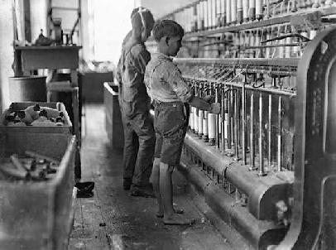

Slide 17
Long Term Effects
Mass produced goods instead of hand crafted ones are available today; not available 50-60 years ago
Profits from factories and companies transferred to tax revenue for the gov’t

Slide 18
Industrial Revolution Closer
Using your notes and your book (chapter 7), complete the Pro / Con worksheet on Industrialization.
Answer the question “Was society better or worse off as a result of the Industrial Revolution?” in the form of a strong Thesis statement.
A Thesis statement must take a stand. It can’t be either / or.
It can be one or two sentences long.
It MUST answer the question with specificity.

