Slide 1
Mid Course Review 1
Mr. Wyka
Economics
Citrus High School

Slide 2
Entrepreneurs
Entrepreneurs are the risk takers who pull together ALL the other Factors of production and put them to work in an enterprise.
Land
Labor
Capital
Why do they do this and risk an economic loss?
For the chance of an economic gain.

Slide 3
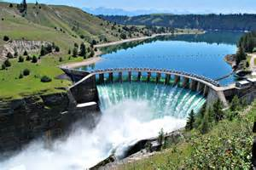
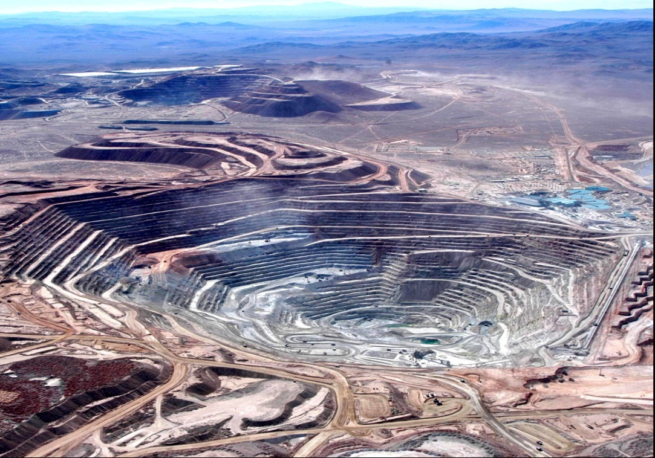
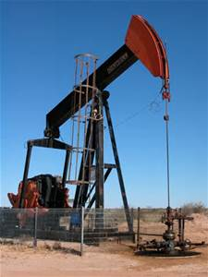
What is a renewable resource?

Slide 4
Opportunity Cost
Example:
1. The opportunity cost of moving from a to b is…
2 Bikes
2.The opportunity cost of moving from b to d is…
7 Bikes
3.The opportunity cost of moving from d to b is…
4 Computer
4.The opportunity cost of moving from f to c is…
0 Computers
5.What can you say about point G?
Unattainable

Slide 5
Production Possibilities
Which points demonstrate Efficiency in an economy? Inefficiency but possible to attain? Impossible to Attain?
14
12
10
8
6
4
2
0
Impossible/Unattainable
(given current resources)
A
B
G
C
Bikes
F
Efficient
D
Inefficient/ Unemployment
E
0 2 4 6 8 10
Computers

Slide 6
The United States has what type of economy?
Mixed Economy
Command Economy
Market Economy
Traditional Economy
The MIXED ECONOMY of the United States has aspects of a Market Economy (most resources are privately owned and allocated by the free market) and some aspects of a Command Economy (some services are provided by the government and financed by taxes, and business is regulated the government).

Slide 7
PROFIT MOTIVE
Is PROFIT MOTIVE an element of a Market Economy or a Command Economy?
Market Economy
Command Economy

Slide 8
http://www.youtube.com/watch?v=bO7FQsCcbD8

