Slide 1
Mid Course Review 2
Mr. Wyka
Economics
Citrus High School

Slide 2
In a market economy…
In a market economy, producers decide
WHAT to produce,
HOW MUCH to produce,
WHAT PRICE will be asked, and even
HOW to produce.
They do this by responding to consumers needs and wants.
In a command economy, the government answers these questions.

Slide 3
In a market economy…
In a market economy, producers decide
WHAT to produce,
HOW MUCH to produce,
WHAT PRICE will be asked, and even
HOW to produce.
They do this by responding to consumers needs and wants.
A company deciding to limit production of its product is an example of which of the above?
A company deciding to switch to robots and lay off workers is an example of which of the above?

Slide 4
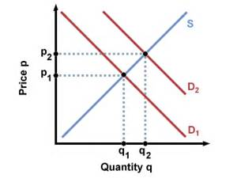
What would cause the Demand Curve to shift to the right, from D1 to D2?
If the product drops in price
If the product is highlighted by Oprah causing an increase in Consumer Preference for the product.
A decrease in the cost of producing the product
An improvement in the technology used to produce the product
An increase in government taxes on this particular product.

Slide 5
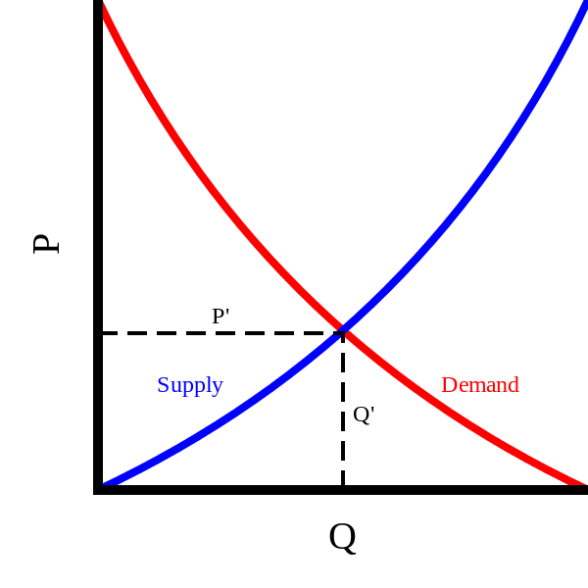
In this Graph, what is the significance of the intersection of the Supply Curve and the Demand Curve?
It’s the equilibrium price level; the price at which market forces determine the price.

Slide 6
If you want to open a business, you have a number of options…

Slide 7
Business organization
Which of the types of business organizations in the video is the easiest to establish and also, the most common?
Sole Proprietorship
Which type of business offers protection from lawsuits directed at you, and can survive your death?
Corporation

Slide 8
Business Organization
If you start a business with your best friend and agree to share the profit or loss equally among yourselves, what type of business is this?
A Partnership

Slide 9
You are going to open a business (Peter’s Pickles). You want to choose a business type that limits a customer’s ability to sue you personally should he choke on one of your products. Should you choose …
Corporation
Sole Proprietorship?

