Slide 1
Mid Course Review 3
Mr. Wyka
Economics
Citrus High School

Slide 2
Market Structures
Perfect (Pure) Competition
Lots and lots of firms selling almost identical stuff
Oligopoly
A few large firms
Monopolistic Competition
A large number of firms selling similar but different (differentiated) products
Monopoly
One seller sells a product for which there are no close substitutes

Slide 3
OK, let’s see what you remember…
A few large firms dominating a market is what type of market structure?
Oligopoly
A market dominated by one seller of a good for which you can’t easily find a substitute is a ….
Monopoly

Slide 4
OK, let’s see what you remember…
A Market structure that has a lot of firms selling similar (but not identical) products is an example of
Monopolistic competition
Relies on marketing/advertising to differentiate its product from the rest
A market that’s easy to get into, and has loads of firms selling identical products, is
Pure or Perfect Competition

Slide 5
If you’re in business and…
Your main competitor drops her price, how might you respond without having to drop your price too?
Hire a government lobbyist to push for a subsidy
Advertise the uniqueness of your product or service
Cut back on production
Cut your product’s price even more than your competition.

Slide 6
More Monopolistic Competition
One of the four market structures
Pretty easy for new firms to enter the market
Similar products but with unique features
Requires advertising to differentiate one firm’s product from the others.

Slide 7
What would happen if…
If government raised the minimum wage to $15 an hour.
People who are on the couch now would join the workforce.
(In technical terms, the Labor Supply would Increase.)

Slide 8
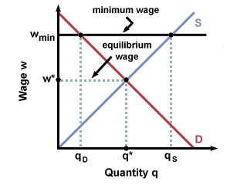
Let’s take a look at that a little closer…
The government raises the minimum wage. Check out the graph.
It’s NOT a Supply Shift
It’s a movement along the Labor Supply curve.
Identify where wages were.
Identify where they are now.
Why?

Slide 9
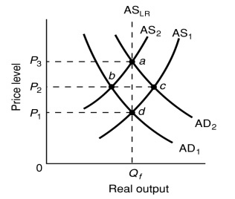
How to find the equilibrium…
When you have a bunch of curve shifts, it can be tricky to find the new equilibrium.
Let’s practice….
WHAT THE HECK IS THAT?
That’s your first reaction, but don’t worry…
I promise.

Slide 10
How to find the equilibrium…
#1. Find the original Equilibrium. (It’s where the lines marked “1” intersect.) Hint: It doesn’t even matter to the question what the lines mean.
#2. Find the new equilibrium after lines AD1 and AS1 shift. (Where AD2 and AS2 meet.)
d
a

