Slide 1
Mid Course Review 4
Mr. Wyka
Economics
Citrus High School

Slide 2
Subsidy
A Subsidy is…
When the government pays a producer to producer more of a certain good.
OR, when the government pays a producer to NOT sell a certain good.

Slide 3
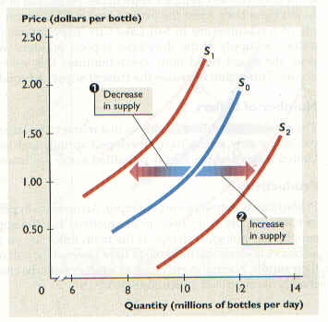
Subsidy
Why might the government subsidize certain products?
The Supply of some products, like farm goods (wheat, dairy, etc.) can fluctuate wildly because of natural forces (drought, good weather, etc.)
Remember what an increase or decrease in Supply can do to the market price?

Slide 4
Subsidy
Why might the government subsidize certain products (continued)?
Since the price of farm products can fluctuate wildly, the gov’t will subsidize the product and pay farmers to produce or even NOT to produce in order to keep the market price stable.
This is because the gov’t deems farm products important to the overall economy.

Slide 5
Subsidy review
With what you just learned about subsidies, this question should be easy.
Why might the government pay farmers NOT to produce or sell their product on the market?
To force farmers to find other careers.
To keep prices stable and encourage stable production in the future.
To encourage farmers to move into livestock rather than crop production.
To force a supply shift to the left thereby increasing prices for consumers.
To force a supply shift to the right thereby encouraging the export of our crops to foreign countries.
To encourage citizens to visit the Abe Froman Sausage Adventure Theme Park in Chicago.

Slide 6
Monetary Policy
Monetary Policy is one of two tools the Government can use to affect the economy.
It is used by the Federal Reserve (the Fed).

Slide 7
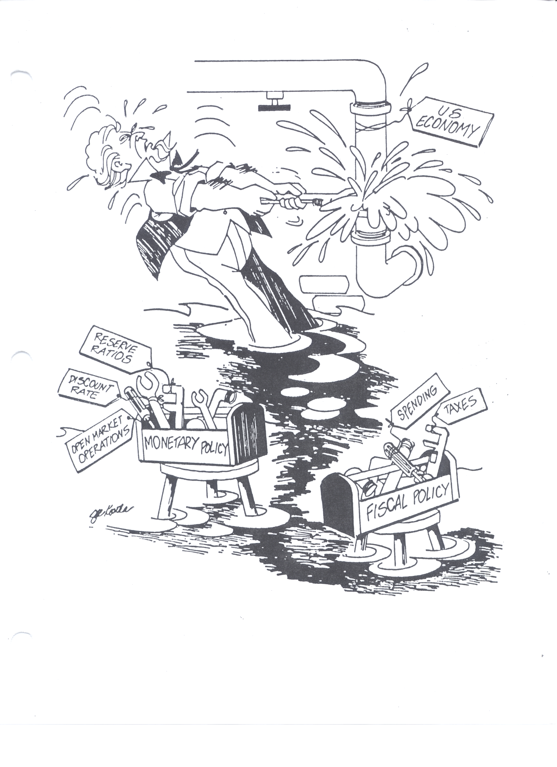
How the Government Stabilizes the Economy

Slide 8
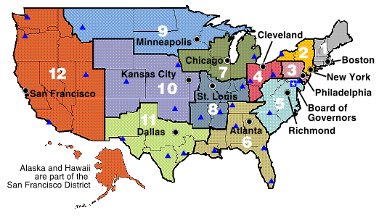
Monetary Policy
When the FED adjusts the money supply to achieve its macroeconomic goals
8

Slide 9
How the FED Stabilizes the Economy
These are the three Shifters of Money Supply
Monetary Policy consists of three tools by which the Fed affects the money supply.

Slide 10
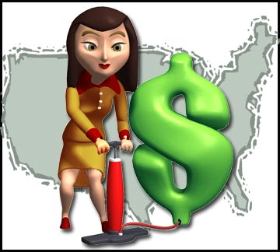
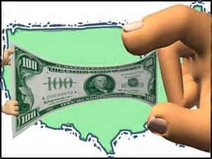
Monetary Policy
If the economy is in a recession (sluggish), the Fed will shift to EXPANSIONARY policy.
If the economy is running too hot, the Fed will try to rein it in.
This is called CONTRACTIONARY policy.

Slide 11
Monetary Policy review
During a recession (sluggish economy), the Federal Reserve might BUY BONDS to stimulate the economy.
They give ordinary folks $$$ for their bonds, putting more $$$ into the pockets of ordinary folks who will (hopefully) spend it, thereby stimulating growth.

Slide 12
Monetary Policy review
During a hot or inflationary economy, the Federal Reserve might SELL BONDS to rein in the economy.
They take $$$$ out of the economy by selling bonds to folks. In exchange for the bonds, folks give the FED $$$.
That’s $$$$ that CAN’T be used in the economy anymore. Therefore, the economy slows down a little.

Slide 13
The Business Cycle
Just like you and me, the economy has natural ups and downs.
Vocabulary:
Growth = Expansion
Recession = Contraction
Trough = Depression
Expansion
Contraction

Slide 14
3 Types of Money
Liquidity- ease with which an asset can be accessed and converted into cash (liquidized)
M1 (High Liquidity) - Coins, Currency, and Checkable deposits (personal and corporate checking accounts).
In general, this is the MONEY SUPPLY
M2 (Medium Liquidity) - M1 plus savings deposits (money market accounts), time deposits (CDs = certificates of deposit), and Mutual Funds below $100K.
M3 (Low Liquidity) - M2 plus time deposits above $100K.

Slide 15
So knowing the 3 types of money now…
What is cash in your wallet?
M1
What is your checking account?
M1
What is a Money Market account or a Certificate of Deposit?
M2
What is a $100,000 + account that is locked in for five years before I can touch it?
M3

Slide 16
So knowing the 3 types of money now…
If you take the cash that’s in your wallet, and deposit it into your checking account, will this have an affect on M1 and M2?
Nay, Nay!
Why?
Cash & a checking account are both M1. Moving cash into a checking account is like moving your cash from one pocket to another. It has a neutral affect on M1 and NO affect on M2, since neither cash or checking is M2.

