Slide 1
Mid Course Review 5
Mr. Wyka
Economics
Citrus High School
Notes:
Questions 23-29

Slide 2
The government is running a deficit. So what? What’s $18,800,000,000,000 between friends?
When government deficit spends, it has to borrow $$$ to cover it.
This artificially increases the demand for loans which increases interest rates and “crowds out” private investors.
This is an example of the “crowding out” effet of government action.
Budget Deficit Demand for Loans Interest Rates

Slide 3
Investing Your Money
Stocks – Ownership shares in a company
Value is based on the performance of the company
Not guaranteed! Not Insured!
Bonds – A Loan Instrument
If you buy a bond, you are LOANING money to the company or gov’t who issued the bond.
They agree to pay you INTEREST plus the face value of the bond.
U.S. Gov’t bonds are guaranteed (barring a Zombie Apocalypse, then run for your lives).
Corporate or company bonds are not guaranteed.

Slide 4
Knowing what you do about investing your money….
Would you expect to receive regular interest payments from holding BONDS or STOCKS?
Bonds

Slide 5
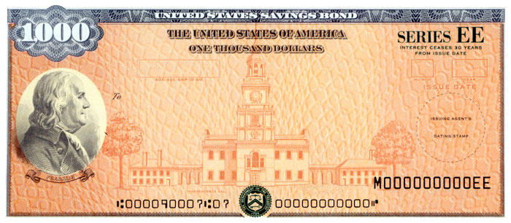
Knowing what you do about investing your money….
Which category of investment is guaranteed (involves almost no risk)?
U.S. Treasury Bonds
Corporate Bonds
Stock

Slide 6
More on investing…
The time to take risk in your investing is when you’re young.
When you get closer to retirement, or are in retirement, you investment your money in safe instruments, like bonds, rather than more risky stocks.

Slide 7
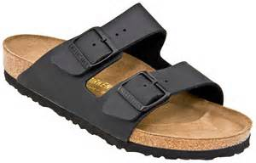
As such…..
Which investment portfolio seems the best fit for a 68 year old retired school teacher?
100% Apple Stock
100% Birkenstocks
70% Stocks, 30% Bonds
15% Stocks, 85% Bonds

Slide 8
GDP – Gross Domestic Product
Gross Domestic Product is essentially the country’s economic output in any given year.
It is used to measure a country’s economic growth.
More specifically, it’s made up of
Important
stuff!
GDP = C + I + G + X_{n}

Slide 9
Four components of GDP:
Consumer Spending
Ex: $5 Little Caesar's Pizza
Investments -When businesses put money back into their own business.
Ex: Machinery or tools
Government Spending
Ex: Bombs or tanks, NOT social security
Net Exports -Exports (X) – Imports (M)
Ex: Value of 3 Ford Focuses minus 2 Hondas
GDP = C + I + G + X_{n}

Slide 10
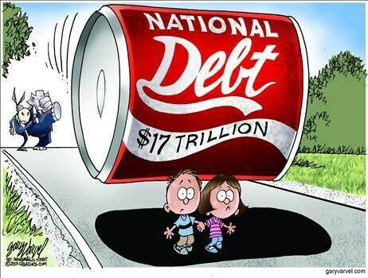
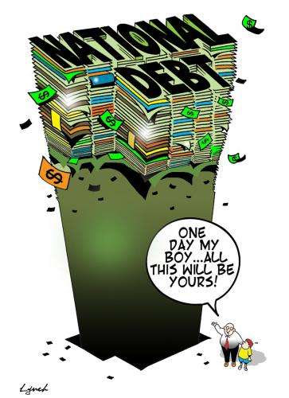
What are these cartoons saying?

